Slide 1
Azure Web App服务
Lei Zhang
leizha@microsoft.com

Slide 2
日程安排
Azure Web App 概念
Azure Web App 架构
Azure Web App 实例大小
Demo: 创建Azure Web App
Demo: 使用FTP部署
Demo: 使用Visual Studio部署
Demo: 使用GitHub部署
Demo: Kudu
Web App备份
Web App时区

Slide 3



  Windows Azure
  Your Datacenter
  Virtual Machines
  Cloud Services
  Web
  Sites
Applications
Applications
Applications
Applications
Data
Data
Data
Data
Firewall
Firewall Rules
Firewall Rules
Network
Virtual Network
Virtual Network
O/S
O/S
Virtualization
Hardware
Focus on the Application
Notes:
Slide Objectives:
Explain the differences between traditional self-hosting and the three options of Windows Azure hosting.
Notes:
In a traditional environment you must manage the full stack. With Windows Azure you can choose a variety of options depending on your needs.

Slide 4
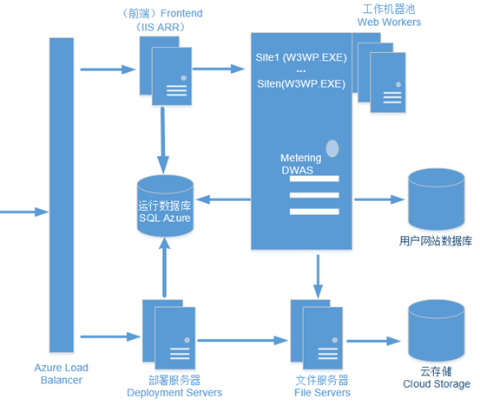
Azure Web Site架构

Slide 5
Azure部署单元公网IP - China
部署单元 | 入站IP | 出站IP
BJB-001 (北京) | 42.159.5.43 | 42.159.4.73
 |  | 42.159.4.84
 |  | 42.159.4.211
 |  | 42.159.4.160
SHA-001 (上海) | 42.159.132.179 | 42.159.135.109
 |  | 42.159.135.174
 |  | 42.159.135.208
 |  | 42.159.133.172

Slide 6
Azure部署单元公网IP - East Asia Region
https://social.msdn.microsoft.com/Forums/azure/en-US/fd53afb7-14b8-41ca-bfcb-305bdeea413e/maintenance-notice-upcoming-changes-to-increase-capacity-for-outbound-network-calls?forum=windowsazurewebsitespreview
部署单元 | 入站IP | 出站IP
waws-prod-hk1-001 |  | 65.52.168.77
 |  | 65.52.168.81
 |  | 65.52.168.84
 |  | 65.52.160.98
waws-prod-hk1-003 |  | 207.46.144.46
 |  | 207.46.144.85
 |  | 207.46.144.91
 |  | 207.46.148.246

Slide 7
Azure Web Site 计算单元
类型 | CPU核心 | 内存
Small (S) | 1 | 1.75GB
Medium (M) | 2 | 3.5GB
Large (L) | 4 | 7GB

Slide 8
Azure Web Site Offer
 | 免费 | 共享 | 基本 | 标准
Web Site | 10 | 100 | Unlimited | Unlimited
Storage | 1GB | 1GB | 10GB | 50GB
Compute Instance | Shared | Shared | Dedicated | Dedicated
Scale-Out |  | 6 Shared Instance | 3 Dedicated Instance | 10 Dedicated Instance
SLA |  |  | 99.9% | 99.9%
http://azure.microsoft.com/en-us/pricing/details/web-sites/

Slide 9
Azure Web App限制
单个Web App实例最大计算单元4Core/7GB
Azure Web Apps支持最大横向扩展10个节点
只支持开放80端口和443端口

Slide 10

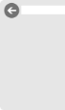

web sites
shared
standard
1
shared
Shared instances
:-)
Notes:
Slide Objectives:
Explain how you can start with a small site hosted for free.
Notes:

Slide 11
web sites
shared
standard
2
shared
Shared instances
:-)
:-)
Notes:
Slide Objectives:
Explain how you can scale your site to multiple shared instances.
Notes:

Slide 12

web sites
shared
standard
1
0
standard
Shared instances
Standard instance
:-)
:-)
:-)
Notes:
Slide Objectives:
Explain how you can move to standard instances for additional scale.
Notes:

Slide 13
web sites
shared
standard
2
standard
Standard instance
Standard instance
:-)
:-)
Notes:
Slide Objectives:
Explain how you can scale up standard instances to multiple instances as needed.
Notes:

Slide 14

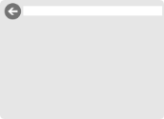
web sites
shared
standard
2
standard
Standard instance
Standard instance
:-)
:-)
:-)
:-)
:-)
:-)
:-)
:-)
Notes:
Slide Objectives:
Explain how you can host multiple sites that you own on a your standard instances.
Notes:

Slide 15
演示 :
Demo: 创建Azure Web App
Demo: 使用FTP部署
Demo: 使用Visual Studio部署
Demo: 使用GitHub部署
Demo: Kudu
Web App备份
Web App时区

Slide 16
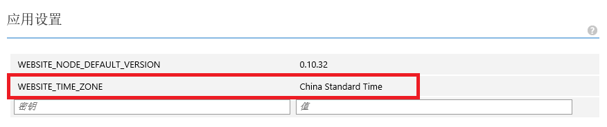
Web App 时区

Slide 17
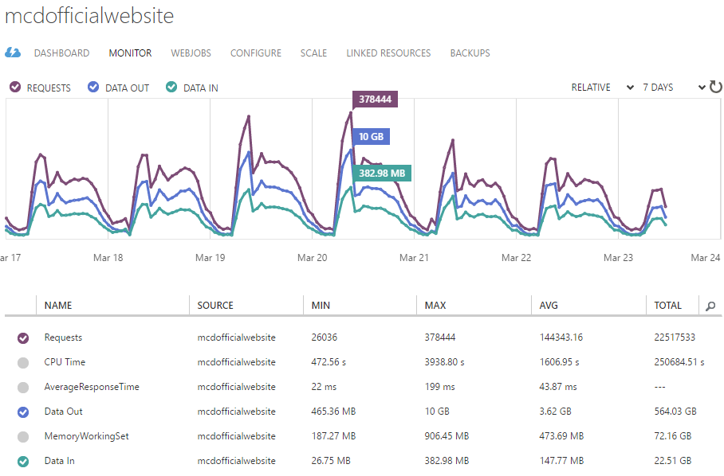
案例分享

Slide 18
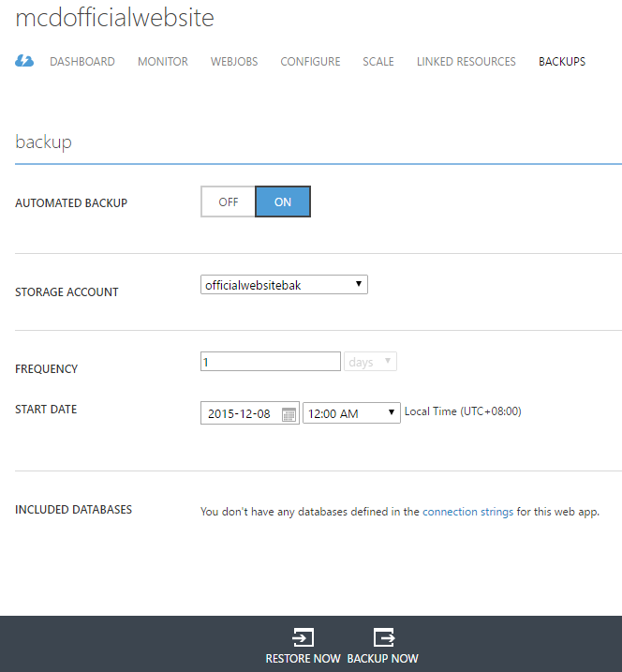
案例分享

Slide 19
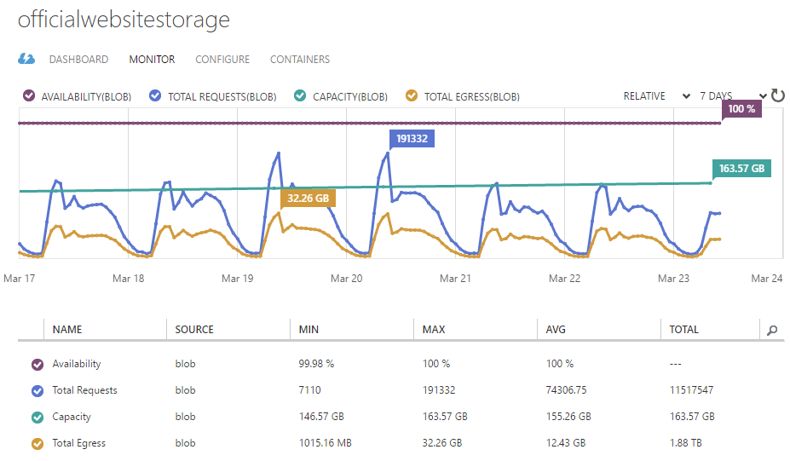
案例分享

