Slide 2


SRA: A Secure ReRAM-Based DNN Accelerator
Lei Zhao⁺, Youtao Zhang⁺, Jun Yang*
⁺Department of Computer Science, University of Pittsburgh
* Department of Electrical and Computer Engineering, University of Pittsburgh
Notes:
My name is Lei Zhao from the University of Pittsburgh. Thank you very much for attending my presentation. Today I will be our most recent work to design a secure ReRAM based accelerator that can protect the embedded neural networks.

Slide 3
Motivation
ReRAM is a good fit for DNN’s MAC operations
Extremely high parallelism
Process-in-memory: avoids massive data movements
New security issues
Crossbar-based PIM: can only compute on cleartext data
Non-volatility: DNN model is exposed even if the system is powered off
We need new DNN protection solutions for ReRAM crossbar based PIM accelerators !
Notes:
ReRAM has already been widely explored for neural network accelerators. Because ReRAM is a resistive device, when it is organized as a crossbar structure, it is a perfect fit tor multiply-accumulate operations, which are the major type of operations in deep neural networks. The benefit mainly comes from two aspects, firstly, the crossbar structure provides much higher parallelism compared to conventional ALU based implementations; secondly,, ReRAM’s crossbar structure can perform computation inside the memory, therefore it could avoid massive data movements back and force between the computation unit and the memory.
However, this structure also brings new security issues, and these issues have not been fully examined.
First of all, the crossbar structure can only compute on cleartext data, I will show this later with more details, so the neural network weights programmed inside the ReRAM cells cannot be protected with conventional encryption based methods.
Secondly, ReRAM is a non-volatile device, this means all the data will be retained inside the if the power if suddenly cut off, so the cleartext neural networks weights will be directly exposed to the adversaries.
Therefore, we need new DNN protection solutions for ReRAM corssbar based PIM accelerators.

Slide 4
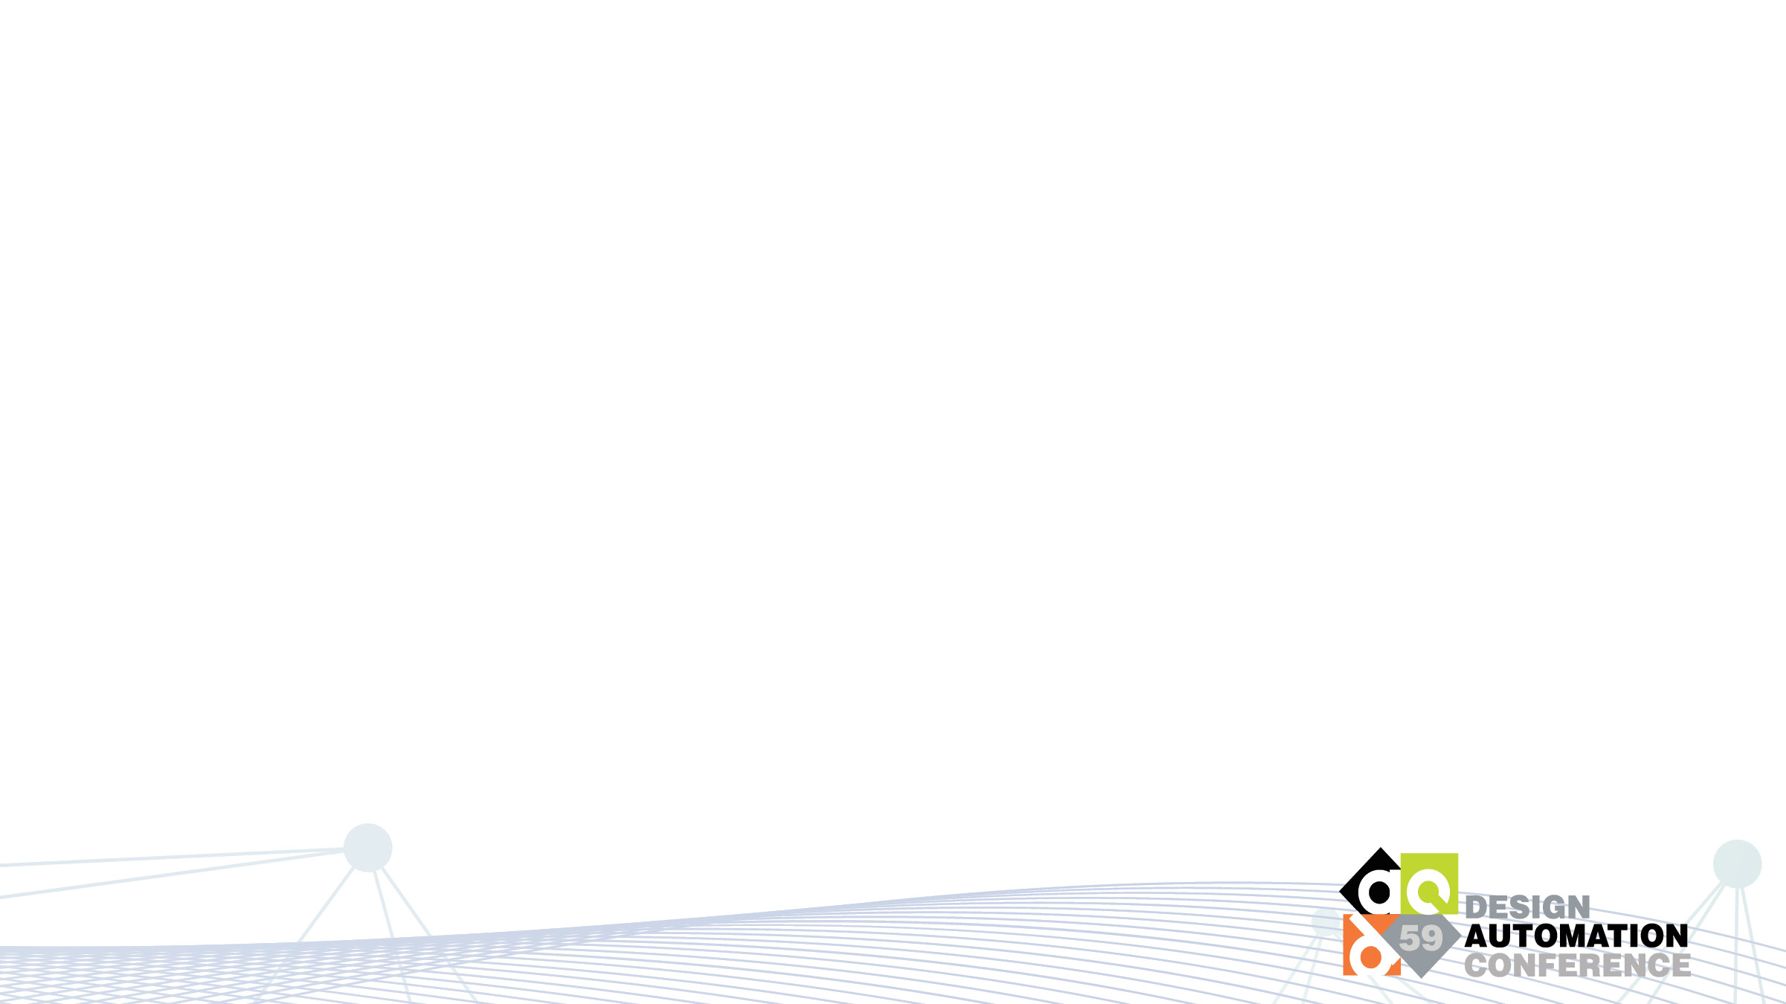
ReRAM Basics
+
-
bitline
wordline
Top
Top
I₁
Electrode
RESET
Electrode
W₁
I₂
W₂
...
...
...
...
I_{n}
SET
W_{n}
Bottom
Bottom
Electrode
Electrode
∑(I_{i}×W_{i})
-
+
Low Resistance
Logic ‘0’
High Resistance
Logic ‘1’
Data cannot be encrypted in PIM crossbars
(We use Stochastic Computing to support protection)
Notes:
Before we dive into the design, I will first give some background on ReRAM basics.
A ReRAM cell is a resistance device consisting of 3 layers.
When an appropriate voltage is applied across the top and bottom electrodes, a tunnel of oxygen vacancy filament will be constructed, so that the cell has a better conductivity.
An opposite voltage will destruct the filament to decrease the cell’s conductivity.
Therefore, we can store one or multiple bits according to the resistance of the cell.
For example, we can use the low resistance state to store 0 and use the high resistance state to store 1.
ReRAM cells can be organized as a crossbar structure.
The vertical lines are called bitlines and the horizontal lines are called wordlines.
ReRAM cells sit at each crosspoint of the bitlines and wordlines.
This structure is very suitable for multiply-accumulate operations.
For example, to do a multiplication between an input I and a weight vector W, the elements of W are programed as ReRAM resistance in the same column.
While the elements of vector I are programed as voltages on the horizontal wordlines.
As a result, the total electric current flowing out from the bitline is the product of this vector multiplication.
Because the data are represented using voltages and resistance, and the computation is based on the laws of electricity, the resistance and voltage need to be programed according to the cleartext values of the two vectors.
In this paper, before we program the resistance and voltage, we first convert the values into Stochastic Computing format in order to support our later protection schemes.

Slide 5

Stochastic Computing
SC Numbers are represented by the probability of 1s in a bit stream
4 bits
2⁴=16 bits
Exponential storage overhead
E.g., : X = 0.75 = 0.110_{b} = 1001111011011111_{sc}
Prob(X_{i} = 1) = 0.75
Binary format
SC format
Addition and multiplication can be implemented using simple logic
A
00101101
A
00101101
MUX
10001101
C
AND
00001100
C
B
10011100
B
10011100
0.5
C = $\frac{1}{2}$×(A+B)
C = A×B
Notes:
We use 0.75 as an example to show how to represent a number in stochastic computing format.
The blue number is to use the conventional 4-bit fixed point binary format to represent this number.
In stochastic computing, we represent the number using a bit stream. Assuming we use a bit stream of 16 bits as shown in green
The value of a bit stream is determined by the percentage of 1s in the bit stream.
In this example, there are 75% of the bits are 1 in the bit stream, so this bit stream represents the value of 0.75.
One thing worth noticing here is that it is not unique to represent a value using stochastic computing format.
As long as the percentage of 1s are the same, the bit stream will always represent the same value, so the position of 1s does not matter.
The benefit of this representation is that addition and multiplication can be implemented using very simple element-wise logic gates.
For example, we can use an element-wise AND gate to compute A multiple B.
Addition can be implemented using a MUX gate, but in this paper, we do not need to perform addition in stochastic computing format.
The drawback of stochastics computing is its large storage overhead. Usually in order to provide similar precision as the binary format, the length of the bit stream needs to be exponential to their binary format.
For example, for this 4-bit fixed point binary number, we need a bit stream of 16 bits. So there is an exponential storage overhead.

Slide 6
PIM Using SC Numbers
BN Crossbar
SC Crossbar
I₁
I_{1,1}
W₁
I₁ = (I_{1,n}, I_{1,n-1}, …, I₂, I₁)
W_{1,1}
I₂
W₁ = (W_{1,n}, W_{1,n-1}, …, W₂, W₁)
I_{1,2}
W₂
W_{1,2}
...
...
...
...
...
...
I_{n}
I_{1,n}
W_{n}
W_{1,n}
∑(I_{i}×W_{i})
I₁×W₁
(number of 1s in resulting bit stream)
Notes:
This crossbar is the same as we just saw in previous slide.
All the weights values and input values are in binary format.
In our design, instead of using the binary format values, we store their stochastic computing format bit streams in the crossbar.
For example, I1 is the first element of the input vector, W1 is the first element of the weight vector.
We first convert them into bit streams.
Then we program each bit of W1 in a column of ReRAM cells.
The bits of I1 determines the voltage applying on the wordlines.
Therefore, the electric current flowing from the bit line represents the number of 1s of the product result.
Now we have shown how to use ReRAM crossbar to perform multiplication in stochastic computing format, next we will describe how to protect the weight bits in the crossbar.

Slide 7
1T4R Crossbar Structure
BL0
BL1
BL2
BL3
WL0
WL1
BL0
BL1
BL2
BL3
WL2
GWL0
WL3
WL Driver
GWL1
… … … …
GWL0
GSL0
GSL1
… … … …
GWL1
GSL0
GSL1
ADC
[Yeh et al., JSSC’15]
Notes:
Before that, I still need to introduce a previous work as background.
Recently, a previous work has prototyped a 1T4R corssbar structure. As the name implies, every 4 ReRAM cells are controlled by a transistor.
The upper figure shows the layout of a small 4-by-4 ReRAM region in the crossbar.
The vertical lines are still bitlines and horizontal line are still wordlines.
There is a ReRAM cell at each crosspoint, shown by the orange blocks.
The figure below shows 4 transistors, each transistor controls 4 ReRAM cells of a row in the upper figure.
The 4 transistors are fabricated in a different layer underneath the ReRAM cells.
They have proven that the 4 transistors can be fully hidden under the 4-by-4 ReRAM region.
Thus the footprint is still the same with original crossbar.
The right figure shows an entire crossbar consisting of multiple such small 4-by-4 region.
The vertical lines are still bitlines, the horizontal lines are now called global wordlines.
In addition, there are also pairs of global select lines, or GSLs for short.
The GSLs controls the transistors.

Slide 8
Secure Crossbar Design
W1
W3
WL Driver
WL Driver
… … … …
W2
W4
… … … …
01
10
10
01
01
10
ADC
We Only need to keep the GSL bits secret to hide the bit streams
Notes:
The transistors separate the cells into small segments, as shown by different color in this figure.
In this paper, we exchange the positions of the ADCs and the wordline drivers.
The schematic is shown on the right.
The vertical lines are called wordlines, and the horizontal lines are called global bit lines.
By setting the GSLs, different segments of cells will be connected to the global bit lines.
For example, the first pair of GSL connect the second and fourth segment to the global bitlines.
While the other two pairs connect the first and third segments to the global bitlines.
We call the cells that are dynamically connected to the same global bitlines as logical bitline,
And we can store the weight bit stream along the logical bit lines.
Therefore, we only need to keep the GSLs secrete, the actual patterns to store the bit streams will also be secure.
Now, we still have the problem of the exponential storage overhead.

Slide 9
Bit Sharing Design
S₀ + S₆₅ + S₆₆ + … + S₆₃ = W₀ × 256
S₆₄ + S₁ + S₂ + … + S₁₂₇ = W₁ × 256
S₆₄ + S₆₅ + S₂ + … + S₁₂₇ = W₂ × 256
S₀ + S₁ + S₆₆ + … + S₆₃ = W₂ × 256
S_{i} {0,1,2,3,4}
S₀
S₁
S₂
…
S₆₃
0 ≤ Si ≤ 4
S₆₄
S₆₅
S₆₆
…
S₁₂₇
Si ℤ
Mixed-integer linear programming
(MIP) model
GSL
GSL
1 0 0 … 1
0 0 1 … 0
…
…
+
S₆₃
S₀
+
+
S₁₂₇
S₆₄
+
W₀ × 256
=
W₂ × 256
S₆₅
=
+
S₆₅
+
+
S₆₆
+
S₂
…
…
+
S₁₂₇
S₆₄
+
+
S₆₃
S₀
+
W₁ × 256
=
W₃ × 256
S₁
=
+
S₁
+
+
S₂
+
S₆₆
Notes:
We propose a bit sharing design to reduce the overhead.
We take two rows from the crossbar as an example.
Because each segment has 4 cells, we can assign a variable S to each segment to represent the number of 1s in the segment.
So, S can be 0, 1, 2, 3, or 4.
Given GSL signals, we can construct two equations, one for each logical bit line to encode the DNN weight.
We can use another set of GSL signals, to encode another two weights in the bitline segments.
As a result, we can get a set of equations and some constrains, which can be solved by a mixed-integer linear programming model.

Slide 10
Bit Sharing Design
Number of different GSLs
Number of different GSLs
With more GSLs, the difference between original weights and the mapped weights increases
Different DNN can use different number of GSLs
We conservatively use the smallest number, i.e., 8
Notes:
Of course, there is an upper bound of the number of weights that can be encoded in the same set of bitline segments before the DNN accuracy starts to degrade.
These two figures shows two of our benchmarks.
As we can see, as the number of GSL signals increase as shown on the x axis, the accuracy will drop accordingly.
We can also observe that the number of weights that can be encoded in the same set of bitline segments vary between benchmarks.
We conservatively select 8 for all our benchmarks in our evaluation.
this also means that we constantly reduces the storage overhead from 32x to 4x.

Slide 11
SC Conversion
Sign bit crossbar
Example: Convert 0.85 to SC format
Sign bits
1100
1001
…
0110
0010
…
P(x=1) ≈ 0.4
Bitwise OR
(0.85-0.4) × 256 = 115
1111
1111
…
1110
0000
…
P(x=1) ≈ 0.449
115 1s
=
1111
1111
…
1110
1111
…
P(x=1) ≈ 0.85
Inputs also contains sensitive information of the neural network
Use different insert positions to introduce precision variation

Slide 12
Workflow Overview

Slide 13
Accelerator Architecture

Slide 14
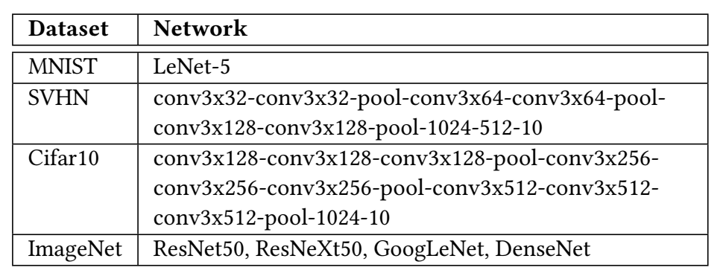
Methodology
We use PyTorch for DNN training and fine-tuning
We use the PuLP library to solve the MIP optimization
We compare SRA with ISAAC[ISCA’2016]
Notes:
To evaluate the effectiveness of our protection scheme and the performance and energy gains,
We test on four datasets with various DNN structures.
We use pytorch for DNN training and fine-tuning.
We use the PuLP library to solve the mixed-integer linear programming problem.
We compare our design with ISAAC as the baseline.

Slide 15
Security
 | Baseline | Target Device | Pirate Device | Binary Inputs
MNIST | 99.35% | 99.36% | 14.98% | 77.83%
SVHN | 95.94% | 95.23% | 67.75% | 62.03%
Cifar10 | 90.13% | 90.11% | 39.47% | 52.29%
ResNet50 | 76.13% | 75.43% | 14.82% | 20.8%
ResNeXt50 | 77.61% | 77.01% | 13.9% | 17.84%
GoogLeNet | 69.77% | 67.82% | 10.44% | 11.81%
DenseNet | 74.434% | 73.86% | 20.44% | 32.55%
Target Device: Use the same GSLs and SC conversion offset as in training
Pirate Device: Use random GSLs and SC conversion offset
Binary Inputs: Use the binary format inputs directly
Notes:
This table shows the effectiveness of our protection method.
The first column lists all our tested benchmarks.
The second column shows the baseline accuracies.
The third column shows the inference accuracy on our target device. The target devices uses the same GSL and SC conversion offset as in training. So the accuracy is almost the same with the baseline.
Because the GSLs and SC conversion offset are kept secrete, the fourth column shows the inference accuracy on pirate devices by using some random GSLs and SC conversion offset. There is a severe accuracy degradation.
We also show how our proposed SC conversion method protects the inputs in particular. We assume the correct GSLs are used, so the correct weights are known, but the inputs are used directly in binary format without converting them into stochastic computing bit streams. As shown in the last column, the accuracy is still significantly lower than the baseline.

Slide 16
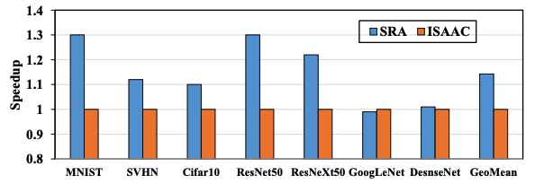
Performance
(1) ISAAC: activate entire crossbar.
(2) SRA: only activate half of the cells, 1.14X speedup.
Notes:
We can achieve better performance over the ISAAC baseline, because our new design only activates half of the cells in the crossbar at the same time, the computing speed is higher than ISAAC, which need to activate the entire crossbar. On average there is a 1.14X speedup.

Slide 17
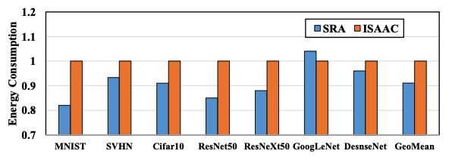
Energy
(1) Only activate half of the cells in a crossbar.
(2) The transistors can avoid sneak current, thus reducing energy waste.
Notes:
The energy saving of our design comes from two aspects.
The first one is still from less activated cells for each computation.
For the second aspect, the transistors can isolate the activated cells from the unactivated cells thanks to the 1T4R structure, so less energy waste caused by sneak current.
Therefore, there is a 9% energy saving compared to ISAAC.

Slide 18
Conclusion
Problem
ReRAM’s non-volatility rises new security risk
ReRAM’s crossbar structure cannot compute encrypted data
Solution
Use shuffled bit stream segments to protect weights
Share bits among multiple bit streams to reduce storage overhead
Use different inject position during SC conversion to protect inputs
Results
Both inputs and weights can be protected effectively in ReRAM
ReRAM’s PIM capability is maintained
Performance and energy benefits
Notes:
As a conclusion, this paper tries to solve the new security issues caused by ReRAM’s non-volatitily and crossbar structure.
Our proposed design has 3 main parts. First we use shuffled bit stream segments to protect weights.
Second, we share bits among multiple bit streams to reduce storage overhead.
Last, we proposed a new SC conversion method to protect the inputs to the neural networks.
Our results shows that both weights and inputs can be effectively protected.
To the best of our knowledge, this is the first DNN protection scheme for ReRAM PIM accelerators.
We can also achieve performance and energy improvements.

Slide 19
Q & A
Thank you

