Slide 1

Mitigating Shift-Based Covert-Channel Attacks in Racetrack Last Level Caches
Lei Zhao, Youtao Zhang, Jun Yang
Department of Computer Science
University of Pittsburgh

Slide 2
Outline
Racetrack Memory
Timing Attacks
Mitigations
Experiment Setup
Evaluation

Slide 3
Outline
Racetrack Memory
Timing Attacks
Mitigations
Experiment Setup
Evaluation

Slide 4
Racetrack Memory
Multiple bits stored on the track
Adjacent bits share the same Read/Write Port
Read/Write Port
Shift Port
BL
RL
WL
SWL
…
SWL
SL
Shift Port

Slide 5
Head Management Policy
Lazy policy
  Leave the head at where it is after each access
  Better performance
  Vulnerable to shift covert channels
  Eager policy
  Move the head back to a fixed position after each access
  Poor performance
  No shift covert channels

Slide 6
Outline
Racetrack Memory
Timing Attacks
Mitigations
Experiment Setup
Evaluation

Slide 7
Timing Attacks
Side Channel Attack
  Victim leaks information unintendedly to attack through timing channels
Covert Channel Attack
  Malicious threads transfer information that is not allowed through timing channels

Slide 8
Miss Based Attack
The cache is filled with
receiver’s data
Set 1
Set 2
Set n
Way 1
Sender flush the cache
with its own data
sender
Way 2
receiver
Way m
Receiver probe the cache
to see whether its data is
still there
T_{mem}
Main Memory

Slide 9
Shift Based Attack
sender
receiver
The heads are at random positions
Set 1
Set 2
Set n
Way 1
Sender moves the heads to its data
Way 2
Receiver probe its data to check
shift latency
Way m

Slide 10
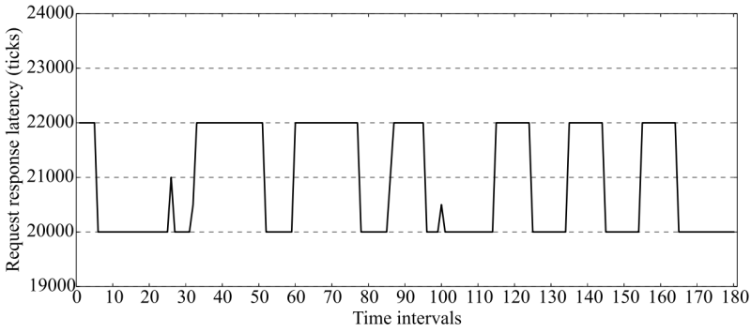
Shift Based Attack
1
0
sender
receiver
sender
receiver
100011011010010101

Slide 11
Outline
Timing Attacks
Racetrack Memory
Mitigations
Experiment Setup
Evaluation

Slide 12
Naïve Method
Eager Head Management Policy
  Move head back to a fixed position after each access
  Pros
  eliminate shift covert channel
  Simple implementation
  Cons
  Cannot exploit data locality, poor performance

Slide 13
Security Level-Aware Approach
L: security level (00: lowest, 11: highest)
R: recency information (000: least recently used)
Reset to the most recently used cache line of the lowest security thread
Tag
L
R
Data
00
001
10
110
sender
receiver
others
10
011
Security Level
>
>
01
000
00
010
01
111
01
100
00
011

Slide 14
Epoch-based Approach
Within each epoch, reset head to the hottest position in previous epoch
Change the default position only at the beginning of an epoch
Epoch 1
Epoch 2
Default Position
Default Position

Slide 15

Epoch-based Approach
Interval | Bit Rate
50M | 39.3bps
100M | 19.9bps
200M | 9.9bps
At 200M interval, shift covert channel achieves the same bit rate with miss based covert channel (9.9bps)

Slide 16
Outline
Timing Attacks
Racetrack Memory
Mitigations
Experiment Setup
Evaluation

Slide 17
Experiment Setup
We model a four core CMP with Gem5
Choose both memory intensive and non-intensive benchmarks from SPEC 2006
We evaluate four schemes:
  Baseline: Leave the head at where it is, no cover channel protection
  Eager: always reset head to a fixed position
  SL: security level aware protection
  Epoch: change default head position only at beginning of epoches

Slide 18
Experiment Setup
Simulator Configuration
Parameter | Value
Processor | Alpha ISA, 4 cores, 8-way OoO core
L1 Cache | 4-way, 32 KB, 2 cycles
L2 Cache | 16-way, 32 MB, R/W/S: 24/24/4 cycles
Memory | DDR3 800MHz, tRAS=35ns, tRCD=13ns, tRP=13ns, tCL=13ns, tWR=15ns

Slide 19
Outline
Timing Attacks
Racetrack Memory
Mitigations
Experiment Setup
Evaluation

Slide 20
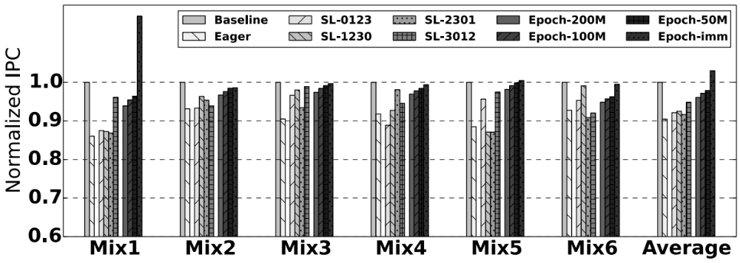
Performance
Both SL and Epoch outperform Eager
On average Epoch even outperforms Baseline

Slide 21
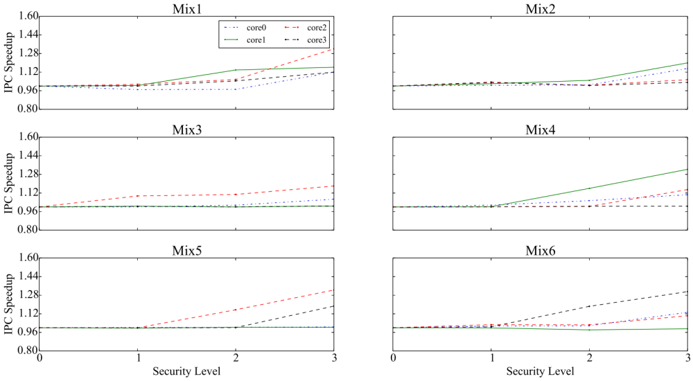
Individual Thread IPC for Epoch
The lower security level thread has better speedup

Slide 22
Conclusion
We are the first to elaborate the existence of a new LLC covert channel in RM
Our security level aware scheme can eliminate this covert channel with a better performance than the naïve approach
Our epoch scheme reduces the newly discovered covert channel’s information leakage rate by up to 260 times with modest performance overhead

