Slide 1

A DNN Protection Solution for PIM Accelerators with Model Compression
Lei Zhao⁺, Youtao Zhang⁺, Jun Yang*
⁺Department of Computer Science, University of Pittsburgh
* Department of Electrical and Computer Engineering, University of Pittsburgh
Notes:
Hi, everyone. Thank you very much for attending my presentation. My name is Lei Zhao, from the University of Pittsburgh. Today I will talk about our recent work on a DNN protection solution for PIM accelerators with model compression.

Slide 2
Motivation
ReRAM is a good fit for DNN’s MVM operations
Extremely high parallelism
Process-in-memory: avoids massive data movements
New security issues
Non-volatility: DNN model is exposed even if the system is powered off
Crossbar-based PIM: can only compute on cleartext data
We need new DNN protection solutions for ReRAM crossbar based PIM accelerators !
Notes:
ReRAM has been widely explored for DNN accelerators because it can perform matrix-vector multiplication inside the storage, achieving extremely high parallelism and less data movements.
However, ReRAM based accelerators also raises new security issues:
Firstly, ReRAM is a non-volatile device, so the embedded DNN model is exposed to adversaries even if the system is powered off.
Secondly, ReRAM uses the crossbar structure to store DNN weights, and because the ReRAM crossbar structure can only compute on cleartext data, conventional encryption based method can not be used to protect the weights.
Therefore, we need to find new DNN protection solutions for ReRAM crossbar based PIM accelerators.

Slide 3
Stochastic Computing
SC Numbers are represented by the probability of 1s in a bit stream
E.g., : X = 0.75 = 0.110_{b} = 1001111011011111_{sc}
Prob(X_{i} = 1) = 0.75
Binary format
SC format
Use simple logic to implement addition and multiplication
Addition
Multiplication
A_{sc}
MUX
C_{sc}
A_{sc}
B_{sc}
AND
C_{sc}
B_{sc}
0.5
Prob(C_{i} = 1) =0.5 * (Prob(A_{i} = 1) + Prob(B_{i} = 1))
Prob(C_{i} = 1) = Prob(A_{i} = 1) * Prob(B_{i} = 1)
(1) Converting overhead from binary format to SC format is huge.
(2) Long bit stream overhead. n-bit binary requires 2^{n} bits in SC
Notes:
Before we start describing the design details, it is necessary to give some background techniques that are used in our design.
Instead of using conventional binary based numbers to represent values, we use Stochastic Computing representation, or SC for short.
SC numbers are represented by the probability of 1s in a bit stream.
For example, 0.75 is represented as 0.110 in conventional binary format.
If we set the bit stream length to 16, this number can be represented as the green bit stream.
The representation is not unique, as long as 75% of bits are 1.
The benefit of SC is its simple implementation of add and multiply operations.
To add two numbers, we use a MUX to randomly select one bit from either input with 50% probability.
To multiply two numbers, we can use a simple AND gate.
However, there are two drawbacks of SC.
First, converting from binary to SC format requires random number generators, which incur latency and implementation overheads.
Second, to represent a number with higher precision, we need longer bit streams. Usually, for an n-bit binary number, we needs a bit stream of 2 to the power of n bits in SC format. This incurs an exponential storage overhead.
For example, most PIM designs uses 8-bit fixed point, which requires 256 buts in SC format. That is 32x more storage overhead.

Slide 4
ReRAM Basics
Top
Top
Electrode
SET
Electrode
RESET
Bottom
Bottom
Electrode
Electrode
High Resistance
Logic ‘1’
Low Resistance
Logic ‘0’
Matrix vector multilication in parallel
Notes:
Now let’s take a look at some ReRAM basics.
A ReRAM cell is a resistance device.
By applying voltages on the top and bottom electrodes, a tunnel of oxygen vacancy filament can be constructed or destructed to change the conductivity of the cell.
If the cell is in high resistance state, it stores a 1. Otherwise, if the cell is in low resistance state, it stores a 0.
In order to do matrix-vector multiplication, ReRAM cells are organized in a crossbar structure, as shown on the right.
Horizontal lines are called word lines, and vertical lines are called bit lines.
A ReRAM cell sits at each crosspoint of a word line and bit line.
The values of the matrix are programmed as the resistance of the ReRAM cells, shown by letters G in the figure.
The values of the vector are converted into voltage level, shown by letters V in the figure.
So, the current flowing out from each bit line represents the multiply and accumulate result between the vector and the columns of the matrix.

Slide 5
1T4R Crossbar Structure
BL0
BL1
BL2
BL3
WL0
WL1
BL0
BL1
BL2
BL3
WL2
GWL0
WL3
WL Driver
GWL1
… … … …
GWL0
GSL0
GSL1
… … … …
GWL1
GSL0
GSL1
ADC
[Yeh et al., JSSC’15]
Notes:
Recently, a new 1T4R structure has been proposed.
This figure shows a 4-by-4 small region in a crossbar.
The figure below shows four transistors.
These 4 transistors are fabricated in a different layer beneath the crossbar.
Each transistor controls 4 ReRAM cells on the same row in the 4-by-4 region,
The schematic view is shown on the right,
A full crossbar is composed of multiple such 4-by-4 small regions.
In addition to the horizontal word lines and vertical bit lines, these 1T4R structure also has multiple pairs of Global Select Lines, or GSLs for short, to control the transistors.

Slide 6
Secure Crossbar Design
WL Driver
WL Driver
… … … …
… … … …
01
10
10
01
01
10
ADC
We Only need to keep the GSL bits secret
Notes:
In this work, we utilize the 1T4R structure with some modifications to provide protection capability.
Because the crossbar is a symmetrical structure, we exchange the locations of the Word Line Driver and the Analog Digital Converter.
So, the bit lines are now horizontal and the word lines are now vertical.
By providing different GSL signals, we can dynamically construct a logical bit line.
For example, the first pair of GSL signals will connect the second row and fourth row to the bit lines, while the other two pairs of GSL signals will connect the first and third row to the bit lines.
Accordingly, if we flip the GSL signals, the other cells will be connected to the bit lines.
So, we can use the logical bitline to store the SC bit stream of one weight.
As a result, we only need to keep the GSL bits secret to hide the logical bit lines from the adversary.

Slide 7
Bitline Level Sharing
S₀ + S₆₅ + S₆₆ + … + S₆₃ = W₀ × 256
S₆₄ + S₁ + S₂ + … + S₁₂₇ = W₁ × 256
S₆₄ + S₆₅ + S₂ + … + S₁₂₇ = W₂ × 256
S₀ + S₁ + S₆₆ + … + S₆₃ = W₂ × 256
S_{i} {0,1,2,3,4}
S₀
S₁
S₂
…
S₆₃
0 ≤ Si ≤ 4
S₆₄
S₆₅
S₆₆
…
S₁₂₇
Si ℤ
Mixed-integer linear programming
(MIP) model
GSL
GSL
1 0 0 … 1
0 0 1 … 0
…
…
+
S₆₃
S₀
+
+
S₁₂₇
S₆₄
+
W₀ × 256
=
W₂ × 256
S₆₅
=
+
S₆₅
+
+
S₆₆
+
S₂
…
…
+
S₁₂₇
S₆₄
+
+
S₆₃
S₀
+
W₁ × 256
=
W₃ × 256
S₁
=
+
S₁
+
+
S₂
+
S₆₆
Notes:
However, SC bit streams have large storage overhead compared to the binary format.
In order to reduce this overhead, we propose to share the bitline segments among multiple weights.
We take two rows from the crossbar as an example.
Because each segment has 4 cells, we can assign a variable S to each segment to represent the number of 1s in the segment.
So, S can be 0, 1, 2, 3, or 4.
Given GSL signals, we can construct two equations, one for each logical bit line to encode the DNN weight.
We can use another set of GSL signals, to encode another two weights in the bitline segments.
As a result, we can get a set of equations and some constrains, which can be solved by a mixed-integer linear programming model.

Slide 8
Bitline Level Sharing
With more GSLs, the difference between original weights and the mapped weights increases
Different DNN can use different number of GSLs
We conservatively use the smallest number, i.e., 8 (reduces storage overhead from 32X to 4X)
Notes:
Of course, there is an upper bound of the number of weights that can be encoded in the same set of bitline segments before the DNN accuracy starts to degrade.
These two figures shows two of our benchmarks.
As we can see, as the number of GSL signals increase as shown on the x axis, the accuracy will drop accordingly.
We can also observe that the number of weights that can be encoded in the same set of bitline segments vary between benchmarks.
We conservatively select 8 for all our benchmarks in our evaluation.
this also means that we constantly reduces the storage overhead from 32x to 4x.

Slide 9
















Crossbar Level Sharing -- Overview
Cluster 1
Cluster 2
Decomposing
Clustering
Pre-train model
Accuracy < Threshold
Flipping
Cluster 1
Cluster 2
Calibrating
Reconstructing
Training data
Accuracy > Threshold
Mapping
Accelerator
Notes:
To tackle the remaining 4x storage overhead, we propose another sharing scheme at the crossbar level.
We first give an overview of all the steps in the crossbar level sharing.
Given a pretrained DNN model, we first decompose the weight matrices into bit matrices.
Then we group the bit matrices into clusters according to their differences.
Within each cluster, we compute a centroid matrix by averaging all bit matrices.
Then we flip the bits of each bit matrix to make it as close as possible to the centroid matrix.
Then, we discard all the bit matrices and only keep the centroid matrix.
During computation, we use the centroid matrix to reconstruct all other bit matrices.
With this newly reconstructed DNN weights, we use the training data to calibrate the DNN to restore the accuracy.
Finally, the calibrated DNN will be deployed on the accelerator.

Slide 10
Crossbar Level Sharing -- Decomposing
Weight matrix is decomposed into bit matices according to bit significance
Weight Matrix
0101
1010
1000
0011
0
1
1
0
0
1
1
0
1
0
0
0
0
1
0
1
MSB
LSB
Bit Matrice
Notes:
Now, let dive into the details of each step.
Assume we have a 2-by-2 weight matrix.
Each weight is a 4-bit fixed point number.
The decomposing step is to store the four bits of all the weights into separate matrices.

Slide 11


Crossbar Level Sharing -- Clustering
Divide all bit matrices into clusters using Kmeans
Calculate the centroid bit matrix by averaging all clustered bit matrices
Cluster 1
…
Cluster n
Bit Matrices
Notes:
The clustering step calculates the hamming distance between each pair of bit matrices, and use Kmeans to group them into cluseters.
Within each cluster, we calculate the centroid matrix by averaging all bit matrices in the cluster.

Slide 12

Crossbar Level Sharing -- Flipping
Cluster n
0
1
0
1
1
0
0
0
1
1
0
0
1
0
0
1
1
1
CFV
Row
Score
0
0
0
0
0
0
Matrix C
Matrix A
1
1
1
0
1
0
0
0
1
2
1
3
1
0
1
2
0
1
0
1
1
0
0
1
0
0
0
0
0
0
2
3
3
2
0
2
1
1
0
0
1
0
1
0
1
0
1
1
0
0
1
0
1
0
Matrix B
Centroid Matrix
2
3
3
2
0
1
2
0
1
0
0
1
Matrix A
0
1
0
RFV
2
1
3
0
0
4
1
1
0
1
0
1
0
1
0
1
0
1
0
CFV
1
1
1
0
1
0
2
1
3
2
0
1
2
0
1
0
0
1
0
1
1
1
0
1
0
1
0
1
0
0
1
0
1
2
1
3
0
0
1
2
0
1
0
0
1
0
0
0
0
0
1
0
0
0
1
0
1
0
1
0
1
0
3
2
4
2
1
0
3
2
2
2
1
5
2
3
3
3
2
0
1
2
2
2
3
2
3
2
3
1
0
2
0
1
0
0
1
0
0
1
1
0
1
0
Column
Score
1
0
0
0
1
0
0
1
0
1
1
1
0
RFV
1
0
0
1
0
0
0
0
1
0
0
0
1
Total Score =
20
36
16
28
24
0
1
0
0
0
1
0
Centroid Matrix
1
0
0
0
1
0
0
Notes:
In the flipping step, we flip the bits to make the clustered bit matrices as close as possible to the centroid matrix.
This example shows how to make matrix A close to the centroid matrix.
We first do a bit-wise XOR operation.
In the resulting matrix, a 1 means there is a mismatch in the corresponding position of matrix A and the centroid matrix.
We add two vectors as metadata. The CFV records the flipping status of each column, the RFV records the flipping status of each row.
We also calculate the number of 1s for each column and each row, called column score and row score.
For each column or row whose score is larger than half the matrix size, we flip the row or column, together with the bit in the metadata.
After each flip, we need to recalculate the scores.
Note that even if all scores are not larger than half the matrix size, it is still possible to flip multiple rows and columns simultaneously to further reduce the score.
Similarly, we do the same for all other bit matrices in the cluster.

Slide 13
Crossbar Level Sharing -- Reconstructing
Cluster n
0
1
0
1
1
0
0
0
1
1
0
0
Only keep centroid matrix and metadata
1
0
0
1
1
1
CFV
Row
Score
Matrix C
Matrix A
1
1
0
1
0
0
0
1
0
0
0
1
0
0
1
0
0
0
0
0
1
1
0
0
0
1
1
0
0
1
0
1
1
1
0
0
0
1
0
2
Matrix B
Centroid Matrix
0
0
0
0
1
1
0
2
Matrix A
RFV
1
0
0
0
0
0
0
0
CFV
1
1
1
0
1
0
0
1
1
1
0
1
0
0
1
0
0
1
0
2
1
0
0
1
0
1
0
0
0
0
0
0
0
0
0
0
1
0
0
0
1
0
1
0
1
0
1
0
0
2
2
2
2
1
0
1
0
0
1
0
0
1
1
0
1
0
Column
Score
1
0
0
0
1
0
0
1
0
1
1
1
0
RFV
1
0
0
1
0
0
0
0
1
0
0
0
1
Total Score =
16
0
1
0
0
0
1
0
Centroid Matrix
1
0
0
0
1
0
0
Notes:
After the flipping is done, we only keep the metadata and the centroid matrix and discard the other bit matrices.

Slide 14
Crossbar Level Sharing -- Resconstructing
0
1
1
1
0
1
1
1
0
1
0
0
0
0
1
1
1
1
1
1
0
0
1
1
0
1
1
1
0
1
0
0
1
1
1
0
0
0
0
1
1
0
0
1
0
1
0
0
1
0
1
1
1
0
0
0
1
1
0
0
1
1
0
0
1
0
1
0
1
0
1
1
1
0
0
1
1
1
1
0
0
1
1
0
1
0
1
1
0
1
0
0
0
0
1
1
0
0
1
1
1
1
1
1
0
1
0
1
1
1
0
0
1
0
0
0
1
1
0
0
0
0
0
0
1
0
1
0
0
0
1
1
Centroid Matrix
Notes:
So on the accelerator, we only need to store the centroid matrix and the metedata, which significantly reduced the storage requirement.

Slide 15
Crossbar Level Sharing -- Reconstructing
There are mismatched bits between the reconstructed matrix and the original matrix
0
1
1
1
0
1
1
1
0
1
0
0
0
1
1
1
0
1
0
0
1
1
1
0
1
0
0
0
1
0
0
1
1
1
1
0
0
1
0
1
0
1
0
0
1
0
1
1
1
0
1
1
0
0
0
0
1
0
1
0
1
1
0
1
0
1
0
1
1
0
0
1
1
1
1
1
0
1
0
1
0
1
1
0
1
0
1
0
1
1
0
1
0
0
0
1
1
0
1
0
0
1
0
1
0
1
0
1
1
1
0
0
1
0
1
1
1
0
0
1
0
1
0
0
1
0
1
0
1
0
1
0
0
1
0
0
0
1
1
0
1
0
0
0
1
1
0
1
1
1
0
1
1
0
1
0
Reconstructed Matrix B
Reconstructed Matrix A
1
0
1
1
1
0
0
1
0
0
0
1
Centroid Matrix
Notes:
Then we reconstruct the bit matrices by using the centroid matrix and the metadata.
Note that there are mismatched bits between the reconstructed matrix and the original matrix, indicated by the red bits.
So, we need to calibrate the reconstructed DNN to restore the accuracy.

Slide 16





Crossbar Level Sharing -- Calibrating
The mismatched bits will change the distribution of each layer’s output
Re-run the forward propagation pass on training data to update BN’s parameters
W
W’
W
W’
W
W’
W
W’
Batchnorm
Batchnorm
Batchnorm
Batchnorm
Notes:
For all DNNs, we add a batch norm layer after each convolutional and fully connected layer.
With the original weights, the batch norm layers normalized the intermediate results.
However, if we use the reconstructed weights, the batch norm layer may no longer make the intermediate results standard normalized.
So, we re-run the forward pass of the DNN to update the batch norm layer’s parameters.

Slide 17
SC Conversion
Sign bit crossbar
Example: Convert 0.85 to SC format
Sign bits
1100
1001
…
0110
0010
…
P(x=1) ≈ 0.4
Bitwise OR
(0.85-0.4) × 256 = 115
1111
1111
…
1110
0000
…
P(x=1) ≈ 0.449
115 1s
=
1111
1111
…
1110
1111
…
P(x=1) ≈ 0.85
Notes:
Since all weights are in SC format, the inputs also need to be converted to SC format before computing with the weights.
We use a separate crossbar to store the sign bits of the weights.
Because the weights are pretrained, we can know the percentage of 1s in each row of this crossbar once after the DNN finishes training.
This example shows the process of converting 0.85 from binary format to SC format.
Assume the bit stream read out from the row is 0.4.
We calculate the number of 1s needed to insert into the bit stream, and then apply a bit-wise OR operation to insert the 1s in a fixed position.
The number of 1s needed to be inserted can be precomputed and stored in a look up table.

Slide 18
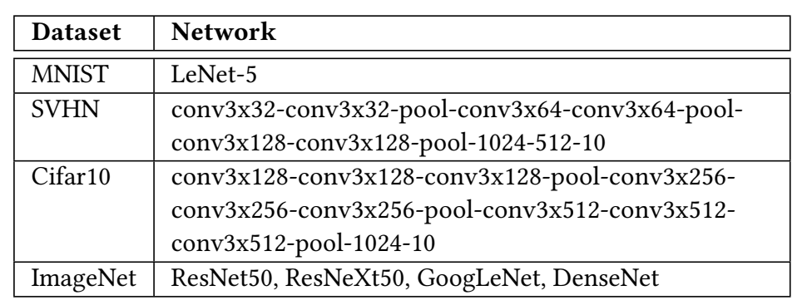
Methodology
We use PyTorch for DNN training and fine-tuning
We use the PuLP library to solve the MIP optimization
We compare with ISAAC[ISCA’2016]
Notes:
To evaluate the effectiveness of our protection scheme and the performance and energy gains,
We test on four datasets with various DNN structures.
We use pytorch for DNN training and fine-tuning.
We use the PuLP library to solve the mixed-integer linear programming problem.
We compare our design with ISAAC as the baseline.

Slide 19
Security
 | Baseline | GSL Pattern A | GSL Pattern B
MNIST | 99.35% | 99.36% | 14.98%
SVHN | 95.94% | 95.23% | 67.75%
Cifar1o | 90.13% | 90.11% | 39.47%
ResNet50 | 76.13% | 75.43% | 14.82%
ResNeXt50 | 77.61% | 77.01% | 13.9%
GoogLeNet | 69.77% | 67.82% | 10.44%
DenseNet | 74.434% | 73.86% | 20.44%
Pattern A: Use the same set of GSLs as in training
Pattern B: Use a different set of GSLs as in training
Notes:
The second column shows the original accuracy of each benchmark.
If we use the same set of GSLs as in training for inference, we can achieve similar accuracy, as shown in the third column.
The last column shows If we use a different set of GSLs in inference, the accuracy is significantly lower.

Slide 20
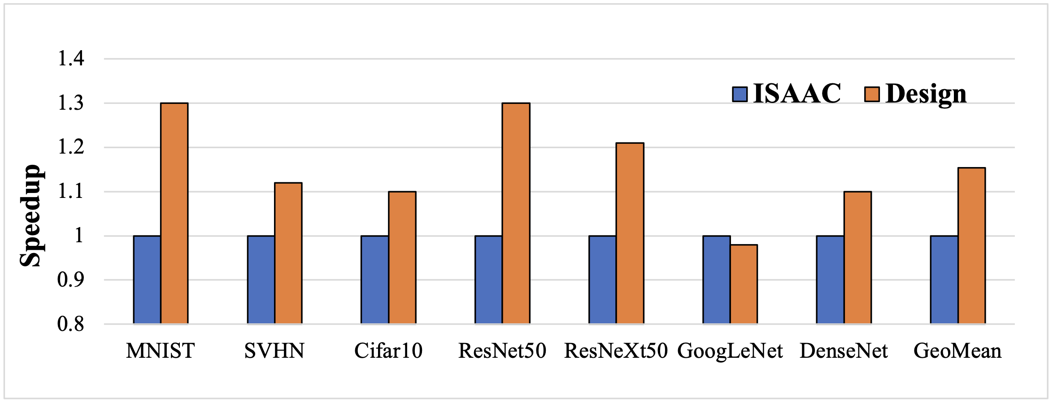
Performance
(1) ISAAC: activate entire crossbar.
(2) Design: only activate half of the cells, 1.14X speedup.
Notes:
Because our new design only activates half of the cells in the crossbar at the same time, the computing speed is higher than ISAAC, which need to activate the entire crossbar. On average ther is a 1.14X speedup.

Slide 21
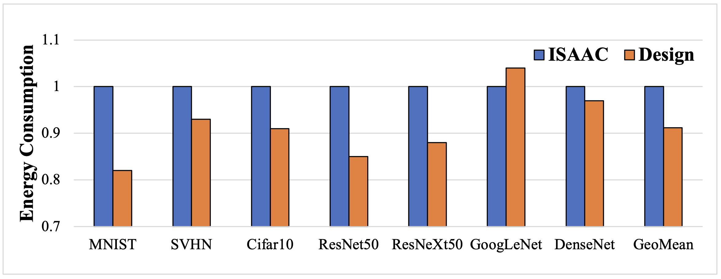
Energy
(1) Only activate half of the cells in a crossbar.
(2) The transistors can avoid sneak current, thus reducing energy waste.
Notes:
The energy saving comes from two aspects.
The first one is still from less activated cells for each computation.
For the second aspect, the transistors can isolate the activated cells from the unactivated cells thanks to the 1T4R structure, so no sneak current will not incur energy waste.
Therefore, there is a 9% energy saving compared to ISAAC.

Slide 22
Q & A
Thank you

