Slide 1
SaasHub Sales Analysis and Strategies
By: Karan Maheshwari
Cornell University

Slide 2
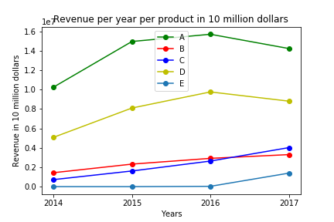
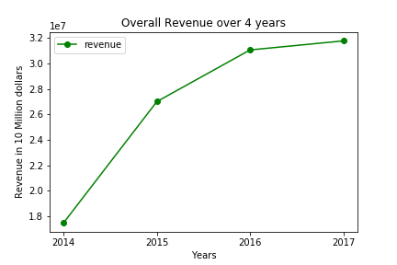
After analyzing the sales data it could be observed that,
Highest growing product in terms of revenue growth is Product E (42.1% revenue increase and 40.1% sales number (licenses sold)). Even though E has lowest revenue in 2017, it has the maximum % increase in revenue because E was launched last year with near zero revenue in 2016 and now with even a small revenue in 2017 it has maximum growth in revenue.
A has highest sales and revenue
Overall 82% increase in revenue from 2014 to 2017 (but not able to keep up with growth, its slowing down)
But, if we exclude E and look at past 4 years of data,
C has highest revenue growth (4.56%) and sales growth (4.75%)
Notes:
After analyzing the sales data it could be observed that, highest growing product in terms of revenue growth is Product E (42.1% revenue increase and 40.1% sales number (licenses sold)). Also it can be seen that Product A has highest sales and revenue.
But Product E was released in 2016 so let's find out product which has highest growth for 4 years of sales
If we exclude E and look at past 4 years of data
- C has highest revenue growth (4.56% increase) and sales growth (4.75% increase)
In addition to this it is found that
- Increase in revenue by 54.0% from year 2014 to year 2015
- Increase in revenue by 15.0% from year 2015 to year 2016
- Increase in revenue by 2.0% from year 2016 to year 2017
- Increase in revenue by 82.0% from year 2014 to year 2017
It shows that we are not able to keep up with the growth rate and if the trend continues we might have stagnated growth or negative growth.

Slide 3
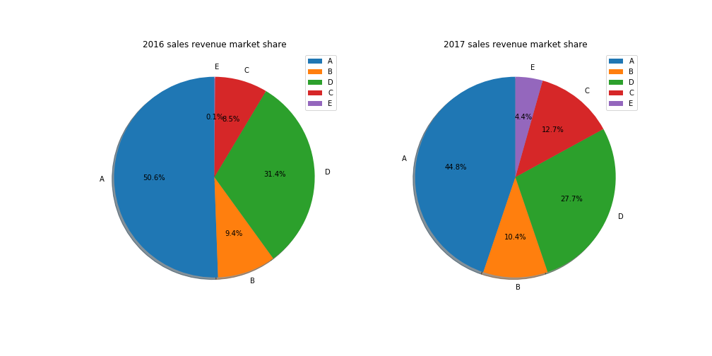
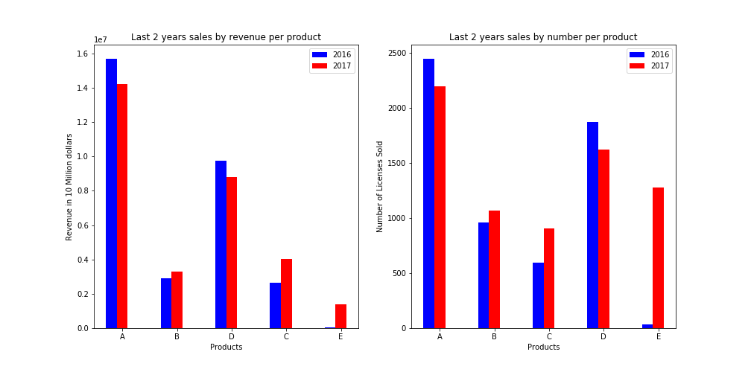
Since now we need to give some suggestions about how to increase the overall growth. Let’s dig in deeper.
As observed there’s a negative decline in last 2 years:
Not able to keep up with the growth rate
Revenue generated and licenses sold by our top products (A and D) have declined
This calls for further investigation:
Notes:
Now we can see that in last 2 years the sales of A and D (our top products) have declined. An in order to grow overall revenue (keeping up with growth rate).
It is obvious that in order to grow overall we need to keep up with the growth rate.
One way of keeping up with the growth is by not declining. As there’s a decline in our top products, we need to find some probable reasons of decline and make some strategies to tackle those and be back on the growth trajectory.

Slide 4
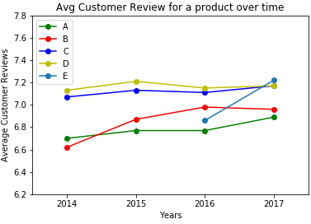
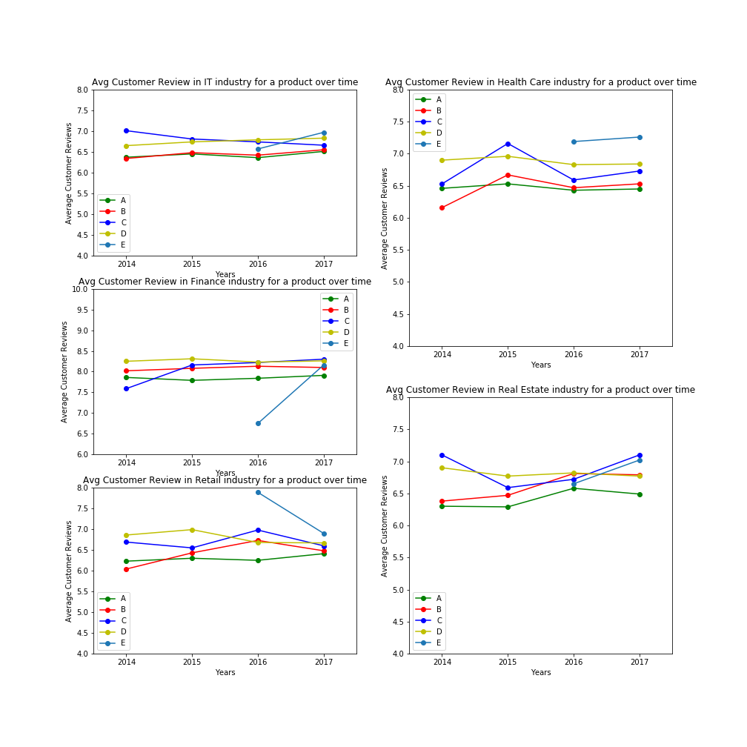
Now, there can be 2 possibilities of decline in sales and revenue of our top products
The products have been faulty and there have been bugs reported and customers not satisfied
Products don’t have issues, the industry has changed and products might be outdated by newer products in the market.
Thus we need to see customer reviews across products and industry trends.
The average customer satisfaction ranges between 6.5 to 7.5. This is poor!
For a million dollar company like ours, we have a scope of improvement.
Let’s dig deeper in customer satisfaction to device a strategy →
Notes:
As we want to be on path of trajectory, we want to see why products have negative sales and revenue. I have come up with two reasons.
Either faulty products and bad service
Or, decline in industry and outdated product

Slide 5
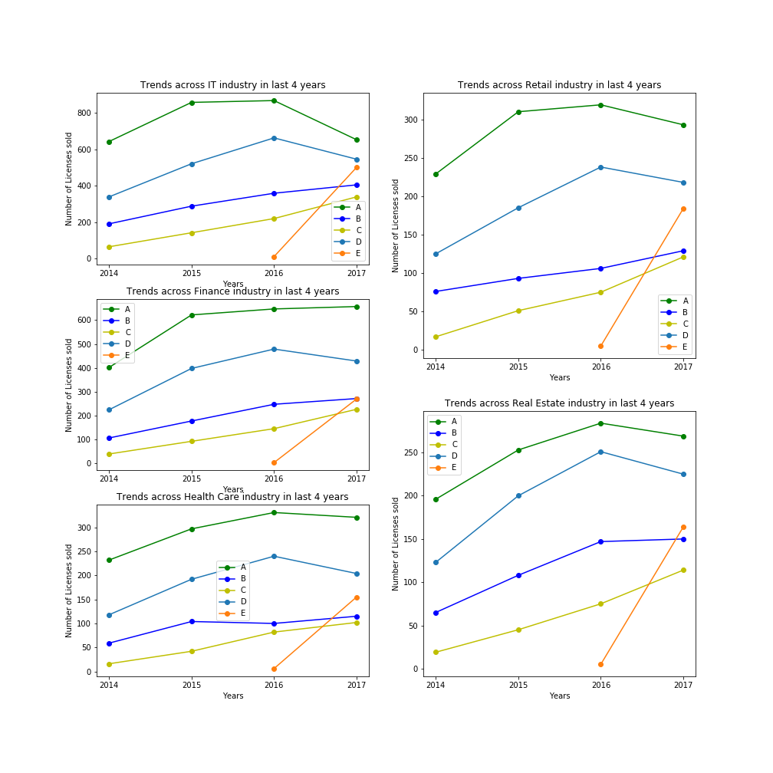
Finance industry is pretty stable. We can utilize this to further increase our sales.
3 out of 5 products have decline in Retail so maybe a change in sale strategy is required. Maybe we can adopt more customer
Centric strategies like Finance Team does.
The numbers of client dropped from 2016 to 2017 for product A is: 874
The numbers of client dropped from 2016 to 2017 for product B is: 348
The numbers of client dropped from 2016 to 2017 for product C is: 208
The numbers of client dropped from 2016 to 2017 for product D is: 652
Data shows that A and D have most number of client dropouts.
Let’s have a deeper look at general trends across the
industries to find some other causes for decline in
sales and further incorporate some strategies. →
A one of our top products sold less than previous year (16-17) in IT, Real Estate, Retail and Health Care.
D sold less in all industries.
E is soon to be top product.
Notes:
One of the probable reason can be that industries have changed. These products came in market 4 years ago. Maybe they have become outdated and industries have more demands. Customers don't have bad reviews because products don't have any bugs but maybe industries need more functionalities now.
Also E is a new upcoming product with high growth rate. Therefore more resources should be allocated to development of E's newer versions.
Newer products/versions should be developed to replace current A and D.

Slide 6
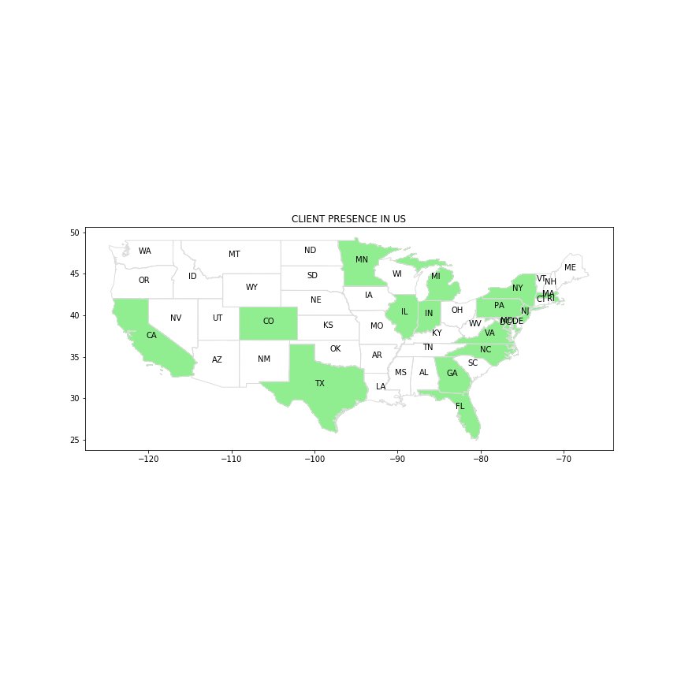
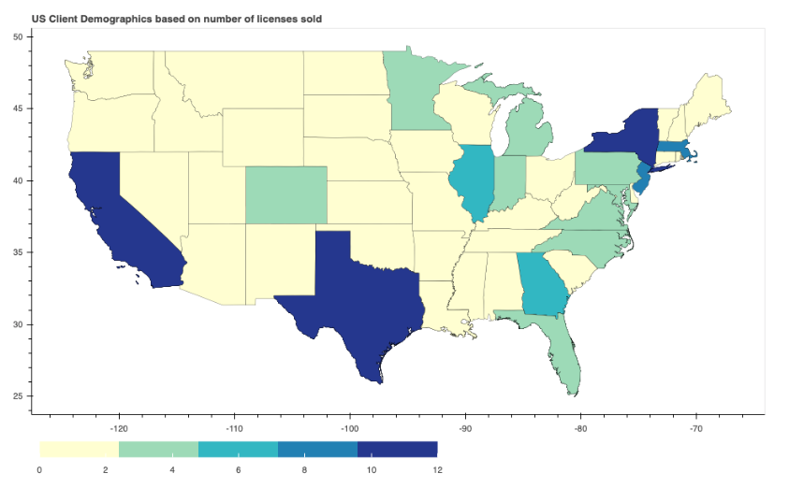
Let’s see where our clients are based at:
This shows the demographics of our clients:
This isn’t quite informatic, let’s see where the most sales is happening
We have divided regions based on percentage
of sales in geographic area.
We realize California, Texas and NY are the states with highest sales (more than 10%) (number of licenses sold). Also, CO, NC, GA and IL are upcoming.
Maybe these are the next software hubs like silicon valleys. We should explore these markets.
Resources should be allocated based on this info for the strategies incorporated earlier.
Notes:
We have devised the strategies but how to allocate resources? Which team should get the most funds? California one or Michigan one?
Which sales team needs newer members? Which is an upcoming market?
Let’s answer these questions

Slide 7
More ideas?
It can be observed that we have information of company size, and number of licenses used by the company.
So maybe further enquiry should happen for company of large size, with with very few licenses.
Other ideas can be brainstormed with more data
Thank You

