Slide 2
Mission
( Mechanism )
f
“doing”
Mechanism
Accomplished
Nonsence

Slide 3
Mission
f
Dynamics
( Mechanism )
f
f
“doing”
Regulations
Mechanism
f
people
Accomplished
f
Nonsence
NaF

Slide 4
f
f
( Mechanism )
people
Dynamics
f
Mechanism
f
f
NaF
Regulations
f
Intelligence

Slide 5
f
f
f
f
people
Dynamics
people
Dynamics
f
f
f
f
AI
Regulations
AI
Regulations
f
Dynamics
f
f
f
AI
f
f
people
Dynamics
people
Dynamics
f
f
f
f
AI
Regulations
AI
Regulations

Slide 6
Mission
Mission
f
“guidance”
Universal approximation theorem
Cybernetics
Hyper Control
“Navigation”
“doing”
f
Dynamics
Basic Control
“PID”
done
Accomplished
ground
Test & Tuning
done
Accomplished

Slide 7
Mission
Mission
Mission
f
Universal approximation theorem
Cybernetics
“MLP”
“KAN”
“doing”
Embodied
f
Dynamics
Basic Control
“pwm”
Test Bench
Accomplished
ground
Test & Tuning
“Application”
Accomplished
Accomplished

Slide 8
Mission
Mission
Mission
Mission
f
f
Cybernetics
Cybernetics
f
f
Embodied
“MLP”
“KAN”
“doing”
Design
f
f
Dynamics
Physics
Environment
“touch”
Accomplished
ground
ground
Accomplished
Accomplished
Accomplished

Slide 9
Guidance
Cybernetics
Navigation
f
Embodied
Flight Control
Design
Motor Control
Structure Mechanics
Physics
Electrics
Aerodynamics
Environment
ground
Atmosphere

Slide 10
Mission
Environment
Agent
Body
“bodies”
Ground

Slide 11


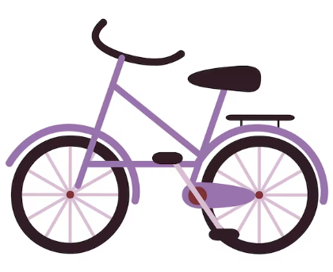
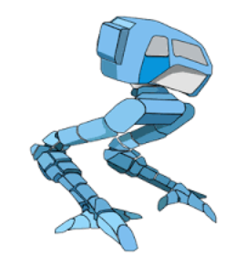
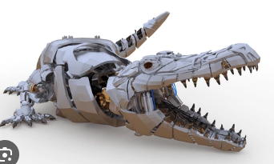
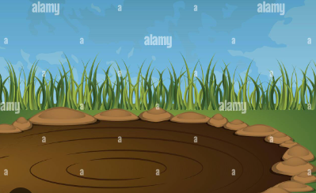
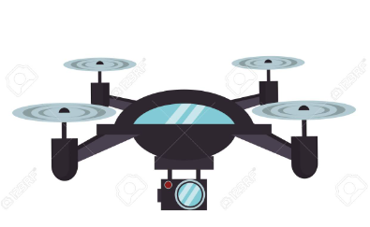
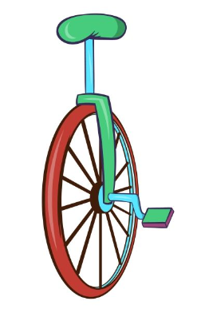
Mission
Environment
Auto-riding Agent

Slide 12
Sdem Agent Algorithm
×
×
different vehicles
Terrians
MLP
large scale
KAN
Brain-like
…
Bike
Snake
Crocodile
Fish
…
Grass
Rocks
Mud
pool
…
Simulation
Monk
Test Bench
S.R.
N.C.S

Slide 13
Computational Resource
Research
( S.D.E.M. )
Auto-riding
Development Platform
Unmanned Vehicle Companies
Applications

Slide 14
Mission
Environment
Agent
Body
“bodies”
Ground

