Slide 1
Objects and Methods (Chapter 6)
Constructors
Static variables and methods
Overloaded methods
Math class
Wrapper classes
Overloaded methods

Slide 2
Constructors: Outline
Defining Constructors
Calling Methods from Constructors
Calling a Constructor from Other Constructors

Slide 3
Defining Constructors
A special method called when instance of an object created with new
    Create objects
    Initialize values of instance variables
Can have parameters
    To specify initial values if desired
May have multiple definitions
    Each with different numbers or types of parameters

Slide 4
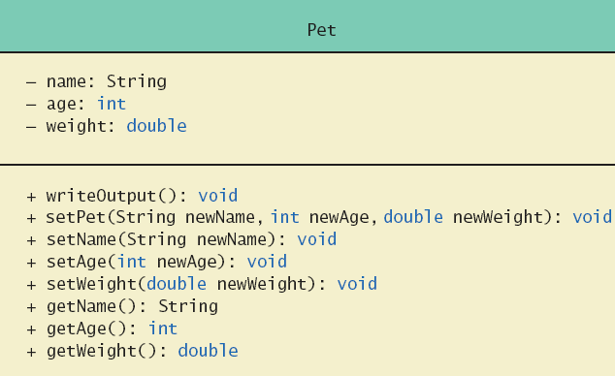
Defining Constructors
Example: Class Pet

Slide 5
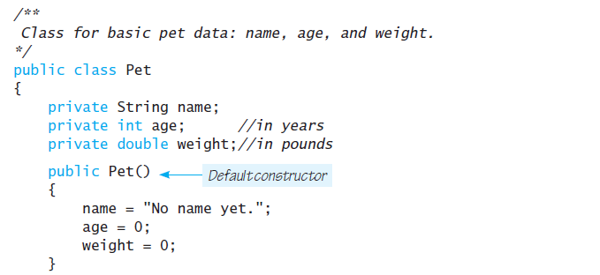
Defining Constructors – example
Example: Class Pet

Slide 6
Defining Constructors
Constructor without parameters is the default constructor
    Java will define this automatically if the class designer does not define any constructors
    If you do define a constructor, Java will not automatically define a default constructor
Usually default constructors not included in class diagram

Slide 7
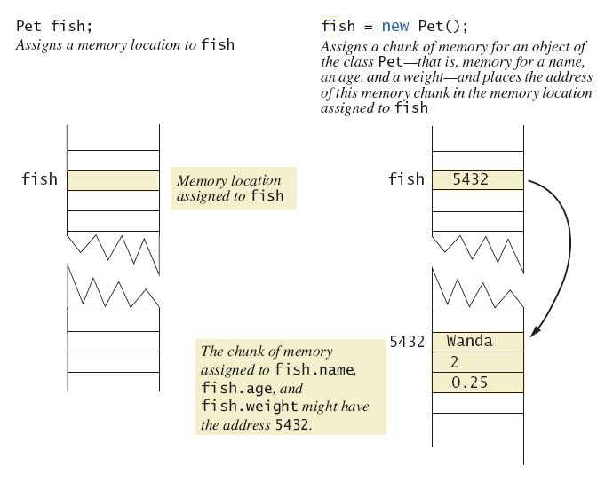
Defining Constructors
A constructor returning a reference

Slide 8
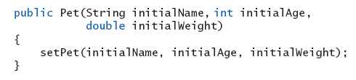
Calling Methods from Other Constructors
Constructor can call other class methods
    Keeps from repeating code

Slide 9
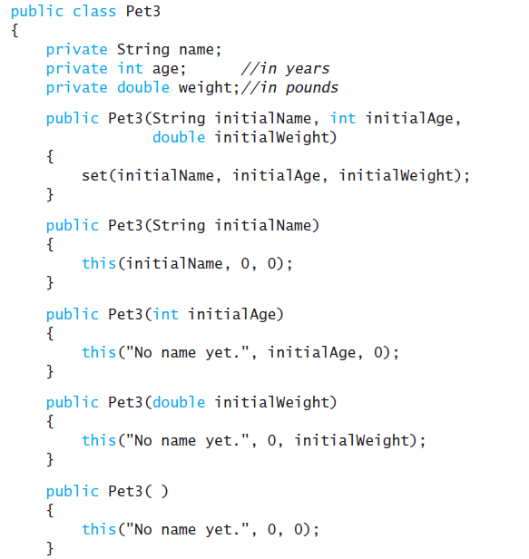
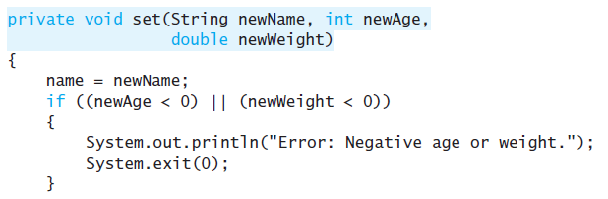
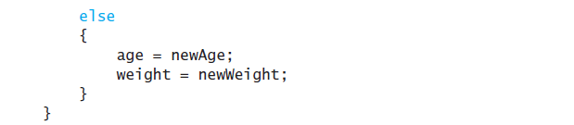
Calling Constructor from Other Constructors

Slide 10
Static Variables
Static variables are shared by all objects of a class
    Variables declared static final are considered constants – value cannot be changed
Variables declared static (without final) can be changed
    Only one instance of the variable exists
    It can be accessed by all instances of the class

Slide 11
Static Variables
Static variables also are called class variables
    Contrast with instance variables
Do not confuse class variables with variables of a class type
Both static variables and instance variables are sometimes called fields or data members

Slide 12
Static Methods
Some methods may have no relation to any type of object
Example
    Compute max of two integers
    Convert character from upper- to lower case
Static method declared in a class
    Can be invoked without using an object
    Instead use the class name

Slide 13
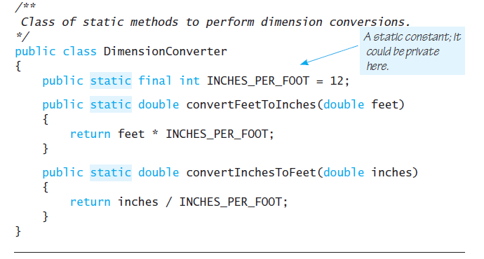
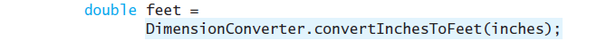
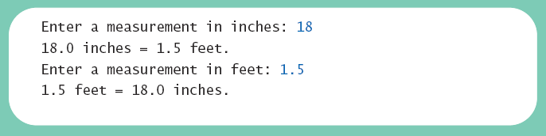
Static Methods
Sample
screen output

Slide 14
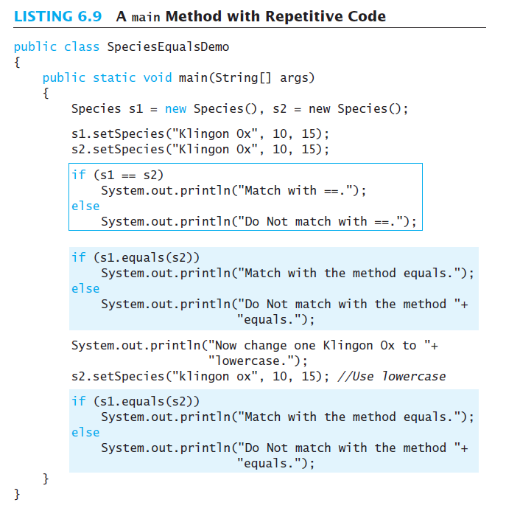
Tasks of main
main method with repetitive code

Slide 15
Adding Method main to a Class
Method main used so far in its own class within a separate file
Often useful to include method main within class definition
    To create objects in other classes
    To be run as a program

Slide 16
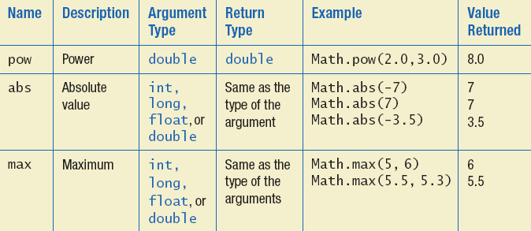
The Math Class
Provides many standard mathematical methods
    Automatically provided, no import needed
Example methods

Slide 17
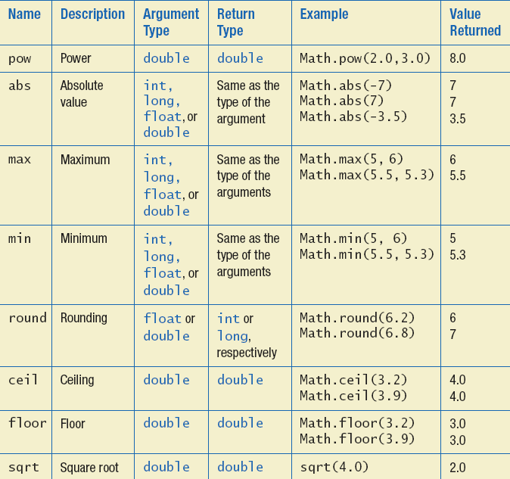
The Math Class
Example methods

Slide 18
Random Numbers
Math.random() returns a random double that is greater than or equal to zero and less than 1
Java also has a Random class to generate random numbers
Can scale using addition and multiplication; the following simulates rolling a six sided die
  int die = (int) (6.0 * Math.random()) + 1;

Slide 19
Wrapper Classes
Java provides wrapper classes for each primitive type
    Methods provided to act on values
    Allow programmer to have an object that corresponds to value of primitive type
    Contain useful predefined constants and methods
    Wrapper classes have no default constructor
      Programmer must specify an initializing value when creating new object
    Wrapper classes have no set methods

Slide 20
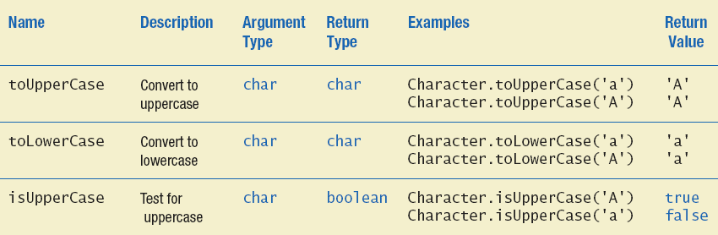
Wrapper Classes
Static methods in class Character

Slide 21
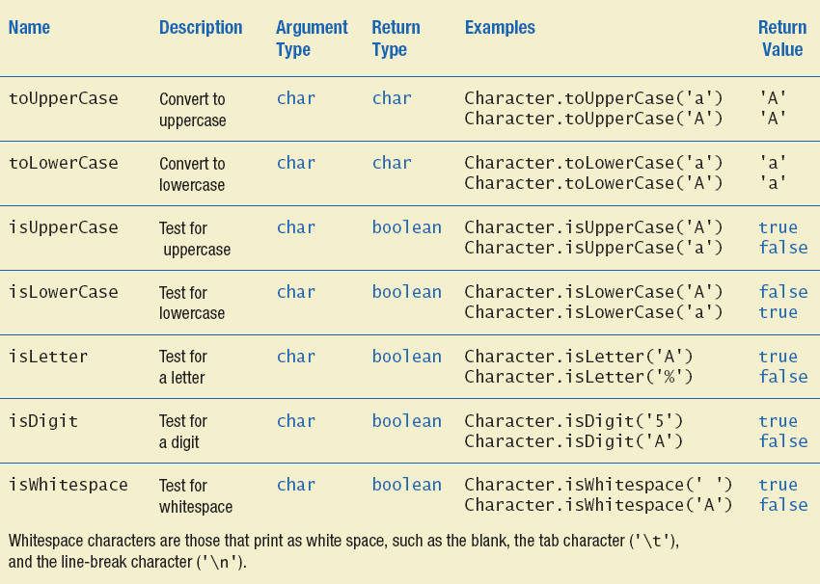
Wrapper Classes
Static methods in class Character

Slide 22
Decomposition
With this pseudocode we decompose the task into subtasks
    Then solve each subtask
    Combine code of subtasks
    Place in a method

Slide 23
Addressing Compiler Concerns
Compiler ensures necessary tasks are done
    Initialize variables
    Include return statement
Rule of thumb: believe the compiler
    Change the code as requested by compiler
    It is most likely correct

Slide 24
Testing Methods
To test a method use a driver program
Every method in a class should be tested
Bottom-up testing
    Test code at end of sequence of method calls first

Slide 25
Overloading Basics
When two or more methods have same name within the same class
Java distinguishes the methods by number and types of parameters
    If it cannot match a call with a definition, it attempts to do type conversions
A method's name and number and type of parameters is called the signature

Slide 26
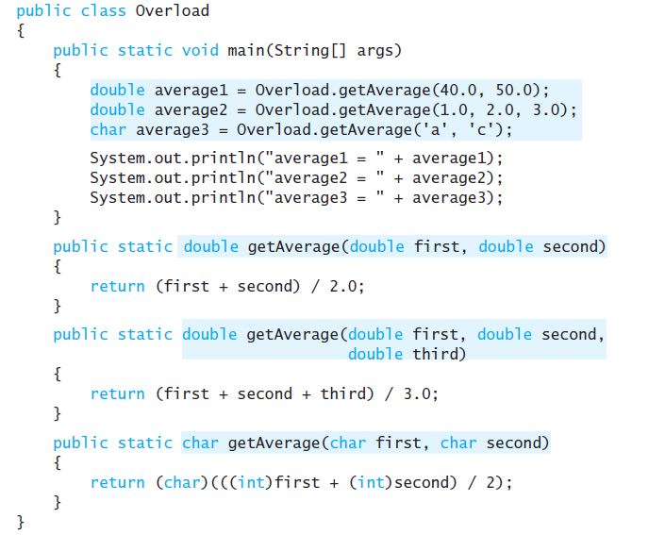
Overloading Basics – example

Slide 27
Overloading and Type Conversion
Overloading and automatic type conversion can conflict
Remember the compiler attempts to overload before it does type conversion

Slide 28
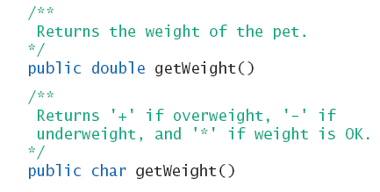
Overloading and Return Type
You must not overload a method where the only difference is the type of value returned !!

Slide 29
Programming Example
public class Money
{
public void set(long newDollars) {
}
public void set(double newAmount) {
}
public void set(Money moneyObject) {
}
}

Slide 30
Information Hiding Revisited
Privacy Leaks
Instance variable of a class type contain address where that object is stored
Assignment of class variables results in two variables pointing to same object
    Use of method to change either variable, changes the actual object itself

Slide 31
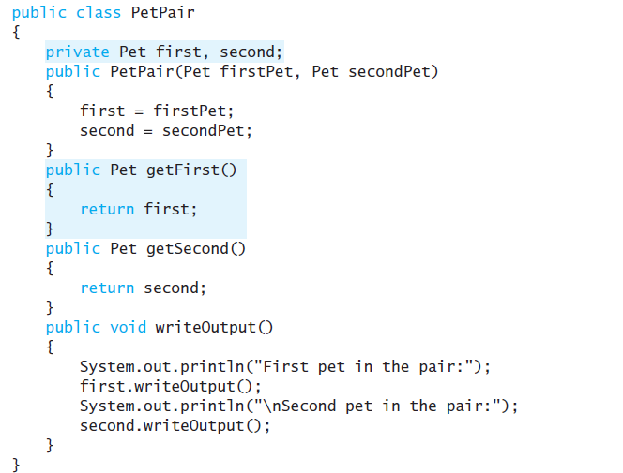
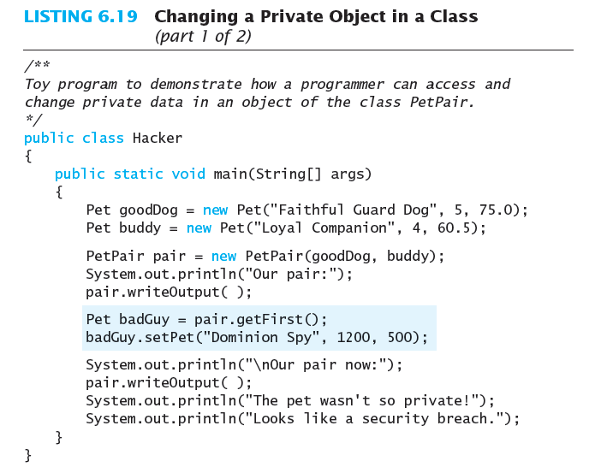
Information Hiding Revisited

Slide 32
Enumeration as a Class
Consider defining an enumeration for suits of cards
enum Suit {CLUBS, DIAMONDS, HEARTS, SPADES}
Compiler creates a class with methods
  equals
  compareTo
  ordinal
  toString
  valueOf

Slide 33
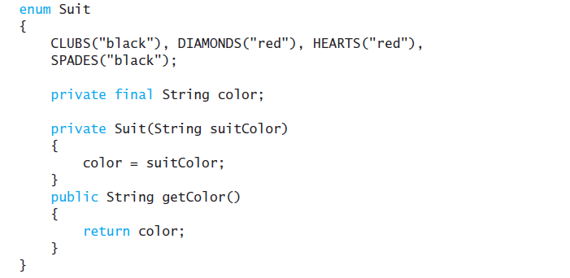
Enumeration as a Class
This calls constructor Suit(“black”)

Slide 34
Packages and Importing
A package is a collection of classes grouped together into a folder
Name of folder is name of package
Each class
    Placed in a separate file
    Has this line at the beginning of the file
    package Package_Name;
Classes use packages by use of import statement

Slide 35
Package Names and Directories
Package name tells compiler path name for directory containing classes of package
Search for package begins in class path base directory
    Package name uses dots in place of / or \
Name of package uses relative path name starting from any directory in class path

Slide 36
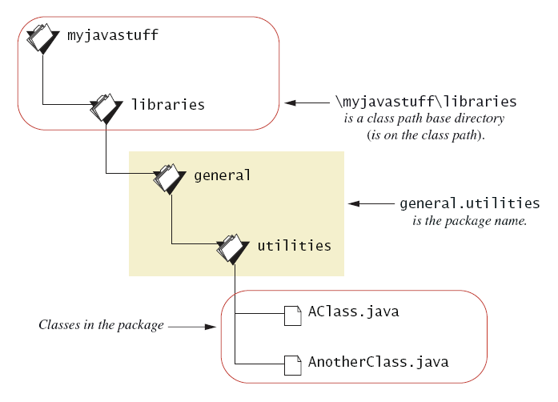
Package Names and Directories
A package name

Slide 37
Name Clashes
Packages help in dealing with name clashes
  When two classes have same name
Different programmers may give same name to two classes
  Ambiguity resolved by using the package name

