Slide 1


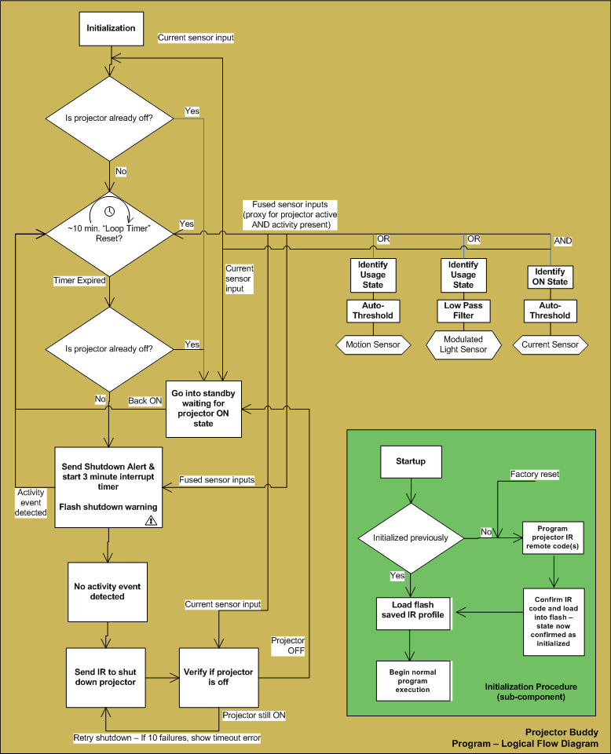
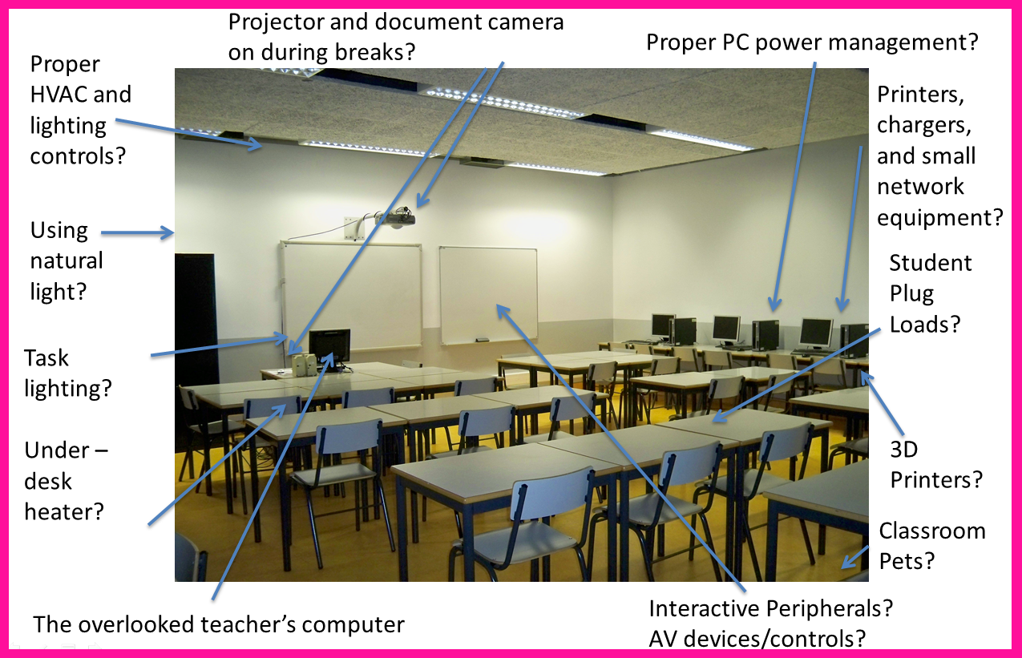
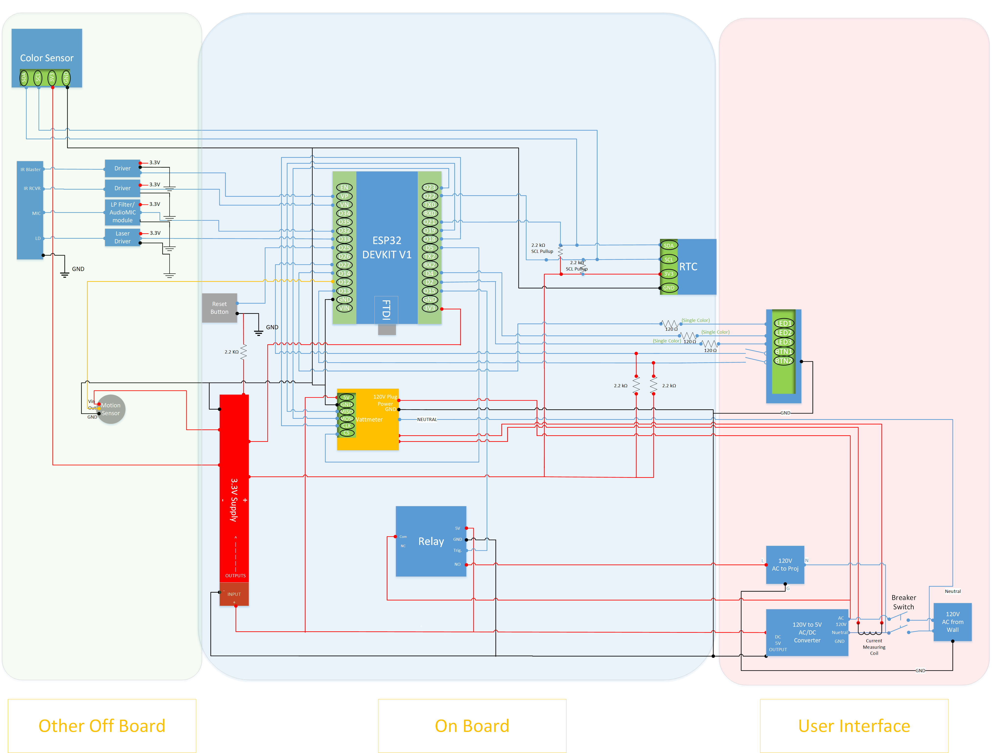
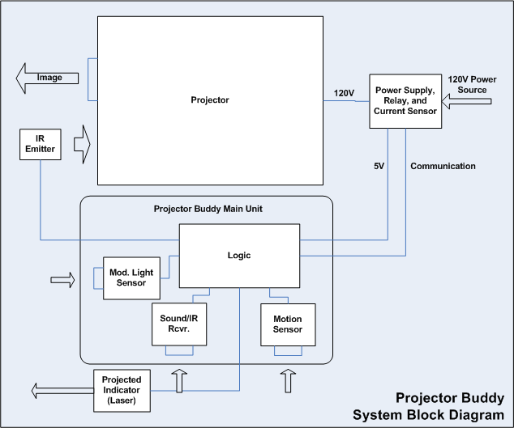

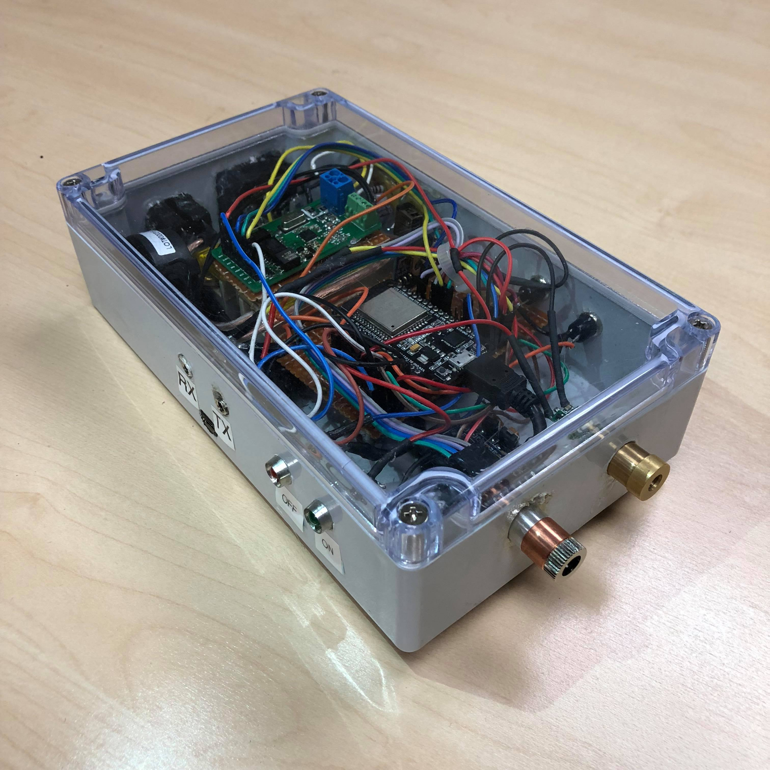
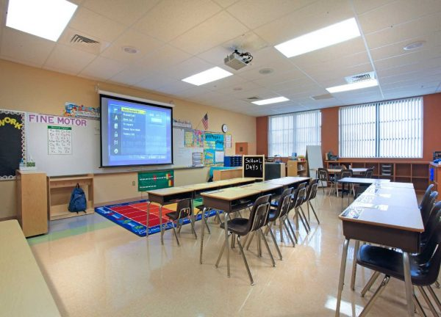
Projector Buddy: A Tool for Classroom Energy Management Jerry Lee, Justin Le, Sean Santarsiero, Sid Kasat Project Advisors: Dr. Michael Klopfer, Dr. Jason Luo, Dr. Crystal Rapier, Prof. G.P. Li California Plug Load Research Center (CalPlug)
May 2016
Background
Proposed Solution
Technology enabled classrooms are key in preparing students for the 21st century. The increasing variety and number of new devices in the classroom permit educators to capture and engage a wider variety of learners. Many educational devices are plug load (plug-in) consumer electronics. The energy foot print of “smart” classrooms (K-16) is an open question. Numerous devices and systems in the classroom could be investigated for the opportunity to boost energy efficiency and reduce power consumption.
Projectors are an essential part of the “smart” classroom and are easy targets for energy savings. These devices can consume several hundred watts of power in operation and non-negligible power in standby mode. Misconfigured/disabled power save settings on the projectors or control systems that keep projectors “awake” can prevent practical energy savings.
A “smart” device to control user interface devices (projectors, TVs, stereos, etc.) needs to identify user engagement and enact power savings in a way that does not interfere with user experience. Building upon CalPlug’s “5W5S” device, we have designed a system to detect users in the location of a projector and turn it off if no usage is detected. The current proof-of-concept device uses three mechanisms. Motion (1) is used to detect movement, modulated light/audio (2) is used to detect changes in images on the screen/sound in the room, and projector current (3) is used to identify if the projector is in use. Through correlation of sensor inputs, user engagement can be inferred in common classroom usage scenarios. For example, a changing picture/sound with no detected motion may be a video based lecture. In this case, students would be seated and watching a video. Multiple motion events over a short period of time with an unchanging screen image may be indicative of the beginning or end of a class period. In general, only when a fixed picture is observed and no motion/characteristic audio is detected will the system begin the shutdown process after a specified delay period.
Reduction in vampire load (standby power) can be accomplished by relay control. The power to the projector can be removed when it is fully shut down and restored eminently before the projector is turned back on. The IR transceiver component of the device can relay commands to power on and off the projector as needed. The device will be programmed at time of installation with the On and OFF IR codes for the particular projector it will be connected to. A simple programming sequence will be used to allow semi-skilled technical laborers to install the device in the period of 10 minutes.
The initial proof-of-concept device was constructed using an Arduino Due (ARM Cortex M3 microcontroller). The full working prototype was made using an ESP32 microcontroller due to its in-built capabilities.
Before shutdown occurs, a tell-tale indicator message is flashed on the screen using a laser projected static stencil. A laser provides proper focus at a variety of projector-to-screen distances.
This projected indicator serves as a final warning before the projector is powered down gracefully via infrared (IR) commands.
This can lead to shorter projector bulb and device lifetimes in addition to increased energy usage. Can a simple, low cost device save energy and money for schools by automatically turning projectors off when they are not in use? What other opportunities are available for similar approaches?
The design is aimed so the user can simply plug it in and immediately begin reducing power consumption. With our newest design, we have adapted our system to use even less power yet added a more Real-time interaction with the environment using a new multi-process algorithm that adds task parallelism and concurrency to the low throughput system. Classroom energy management can easily benefit from Projector Buddy and can be the a gateway to a more energy friendly ecosystem in this age of rising technologies.
Future Work
Now that a fully functional, low power prototype has been made, the next step for the project will be a PCB design. The goal of this design is to fully utilize space and functionalities of the ESP32 such as the dual processors and low power usage in order to expand this system to work with other classroom plug load devices. Providing a “middle-man” between devices can greatly reduce the impending vampire load found in consumer products.
Notes:
To match other CalPlug posters for Spring Workshop 2016 – print onto ANSI Size E with scaling on HP 1055cm printer
1. Header section – provide title, logo, location of the hardware.
2. List team members – include major (ie. EE, CpE, CSE) and advisors.
3. Goal - goal of the project and system requirements. Include a website if any, or design challenge site.
4. Background – overview of system design. --Decompose the system into subsystems, provide drawings, photographs and experiments if any.
5. Team organization -- present the organization chart, with majors of participants.
-Identify subsystem teams and team leads, explain design trade-off are managed.
6. Subsystem presentations -- describe each subsystem design.
-- Goal, Assembly drawings, Reports, Parts drawings, Purchase parts list, Cost.
7. Parts List and Budget (Bill of Material) and Manufacturing Plan
-- Provide list of assemblies, list of machined parts and the list of purchase parts, and the total estimated cost. Outline a manufacturing process and estimate its cost per finished product.
8. Describe the Results, Innovation and Business Opportunity
-- Identify the feature or features that distinguish this product from the competition. Describe the target market, its size and location, and estimate a sales price and volume.
9. Plan – describe the plan and schedule for the next phase. Include website address and contact information for those seeking more about the project.
10. Summary and Team Photo.
1

