Slide 1
Human Identification (Category: Defense)

Slide 2
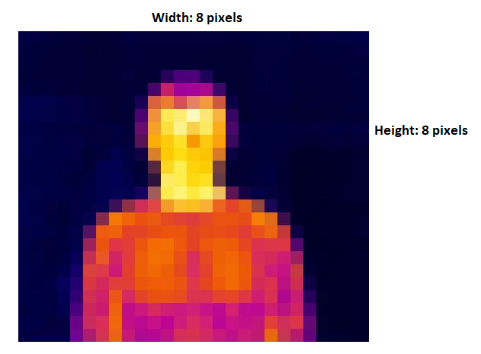
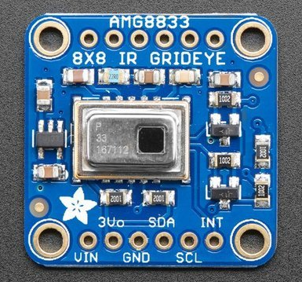
Quick Explanation
Using a thermal sensor attached to an Arduino, output whether or not the captured object is a human based on temperature readings (human body temperature = 37 degrees Celcius).
Capture Temperature Readings [8x8 Array]
HUMAN

Slide 3
Applications
Defense:
Used by military to detect enemies in hostile environments
Can detect fallen allies in darkness within a certain range

Slide 4
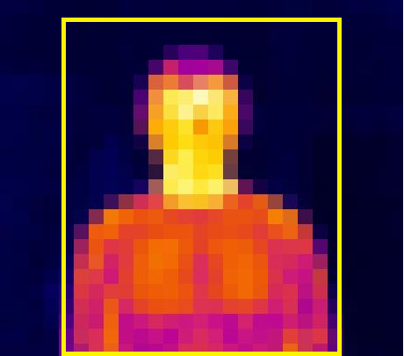
Algorithm
The sensor will output to the computer an 8x8 array consisting of temperatures for each pixel (64 total).
We select only some pixels (center ones).
Of the center pixels, delete all pixels that are considered cold (blue).
Add up all the pixels that aren’t cold and find the mean value. If this value is not close to 37 degrees (average human temperature), then object is not human.
Sensor ($40): https://www.adafruit.com/product/3538?gclid=EAIaIQobChMIp7DpodiV1wIVhJN-Ch2rHgxDEAQYBSABEgJmxvD_BwE

Slide 5
Pros and Cons
Pros:
Meets the requirements of the project
Can get done in < 3 weeks (code for the sensor is posted online)
Somewhat creative/unique
Cons:
Sensor $40 (+ shipping time)
Memory concerns (but can be fixed using multiple arduinos i.e. one to capture readings, one to compute, one to output results)
Concept might not work

