Slide 1
Reasoning
(using first-order predicate logic)

Slide 2
Resolution Refutations
Example:
Given {BAT_OK, MOVES', BAT_OK ∧ LIFTABLE → MOVES}
Prove ¬LIFTABLE
Nilsson

Slide 3
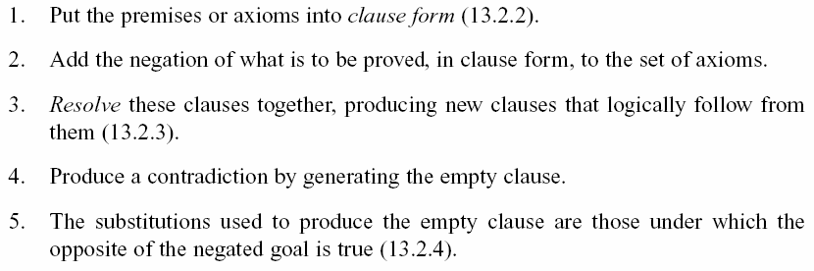
Resolution Refutations
Example:
Given {BAT_OK, MOVES', BAT_OK ∧ LIFTABLE → MOVES}
Prove ¬LIFTABLE
Resolution refutation proofs involve the following steps:
Luger: Artificial Intelligence, 5th edition. © Pearson Education Limited, 2005

Slide 4
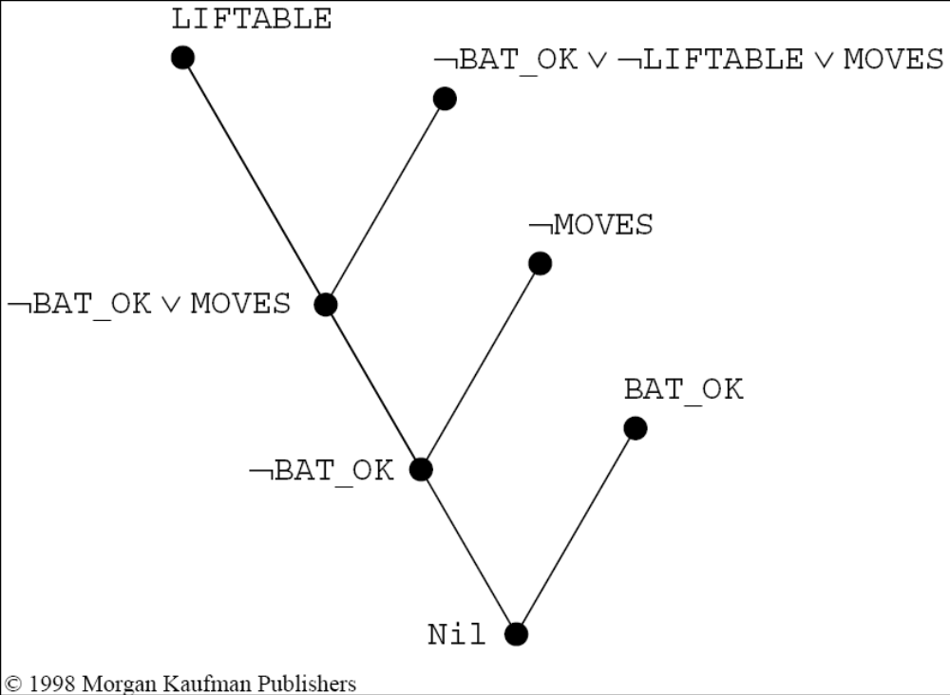
Resolution Refutations
Example:
Given {BAT_OK, MOVES', BAT_OK ∧ LIFTABLE → MOVES}
Prove ¬LIFTABLE
Nilsson

Slide 5
Anyone passing his history exams and winning the lottery is happy. But anyone who studies or is lucky can pass all his exams. John did not study but is lucky. Anyone who is lucky wins the lottery. Is John happy?
Luger: Artificial Intelligence, 5th edition. © Pearson Education Limited, 2005

Slide 6
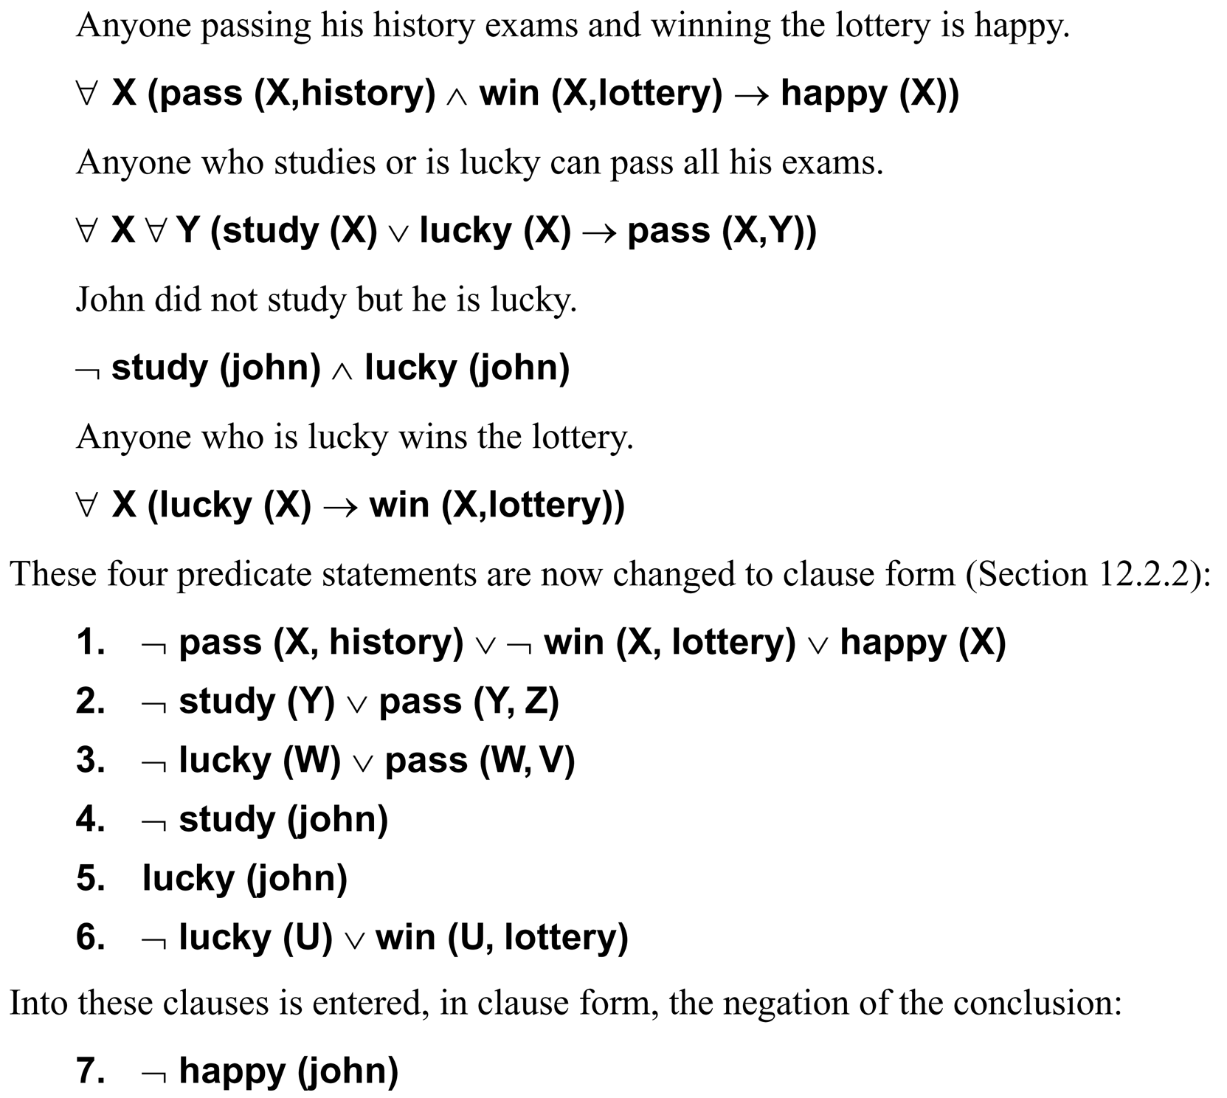
Luger: Artificial Intelligence, 5th edition. © Pearson Education Limited, 2005

Slide 7
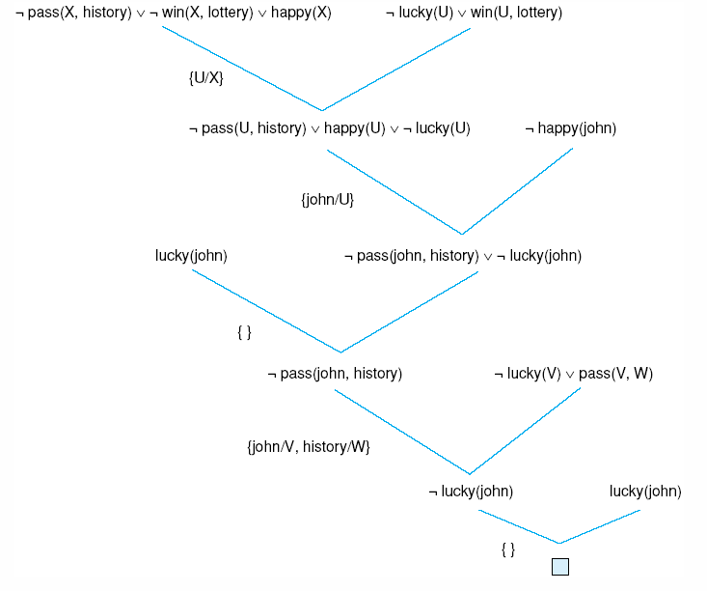
One refutation for the “happy student” problem.
Luger: Artificial Intelligence, 5th edition. © Pearson Education Limited, 2005

Slide 8
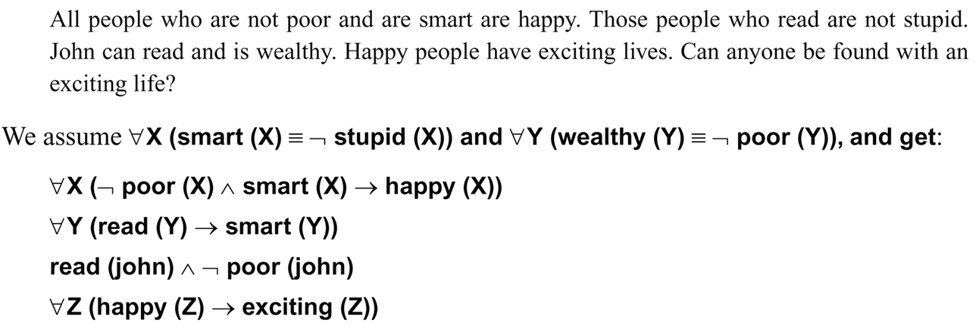
Luger: Artificial Intelligence, 5th edition. © Pearson Education Limited, 2005

Slide 9
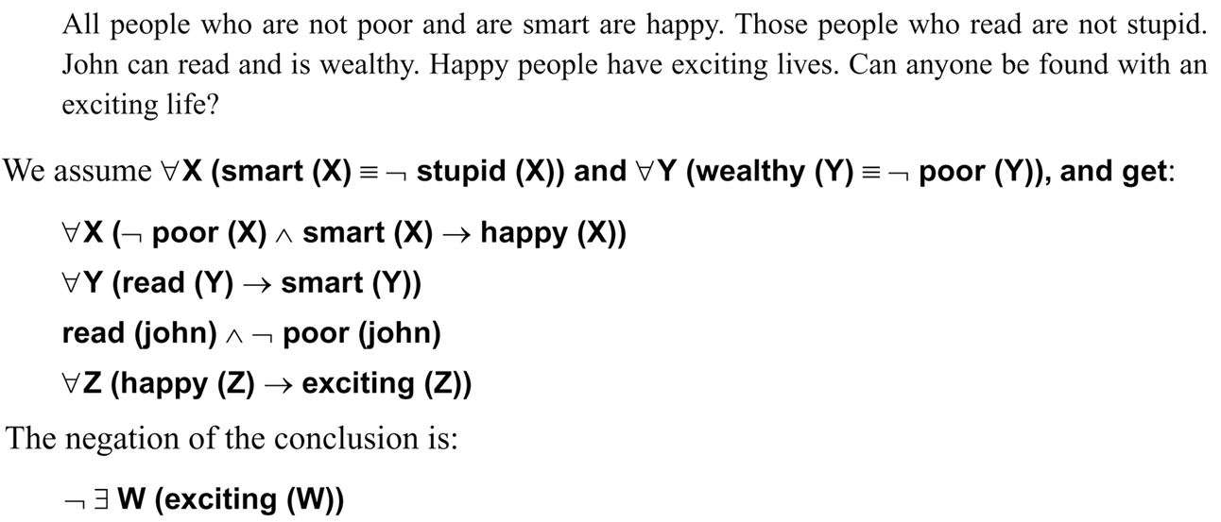
Luger: Artificial Intelligence, 5th edition. © Pearson Education Limited, 2005

Slide 10
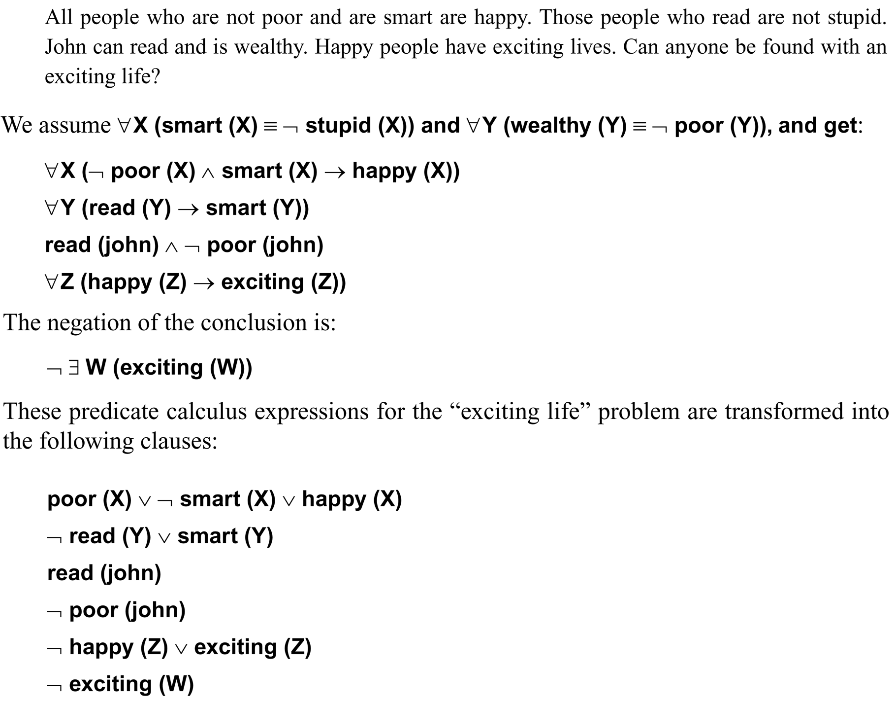
Prove (∃W)exciting(W)
¬[(∃W)exciting(W)] = (∀W)¬exciting(W)
Luger: Artificial Intelligence, 5th edition. © Pearson Education Limited, 2005

Slide 11
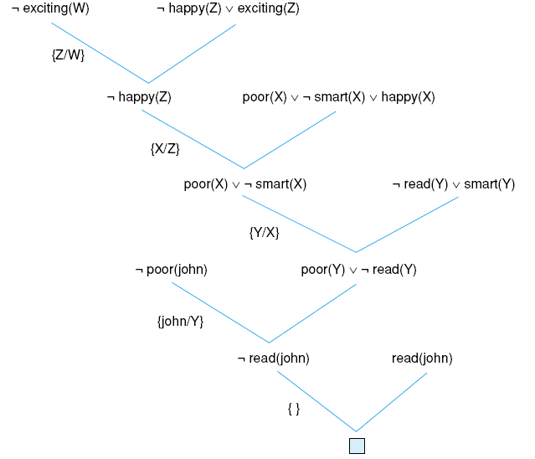
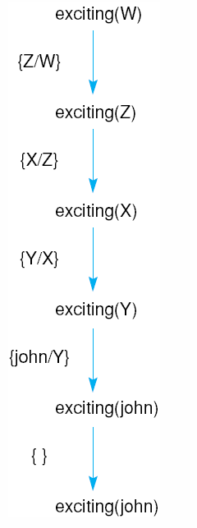
Unification substitutions
Resolution proof for the “exciting life” problem
exciting(W)
happy(Z)
smart(X)
poor(Y)
read(john)
Luger: Artificial Intelligence, 5th edition. © Pearson Education Limited, 2005

Slide 12
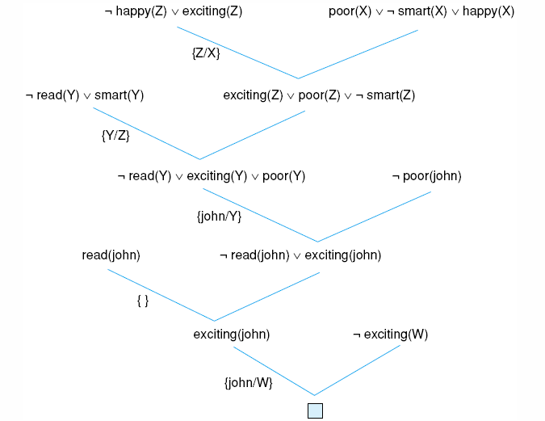
Another resolution refutation for the previous example
Luger: Artificial Intelligence, 5th edition. © Pearson Education Limited, 2005

Slide 13
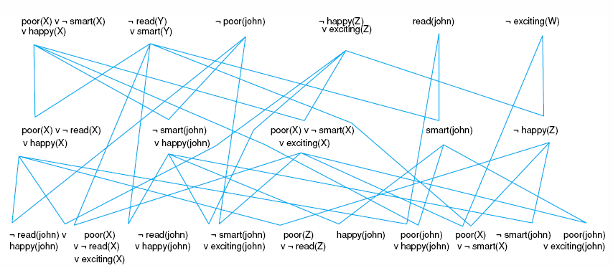
Complete state space for the “exciting life” problem generated by breadth-first search (to two levels).
Luger: Artificial Intelligence, 5th edition. © Pearson Education Limited, 2005

Slide 14
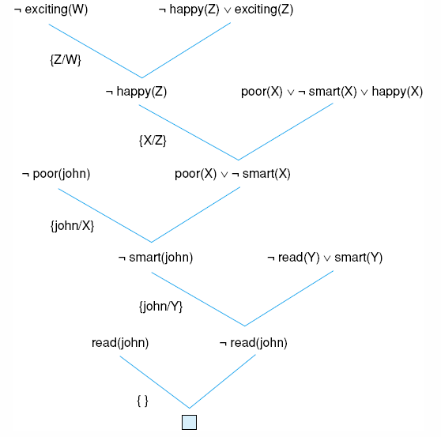
Using the unit preference strategy on the “exciting life” problem.
Luger: Artificial Intelligence, 5th edition. © Pearson Education Limited, 2005

Slide 15
Converting Arbitrary WFFs to Clause Form
Eliminate implication signs.
Reduce scopes of negation signs.
Standardize variables. Note: variables within the scope of quantifiers are “dummy” variables and can be renamed so that each quantifier has its own variable symbol. Example: (∀X)p(X)' ∨ (∃X)q(X) can be rewritten as (∀X)p(X)' ∨ (∃Y)q(Y).
Eliminate existential quantifiers (e.g., use a Skolem function to convert (∀X)[(∃Y) height(X,Y)] (meaning, X is of height Y) to (∀X)height(X,h(X)).
Nilsson

Slide 16
Converting Arbitrary WFFs to Clause Form
Some examples involving Skolem functions:
Given: [(∀W)q(W)]→(∀X){(∀Y){(∃Z)[p(X,Y,Z)→(∀U)r(X,Y,U,Z)]}}
Convert to:
[(∀W)q(W)]→(∀X)(∀Y)[p(X,Y,g(X,Y))→(∀U)r(X,Y,U,g(X,Y)]
Given:
(∀X){p(X)' ∨ {(∀Y)[p(Y)'∨ p(f(X,Y))] ∧ (∃W)[q(X,W) ∧ p(W)']}}
Convert to:
(∀X){p(X)' ∨ {(∀Y)[p(Y)'∨ p(f(X,Y))] ∧ [q(X,h(X)) ∧ p(h(X))']}}
Given:
(∃X)p(X)
Convert to:
p(sk) where sk is a constant not used in any other expression
Nilsson

Slide 17
Problem: Sam, Clyde, and Oscar are elephants. We know the following facts about them:
  Sam is pink.
  Clyde is gray and likes Oscar.
  Oscar is either pink or gray (but not both) and likes Sam.
Prove that a gray elephant likes a pink elephant.
Nilsson

Slide 18
Problem: Sam, Clyde, and Oscar are elephants. We know the following facts about them:
  Sam is pink.
  Clyde is gray and likes Oscar.
  Oscar is either pink or gray (but not both) and likes Sam.
Prove that a gray elephant likes a pink elephant.
Predicates:
p(X) X is Pink
g(X) X is Gray
l(X,Y) X Likes Y
Constants:
s Sam
c Clyde
o Oscar
Nilsson

Slide 19
Problem: Sam, Clyde, and Oscar are elephants. We know the following facts about them:
  Sam is pink.
  Clyde is gray and likes Oscar.
  Oscar is either pink or gray (but not both) and likes Sam.
Prove that a gray elephant likes a pink elephant.
Knowledge Base:
p(s) p(s) 1
g(c) g(c) 2
l(c,o) l(c,o) 3
p(o) ∨ g(o) p(o) ∨ g(o) 4
p(o) → g(o)' p(o)' ∨ g(o)' 5
l(o,s) l(o,s) 6
(∃X,Y)[g(X)∧p(Y)∧l(X,Y)] (prove) g(X) ∧ p(Y) ∧ l(X, Y)
(assume) g(X)' ∨ p(Y)' ∨ l(X, Y)' 7
Nilsson

Slide 20
p(s) Given
g(c) Given
l(c, o) Given
p(o) ∨ g(o) Given
p(o)' ∨ g(o)' Given
l(o, s) Given
g(X)' ∨ p(Y)' ∨ l(X, Y)' Assumed

Slide 21
p(s) Given
g(c) Given
l(c, o) Given
p(o) ∨ g(o) Given
p(o)' ∨ g(o)' Given
l(o, s) Given used
g(X)' ∨ p(Y)' ∨ l(X, Y)' Assumed used
g(o)' ∨ p(s)' 6,7

Slide 22
p(s) Given used
g(c) Given
l(c, o) Given
p(o) ∨ g(o) Given
p(o)' ∨ g(o)' Given
l(o, s) Given used
g(X)' ∨ p(Y)' ∨ l(X, Y)' Assumed used
g(o)' ∨ p(s)' 6,7 used
g(o)' 1,8

Slide 23
p(s) Given used
g(c) Given
l(c, o) Given
p(o) ∨ g(o) Given used
p(o)' ∨ g(o)' Given
l(o, s) Given used
g(X)' ∨ p(Y)' ∨ l(X, Y)' Assumed used
g(o)' ∨ p(s)' 6,7 used
g(o)' 1,8 used
p(o) 4,9

Slide 24
p(s) Given used
g(c) Given used
l(c, o) Given
p(o) ∨ g(o) Given used
p(o)' ∨ g(o)' Given
l(o, s) Given used
g(X)' ∨ p(Y)' ∨ l(X, Y)' Assumed used
g(o)' ∨ p(s)' 6,7 used
g(o)' 1,8 used
p(o) 4,9
p(Y)' ∨ l(c, Y)' 2,7

Slide 25
p(s) Given used
g(c) Given used
l(c, o) Given
p(o) ∨ g(o) Given used
p(o)' ∨ g(o)' Given
l(o, s) Given used
g(X)' ∨ p(Y)' ∨ l(X, Y)' Assumed used
g(o)' ∨ p(s)' 6,7 used
g(o)' 1,8 used
p(o) 4,9 used
p(Y)' ∨ l(c, Y)' 2,7 used
l(c, o)' 10,11

Slide 26
p(s) Given used
g(c) Given used
l(c, o) Given used
p(o) ∨ g(o) Given used
p(o)' ∨ g(o)' Given
l(o, s) Given used
g(X)' ∨ p(Y)' ∨ l(X, Y)' Assumed used
g(o)' ∨ p(s)' 6,7 used
g(o)' 1,8 used
p(o) 4,9 used
p(Y)' ∨ l(c, Y)' 2,7 used
l(c, o)' 10,11 used
□ 3,12

Slide 27
p(s) Given used
g(c) Given used
l(c, o) Given used
p(o) ∨ g(o) Given used
p(o)' ∨ g(o)' Given
l(o, s) Given used
g(X)' ∨ p(Y)' ∨ l(X, Y)' Assumed used
g(o)' ∨ p(s)' 6,7 used
g(o)' 1,8 used
p(o) 4,9 used
p(Y)' ∨ l(c, Y)' 2,7 used
l(c, o)' 10,11 used
□ 3,12
Is there another solution?

Slide 28
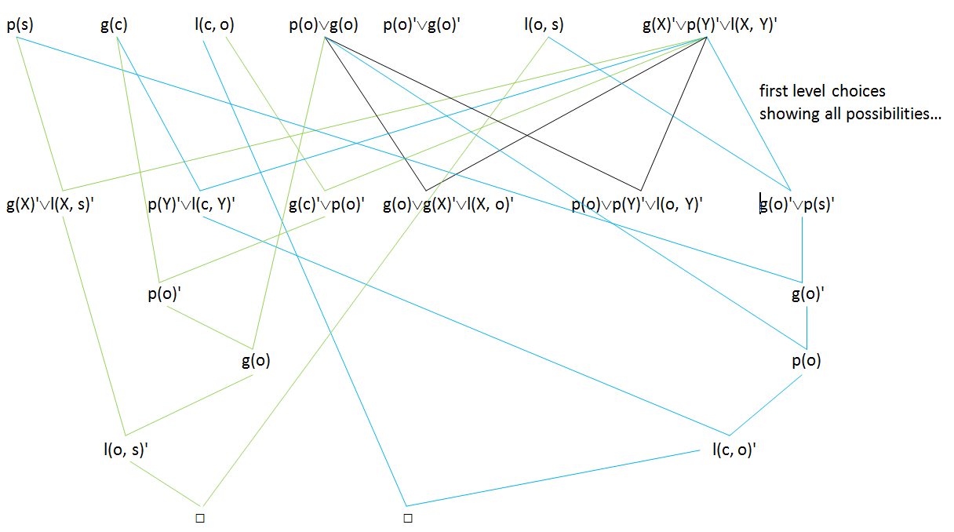
Those crazy elephants…
Different solution
Previous solution
Although at first sight there may not appear to be enough information to prove what is asked, consider that there are only two “likes” predicates in the knowledge base. Consequently, the only two possibilities are g(c)∧p(o)∧l(c, o) and g(o)∧p(s)∧l(o, s). Because we know g(c) and p(s), the first of these will be true for p(o) and the second for g(o). But we also know p(o)∨g(o) so, even though we don’t know what color Oscar is, we do know that one of those statements, (g(c)∧p(o)∧l(c, o) or g(o)∧p(s)∧l(o, s), must be true. Note that the two solutions shown above reflect the two possibilities.

Slide 29
Prove: (∃X)(∃Y)[g(X)∧p(Y)∧l(X,Y)]
p(s) hypothesis
g(c) hypothesis
l(c, o) hypothesis
p(o) ∨ g(o) hypothesis
p(o) → g(o)' hypothesis
l(o, s) hypothesis
{(∃ X)(∃Y)[g(X)∧p(Y)∧l(X,Y)]} ' assumption for proof by contradiction
(∀X)(∀Y)[g(X)' ∨ p(Y)' ∨ l(X, Y)'] 7, negate and use DeMorgan’s law
(∀X)(∀Y)[l(X, Y) → (g(X) ∧ p(Y))'] 8, rewrite implication and use DeMorgan’s law
l(c, o) → [g(c) ∧ p(o)]' 9, universal instantiation
[g(c) ∧ p(o)]' 3,10, modus ponens
g(c)' ∨ p(o)' 11, DeMorgan’s law
g(c) → p(o)' 12, rewrite implication
p(o)' 2, 13, modus ponens
p(o)' → g(o) 4, rewrite implication
g(o) 14,15, modus ponens
l(o, s) → [g(o) ∧ p(s)]' 9, universal instantiation
[g(o) ∧ p(s)]' 6, 17, modus ponens
g(o)' ∨ p(s)' 18, DeMorgan’s law
g(o) → p(s)' 19, rewrite implication
p(s)' 16, 20, modus ponens ← contradiction with 1
Alternatively, we can consider a standard proof sequence for the elephant problem (still employing a proof by contradiction)…

Slide 30
Problem: Tony, Mike, and John belong to the Alpine Club. Every member of the Alpine Club is either a skier or a mountain climber or both. No mountain climber likes rain, and all skiers like snow. Mike dislikes whatever Tony likes and likes whatever Tony dislikes. Tony likes rain and snow. Who is a member of the Alpine Club who is a mountain climber but not a skier?
Nilsson

Slide 31
Problem: Tony, Mike, and John belong to the Alpine Club. Every member of the Alpine Club is either a skier or a mountain climber or both. No mountain climber likes rain, and all skiers like snow. Mike dislikes whatever Tony likes and likes whatever Tony dislikes. Tony likes rain and snow. Who is a member of the Alpine Club who is a mountain climber but not a skier?
Predicates:
a(X) X is a member of the Alpine club
m(X) X is a Mountain climber
s(X) X is a Skier
l(X,Y) X Likes Y
Constants:
t Tony
m Mike
j John
r Rain
s Snow
Nilsson

Slide 32
Problem: Tony, Mike, and John belong to the Alpine Club. Every member of the Alpine Club is either a skier or a mountain climber or both. No mountain climber likes rain, and all skiers like snow. Mike dislikes whatever Tony likes and likes whatever Tony dislikes. Tony likes rain and snow. Who is a member of the Alpine Club who is a mountain climber but not a skier?
Knowledge Base:
a(t) a(t) 1
a(m) a(m) 2
a(j) a(j) 3
(∀x)[a(X) → s(X) ∨ m(X)] a(X)' ∨ s(X) ∨ m(X) 4
(∀x)[m(X) → l(X,r)'] m(X)' ∨ l(X,r)' 5
(∀x)[s(X) → l(X,s)] s(X)' ∨ l(X,s) 6
(∀x)[l(t,X) → l(m,X)'] l(t,X)' ∨ l(m,X)' 7
(∀x)[l(t,X)' → l(m,X)] l(t,X) ∨ l(m,X) 8
l(t,r) l(t,r) 9
l(t,s) l(t,s) 10
a(X) ∧ m(X) ∧ s(X)' (prove) a(X)' ∨ m(X)' ∨ s(X) ∨ Ans(X) (assume) 11
Nilsson

Slide 33
a(t) Given
a(m) Given used
a(j) Given
a(X)' ∨ s(X) ∨ m(X) Given used
m(X)' ∨ l(X,r)' Given used
s(X)' ∨ l(X,s) Given used
l(t,X)' ∨ l(m,X)' Given used
l(t,X) ∨ l(m,X) Given
l(t,r) Given used
l(t,s) Given used
a(X)' ∨ m(X)' ∨ s(X) ∨ ans(X) Assumed used
Nilsson

Slide 34
a(t) Given
a(m) Given used
a(j) Given
a(X)' ∨ s(X) ∨ m(X) Given used
m(X)' ∨ l(X,r)' Given used
s(X)' ∨ l(X,s) Given used
l(t,X)' ∨ l(m,X)' Given used
l(t,X) ∨ l(m,X) Given
l(t,r) Given used
l(t,s) Given used
a(X)' ∨ m(X)' ∨ s(X) ∨ ans(X) Assumed used
l(m,s)' 7,10 used
Nilsson

Slide 35
a(t) Given
a(m) Given used
a(j) Given
a(X)' ∨ s(X) ∨ m(X) Given used
m(X)' ∨ l(X,r)' Given used
s(X)' ∨ l(X,s) Given used
l(t,X)' ∨ l(m,X)' Given used
l(t,X) ∨ l(m,X) Given
l(t,r) Given used
l(t,s) Given used
a(X)' ∨ m(X)' ∨ s(X) ∨ ans(X) Assumed used
l(m,s)' 7,10 used
m(t)' 5,9
Nilsson

Slide 36
a(t) Given
a(m) Given used
a(j) Given
a(X)' ∨ s(X) ∨ m(X) Given used
m(X)' ∨ l(X,r)' Given used
s(X)' ∨ l(X,s) Given used
l(t,X)' ∨ l(m,X)' Given used
l(t,X) ∨ l(m,X) Given
l(t,r) Given used
l(t,s) Given used
a(X)' ∨ m(X)' ∨ s(X) ∨ ans(X) Assumed used
l(m,s)' 7,10 used
m(t)' 5,9
s(m)' 6,12 used used
Nilsson

Slide 37
a(t) Given
a(m) Given used
a(j) Given
a(X)' ∨ s(X) ∨ m(X) Given used
m(X)' ∨ l(X,r)' Given used
s(X)' ∨ l(X,s) Given used
l(t,X)' ∨ l(m,X)' Given used
l(t,X) ∨ l(m,X) Given
l(t,r) Given used
l(t,s) Given used
a(X)' ∨ m(X)' ∨ s(X) ∨ ans(X) Assumed used
l(m,s)' 7,10 used
m(t)' 5,9
s(m)' 6,12 used used
a(m)' ∨ m(m) 4,14 used
Nilsson

Slide 38
a(t) Given
a(m) Given used
a(j) Given
a(X)' ∨ s(X) ∨ m(X) Given used
m(X)' ∨ l(X,r)' Given used
s(X)' ∨ l(X,s) Given used
l(t,X)' ∨ l(m,X)' Given used
l(t,X) ∨ l(m,X) Given
l(t,r) Given used
l(t,s) Given used
a(X)' ∨ m(X)' ∨ s(X) ∨ ans(X) Assumed used
l(m,s)' 7,10 used
m(t)' 5,9
s(m)' 6,12 used used
a(m)' ∨ m(m) 4,14 used
a(m)' ∨ s(m) ∨ ans(m) 11,15 used
Nilsson

Slide 39
a(t) Given
a(m) Given used
a(j) Given
a(X)' ∨ s(X) ∨ m(X) Given used
m(X)' ∨ l(X,r)' Given used
s(X)' ∨ l(X,s) Given used
l(t,X)' ∨ l(m,X)' Given used
l(t,X) ∨ l(m,X) Given
l(t,r) Given used
l(t,s) Given used
a(X)' ∨ m(X)' ∨ s(X) ∨ ans(X) Assumed used
l(m,s)' 7,10 used
m(t)' 5,9
s(m)' 6,12 used used
a(m)' ∨ m(m) 4,14 used
a(m)' ∨ s(m) ∨ ans(m) 11,15 used
s(m) ∨ ans(m) 2,16 used
Nilsson

Slide 40
a(t) Given
a(m) Given used
a(j) Given
a(X)' ∨ s(X) ∨ m(X) Given used
m(X)' ∨ l(X,r)' Given used
s(X)' ∨ l(X,s) Given used
l(t,X)' ∨ l(m,X)' Given used
l(t,X) ∨ l(m,X) Given
l(t,r) Given used
l(t,s) Given used
a(X)' ∨ m(X)' ∨ s(X) ∨ ans(X) Assumed used
l(m,s)' 7,10 used
m(t)' 5,9
s(m)' 6,12 used used
a(m)' ∨ m(m) 4,14 used
a(m)' ∨ s(m) ∨ ans(m) 11,15 used
s(m) ∨ ans(m) 2,16 used
ans(m) 14,17
Nilsson

Slide 41
a(t) Given
a(m) Given used
a(j) Given
a(X)' ∨ s(X) ∨ m(X) Given used
m(X)' ∨ l(X,r)' Given used
s(X)' ∨ l(X,s) Given used
l(t,X)' ∨ l(m,X)' Given used
l(t,X) ∨ l(m,X) Given
l(t,r) Given used
l(t,s) Given used
a(X)' ∨ m(X)' ∨ s(X) ∨ ans(X) Assumed used
Same problem using another selection order…
Nilsson

Slide 42
a(t) Given used
a(m) Given
a(j) Given
a(X)' ∨ s(X) ∨ m(X) Given
m(X)' ∨ l(X,r)' Given
s(X)' ∨ l(X,s) Given
l(t,X)' ∨ l(m,X)' Given
l(t,X) ∨ l(m,X) Given
l(t,r) Given
l(t,s) Given
a(X)' ∨ m(X)' ∨ s(X) ∨ ans(X) Assumed used
m(t)' ∨ s(t) ∨ ans(t) 1,11
Nilsson

Slide 43
a(t) Given used
a(m) Given
a(j) Given
a(X)' ∨ s(X) ∨ m(X) Given
m(X)' ∨ l(X,r)' Given
s(X)' ∨ l(X,s) Given used
l(t,X)' ∨ l(m,X)' Given
l(t,X) ∨ l(m,X) Given
l(t,r) Given
l(t,s) Given
a(X)' ∨ m(X)' ∨ s(X) ∨ ans(X) Assumed used
m(t)' ∨ s(t) ∨ ans(t) 1,11 used
l(t,s) ∨ m(t)' ∨ ans(t) 6,12
Where do we go from here?
Nilsson

