Slide 1

UML Diagram
Structural Diagram
Behavioral Diagram
Package 2
Package 1
Activity Diagram
Use Case Diagram
Composite structure diagram
Deployment Diagram
Profile Diagram
State Machine Diagram
Interaction Diagram
Class Diagram
Package Diagram
Component Diagram
Package 3
Sequence Diagram
Timing Diagram
Object Diagram
Interaction Overview Diagram
Communication Diagram

Slide 2
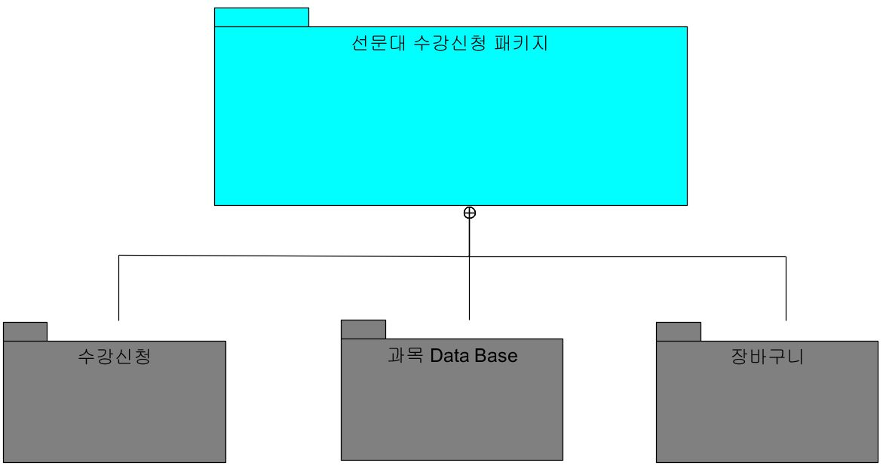

Slide 3
