Slide 1

IT 334 – DevOps Engineering on AWS Cloud
Project – Building a Highly Available, Scalable Web Application
Group 10: Lejla Srna
Faris Čaušević
Naida Smailbegović
Date 10.06.2023.
Teacher: Dzenana Dzevlan

Slide 2
Business scenario overview
The current web application for student records at Example University experiences performance issues and downtime during peak admissions periods, resulting in a poor user experience. The admissions department has received complaints about the application's slowness or unavailability, impacting their ability to efficiently manage student records. The university needs a solution to improve the performance, scalability, and availability of the web application to ensure a smooth admissions process.
Solution Requirements:
Functional
Load Balanced
Scalable
Highly Available
Secure
Cost Optimized
High Performing
Notes:
You can also go more in depth about the design considerations and trade-offs that you made.

Slide 3
Solution overview
The project involves hosting the student records web application for Example University in the AWS Cloud. The goal is to design and implement an architecture that addresses the performance issues, scalability, and availability concerns of the current system. The solution should ensure seamless access to student records, even during peak admissions periods, while maintaining security and optimizing costs.
USE CASES:
User management and access: Users should have secure online access to the web application and be able to view, add, delete, and amend student records. Mechanisms for user authentication and permission should be in place to guarantee that only authorized users can carry out these tasks.
Scalability during Peak Admissions: To accommodate the increased traffic during peak admissions periods, the design should be able to seamlessly expand resources, such as web servers and database capacity. For users, this guarantees top performance and responsiveness.
High Availability: The system should integrate redundancy and failover strategies to offer high availability. The system should continue to function without interruption even if a web server or database goes down, guaranteeing continuous access to student records.
Performance Optimization: The architecture should be designed to deliver high performance, allowing routine operations like viewing, adding, deleting, or modifying records to be performed without any perceivable delay, even under varying loads.
Notes:
Explain at a high level what you have built.
For example: “I built a web application for a company to host their blog.“
Talk about why you chose certain parts of the solutions and any tradeoffs that you made. Focus on how you designed the solutions and how you applied the AWS Well-Architected Framework as part of the process (AWS Well-Architected Framework: https://docs.aws.amazon.com/wellarchitected/latest/framework/welcome.html).
For example: “I configured load balancers and auto scaling to make the application highly available and reliable.”
Include the use cases that you are addressing. Think about who your users are and how they would want to interact with your solution to solve their problem.
For example: “Users can view, upload, edit, and delete blog posts. Administrators can approve blog posts.”
Talk about the use cases that you addressed as part of the minimum viable product (MVP) that you scoped and built.
Note:
An above-bar description is concise and includes the most important benefits. For example: “The solution allows customers to quickly upload, store, and search large catalogs of images and videos in Amazon S3.”
A below-bar description is too detailed or not specific. For example: “Our solution analyzes media files.”

Slide 4
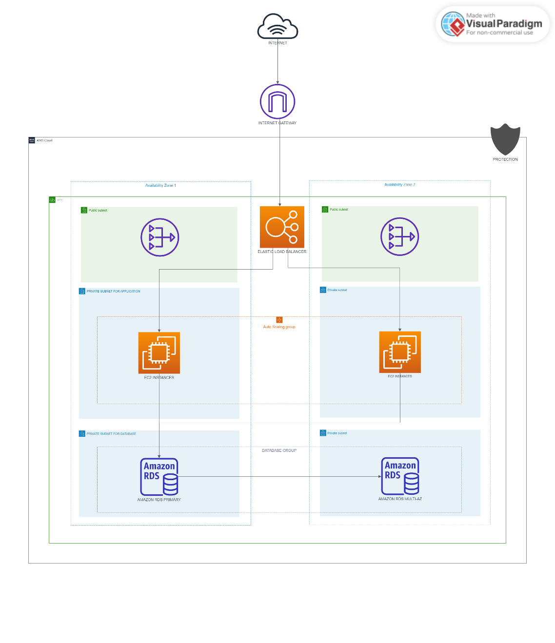
Architecture diagram of the solution : EXAMPLE
Diagram made in Visual Paradigm online tool for designing different types of diagrams.
3 most important components on diagram are:
EC2 instances for the web servers
ELB (ALB) for load balancing
RDS for the database
Based on the given requirements and assumptions, it is not explicitly mentioned whether outbound internet access is required for the web application or if the web servers in the private subnet need to communicate with external services, but we added NAT Gateway, so web servers in the private subnet can initiate outbound connections.
We know that including NAT Gateway affecting goal of the project to design a highly available, scalable, load-balanced, and secure because it is not explicitly required, but it was for us easier to include it.
Notes:
Note: Remove this slide from your final presentation.
This example architecture diagram shows a solution to configure a webhook to link Git with AWS. You can find this example in the Toolkits for PowerPoint at https://aws.amazon.com/architecture/icons.

Slide 5
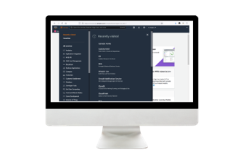
Demo
Notes:
For the demo, guide the audience through the two to three most important benefits of the solution and how it addresses the requirements.
Your demo materials can be screen captures, recordings, or to show AWS console.

Slide 6
Lessons learned
Thanks to the project, we learned a lot, primarily how to approach a project (what are the initial steps, what to pay attention to, etc.). Also, we learned much more to use the AWS options offered and had the opportunity to explore the environment in more detail.
During the implementation of the project, we found helpful these resources:
AWS Documentation
AWS Well-Architected Framework
Lab documentation
YouTube video tutorials
Notes:
Describe any challenges that you encountered and how you overcame those challenges.
For example: “I got stuck when I was creating an EC2 instance to host the application. I used the resources that were listed in the instructions to walk myself through the process to create a new EC2, and I was able to complete the task. The links to labs in other courses were very helpful.”
Describe any new skills that you learned from this project.
For example: “I learned how to set up auto scaling correctly so my resources were automatically adjusted and allocated at the lowest possible cost.”
Discuss any future, out-of-scope use cases in the next steps.
For example: “I would like to scale out the web application so that multiple departments can use it.”

Slide 7

THANK YOU!

