Slide 1
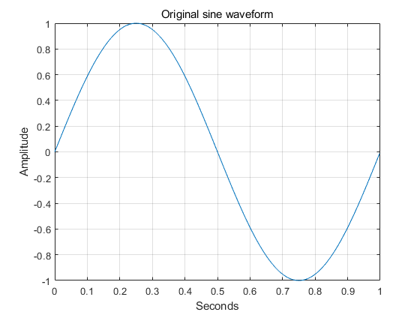
A brief description of the Sine waveform output. (1/4)
Here is information about the properties:
Frequency(f) = 1Hz
Sampling rate(fs) = 512
Amplitude(A) = 0
Time(t) = 0 ~ 1-(1/fs), 512 EA

Slide 2
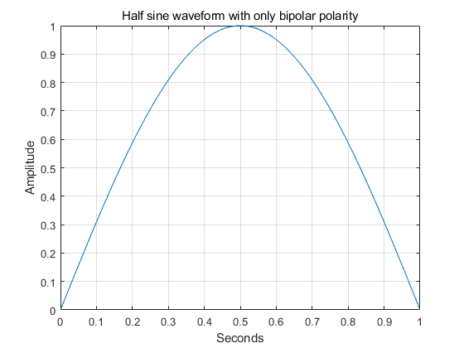
A brief description of the Sine waveform output. (2/4)
Here is information about the properties:
Frequency(f) = 1Hz
Sampling rate(fs) = 512
Amplitude(A) = 0
Time(t) = 0 ~ 1-(1/fs), 512 EA

Slide 3
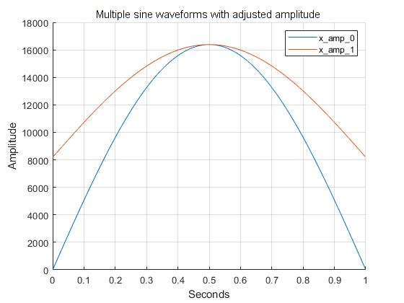
A brief description of the Sine waveform output. (3/4)
Here is information about the properties:
Frequency(f) = 1Hz
Sampling rate(fs) = 512
Amplitude(A) = Blue (x8192), Red (x8192+8192)
Time(t) = 0 ~ 1-(1/fs), 512 EA

Slide 4
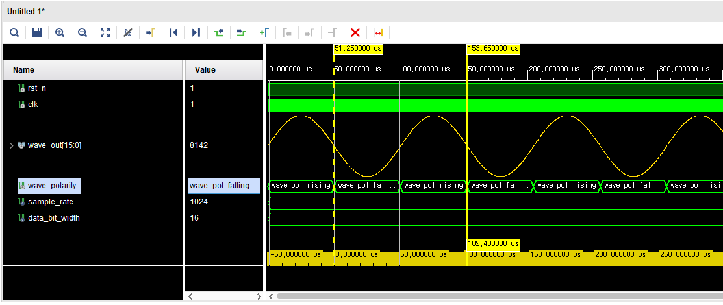
A brief description of the Sine waveform output. (4/4)
This is the time it takes to output one cycle:
102.4 us = 512 Sample * 2 EA * 100 ns (10 MHz)

