Slide 1
Mini-PVA Totalp Bifacial PV Analysis at a High-Alpine Site
Group 1 | Very Steep Ground Inclinations (HN≥ 20°) | Davos Totalp, 2480 m a.s.l.

Slide 2
01
Site & Experiment Setup

Slide 3
Site & Experiment Setup
Site
Location Totalp, Davos, Switzerland
Coordinates N46.838°, E9.813°
Altitude 2480 m a.s.l.
Period Oct 2024 – Mar 2025
Files 180 daily CSV files
Total rows 944’048 measurements
Configuration Parameters
RA
Row spacing
115 – 719 mm
MN
Module tilt (absolute)
10 – 90°
HN
Ground slope
0 – 40 °
Group 1 Focus: HN ≥ 20° (very steep ground inclinations)

Slide 4
02
Data Processing Pipeline

Slide 5
Data Processing Pipeline
1
2
3
4
5
Load & Combine
Clean & Validate
STC Normalise
Day-wise Interpolation
Solar Position
180 daily CSV files concatenated 944’048 rows total
DST handling, MN overflow fix, remove night positions (MN=0)
Pnominal = Pmpp / P_STC
Comparable across channels
Pvlib calculation per timestamp sun_up filter for yield integration
Env. data onto Mini-PV timestamps
No overnight bridging
Key Data Cleaning Issues
Problem | Solution
MN > 1000 (uint16 overflow) | Subtract 65536
8 rows ambiguous timestamp (DST) | Ambiguous = ‘NaT’ → drop
MN = 0 → 7936 rows (night pos.) | Drop (Pmpp ≈ 0)

Slide 6
03
Measurement Overview

Slide 7
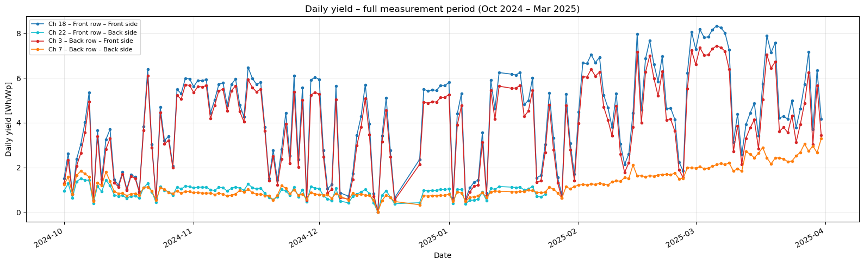
Measurement Overview
Fig. 1 – Daily yield per channel over the full winter period. Seasonal low around December solstice, recovery toward March.

Slide 8
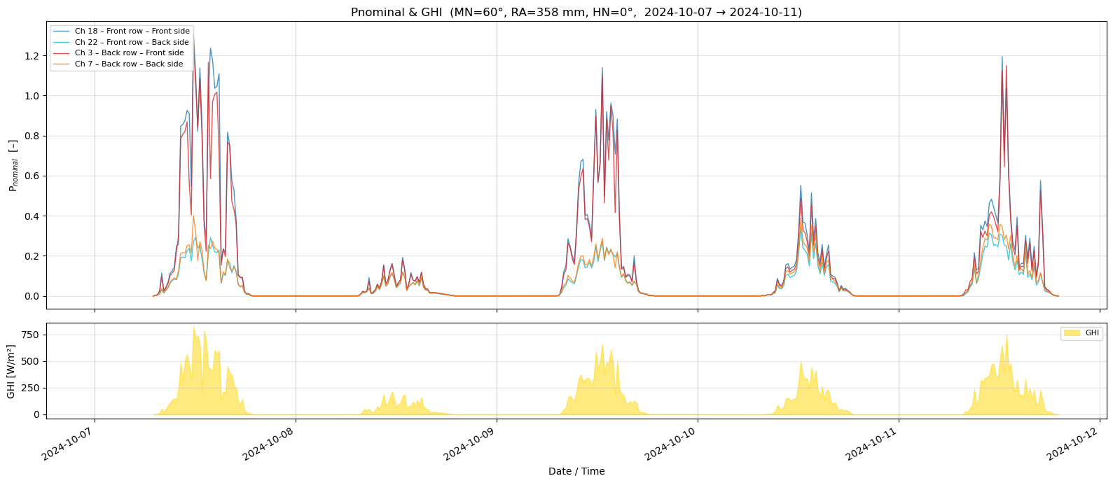
Measurement Overview
Fig. 2 – Normalised power + GHI over 5 sample days (MN=60°, RA=358 mm). Power closely follows GHI on clear days.

Slide 9
04
Performance Map

Slide 10
Performance Map – Group Focus HN ≥ 20°
HN [°] | MN [°] | RA [mm] | Total yield [Wh/Wp] | Yield/day [Wh/Wp] | Days
20° | 40° | 115 – 205 | 478 – 498 | 4.47 – 4.65 | 107
20° | 70° | 115 – 205 | 471 – 485 | 4.40 – 4.53 | 107
30° | 30° | 115 – 137 | 480 – 504 | 4.94 – 4.71 | 107
30° | 60° | 115 – 137 | 476 – 481 | 4.45 – 4.49 | 107
40° | - | - | Insufficient data (<5 days)
Key Findings
At steep ground slopes, flatter module tilts produce more yield. HN=20° → MN=40° optimal | HN=30° → MN=30° optimal.
Reason: The ground slope already contributes effective tilt. Higher MN overcorrects and reduces irradiance capture.

Slide 11
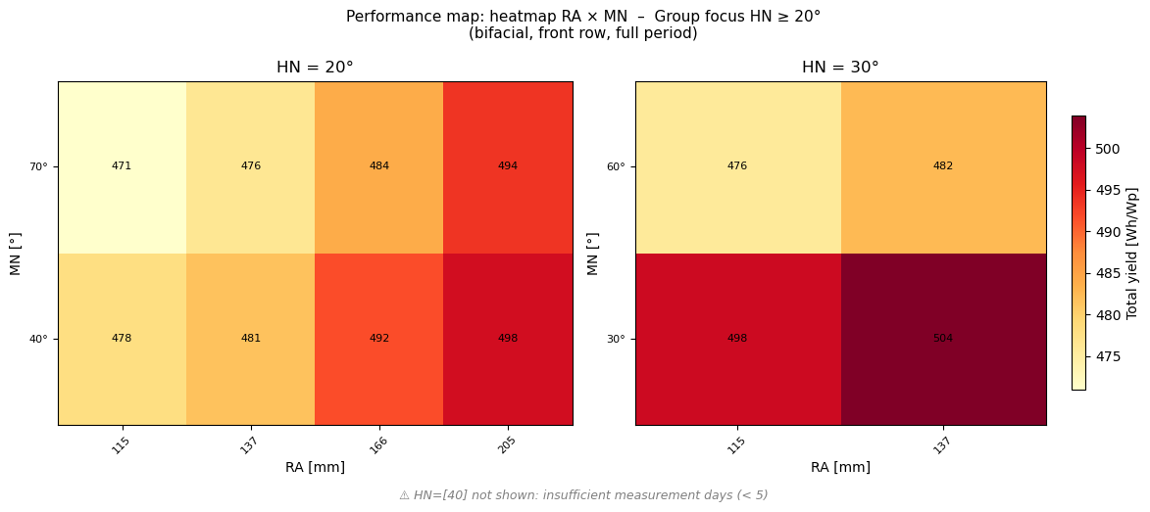
Performance Map – Group Focus HN ≥ 20°
Fig. 3 – Heatmap RA × MN per HN. Values = total bifacial yield [Wh/Wp], full period.

Slide 12
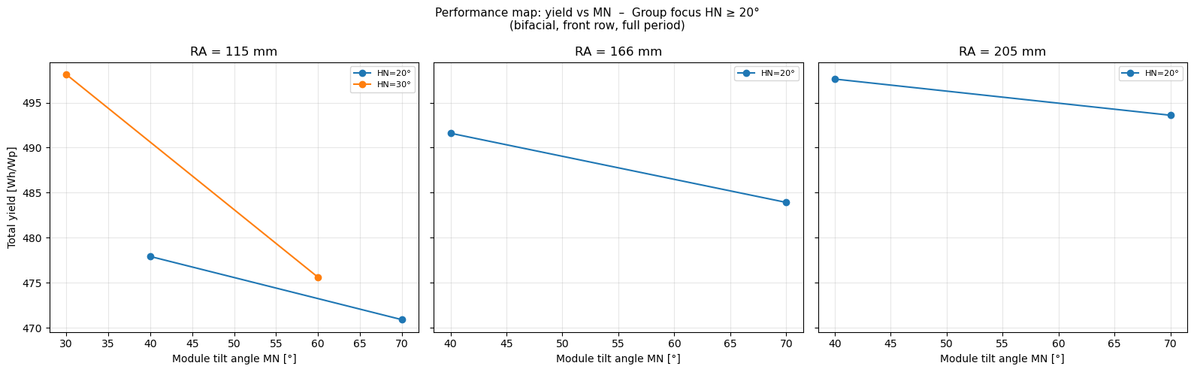
Performance Map – Group Focus HN ≥ 20°
Fig. 4 – Yield vs MN: flatter = better at steep HN.

Slide 13
05
Row Spacing & Bifacial Yield

Slide 14
Row Spacing & Bifacial Yield
Bifacial Yield Formula
Why at integral level?
Front and back sides are measured sequentially (~1s apart). Combining at the daily integral level avoids any timing mismatch.
Back-side contribution: 25-35% of total
Amplified by high alpine snow albedo → more reflected radiation on back side
Y_bif = Y_front + 0.9 × Y_back

Slide 15
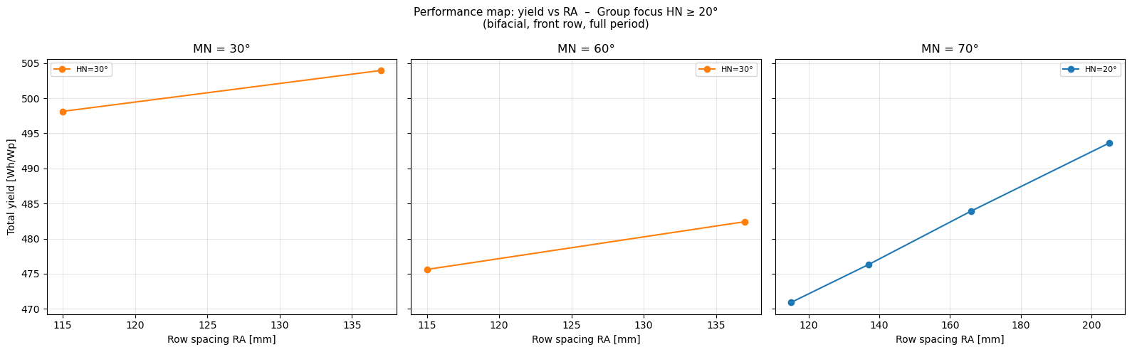
Row Spacing & Bifacial YIeld
Fig. 5 – Yield vs RA: larger spacing → more yield (less inter-row shading).

Slide 16
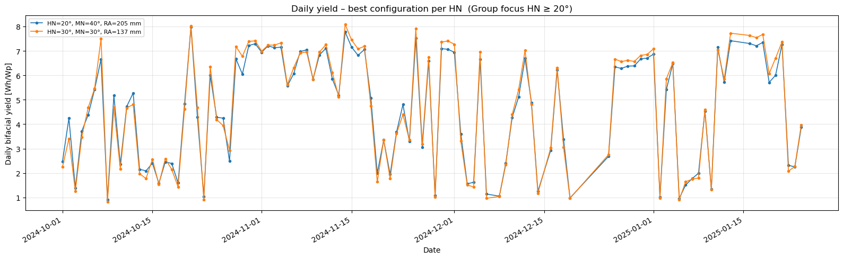
Row Spacing & Bifacial YIeld
Fig. 6 – Daily bifacial yield: best config per HN. HN=30°, MN=30° slightly outperforms HN=20°, MN=40°.

Slide 17
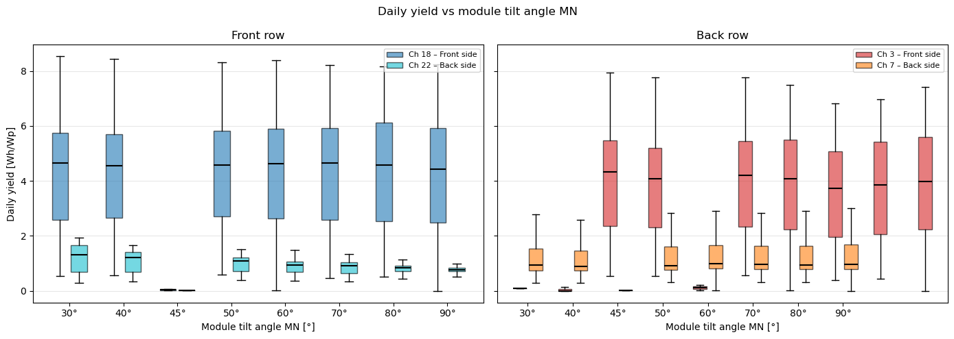
Row Spacing & Bifacial Yield
Fig. 7 – Daily yield distribution vs MN. Front-side (Ch 18) median ~4.5 Wh/Wp across most MN values; back-side (Ch 22) ~1 Wh/Wp. MN=45° shows sparse data (too few days).

Slide 18
06
Solar Position

Slide 19
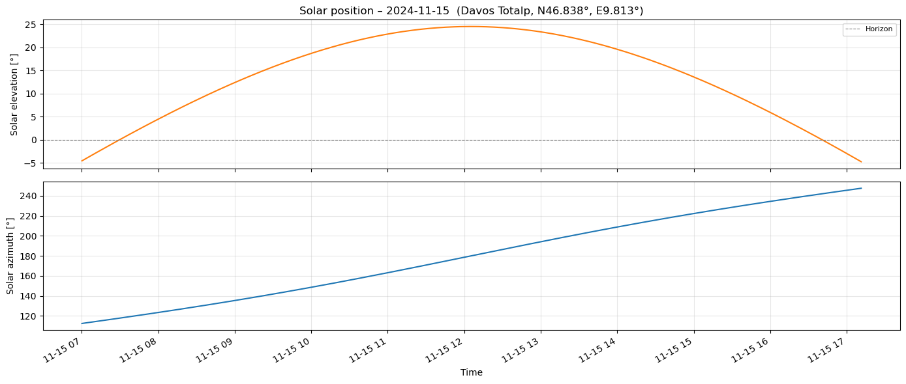
Solar Position
Fig. 8 – Solar position 15 Nov. Max. elevation only ~20° → motivates flatter MN.
At this alpine site in November, maximum solar elevation is only ~20°. A steep MN (e.g. 70-90°) would therefore intercept significantly less direct radiation than a flatter module – especially at HN ≥ 20° where the terrain already tilts the array.

Slide 20
07
POA Irradiance & Regression Model

Slide 21
POA Irradiance & Regression Model
POA Irradiance [Wh/m²]
Regression Model
South-facing (azimuth=180°), full period Oct–Mar
§15 – Aggregated (12 pts)
MN = 30°
61,368
R² = N/A
Too few pts for CV
RA: 49% MN: 31% POA: 19% HN: 2%
MN = 40°
65,050
+6.0%
MN = 60°
67,799
+10.5% ★
§15b – Daily (1260 pts)
R² = 0.942
5-fold CV ✓
MN = 70°
66,782
+8.8%
POA_day: 98% → model learns weather,
not configuration differences
MN=60° has most in-plane irradiance — but yield peaks at lower MN due to slope effect.
⚠ R²=0.94 reflects weather dominance — suitable for interpolation only, not extrapolation to HN=40°.

Slide 22
08
Key Findings

Slide 23
Key Findings & Conclusions
↘
Flatter module tilts are optimal at steep slopes — HN=20° → MN=40° best; HN=30° → MN=30° best. Ground slope contributes effective tilt.
↔
Larger row spacing (+RA) consistently increases bifacial yield through reduced inter-row shading. Effect: ~+4% from 115→205 mm at HN=20°.
☀
Back-side contribution is 25–35% of total bifacial yield, amplified by high alpine snow albedo — significantly higher than flat-terrain sites.
⚠
HN = 40°: insufficient measurement days (<5). No statistically robust conclusions possible for this slope.
∿
Regression model R²=0.94 — but POA_day accounts for 98% feature importance. Model captures weather variability, not configuration effects.

Slide 24
Questions

