Slide 1
Mini-PVA Totalp
Alpine PV Performance Analysis
October 2024 – March 2025 | Totalp, Davos | 2486 m a.s.l.
Chantal Fuchs | Lejla Beganovic | Nicola Noger
Ecological & Energy Engineering – ZHAW | Group 1: HN ≥ 20°

Slide 2
What is the Mini-PVA?
A motorised miniature PV experiment at high altitude
Location
Configuration Parameters
Totalp, Davos — 2486 m a.s.l.
Below the Weissfluhjoch peak
Parameter | Description | Values
RA | Row spacing | 115 – 688 mm
How it works
MN | Module tilt angle | 30° – 90°
Automatically cycles through
combinations of 3 parameters
HN | Ground slope | 0° – 40°
Our group focus: ground slope HN ≥ 20°
Why miniaturised?
Full-scale parameter sweeps are
impossible — 1 robot = 80+ plants

Slide 3
Data Pipeline: From Raw Files to Combined Dataset
3 sources, ~944,000 rows, 6 months
1
2
3
4
Load
Clean
Timezone
Merge
180 daily Mini-PVA CSVs
+ environmental data
+ large installation data
+ STC reference powers
Fix Tluft string → float
Remove Ghor error flags
Fix MN uint16 overflow
Drop MN=0 (night pos.)
Localise to Europe/Zurich
Handle DST transition
27.10.2024 → 8 rows dropped
(ambiguous timestamps)
Day-wise interpolation
(no overnight bridging)
Solar position via pvlib
GHI variability index
Result: combined DataFrame with 944,048 rows | 174 of 182 days have data | 0.8% missing environmental values

Slide 4
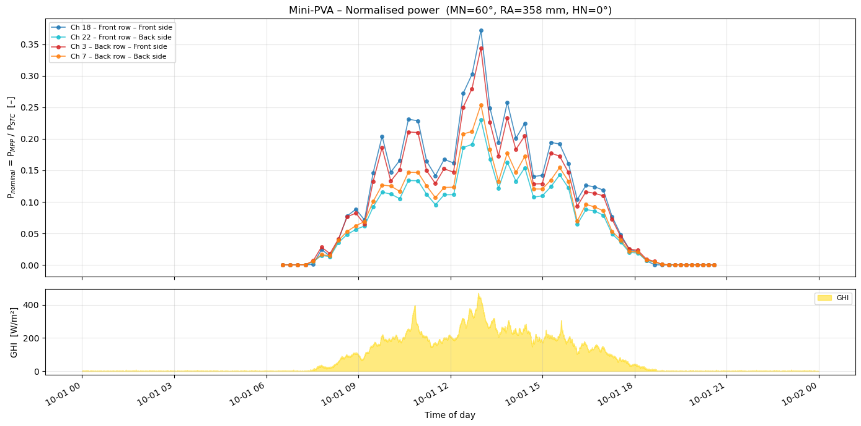
Single Day: Normalised Power & Irradiance
October 1, 2024 | MN=60°, RA=358 mm, HN=0°
Jagged curves = normal
Mini-PVA switches configuration every few minutes
GHI panel confirms: dips in power
align with cloud events

Slide 5
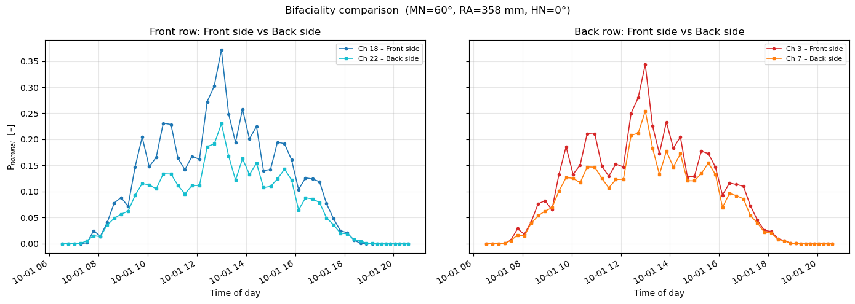
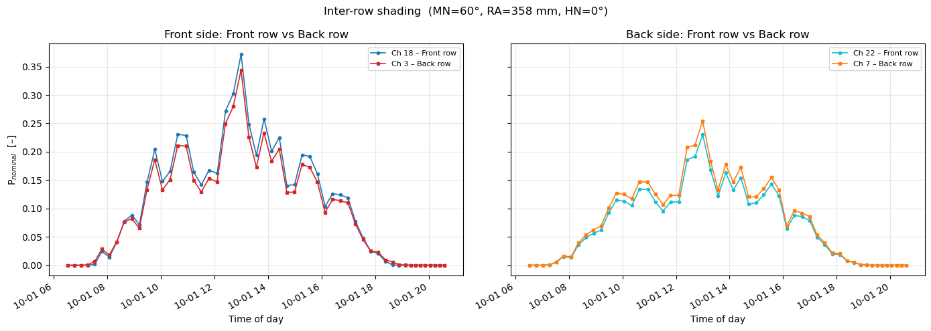
Bifaciality & Inter-row Shading (Single Day)
Two key physical effects visible even on one day
Front side clearly higher than back side
Front row ≈ back row → minimal shading at RA=358 mm
Key takeaways from single-day analysis
• Back side contributes ~20–25% of front-side yield even without snow • At RA=358 mm and MN=60°, inter-row shading is small — front and back row nearly identical • These effects set up the motivation for the multi-day performance map

Slide 6
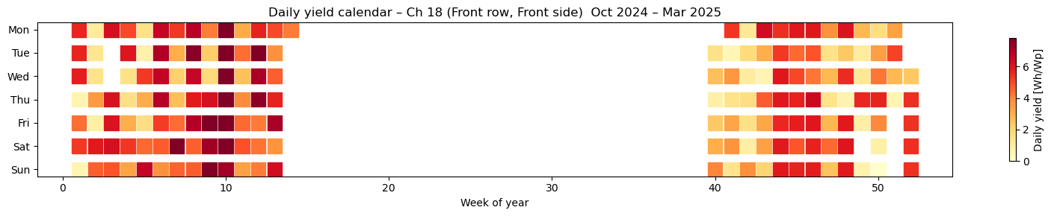
Six Months at a Glance: Daily Yield Calendar
Ch 18 – Front row, Front side | Oct 2024 – Mar 2025
Early Oct (week 40):
weakest yields — no snow yet, short days
Dec–Jan:
low yields — shortest days, lowest sun angles
Feb–Mar (weeks 5–14):
highest yields — longer days + snow albedo boost
Note: ISO week numbers — right cluster = Oct–Dec 2024 (weeks 40–52), left cluster = Jan–Mar 2025 (weeks 1–14)

Slide 7
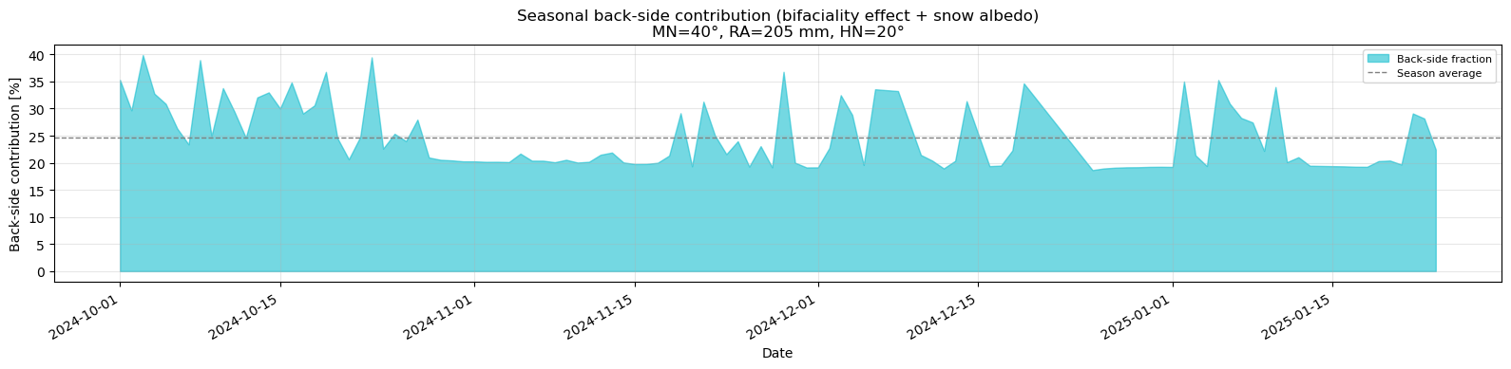
Bifacial Yield: Combining Front & Back Side
As specified in the project assignment | Bifaciality factor = 0.9
Back side avg. ~25% | Peaks to 40% on snow days
Formula: Y_bif = Y_front + 0.9 × Y_back
Combined at daily integral level (front & back measured ~1s apart) Bifaciality factor 0.9 = back side is 90% as efficient as front side Back side → diffuse light + snow albedo reflection
~25%
40%
0.9
Avg back-side
contribution
Peaks on
snow days
Bifaciality
factor

Slide 8
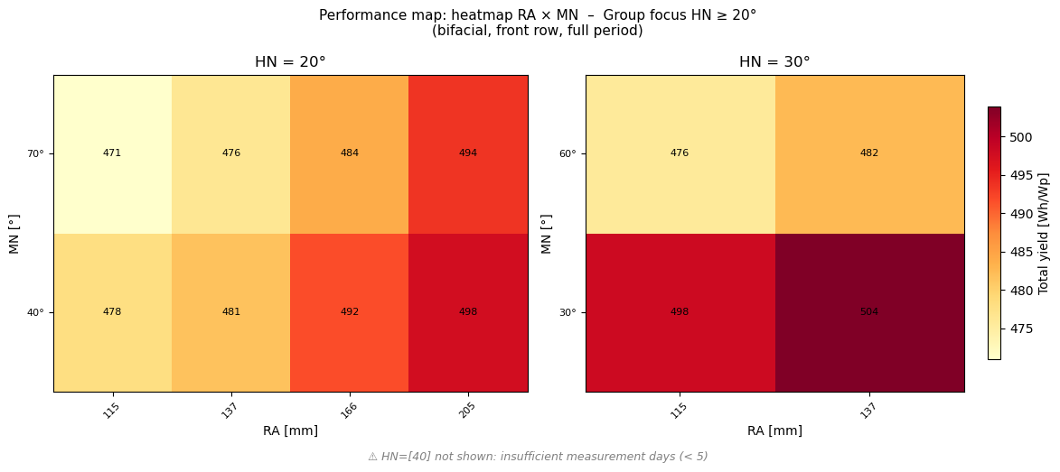
Performance Map: Bifacial Yield Heatmap
Group focus: HN ≥ 20° | Full period Oct 2024 – Mar 2025 | Bifacial, front row | Heatmap: total yield [Wh/Wp]
Measured configurations with ≥ 5 days of data
HN | MN options measured | RA range | Best total yield
20° | 40° and 70° | 115 – 205 mm | 497.6 Wh/Wp (MN=40°, RA=205mm)
30° | 30° and 60° | 115 – 137 mm | 503.9 Wh/Wp (MN=30°, RA=137mm)

Slide 9
Key Findings
Group focus: Very steep ground inclinations HN ≥ 20°
1
Optimal tilt decreases with steeper ground slope
3
Snow albedo amplifies back-side yield
HN=20° → MN=40°, RA=205 mm → 498 Wh/Wp
HN=30° → MN=30°, RA=137 mm → 504 Wh/Wp
The ground slope already tilts the array toward the sun. A high MN on top would overcorrect and reduce yield.
Average back-side contribution ~25%, with peaks to 40% on fresh snow days. This is much higher than typical lowland sites — a key advantage of alpine PV.
2
More row spacing = higher yield
4
Limited data for HN=40°
Yield increases with RA across all configurations. The effect is visible but modest in the measured range (115–205 mm). Wider spacings reduce inter-row shading.
Fewer than 5 measurement days for any HN=40° configuration. Only the regression model provides estimates, with caution advised.

Slide 10
Regression Model: Filling the Gaps
Predicting yield for unmeasured configurations (e.g. HN=40°)
Algorithm
Feature Importance
Gradient Boosting Regressor
(scikit-learn)
POA_day (irradiance)
98.2%
MN (tilt angle)
1.6%
Training data
1,260 daily bifacial yields
(12 configurations × ~105 days)
HN (ground slope)
0.1%
RA (row spacing)
0.1%
Features
HN, MN, RA + POA_day (pvlib irradiance)
⚠ Important limitation
POA_day dominates with 98% feature importance — the model has learned the weather effect (more sun = more yield), not the configuration effect (RA, MN, HN).
Useful for interpolation within measured configs, not robust extrapolation to HN=40°.
Performance
R² = 0.94 (5-fold CV)

Slide 11
Conclusions
Mini-PVA Totalp | Group 1: HN ≥ 20°
Steep ground slopes (HN=20–30°) favour flatter module tilts, optimal MN decreases as HN increases
Wider row spacing consistently improves yield by reducing inter-row shading
Back-side yield contributes ~25% on average, up to 40% on snow days
Seasonal calendar shows lowest yields in early Oct and Dec–Jan, with peak yields in Feb–Mar due to snow albedo
Regression model (R²=0.94) captures weather effects well but cannot reliably separate configuration effects
Ecological & Energy Engineering – ZHAW | Chantal Fuchs, Lejla Beganovic, Nicola Noger | March 2026

Slide 12
Q&A
Thank you for your attention!

