Slide 1

OWASP IoT Top 10
Introduction and exploration of root causes

Slide 2
Overview
IoT Top 10 Intro

Slide 3



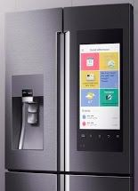

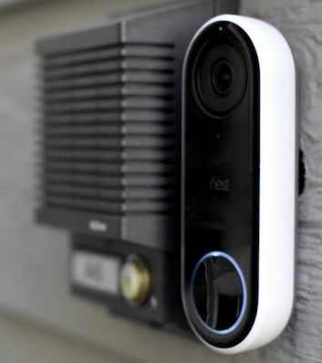
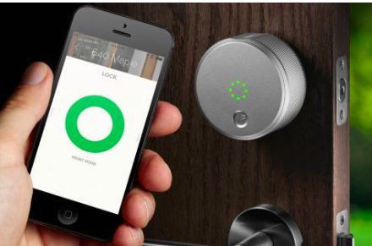
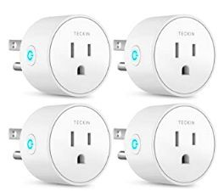

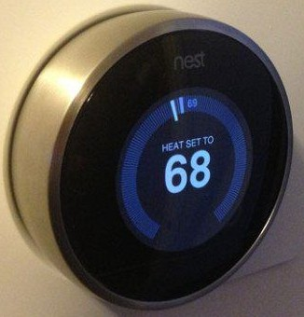
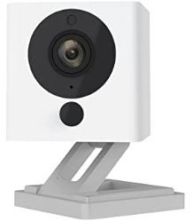
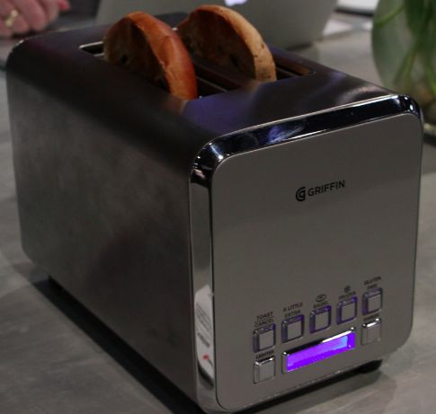

CONNECT ALL THE THINGS!

Slide 4





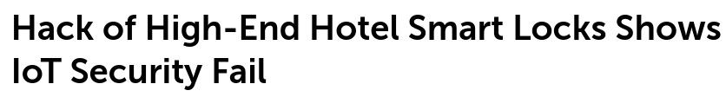

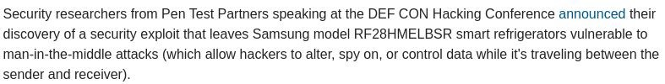
The Cost of Convenience

Slide 5
OWASP IoT Top 10
https://www.owasp.org/index.php/OWASP_Internet_of_Things_Project

Slide 6
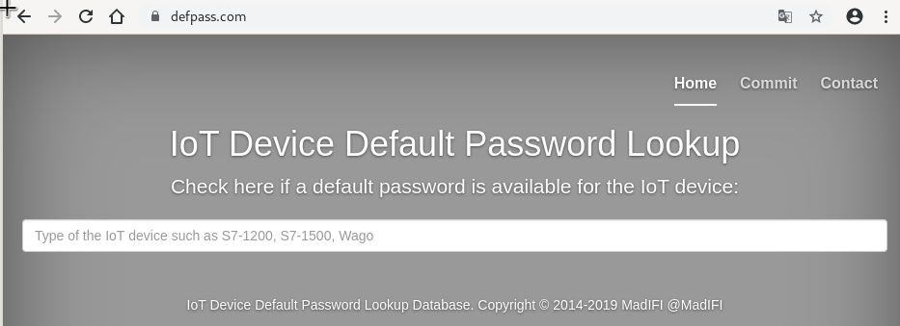
1. Weak, Guessable, or Hardcoded Passwords

Slide 7
1. Weak, Guessable, or Hardcoded Passwords
Use of:
Easily bruteforced
Publicly available
Unchangeable credentials
Including backdoors in firmware or client software that grants unauthorized access.

Slide 8
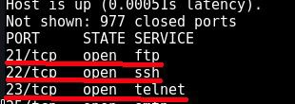
2. Insecure Network Services

Slide 9
2. Insecure Network Services
Unneeded or insecure network services running on the device itself, especially:
Those exposed to the Internet
Any that compromise the confidentiality, integrity/authenticity, or availability of information
Any service that allows unauthorized remote control

Slide 10
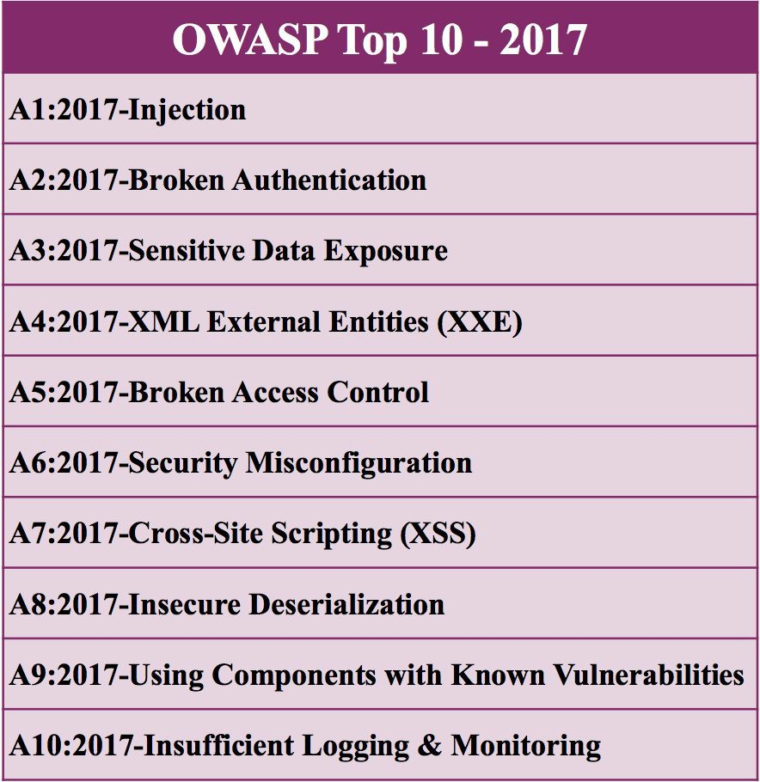
3. Insecure Ecosystem Interfaces

Slide 11
3. Insecure Ecosystem Interfaces
Insecure interfaces in the ecosystem outside the device:
Web
Backend API
Cloud
Mobile
Common issues:
Lack of authentication
Lack of authorization
Lacking or weak encryption
Lack of input and output filtering

Slide 12
4. Lack of Secure Update Mechanism
Lack of ability to securely update the device.
Lack of firmware validation on device
Lack of secure delivery (un-encrypted in transit)
Lack of anti-rollback mechanisms
Lack of notifications of security changes due to updates

Slide 13
4. Lack of Secure Update Mechanism
2016 Carnegie Mellon University Study
On Board Diagnostics: Risks and Vulnerabilities of the Connected Vehicle
Observations: insecure firmware updates and downloads
Researchers were able to make arbitrary firmware modifications and maliciously update remote firmware.
https://resources.sei.cmu.edu/library/asset-view.cfm?assetID=453871

Slide 14
5. Use of Insecure or Outdated Components
Use of deprecated or insecure software components/libraries that could allow the device to be compromised.
Insecure customization of operating system platforms
Third-party software libraries from a compromised supply chain
Third-party hardware components from a compromised supply chain

Slide 15



5. Use of Insecure or Outdated Components
Meltdown
Spectre
Heartbleed

Slide 16
6. Insufficient Privacy Protection
User’s personal information stored on the device or in the ecosystem that is used insecurely, improperly, or without permission.

Slide 17
6. Insufficient Privacy Protection
2017 Cornell University Study
A Smart Home is No Castle: Privacy Vulnerabilities of Encrypted IoT Traffic
“we examine four IoT smart home devices [...] and find that their network traffic rates can reveal potentially sensitive user interactions even when the traffic is encrypted”
https://arxiv.org/abs/1705.06805

Slide 18


7. Insecure Data Transfer and Storage
Lack of encryption or access control of sensitive data anywhere within the ecosystem, including at rest, in transit, or during processing.

Slide 19
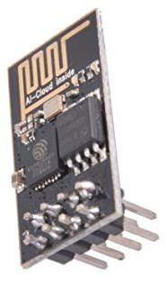
7. Insecure Data Transfer and Storage
“The Espressif ESP8266 chipset makes three-dollar ‘Internet of Things’ development boards an economic reality. According to the popular automatic
firmware-building site nodeMCU-builds, in the last 60 days there have been 13,341 custom firmware builds for that platform. Of those, only 19% have SSL support, and 10% include the cryptography module.”
https://hackaday.com/2017/06/20/practical-iot-cryptography-on-the-espressif-e sp8266/

Slide 20
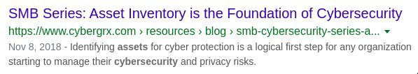
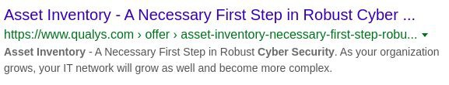
8. Lack of Device Management
Lack of security support on devices deployed in production, including asset management, update management, secure decommissioning, systems monitoring, and response capabilities.

Slide 21
8. Lack of Device Management
We haven’t solved this for non-IoT environments yet..
25% still rely on Excel spreadsheets to track assets
56% verify asset location only once a year, while 10-15% verify only every five years
Staff spends 10+ hours weekly to resolve data accuracy issues
Nearly 66% of IT managers have an incomplete record of their IT assets
https://www.scmagazine.com/home/opinion/executive-insight/tighter-control-over-it
-asset-management-the-key-to-securing-your-enterprise/

Slide 22
9. Insecure Default Settings
Devices or systems shipped with insecure default settings or lack the ability to make the system more secure by restricting operators from modifying configurations.

Slide 23
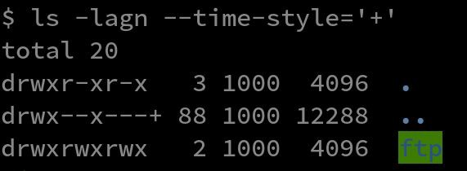
9. Insecure Default Settings
Bad filesystem permissions Exposed services running as root

Slide 24

10. Lack of Physical Hardening
Lack of physical hardening measures, allowing potential attackers to gain sensitive information that can help in a future remote attack or take local control of the device.

Slide 25
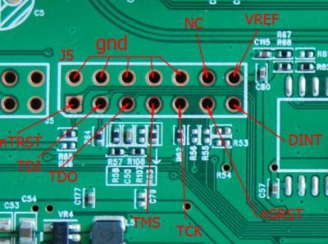
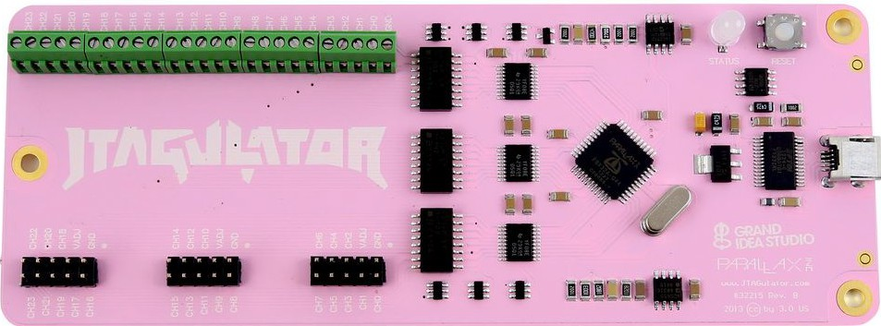
10. Lack of Physical Hardening
Easily Available Debug Port Discovery

Slide 26
Root Cause Examination
Potential common root causes for all the issues
Rapid pace of development to keep up with the market
Product requirements
Low friction deployment & warehouse problem
Outdated training for hardware and software teams

Slide 27
What can we do?
Turn-key ecosystems
Secure base-OS with support for quick and easy updates (docker?)
Libraries and frameworks to solve problems like updates, first-connection trouble, IAM (Identity Access Management)
Education and training (IoT Top 10 a good start)

Slide 28
Thanks!

