Slide 1
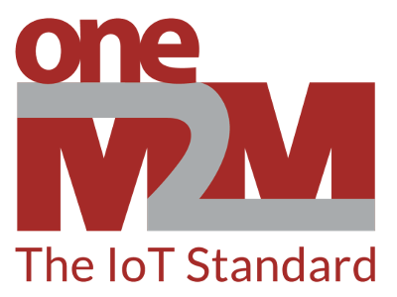
Introduction to oneM2M IoT Platform
Building Open and Interoperable IoT Systems

Slide 2
What is oneM2M?
A global standardization initiative for IoT
Defines a common service layer for interoperable communication between devices and applications
Enables seamless integration of diverse IoT solutions from different vendors
Notes:
oneM2M (short for "one Machine to Machine") is a global standardization body that has developed a set of specifications for an interoperable IoT service layer. This service layer acts as a middleware, sitting between devices, applications, and communication networks. By providing a standardized interface, oneM2M ensures that devices and applications from different vendors can communicate seamlessly, regardless of their underlying technologies or protocols. This facilitates the development and deployment of large-scale IoT solutions that combine components from various sources.

Slide 3
Who is oneM2M?
oneM2M was launched in 2012. It is a global partnership initiative between eight of the world’s preeminent standards development organizations:
ARIB (Japan),
ATIS (U.S.),
CCSA (China),
ETSI (Europe),
TIA (U.S.),
TSDSI (India),
TTA (Korea), and
TTC (Japan)
together with industry fora and consortia (Global Platform) to develop specifications that ensure the most efficient deployment of Machine-to-Machine (M2M) communications systems and the Internet of Things (IoT).

Slide 4

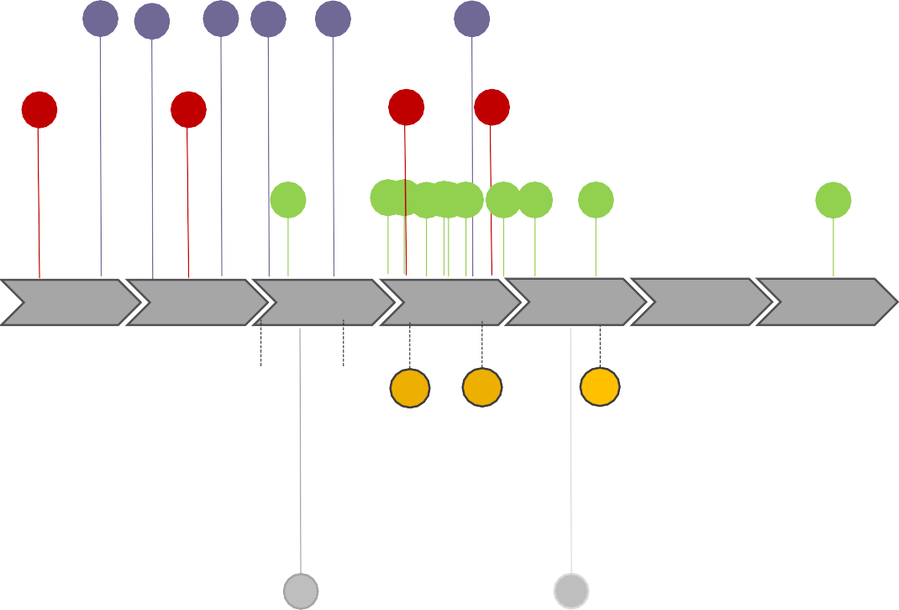









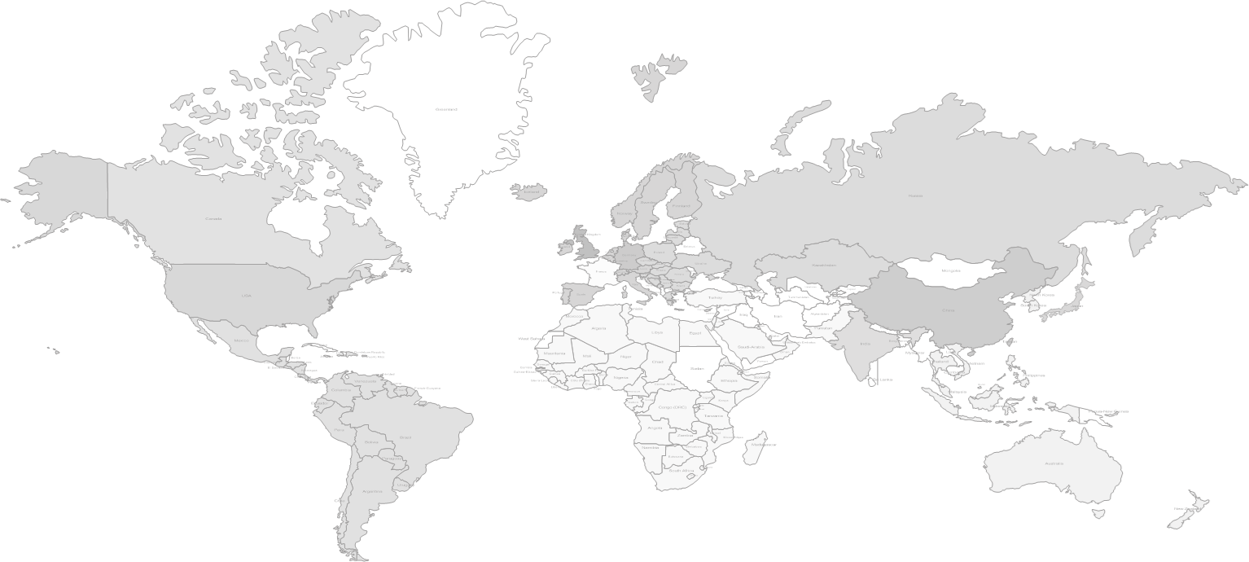







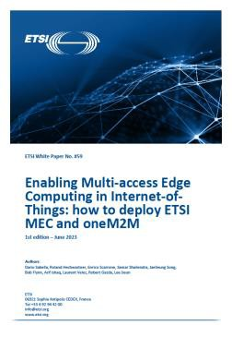

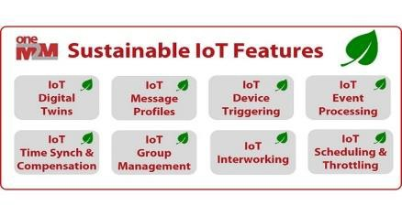

oneM2M Key-Events Timeline
Transposition to ITU-T SG20 Y.4500.x
Academia Relation
Group
Interop 8
Interoperability Events
Release 2A
Release 3
Release 4
Release 5 initial plan
Release 1
Release 2
oneM2M Partnership Project established
oneM2M Hack-a-Thon Events
2012
2015
2016
2017
2018
2019
2020
2021
2022
2023
2024
2025
2026
Industry Days
oneM2M WS & Developers Training
oneM2M White
Paper
IoT for Sustainability
oneM2M White Paper
How oneM2M is Enabling
More Sustainable IoT Deployments
oneM2M & ETSI ISG MEC White Paper
Enabling Multi- access Edge Computing in IoT: How to deploy ETSI ME and oneM2M
oneM2M Certification launch
C
oneM2M Certification launch

Slide 5
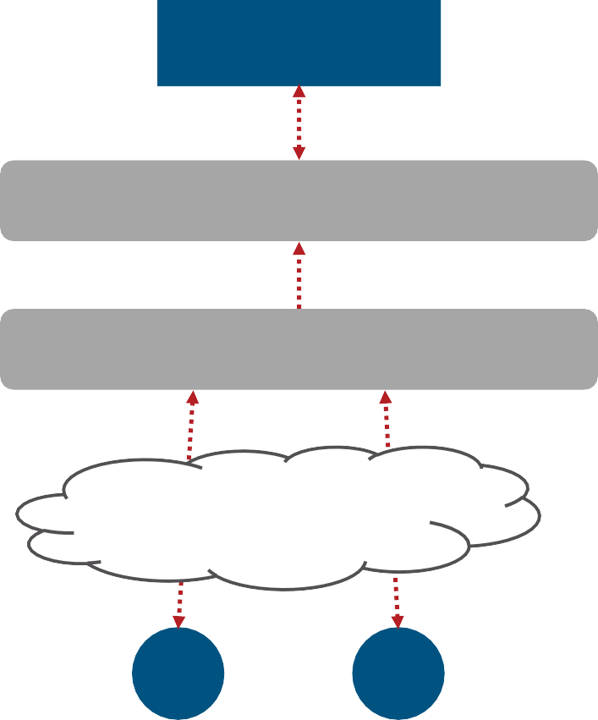





Developers use platform tools to build and support IoT systems
Traditional Market Structure
oneM2M’s Standards-based Structure
Application
Application
Application Enablement Platform
Many hundreds of platforms and incompatible tools
Extensible ‘toolkit’ of common service tools
Common Services Layer
Connected Devices Platform
Communications Networks
Communications
Networks
D
D
D
D
Notes:
The Internet of Things (IoT) is a rapidly growing network of physical devices embedded with sensors, software, and other technologies that allows them to connect and exchange data with other devices and systems over the internet. This interconnectedness offers vast potential for innovation and efficiency in various sectors, from smart cities and homes to industrial automation and healthcare. However, the diversity of devices and communication protocols can create challenges in interoperability and scalability. This is where oneM2M comes in.

Slide 6
Benefits of oneM2M
Interoperability: Enables communication between devices and applications from different vendors
Scalability: Supports the easy integration of new devices and applications as IoT ecosystems grow
Security: Provides robust security mechanisms for data privacy and access control
Flexibility: Offers a modular architecture that can be adapted to specific use cases
Notes:
The adoption of oneM2M standards brings several key benefits to developers and users of IoT solutions. Interoperability allows for seamless integration of components from various vendors, eliminating the need for custom solutions for each device or platform. Scalability ensures that IoT systems can easily grow and adapt to changing needs. Robust security mechanisms protect sensitive data and ensure reliable communication. Finally, the flexible architecture of oneM2M allows for customization to cater to specific use cases and application requirements.

Slide 7
oneM2M Architecture Three-layered architecture
Application layer: Hosts IoT applications and platform services
Service layer: Provides core functionality for managing and interacting with devices (Common Service Entities or CSEs)
Network layer: Handles device communication through various protocols
Notes:
oneM2M utilizes a horizontal, three-layered architecture. The application layer sits at the top and houses IoT applications and various platform services. The service layer forms the core of the architecture and provides essential functionalities for managing and interacting with devices. This layer is populated by Common Service Entities (CSEs) that act as intermediaries between applications and devices. Finally, the network layer handles device communication across various network protocols, ensuring device connectivity regardless of the underlying infrastructure.

Slide 8

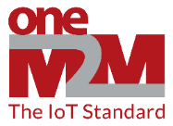





oneM2M Common Services “Toolkit”
Common Service Entity (CSE)
Communication Management
Data Management & Repository
IoT Application Layer
Registration
Security
Discovery
Semantics
oneM2M Common Services Layer
Device Management
Subscription & Notification
Group Management
Application & Service Management
Service Charging & Accounting
Location
IoT Devices and Connectivity Layer (Network Layer)
Network Service Exposure
Transaction Management
Time Management
Session Management
Process Management

Slide 9

Security in oneM2M
Main security functions supported:
Identification and Authentication
▪ Identification: checking if the identity of the request originator provided for authentication is valid.
▪ Authentication: validating if the identity supplied in the identification step is associated with a trustworthy credential. Security Association Establishment
▪ Establishment of a security context between communicating entities to provide confidentiality (encryption) and integrity.
▪ Range of authentication options supported. Authorization (Access Control)
▪ Authorizing services and data access to authenticated entities. Remote Provisioning
Additional security functions:
Identity protection
▪ Capability to use pseudonyms to protect anonymity of transactions. Sensitive data handling
▪ Capability to protect sensitive data (e.g. local credentials) and functions (e.g. data encryption/decryption) in a Secure Environment (e.g. Smart Card or Virtual Smart Card)
Security administration (related to device management)
▪ Creates and administers dedicated Secure Environments and post-provisioning of master credentials.

Slide 10
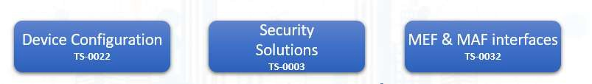

Security in oneM2M
Enrolment services (RSPF / MEF)
Credentials Provisioning/Security Configuration of the M2M System
Secure communications services (SAEF / MAF)
Methods for Securing Information (PSK/PKI/Trusted Party)
Point-to-point and end-to-end solutions (TLS / DTLS)
Access Control & Authorization services
Requester Authentication
Information access Authorization(ACL based) Static and Dynamic solutions
Privacy Policy Management

Slide 11
oneM2M Secure Environment and security levels
« Secure Environment » concept abstracts the security implementation
Expose common services to applications, depending on implementation.
Provide common interface for remote security administration, if needed.
oneM2M supported implementations distinguish 4 security levels
No additional security.
devices otherwise protected from attackers, i.e. on trusted networks.
Software only security (obfuscation, White box crypto etc.)
Always vulnerable to sufficiently motivated attacker. Acceptable when compromise is not critical.
"Trusted Execution Environment" (TEE) relying on main CPU hardware features
Good barrier against software based attacks.
Sufficient for remotely accessible, but not physically exposed devices.
Tamper resistant hardware embedded Secure Element (eSE)
Required to protect secrets within devices physically exposed to attackers (SPA / DPA etc.)
E.g. to protect unattended devices against cloning.

Slide 12


























oneM2M Security Framework
oneM2M provides a Common Services "Toolkit"
Within this toolkit, oneM2M provides a common set of security capabilities to secure IoT devices and applications and prevent/mitigate attacks.
oneM2M exposes an abstracted set
of security related APIs to help simplify security for IoT devices and applications.
Authorization
Dynamic Authorization
Message Security
Privacy Policy Manager
Enrollment & Provisioning
End-to-End Security
Common Service Entity
Registration
Communication Management
Security
Discovery
Data Management & Repository
Semantics
IoT Application Layer
oneM2M Common Services Layer
Device Management
Subscription & Notification
Group Management
Application & Service Management
Service Charging & Accounting
Location
IoT Devices and Connectivity Layer
Network Service Exposure
Transaction Management
Time Management
Session Management
Process Management
12

Slide 13
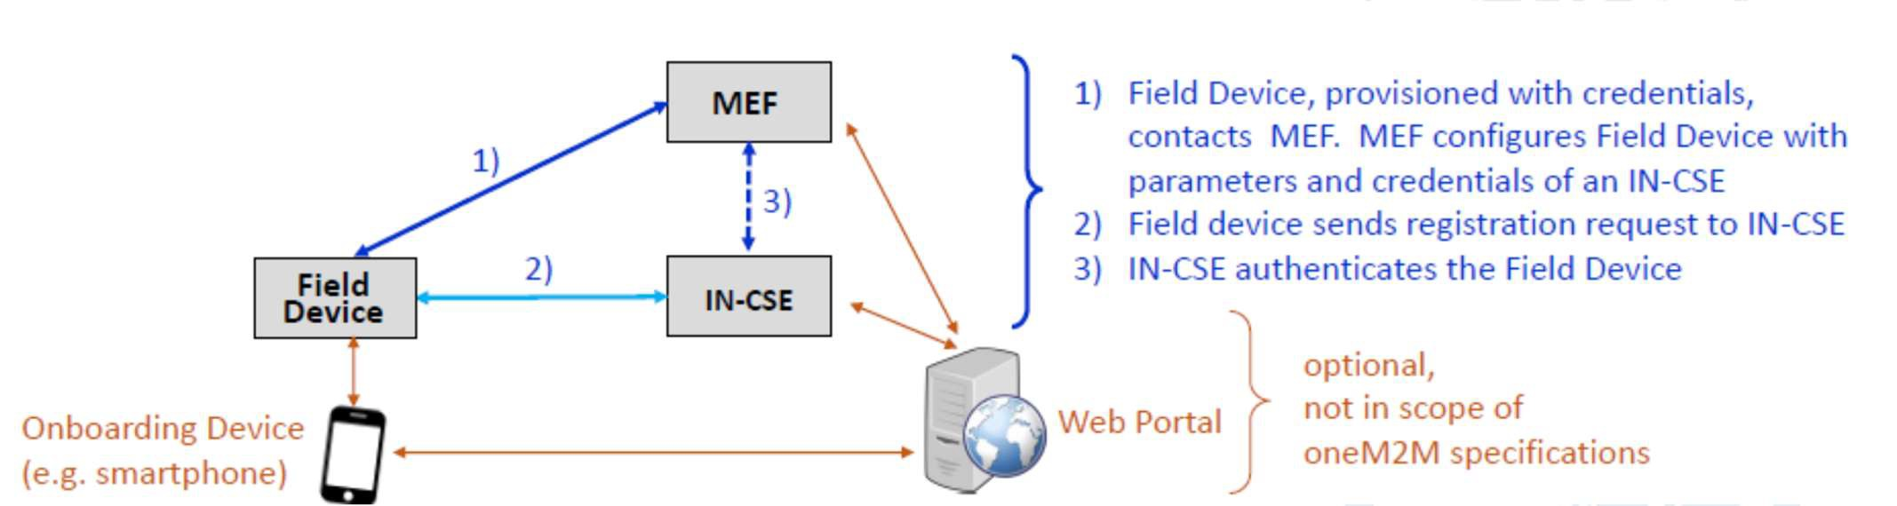
Enrolment & Provisioning (Onboarding)
Onboarding is the procedure of bringing IoT Field Devices into operation in an IoT network
Procedures must cope with large variety of field devices types and Service Provider‘s business models.
oneM2M has specified an “M2M Enrolment Function“ (MEF) which enables stakeholders to setup their preferred onboarding and enrollment mechanisms in an interoperable way

Slide 14





Enrolment & Provisioning (Onboarding)
MEF supports 3 types of 3 types of Remote Security Provisioning Frameworks (RSPF):
Symmetric key authenticated RSPF Certificate authenticated RSPF
GBA-authenticated RSPF; in this case the MEF is the Bootstrapping Server Function (BSF) of 3GPP Generic Bootstrapping Architecture (GBA)
MEF can trigger the Field Device to execute a variety of procedures, including the matching
Configuration of Field devices with registration parameters and authentication profiles applicable to the operational Security Frameworks
Provisioning of symmetric key credentials
Provisioning of certificates (certificate (re-)enrolment using EST and SCEP specified by IETF recommendations)
Keys and Certificates can be provisioned for securing oneM2M communication across a single communication “hop” or across multiple hops in an end-to-end fashion.
MEF is operated by M2M Service Provider or trusted 3rd party (device manufacturer, underlying network operator, etc.)

Slide 15
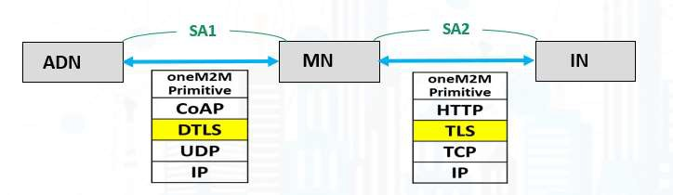
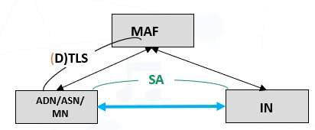
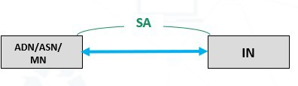
Message Security between adjacent Entities: The operational security framework
Message Security between adjacent Entities: The operational security framework
Uses (Datagram) Transport Layer Security Protocols, TLS/DTLS Version 1.2
Several Security Association Establishment Frameworks are supported:
Authentication and session key establishment using symmetric keys shared by devices
Authentication and session key establishment using Certificates provisioned to devices
Authentication facilitated by an M2M Authentication Function (MAF) hosted by M2M-SP or third-party
The MAF authenticates the end-points (PSK or certificates) and facilitates establishing a symmetric key

Slide 16





Authorization / Access Controls
oneM2M is based on a RESTful architecture
API is based on requests to perform an operation on a resource Operations are Create, Retrieve, Update, Delete
oneM2M Service Layer supports configurable access control policies that define clear rules dictating, for each resource
WHO is authorized to access,
WHAT operations are allowed, and under WHICH conditions (e.g. time, location of entity)

Slide 17
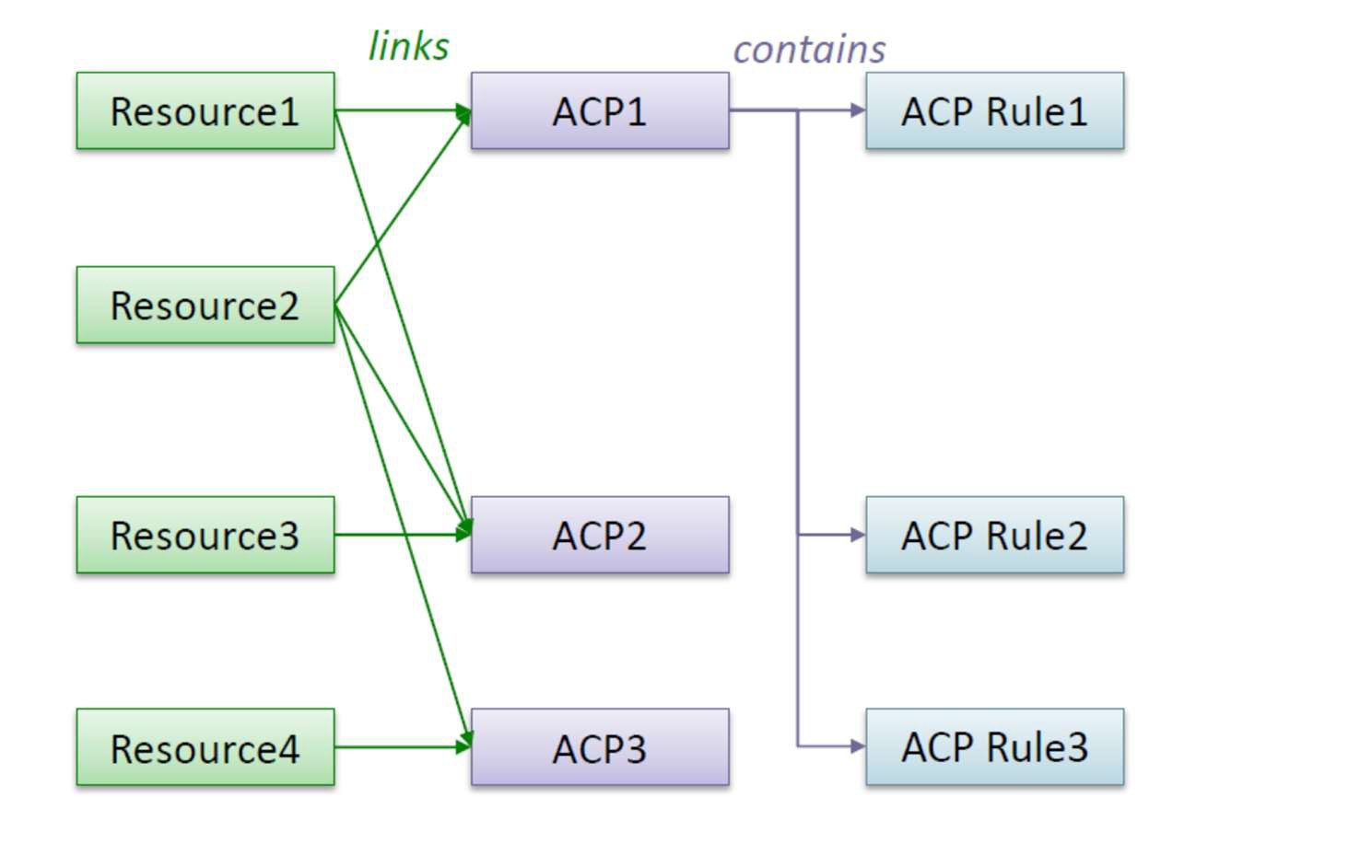
Authorization / Access Controls
Resource access is authorized based upon satisfying at least one Access Control Policy (ACP) rule in one of the linked ACPs.

Slide 18



Dynamic Authorization
Dynamic Authorization: Originator or Hosting CSE requesting authorization of Originator – provided by a Dynamic Authorization System (DAS) Server
Direct Dynamic Authorisation: Hosting CSE submits request to DAS, Originator not communicating with DAS Server
Indirect Dynamic Authorisation: Originator submits request to DAS Server using info provided by Hosting CSE. Similar to Open Authentication (OAuth) mechanism
DAS has multiple options for authorizing: Issue/update access control rules, assign Role(s) to the Originator, issue JSON Web Tokens (JWT)
Direct Dynamic Authorisation
1. Request
Originator (AE or CSE)
Hosting CSE
4. Response (‘success’)
3. Response (with Token or dynamicACPInfo)
3. Request
(with parameters from step 1)
DAS
Server
18

Slide 19

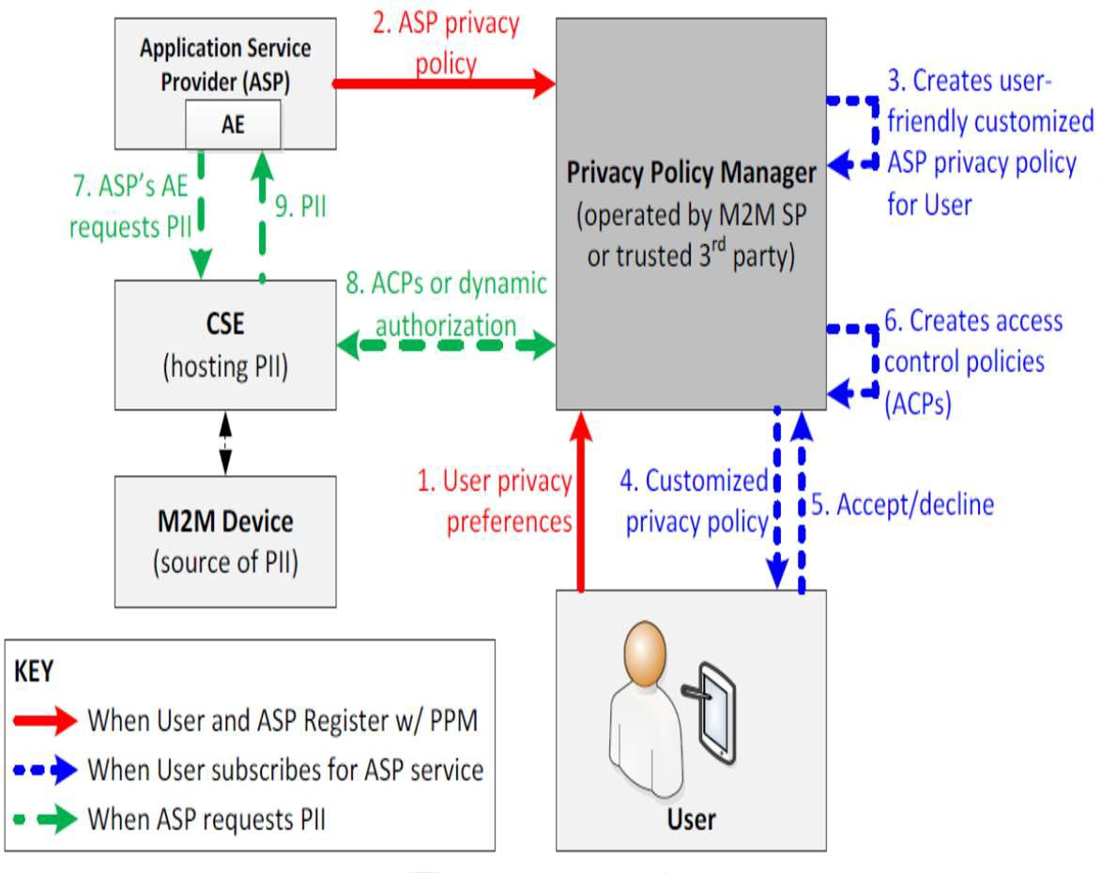



Privacy Policy Manager (PPM)
The PPM is a personal data management framework
The PPM converts a User's privacy preferences into access control information in order to protect the User's Personally Identifiable Information (PII) from access by unauthorized parties
Access control information consists of static and dynamic access control policies (ACP)
PPM uses a "Terms and Conditions Markup language" to derive consensus between the User's privacy preferences and an Application Service Provider's privacy policies
19

Slide 20

oneM2M Use Cases
Enables development of diverse IoT solutions across various sectors
Some key use cases include:
Smart cities: Optimize traffic management, resource utilization, and public safety through interconnected infrastructure
Connected cars: Enhance safety, improve traffic flow, and personalize driving experiences
Industrial automation: Monitor and control manufacturing processes for increased efficiency and productivity
Remote healthcare: Enable remote patient monitoring and facilitate telehealth services
Home automation: Manage smart home devices and create personalized living environments
Notes:
The interoperable and secure nature of oneM2M unlocks the potential for a wide range of IoT applications across various sectors. Here are some key use cases that benefit from oneM2M:
Smart cities: oneM2M facilitates the creation of smart cities by enabling the seamless integration of sensors, actuators, and other devices deployed for traffic management, resource optimization, and public safety applications.
Connected cars: With oneM2M, connected cars can exchange data with each other and roadside infrastructure, improving road safety, optimizing traffic flow, and providing personalized driving experiences.
Industrial automation: In manufacturing settings, oneM2M enables the efficient monitoring and control of industrial processes, leading to increased production efficiency and reduced downtime.
Remote healthcare: oneM2M allows for the development of remote patient monitoring systems, enabling healthcare providers to track patient vitals and health data remotely, facilitating timely intervention and improved care delivery.
Home automation: oneM2M serves as the foundation for smart home solutions, allowing users to control and manage various smart devices within their homes for enhanced comfort, security, and energy efficiency.
These are just a few examples, and the potential applications of oneM2M continue to expand as the IoT landscape evolves.

Slide 21

Conclusion
oneM2M is a key enabler for the future of IoT
Provides a standardized platform for interoperable and secure communication
Fosters innovation and facilitates the development of diverse IoT solutions
Continued adoption will unlock the full potential of the connected world
Notes:
In conclusion, oneM2M plays a crucial role in enabling the future of the Internet of Things. By establishing a standardized platform for interoperable and secure communication between devices and applications, oneM2M fosters innovation and facilitates the development of diverse IoT solutions across various sectors. As adoption of oneM2M standards continues to grow, we can expect to see even more innovative IoT applications emerge, unlocking the full potential of a truly connected world.

