Slide 1

WildGround
Territory capture.
Animal identity.
A browser arcade with optional
Solana holder cosmetics.
Adam, Founder
WILDGROUND
01
Notes:
Project identity and founder supplied by the user. Original WG logo created for this project. No adoption or revenue claims.
Evidence snapshot: 12 October 2026. Project sources: README.md and docs/evidence.md.
Narrative reference: https://docs.google.com/presentation/d/1V9yq8B1nLpF8vPTL2buT_nlmsMwNJ_fRuyADs_k49Sg/edit
Evidence guidance: https://github.com/Marakaya/proofpilot

Slide 2
The player problem
How can a casual game offer a visible token-holder identity without making every player connect a wallet?
DESIGN HYPOTHESIS
A player should try the game first.
A holder should be able to choose a distinct appearance.
WILDGROUND
02
Notes:
This is a product design hypothesis from the founder specification, not a validated survey finding. No customer interviews or demand data have been supplied.
Evidence snapshot: 12 October 2026. Project sources: README.md and docs/evidence.md.
Narrative reference: https://docs.google.com/presentation/d/1V9yq8B1nLpF8vPTL2buT_nlmsMwNJ_fRuyADs_k49Sg/edit
Evidence guidance: https://github.com/Marakaya/proofpilot

Slide 3
Alternative access designs
Open play only
Wallet required for everything
Immediate access to the game.
No holding-based cosmetic choice.
One wallet rule governs all access.
Players must connect before trying a match.
WildGround separates ordinary PLAY from optional SKINS.
WILDGROUND
03
Notes:
These are conceptual design alternatives, not named competitor findings. No competitor defects or superior market position are claimed. The project uses the optional cosmetics model shown in its source.
Evidence snapshot: 12 October 2026. Project sources: README.md and docs/evidence.md.
Narrative reference: https://docs.google.com/presentation/d/1V9yq8B1nLpF8vPTL2buT_nlmsMwNJ_fRuyADs_k49Sg/edit
Evidence guidance: https://github.com/Marakaya/proofpilot

Slide 4
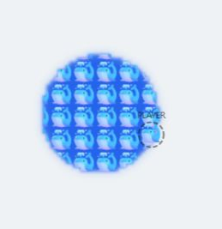
The WildGround approach
Free entry
PLAY opens a local match
against 1–6 bots.
Visible holder identity
Animal heads, matching trails
and emoji-filled territory.
Whale appearance
WILDGROUND
04
Notes:
Source: src/core/constants.ts, skins.ts, render/territoryRenderer.ts, sceneRenderer.ts. The screenshot is from an earlier prototype and demonstrates the implemented appearance. It predates WG holding verification and is not a real holder unlock test.
Evidence snapshot: 12 October 2026. Project sources: README.md and docs/evidence.md.
Narrative reference: https://docs.google.com/presentation/d/1V9yq8B1nLpF8vPTL2buT_nlmsMwNJ_fRuyADs_k49Sg/edit
Evidence guidance: https://github.com/Marakaya/proofpilot

Slide 5
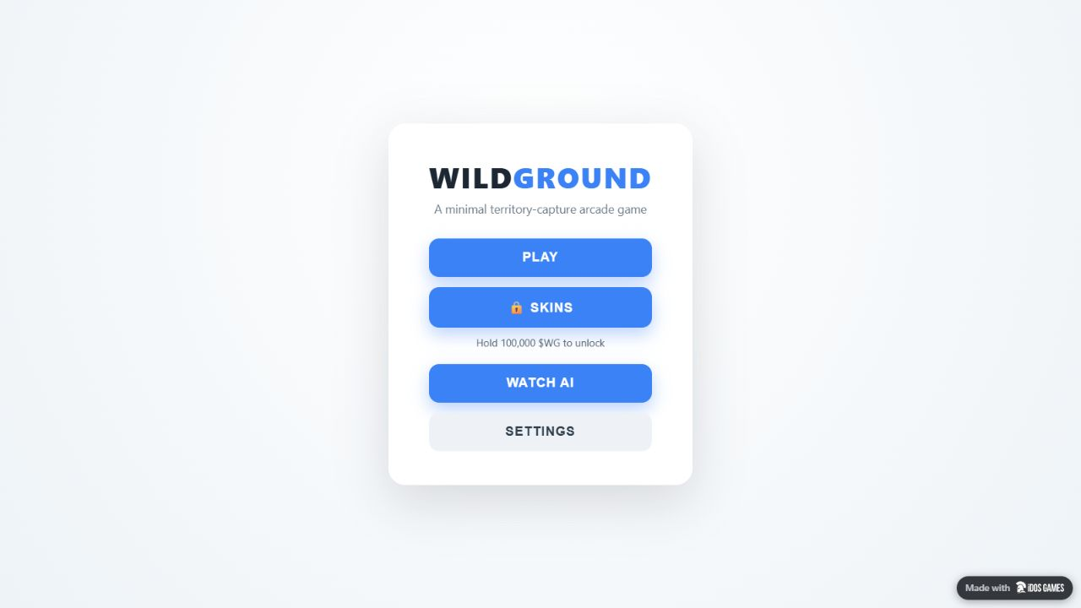
The playable product
A match starts in the browser.
No download or wallet is required for PLAY.
Close a trail to claim territory.
Cut an exposed enemy trail.
Survive to win.
Play the live demo
WILDGROUND
05
Notes:
Live demo: https://idosgames.com/app/XCQ1T7X1/. Menu image captured during WG gate development. Current deployment: build bld4e5277d3034348f68b06efdf2956e06b, Status Live. Rules: src/core/simulation.ts and territoryGrid.ts.
Evidence snapshot: 12 October 2026. Project sources: README.md and docs/evidence.md.
Narrative reference: https://docs.google.com/presentation/d/1V9yq8B1nLpF8vPTL2buT_nlmsMwNJ_fRuyADs_k49Sg/edit
Evidence guidance: https://github.com/Marakaya/proofpilot

Slide 6
Use cases
Available today
Proposed next
Casual solo matches against bots.
Optional animal cosmetics for WG holders.
WATCH AI for spectator play.
Player onboarding pilot.
Repeat-session and cosmetic-use tests.
Multiplayer exploration after validation.
WILDGROUND
06
Notes:
Implemented scope: single-player versus bots and spectator mode. Holder cosmetics are implemented but a real holder positive-flow test is pending. Future activities are proposals, not committed milestones or implemented functions.
Evidence snapshot: 12 October 2026. Project sources: README.md and docs/evidence.md.
Narrative reference: https://docs.google.com/presentation/d/1V9yq8B1nLpF8vPTL2buT_nlmsMwNJ_fRuyADs_k49Sg/edit
Evidence guidance: https://github.com/Marakaya/proofpilot

Slide 7
What is built
LIVE
49
9
Published game
Passing tests
Animal skins
Deployment and test results are verified.
Users, retention and revenue have not yet been measured.
WILDGROUND
07
Notes:
Build v6 published through iDosGames MCP. Local npm test: 49 passed in 9 files on 12 October 2026, after fixing an invalid open-loop test fixture. PLAYER_SKINS has 9 animals plus Classic. These are product metrics, not customer traction.
Evidence snapshot: 12 October 2026. Project sources: README.md and docs/evidence.md.
Narrative reference: https://docs.google.com/presentation/d/1V9yq8B1nLpF8vPTL2buT_nlmsMwNJ_fRuyADs_k49Sg/edit
Evidence guidance: https://github.com/Marakaya/proofpilot

Slide 8
Why this is buildable now
The game and WG token are already live.
Wallet identity
Direct Solana read
iDosGames handles signed wallet login.
The game reads the verified address.
The client derives the standard WG account.
PublicNode returns its current token balance.
WILDGROUND
08
Notes:
This is a technical timing claim, not evidence of a market window. References checked 12 October 2026: https://solana.com/docs/tokens/basics/create-token-account and https://solana.com/docs/rpc/http/getaccountinfo and https://solana.publicnode.com/. Implementation: src/core/tokenSkinAccess.ts. The current browser route does not require outbound CloudCode HTTP.
Evidence snapshot: 12 October 2026. Project sources: README.md and docs/evidence.md.
Narrative reference: https://docs.google.com/presentation/d/1V9yq8B1nLpF8vPTL2buT_nlmsMwNJ_fRuyADs_k49Sg/edit
Evidence guidance: https://github.com/Marakaya/proofpilot

Slide 9
The founder
Adam
Founder of WildGround
Telegram @satoryX
Current focus: a playable MVP,
holder verification and a player pilot.
WILDGROUND
09
Notes:
Founder name, role and public contact were supplied by the user. No employment history, awards, previous projects or additional teammates are claimed.
Evidence snapshot: 12 October 2026. Project sources: README.md and docs/evidence.md.
Narrative reference: https://docs.google.com/presentation/d/1V9yq8B1nLpF8vPTL2buT_nlmsMwNJ_fRuyADs_k49Sg/edit
Evidence guidance: https://github.com/Marakaya/proofpilot

Slide 10
Next milestones
01 Verify
Test a real holder unlock, wallet switching and insufficient balance.
02 Pilot
Invite 20 players. Target 10 completed matches and 6 voluntary replays.
03 Improve
Use pilot evidence to prioritize reliability, retention and multiplayer.
WILDGROUND
10
Notes:
All future milestones and pilot thresholds are proposals. If completion or replay thresholds fail, prioritize controls and onboarding before expansion. No dates, funding, partnerships or awarded grants are assumed. Source: docs/roadmap.md.
Evidence snapshot: 12 October 2026. Project sources: README.md and docs/evidence.md.
Narrative reference: https://docs.google.com/presentation/d/1V9yq8B1nLpF8vPTL2buT_nlmsMwNJ_fRuyADs_k49Sg/edit
Evidence guidance: https://github.com/Marakaya/proofpilot

Slide 11
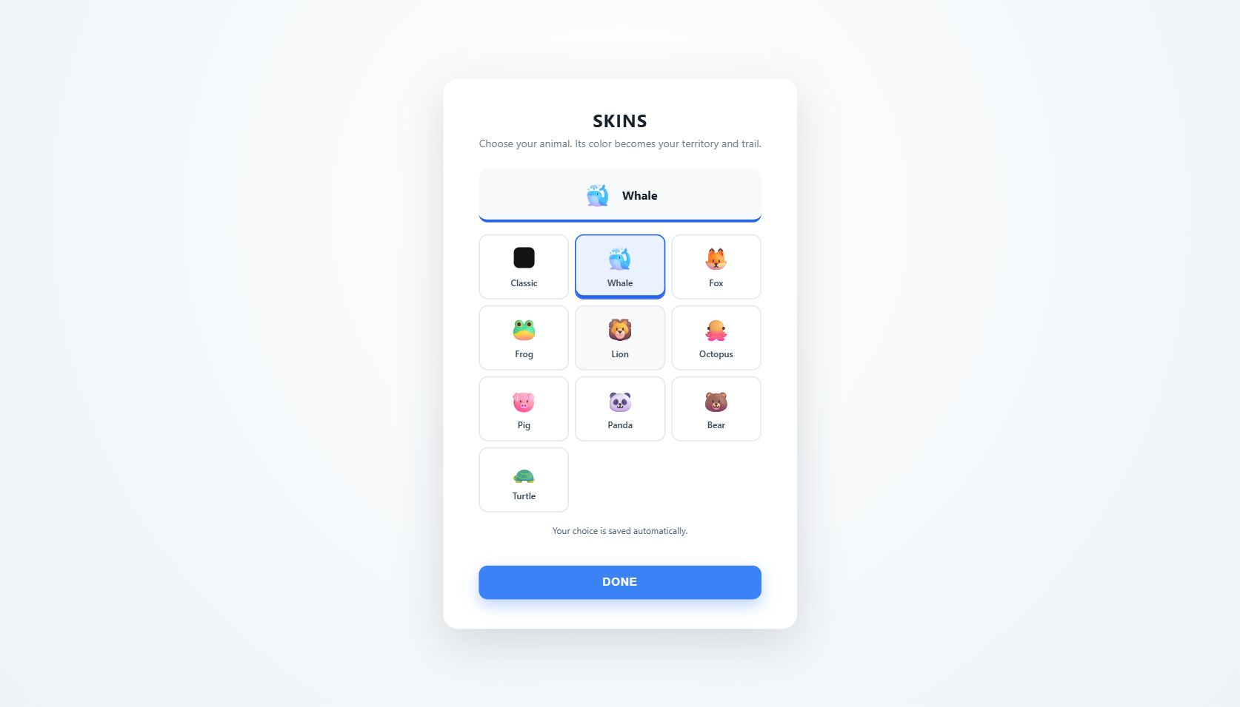
WG utility and business model
100,000 WG
Holding enables cosmetic selection.
The check does not transfer or burn tokens.
The MVP does not charge players.
Revenue and willingness to pay remain unvalidated.
Cosmetic catalogue
WILDGROUND
11
Notes:
Threshold: 100000000000 raw units, 6 decimals. WG mint: 3hZ7a3r5ghQPnceqyjj4KTKi3yneWeKMmSTsqxX4idos. Standard ATA only, not custody/staking/extra accounts. Client-side cosmetic check is bypassable by a modified client and must not authorize payouts. Real holder positive-flow test pending. Catalogue screenshot predates the holding gate and is appearance evidence only. Future cosmetic purchases or platform partnerships are hypotheses, not revenue.
Evidence snapshot: 12 October 2026. Project sources: README.md and docs/evidence.md.
Narrative reference: https://docs.google.com/presentation/d/1V9yq8B1nLpF8vPTL2buT_nlmsMwNJ_fRuyADs_k49Sg/edit
Evidence guidance: https://github.com/Marakaya/proofpilot

Slide 12
WildGround
Play the demo
idosgames.com/app/XCQ1T7X1/
github.com/lekalerta-a11y/wildground
Adam · Telegram @satoryX
WILDGROUND
12
Notes:
Live game, requested repository destination and founder contact. Narrative adapted from Superteam template. Evidence rules based on ProofPilot. No request for token purchase, return promise or hackathon submission is made.
Evidence snapshot: 12 October 2026. Project sources: README.md and docs/evidence.md.
Narrative reference: https://docs.google.com/presentation/d/1V9yq8B1nLpF8vPTL2buT_nlmsMwNJ_fRuyADs_k49Sg/edit
Evidence guidance: https://github.com/Marakaya/proofpilot

