Slide 1


Data Structures & Algorithms in Python Linked Lists – Lab Answers
College of Computing and Data Science

Slide 2
Linked Lists
A LinkedList consists of a connected sequence of Link/Node objects
Each node contains a reference to a datum and a reference to the next node in the sequence.
The datum is just an object. It could be just an int or a string, or it could contain a key/data pair.
The last node in the sequence refers to None as its next node
The sequence of nodes is accessed via a “header” object that contains a reference to the first node in the sequence.
head
0x1000
0x1010
0x1020
0x1030
0x10??
John
18
4.0
Anna
21
3.5
Peter
22
3.8
Jane
25
3.7
…
Last
45
4.5
None
0x1010
0x1020
0x1030
Notes:
Here we analyze the basic anatomy of a LinkedList. It consists of a series of interconnected nodes, where each node contains two parts: a reference to the data it holds and a reference to the next node in the sequence. The data can be any object, such as an integer, a string, or a key-value pair. Each node is linked to the next one in line through its reference, creating a chain of connected nodes. The last node in this sequence points to None, indicating the end of the list. The entire structure is accessed via a header object, which holds a reference to the first node in the list. If the reference to this header is lost, the entire list becomes inaccessible.

Slide 3
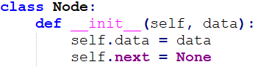

Linked Lists
head
1
2
3
4
5

Slide 4
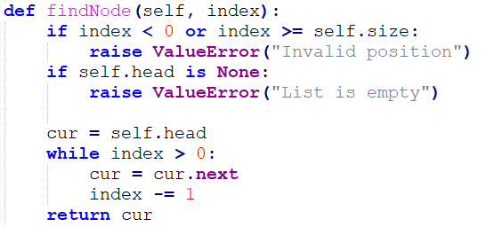
Linked Lists
index = 2
index = 1
index = 0
cur
head
1
2
3
4
5

Slide 5
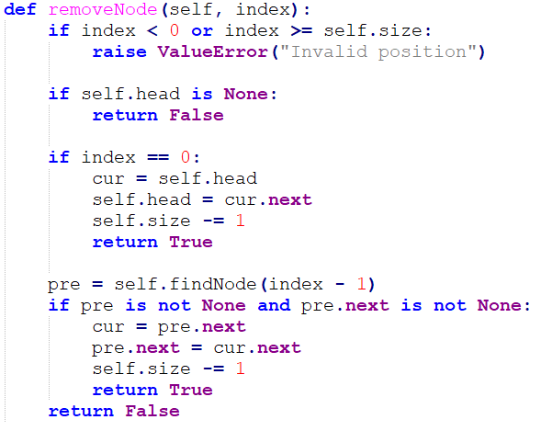
Linked Lists
cur
head
1
2
3
4
5

Slide 6
Linked Lists
index = 2
pre
cur
head
1
2
3
4
5

Slide 7
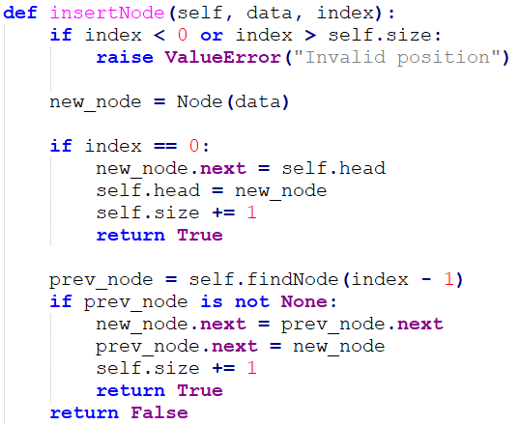
Linked Lists
7
head
1
2
3
4
5

Slide 8
Linked Lists
prev_node
7
head
1
2
3
4
5

Slide 9
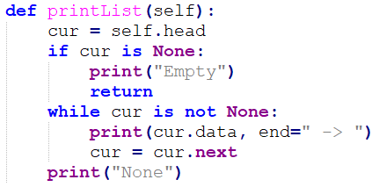
Linked Lists
head
1
2
3
4
5

Slide 10
Q01
Write a function moveOdditemstoback() that moves all odd integers to the back of a linked list.
The function prototype
def moveOdditemstoback(head):

Slide 11
Q01 – Answer
while current:
next_node = current.next
current.next = None
current
next_node
if current.data % 2 == 0:
if not even_head:
even_head = current
even_tail = current
else:
even_tail.next = current
even_tail = current
else:
if not odd_head:
odd_head = current
odd_tail = current
else:
odd_tail.next = current
odd_tail = current
current = next_node
1
3
5
2
4
6

Slide 12
Q01 – Answer
while current:
next_node = current.next
current.next = None
current
next_node
if current.data % 2 == 0:
if not even_head:
even_head = current
even_tail = current
else:
even_tail.next = current
even_tail = current
else:
if not odd_head:
odd_head = current
odd_tail = current
else:
odd_tail.next = current
odd_tail = current
current = next_node
1
3
5
2
4
6

Slide 13
Q01 – Answer
while current:
next_node = current.next
current.next = None
current
next_node
if current.data % 2 == 0:
if not even_head:
even_head = current
even_tail = current
else:
even_tail.next = current
even_tail = current
else:
if not odd_head:
odd_head = current
odd_tail = current
else:
odd_tail.next = current
odd_tail = current
current = next_node
1
3
5
2
4
6
odd_head
odd_tail

Slide 14
Q01 – Answer
while current:
next_node = current.next
current.next = None
current
current
next_node
if current.data % 2 == 0:
if not even_head:
even_head = current
even_tail = current
else:
even_tail.next = current
even_tail = current
else:
if not odd_head:
odd_head = current
odd_tail = current
else:
odd_tail.next = current
odd_tail = current
current = next_node
1
3
5
2
4
6
odd_head
odd_tail

Slide 15
Q01 – Answer
while current:
next_node = current.next
current.next = None
current
next_node
next_node
if current.data % 2 == 0:
if not even_head:
even_head = current
even_tail = current
else:
even_tail.next = current
even_tail = current
else:
if not odd_head:
odd_head = current
odd_tail = current
else:
odd_tail.next = current
odd_tail = current
current = next_node
current
1
3
5
2
4
6
odd_head
odd_tail

Slide 16
Q01 – Answer
while current:
next_node = current.next
current.next = None
current
next_node
if current.data % 2 == 0:
if not even_head:
even_head = current
even_tail = current
else:
even_tail.next = current
even_tail = current
else:
if not odd_head:
odd_head = current
odd_tail = current
else:
odd_tail.next = current
odd_tail = current
current = next_node
1
3
5
2
4
6
odd_head
odd_tail

Slide 17
Q01 – Answer
while current:
next_node = current.next
current.next = None
current
next_node
if current.data % 2 == 0:
if not even_head:
even_head = current
even_tail = current
else:
even_tail.next = current
even_tail = current
else:
if not odd_head:
odd_head = current
odd_tail = current
else:
odd_tail.next = current
odd_tail = current
current = next_node
1
3
5
2
4
6
odd_head
even_head
odd_tail
even_tail

Slide 18
Q01 – Answer
while current:
next_node = current.next
current.next = None
current
current
next_node
if current.data % 2 == 0:
if not even_head:
even_head = current
even_tail = current
else:
even_tail.next = current
even_tail = current
else:
if not odd_head:
odd_head = current
odd_tail = current
else:
odd_tail.next = current
odd_tail = current
current = next_node
1
3
5
2
4
6
odd_head
even_head
odd_tail
even_tail

Slide 19
Q01 – Answer
while current:
next_node = current.next
current.next = None
current
next_node
if current.data % 2 == 0:
if not even_head:
even_head = current
even_tail = current
else:
even_tail.next = current
even_tail = current
else:
if not odd_head:
odd_head = current
odd_tail = current
else:
odd_tail.next = current
odd_tail = current
current = next_node
1
3
5
2
4
6
odd_head
even_head
odd_tail
odd_tail
even_tail

Slide 20
Q01 – Answer
while current:
next_node = current.next
current.next = None
next_node
current
if current.data % 2 == 0:
if not even_head:
even_head = current
even_tail = current
else:
even_tail.next = current
even_tail = current
else:
if not odd_head:
odd_head = current
odd_tail = current
else:
odd_tail.next = current
odd_tail = current
current = next_node
1
3
5
2
4
6
odd_head
even_head
odd_tail
even_tail
even_tail

Slide 21
Q01 – Answer
while current:
next_node = current.next
current.next = None
current
next_node
if current.data % 2 == 0:
if not even_head:
even_head = current
even_tail = current
else:
even_tail.next = current
even_tail = current
else:
if not odd_head:
odd_head = current
odd_tail = current
else:
odd_tail.next = current
odd_tail = current
current = next_node
1
3
5
2
4
6
odd_head
even_head
odd_tail
even_tail
odd_tail

Slide 22
Q01 – Answer
while current:
next_node = current.next
current.next = None
current
if current.data % 2 == 0:
if not even_head:
even_head = current
even_tail = current
else:
even_tail.next = current
even_tail = current
else:
if not odd_head:
odd_head = current
odd_tail = current
else:
odd_tail.next = current
odd_tail = current
current = next_node
1
3
5
2
4
6
odd_head
even_head
even_tail
odd_tail

Slide 23
Q01 – Answer
while current:
next_node = current.next
current.next = None
current
if current.data % 2 == 0:
if not even_head:
even_head = current
even_tail = current
else:
even_tail.next = current
even_tail = current
else:
if not odd_head:
odd_head = current
odd_tail = current
else:
odd_tail.next = current
odd_tail = current
current = next_node
1
3
5
2
4
6
odd_head
even_head
even_tail
odd_tail
even_tail

Slide 24
Q01 – Answer
if not even_head:
return odd_head # No evens, only odds
if not odd_head:
return even_head # No odds, only evens
even_tail.next = odd_head # Connect even list to odd list
odd_tail.next = None # Ensure list ends properly
return even_head
1
3
5
2
4
6
odd_head
even_head
odd_tail
even_tail

Slide 25
Q01 – Answer
if not even_head:
return odd_head # No evens, only odds
if not odd_head:
return even_head # No odds, only evens
even_tail.next = odd_head # Connect even list to odd list
odd_tail.next = None # Ensure list ends properly
return even_head
1
3
5
2
4
6
odd_head
even_head
odd_tail
even_tail

Slide 26
Q02
2. Write the function removeNode() using the LinkedList structure defined in the lecture materials. The function should remove a node at the specified index from the linked list.
The function definition is as follows:
def removeNode(ll, index):

Slide 27
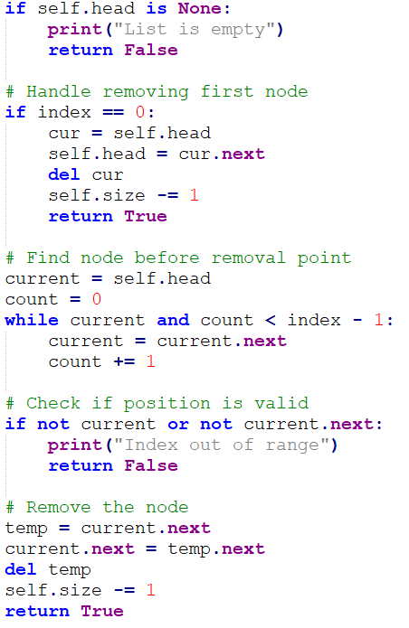
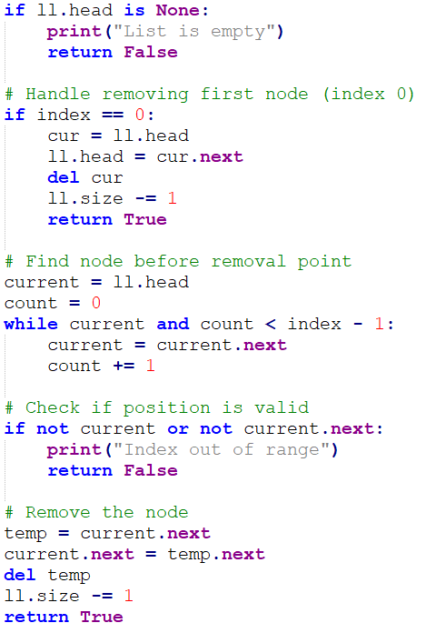
Q02 – Answer

Slide 28
Q03
3. Write a function split() that copies the contents of a linked list into two other linked lists.
The function prototype is given below:
def split(ll):
The function should copy nodes with even indices (0, 2, 4, etc.) to evenList and nodes with odd indices (1, 3, 5, etc.) to oddList. The original linked list should remain unmodified.

Slide 29
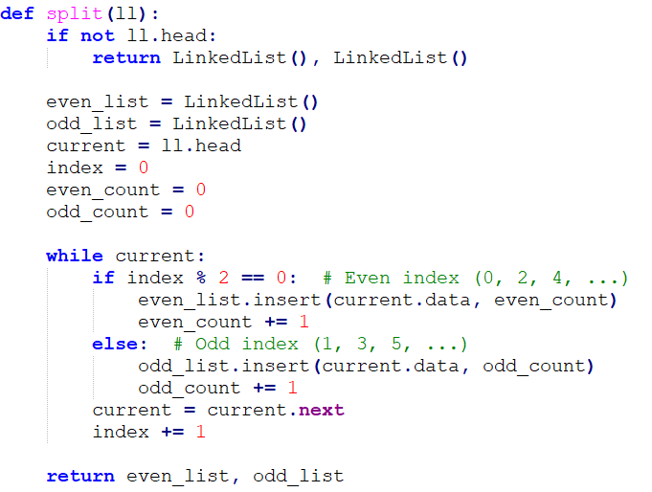
Q03 – Answer
current
head
0
1
2
3
4
even_list
head
0
2
4
odd_list
head
1
3

Slide 30
Q04
4. Write a function duplicateReverse() that creates a duplicate of a linked list with the nodes stored in reverse.
The function prototype is given below:
def duplicateReverse(ll):
The function should return a new LinkedList object containing the reversed duplicate of the input linked list. If the input list is empty, return an empty LinkedList.

Slide 31
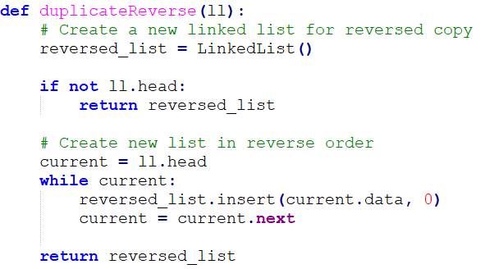
Q04 – Answer
current
head
0
1
2
3
4
head
0
1
2
3
4

