Slide 1


Data Structures & Algorithms in Python Stacks and Queues – Lab Answers
College of Computing and Data Science

Slide 2
linked lists Recap
A LinkedList consists of a connected sequence of Link/Node objects
Each node contains a reference to a datum and a reference to the next node in the sequence.
The datum is just an object. It could be just an int or a string, or it could contain a key/data pair.
The last node in the sequence refers to None as its next node
The sequence of nodes is accessed via a “header” object that contains a reference to the first node in the sequence.
head
0x1000
0x1010
0x1020
0x1030
0x10??
John
18
4.0
Anna
21
3.5
Peter
22
3.8
Jane
25
3.7
…
Last
45
4.5
None
0x1010
0x1020
0x1030
Notes:
Here we analyze the basic anatomy of a LinkedList. It consists of a series of interconnected nodes, where each node contains two parts: a reference to the data it holds and a reference to the next node in the sequence. The data can be any object, such as an integer, a string, or a key-value pair. Each node is linked to the next one in line through its reference, creating a chain of connected nodes. The last node in this sequence points to None, indicating the end of the list. The entire structure is accessed via a header object, which holds a reference to the first node in the list. If the reference to this header is lost, the entire list becomes inaccessible.

Slide 3
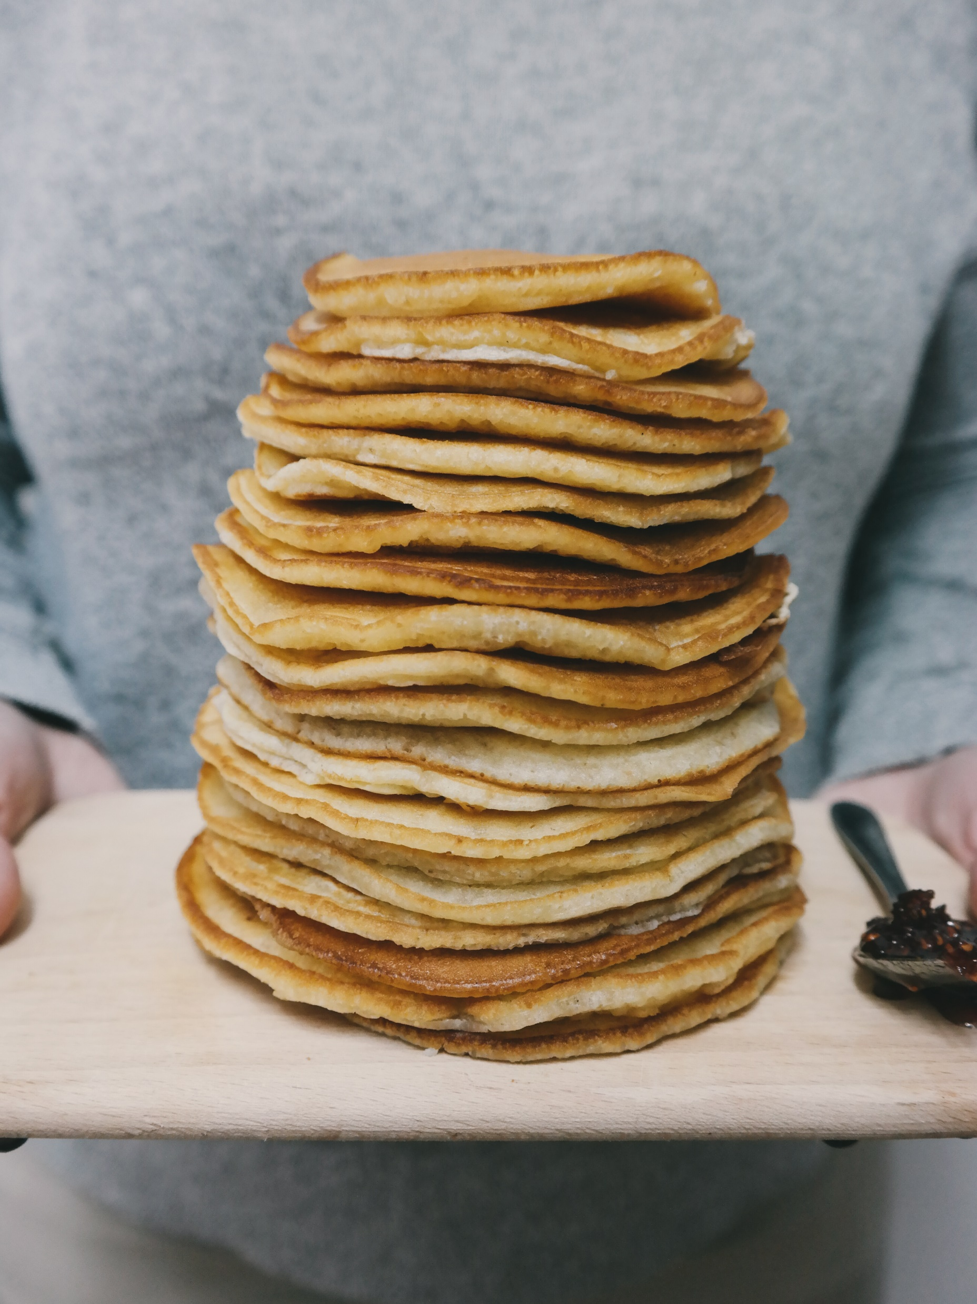
Stacks (of pancakes)
First-In, Last-Out (FILO)
head
5
4
3
2
1
Notes:
<a href="https://stocksnap.io/photo/people-man-UEKFJ08T9T">Photo</a> by <a href="https://stocksnap.io/author/20268">Tohm Brigitte</a> on <a href="https://stocksnap.io">StockSnap</a>

Slide 4
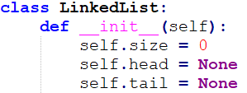

Stacks (of pancakes)
head
5
4
3
2
1
Notes:
<a href="https://stocksnap.io/photo/people-man-UEKFJ08T9T">Photo</a> by <a href="https://stocksnap.io/author/20268">Tohm Brigitte</a> on <a href="https://stocksnap.io">StockSnap</a>

Slide 5

Stacks (of pancakes)
6
5
4
3
2
1
Notes:
<a href="https://stocksnap.io/photo/people-man-UEKFJ08T9T">Photo</a> by <a href="https://stocksnap.io/author/20268">Tohm Brigitte</a> on <a href="https://stocksnap.io">StockSnap</a>

Slide 6
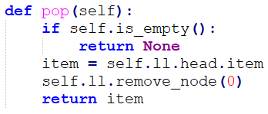

Stacks (of pancakes)
6
5
4
3
2
1
Notes:
<a href="https://stocksnap.io/photo/people-man-UEKFJ08T9T">Photo</a> by <a href="https://stocksnap.io/author/20268">Tohm Brigitte</a> on <a href="https://stocksnap.io">StockSnap</a>

Slide 7
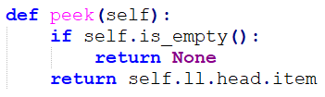
Stacks (of pancakes)
head
5
item
4
3
2
1
Notes:
<a href="https://stocksnap.io/photo/people-man-UEKFJ08T9T">Photo</a> by <a href="https://stocksnap.io/author/20268">Tohm Brigitte</a> on <a href="https://stocksnap.io">StockSnap</a>

Slide 8

Queues (of people)
First-In, First-Out (FIFO)
head
1
2
3
4
5
Notes:
<a href="https://www.vecteezy.com/free-vector/people-queue">People Queue Vectors by Vecteezy</a>

Slide 9

Queues (of people)
head
1
2
3
4
5
Notes:
<a href="https://www.vecteezy.com/free-vector/people-queue">People Queue Vectors by Vecteezy</a>

Slide 10

Queues (of people)
1
2
3
4
5
Notes:
<a href="https://www.vecteezy.com/free-vector/people-queue">People Queue Vectors by Vecteezy</a>

Slide 11
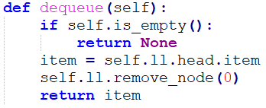

Queues (of people)
1
2
3
4
5
Notes:
<a href="https://www.vecteezy.com/free-vector/people-queue">People Queue Vectors by Vecteezy</a>

Slide 12
Summary
Stacks | Queues
Last-In, First-Out (LIFO) | First-In, First-Out (FIFO)
push() and pop() | enqueue() and dequeue()

Slide 13
Q01
1. Write a function removeUntil() that removes all values from a stack of integers until but not including the first occurrence of a given value. The function accepts two parameters: a reference to the stack and the value to stop at. The function definition is as follows:
def removeUntil(stack, value):
Given a stack [1 2 3 4 5 6 5 4 3 2 1] with the topmost number displayed on the left, calling
removeUntil() with value = 5 will produce the stack [5 6 5 4 3 2 1].

Slide 14
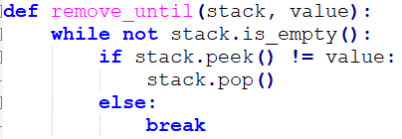
Q01 - Answer
6
5
4
3
2
1

Slide 15
Q01 - Answer
3
2
1

Slide 16
Q02
2. Write a recursive function recursiveReverse() that reverses the order of items stored in a queue of integers. The function accepts a single parameter: a reference to the queue. The function definition is as follows:
def recursiveReverse(queue):

Slide 17
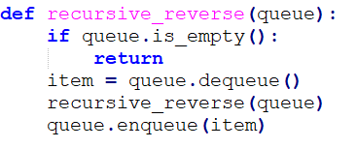
Q02 - Answer
recursive_reverse()
recursive_reverse()
head
1
2
3
item

Slide 18
Q02 - Answer
recursive_reverse()
item
1
recursive_reverse()
recursive_reverse()
head
2
3
item

Slide 19
Q02 - Answer
recursive_reverse()
recursive_reverse()
item
1
item
2
recursive_reverse()
recursive_reverse()
head
3
item

Slide 20
Q02 - Answer
recursive_reverse()
recursive_reverse()
item
1
item
2
recursive_reverse()
recursive_reverse()
head
item
3

Slide 21
Q02 - Answer
recursive_reverse()
recursive_reverse()
item
1
item
2
recursive_reverse()
head
item
3

Slide 22
Q02 - Answer
recursive_reverse()
item
1
recursive_reverse()
recursive_reverse()
head
3
item
2

Slide 23
Q02 - Answer
recursive_reverse()
item
1
recursive_reverse()
head
3
item
2

Slide 24
Q02 - Answer
recursive_reverse()
recursive_reverse()
head
3
2
item
1

Slide 25
Q02 - Answer
recursive_reverse()
head
3
2
item
1

Slide 26
Q03
3. Write a function palindrome() that determines whether a given string is a palindrome. The function accepts a single parameter: the word (a string). The function should return True if the string is a palindrome and False otherwise. The function should ignore whitespace, case, and punctuation. The function definition is as follows:
def palindrome(word):
Sample output:
Enter a string: A man a plan a canal Panama The string is a palindrome.
Enter a string: Superman in the sky The string is not a palindrome.

Slide 27
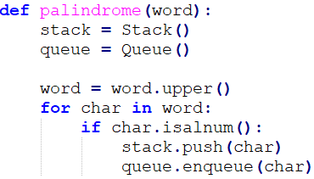
Q03 - Answer
R
A
D
R
A
D
A
R
A
R

Slide 28
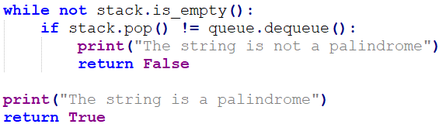
Q03 - Answer
R
A
D
R
A
D
A
R
A
R

Slide 29
Q04
4. Write a function balanced() that determines if an expression comprised of the characters ()[]{} is balanced. The function accepts a single parameter: the expression (a string). The function should return True if the expression is balanced and False otherwise. The function definition is as follows:
def balanced(expression):
The following expressions are balanced because the order and quantity of the parentheses match:
() ([])
{[]()[]}
The following expressions are not balanced:
{{)] [({{)])

Slide 30
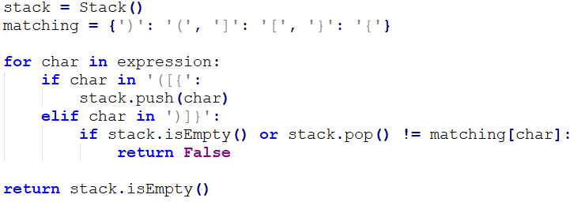
Q04 - Answer
[ ] [ ( ) ]
[

Slide 31
Q04 - Answer
[ ] [ ( ) ]
[

Slide 32
Q04 - Answer
[ ] [ ( ) ]
[

Slide 33
Q04 - Answer
[ ] [ ( ) ]
(
[

Slide 34
Q04 - Answer
[ ] [ ( ) ]
(
[

Slide 35
Q04 - Answer
[ ] [ ( ) ]
[

