Slide 1

SC/CZ/CE2002 Object-Oriented Design & Programming Chapter 8: Modeling OO Application
Dr. Li Fang
Senior Lecturer, College of Computing and Data Science
Notes:
Hello and welcome to Chapter 8 of the CE2002 course on Object-Oriented Design & Programming. You learnt about class diagrams and sequence diagrams. In this lecture, you are going to make use of these two diagrams and model OO application which is what you are going to do for your assignment as well.

Slide 2

Objectives
By the end of this chapter, you should be able to:
Use Class and Sequence diagrams to model Object Oriented (OO) applications
Notes:
By the end of this chapter, you should be able to use class and sequence diagrams to model OO applications.

Slide 3
Modeling Real World Systems
Primary goals of OO is to model real-world systems in ways similar to ways people think.
Identify objects – encapsulated data and behaviours:
Through identifying nouns and verbs in requirements statement.
Model how objects interact with real-world objects.
Student registered courses
Verb
Object
Goal
Action
Actor
Subject
Notes:
The purpose of Object Oriented language is to model the real-life scenarios. In real-life how people interact is how objects work. In theory, we try to identify objects from what we know, what people think the real world is supposed to be. For example, in a clinic setup, you have doctors, nurses, appointments, medical records, drugs and medicines. These are called considered objects in a case scenario.
So if you look at a very simple English language sentence, it will always have a subject, a verb, an object whereby subjects and verb, all three are considered noun. For example, ‘Students register for courses’. Students and courses are nouns so they are possible classes or objects later. If you have verbs, sometimes it gives you a hint of whose responsibility or whose behavior this verb belongs to or responsibility of a class or behavior which ultimately becomes the method or function of that class. Basically you are trying to identify nouns and verbs from a case scenario given a certain text.

Slide 4
Modeling OO Application
Identify Classes.
Add attributes and methods.
Add class relationship.
Add multiplicities, etc.
Entity – Persistent information tracked by System.
Boundary – Interaction between Actor and System.
Control – Logic to realise use case.
Notes:
You identify in a case scenario, for example, in your assignment specifications, you look for nouns that would give you candidate classes, whether they are possible classes, ultimately you need to decide later but it would give you the first draft of what classes you need in your applications or your system. Then, we have classes, these are mainly Entity classes. Remember the three stereotype, we have Entity, Control and Boundaries when you are identifying nouns from this case scenario – requirement specification or customer/system specification, basically are identifying nouns. What are the classes you need to store data information. Subsequently we have done entity classes, then you decide how many boundary classes do you need. So, how do you decide how many boundary classes do you need? Basically, you need to look at a function. You know boundary classes is about input and output, so for certain functions you need to have certain inputs and that needs to present certain outputs, then you consider what are the boundary classes you need at a point of time, when you look at a function. Of course, you have to control. As simple as an application can be, it can just have one control but if the application is too complex, you will notice that with just one control class is going to be overloaded and then this control class code is going to get very huge. That is when you think about it whether you need to speed up, remember the Fingerprint Access System whereby the FAS managers dedicated to the functions of verifying the fingerprints to the fingerprint manager. That’s the point where you think whether you need to speed up some of the logics and leave it to other control classes to specialise on what they are supposed to do by specialising on a logic.
When you are identifying nouns, its first-cut Entity classes, then subsequently you decide how many boundary classes or control classes you need. After you have identified the classes, you can add the attributes and behaviour to complete the attributes and also methods for that class. Classes don’t just stand alone, they are related. Use your class diagrams to map out the relationship. And then the multiplicities, one instance you will have how many instances of the other.

Slide 5
Modeling OO Application
Identify object behaviours and interaction through functional flow.
Enhance classes details.
Implement the model.
Quality testing of application.
Discover more
methods
Notes:
After you have a class, then you look into the function required by the system or applications to identify behaviour. Before you look into functions, when you are identifying classes, you should have a rough idea of what the behaviour of that class is supposed to be other than the get and set methods, you assess your get and set methods. But to the function itself, you notice that you are going to discover more methods to bring out the flow of a certain function. So through the objects and object interactions you need to identify more methods. And then you are going to go back to your class diagram and enhance it with all the details of what you have discovered in your sequence diagrams, then you see that your methods are going to increase because when you are doing your sequence flow, you may identify more methods required by that class. Then you implement the model. If your class likes them and few sequence likes them, you can start to do your coding, implement into codes. With the codes itself, you need to do a testing, quality testing to make sure that the application is of good quality and bugs free.

Slide 6
Software Development Process
Animation to be inserted
Notes:
As simple as the process is, not a very complex SDLC which you are going to learn in software engineering for purpose of this course and what you are going to go through in your assignment. You will be given these assignment specifications like 1D text, a very wordy thing which is good because with more words, it’s useful for you to identify more nouns and then you can discuss whether you need all these classes when you identify all these nouns. And then with this, you identify the nouns, call them your class list and embed them in the class diagram and the relationships. With the requirements and the class diagram, requirements not only gives you nouns but also tells you what the function of that application or system is going to be - functional. And then, you are going to describe what the flow is going to be. Therefore, with the requirements and the class diagrams, can come out with your sequence diagrams to map out the flow. Like I said, sequence diagrams can be used for helping out the system flow of a function or a method especially if the method logic is very complex. So, how many sequence diagrams you need is dependent on your team to see whether its certain functions or certain method logics to too complex. Therefore, you need to have sequence diagrams to map out the flow so that everyone has a better understanding of how to implement the logics.
You have multiple sequence diagrams but how many, it depends. You usually have one class diagram but if the class diagrams are too huge, some may choose to speed up the functions and to the sequence diagrams, you map out, discover more methods and go back to the class diagrams, modify and enhance them. Together with the class diagrams and sequence diagrams, you implement them to the class code., your application class, all your classes. Then, you are going to run the testing. In a usual case, in a proper way of doing testing there will be a test plan with test cases. Just like in your assignments, I have provided certain test cases but of course you can increase it to make sure all the functions are properly tested. You also need to make sure that your application or system is bug free, ad free or bugs before your submit.

Slide 7
A Short Example
“……..A professor is a mentor to at least 1 student. He/she can check the course results of his/her mentees, which the students have registered…..”
Professor
Professor
Student
Student
Course
mentor
1..*
1..*
1..*
Course
- name
1
mentee
- name
register
- courseName
as Student Record
1..*
Result
Result
grade
semYr
Notes:
Lets look at an example, a very short example. Just three statements – “A professor is a mentor to at least one student. He or she can check the course results of his or her mentees, which the students have registered. So, first thing, identify the nouns from a simple English statement – subject, object and of course in between decibel. So you look at it, professor, mentor, student, course, result – they are possible nouns. You need to look at all these and of course mentees. These identified nouns are possible classes and then you will do another round of analysis whether all the nouns you have identified are possible classes. You look at it – Professor, you would need as he is a main thing to decide, to retrieve out and to know about the mentees. Professors have certain required attributes. How about mentor? If you look at mentor itself is actually referring to the professor, playing the role of a mentor. Its basically about the professor, you don’t really need the mentor class. Student, you would need because its for post ref or the information about courses and results later. So, same for course and results. Mentee, same thing, identifying the student as a role with reference to the professor as a mentor. With that, we have come out with your classes, move on to attributes and of course we will get on to methods as well to gather relationship.
Then, you see that mentor and mentee is not really discarded. You can use them as a row name in your class diagram. Subsequently, you can use it as an object reference name in your implementation course. You can see from here that professor is related to this student because professor of at least one to many students and then ofcourse as a student you only have one mentor. If you look at this there are two links between the students – one link is from student to course which is for current registration. The other information is students result. The student result itself is not just the grade but you can also specify if this course has been taken and during which semester and then there is the result. Then, you have a separate association which shows that the course has been taken. You map the students which have been registered,
What are the current courses that the students have registered and what are the past results.

Slide 8
A Short Example
“……..A professor is a mentor to least 1 student. He/she can check the course results of his/her mentees, which the students have registered…..”
Professor
Professor
Student
Student
Course
mentor
1..*
1..*
1..*
Course
- name
1
mentee
- name
register
- courseName
as Student Record
1..*
Result
Result
grade
Notes:
All these are entity classes. What needs to be stored in the system and in which classes and ultimately which objects. With these classes you can also map the flow. The professor can check the course results of his or her mentees, which the students have registered. It can map out a sequence flow from here so that it can draw the sequence diagram. You only identify the entity classes and not the boundary or control classes. With these requirements, you need to have a certain interface for the professor to key in the mentees name and then ultimately the system will give out the mentees records and print out the result.

Slide 9
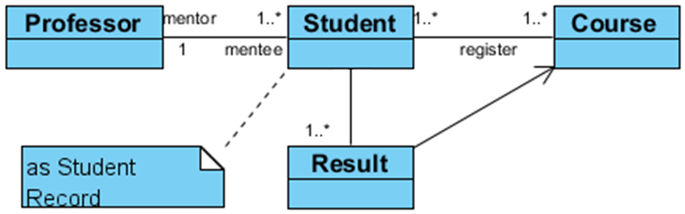
A Short Example
Professor
mentor
1..*
1..*
1..*
“He/she can check the course results of his/her mentees, which the students have registered…..”
Student
Course
1
register
mentee
Result
as Student Record
Sd check mentee result
: SelectForm
AppMgr
mentee : Student
mentor : Professor
student : Student
result : Result
course : Course
professor : Professor
Professor
App Mgr
professor : Professor
student : Student
result : Result
course : Course
select
showMenteeResults()
mentor : Professor
mentee : Student
getMentees()
loop
[foreach student]
getResults()
loop
[foreach result]
getCourse()
getCourseName()
getGrade()
output
Notes:
This here is a function and not a method implementation. You can see that have an actor here to simulate the professor using a form which is identified by this boundary class. You can simply say that it is a select form which is a list down or the mentees to key in the metric numbers. This information is going to pass through a control class. The control class will decide what is the command and operate accordingly. The next step has to be control class. It can be any name you want, but we mostly name the control class according to the function, but you can simply name it as app manager, the application class. You send a command to show mentees result. That is where the other classes come in. The control class knows what to do but needs information. So you have to retrieve this information from the entity classes and objects ultimately. Here you have to refer back to the class diagram to see how to get the information. If you look at the first part, it is the professor which is locked in. So you can assume that the object itself can access it through the log in instantiated. It is just that how you get the other information with these professors records or objects. If you look at the class diagrams, there is an oscillation between the professors and students. The main purpose for us it to retrieve the students records and its result. With the professors objects, you can get the references of all the mentees through the association link. Through this link you can get all the mentees records. Then you can retrieve the information of all the students under him. The next step is where you get the results of all the students. You want to retrieve the list of the number of students and then you traverse through using loop to identify each of the students and then retrieve the result. You will traverse through all the students because you have a list of mentees student objects. Traverse through and get the result which is through this link Each individual student will have its own result. You will then get the results back. A student will of course have multiple results for different semesters and years. You need to traverse the same things through this and then get the course information from here. For course itself, you will have a course name, for result you have the grade. From the result object, you will not only get the courses but also the grades. You will only get the course information from course. You can then present it as an output. This shows how to retrieve the students course and present it.
Now you are aware that sequence diagrams have object names. So instead of using a given name you can use the row name mentor mentees. You can draw this using a rectangle object or you can also put them in the stereotype. If you put them in the stereotype, it is very clear which is the boundary class, which is the control class, and which are the entity classes.

Slide 10
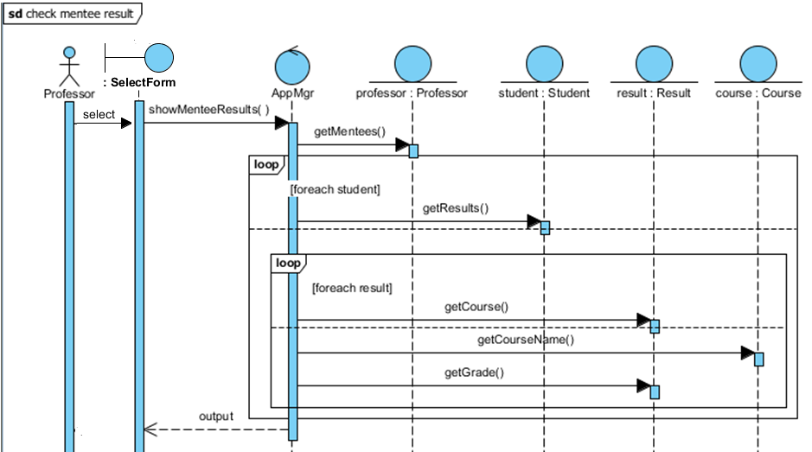
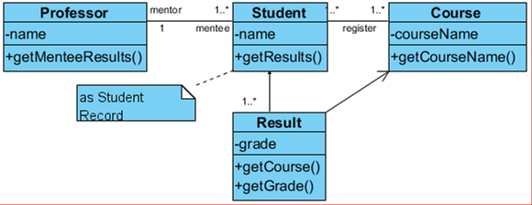
A Short Example
“……..A professor is a mentor to least 1 student. He/she can check the course results of his/her mentees, which the students have registered…..”
x N
Notes:
Here we have an example where you can come up with a class diagram and then probably multiple sequence diagrams depending on the complexity.

Slide 11
A Short Example
“……..A professor is a mentor to least 1 student. He/she can check the course results of his/her mentees, which the students have registered…..”
x N

Slide 12
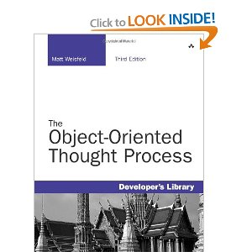
Case Study: A Blackjack Example
Adapted from “The Object-Oriented Thought Process”.
Notes:
If you want to study something related to the assignments, there is a longer example which is the blackjack example. The example has been taken from the reference text Object-Oriented Thought Process.

Slide 13
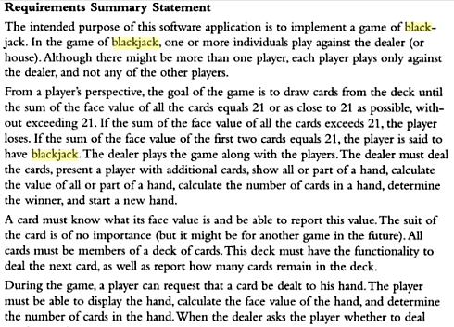

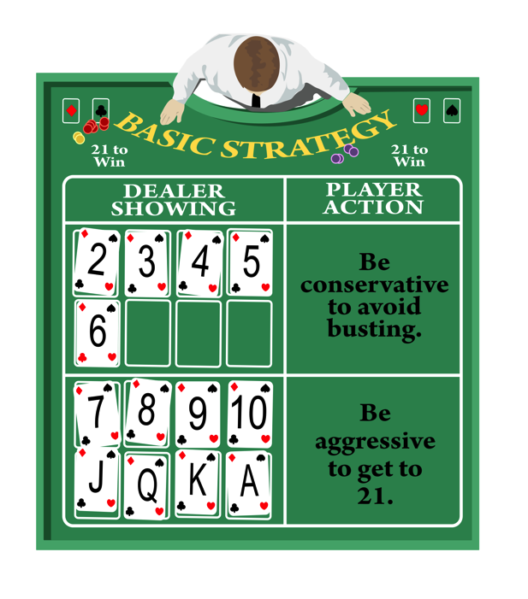
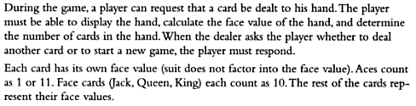
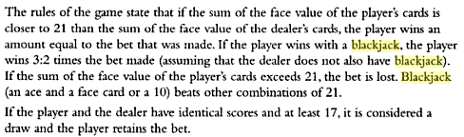
Blackjack Requirement
Click here to view the presentation Blackjack
Notes:
In there is this requirement specification which are going to support with your assignment.
Here we follow the same thing. You go through the list, descriptions and specifications and then find all the nouns. After identifying the nouns, you need to analyse it. Here, even though it is a lot, you will not need these many classes for the applications. You will go through a simple process of eliminating those which are not needed so that you can come up with the class shown in the next slide.
Let us get into more detail.

Slide 14
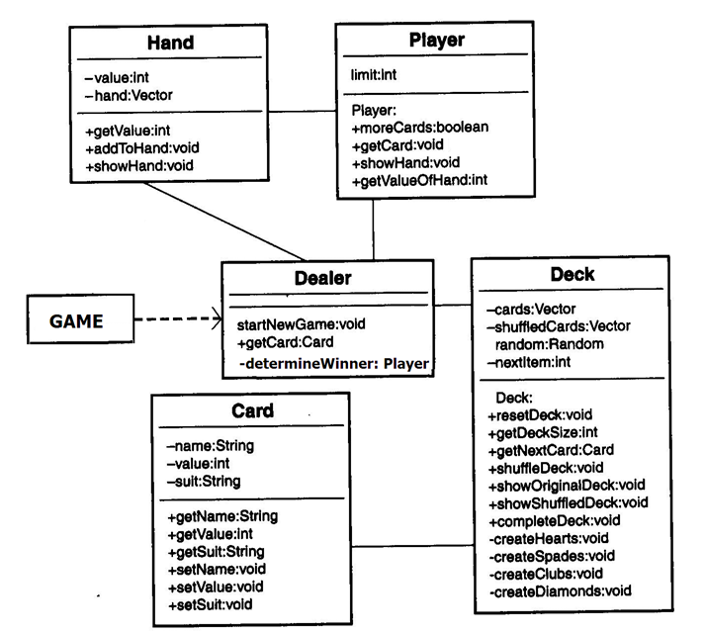
Class Diagram
< show
1
1
1
1..*
show
1
1
give card
deals
52

Slide 15

Objectives
By the end of this chapter, you should be able to:
Explain the steps in creating a design case study to implement a blackjack game in java
Design a java software application based on the game of blackjack

Slide 16

Design Case Study
An example of a blackjack.
A blackjack is also known as twenty one.
Notes:
This work has been adapted from other sources. This will give you a detailed understanding of how to come up with a class diagram.

Slide 17
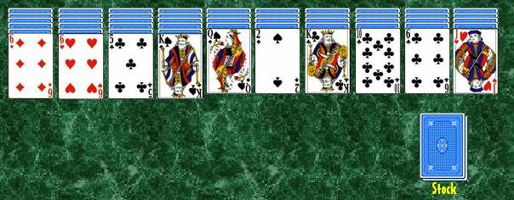
Requirements
The requirement is to design a java software application based on the game of blackjack.
Solitaire. Retrieved December 16, 2016 from
https://upload.wikimedia.org/wikipedia/commons/1/13/Spider_%28solitaire%29.jpg.
Notes:
You must already be familiar with the blackjack game. There will always be a requirement to know what you are supposed to do.

Slide 18
Blackjack Rules
In the game one or more individual players play against the dealer or house.
A player plays against the dealer and not against each other.
Notes:
And certain rules for you to map out the functions of the applications. In this game, each player plays against the dealer.

Slide 19
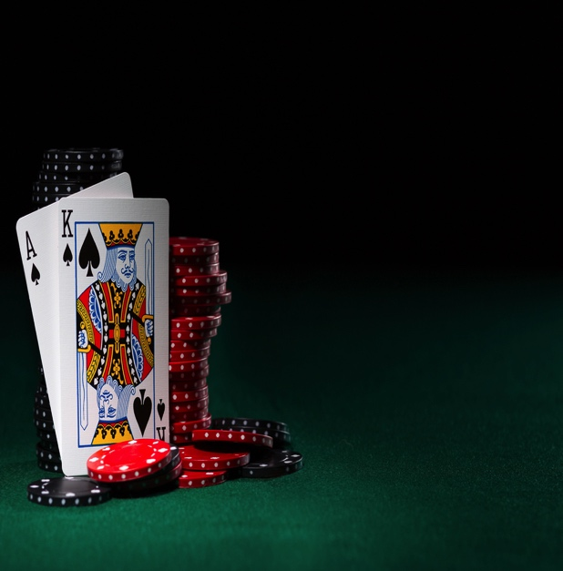
Goal of Game
The blackjack winner`s card value will be equal to 21.
The player draws cards from the deck until the sum of the face value of all the cards is equal to 21.
The player loses if his/her card value is over 21.
Notes:
It is a game about the 21 points. Ultimately, all cards need to add to 21 and not beyond. The winner will be the one with blackjack or 21 points.

Slide 20

Dealer’s Role
The player plays against the dealer.
The dealer:
Deals with the cards.
Presents a player with additional cards if requested.
Shows all or part of a hand.
Calculates the value of all or part of a hand.
Calculates the number of cards in a hand.
Determines a winner and start a new hand.
Notes:
Let us talk about the row of the dealer. The dealer is the main controller of the game. He deals the cards to the players and then distributes the cards further to the players if they need and then check the cards they have in hand and finally decide the winners.

Slide 21
Card
A card must know what its face value is, and be able to report the value. The suit of the card is of no importance. All cards must be a member of a deck of cards. There are 52 cards in a deck. This deck must have the functionality to deal with the next card as well and report on how many cards are there in the deck.
Notes:
Cards have different face values and different suits.

Slide 22

Player
During the game, a player can request that a card be dealt to his hand.
The player must be able to display the hand, calculate the face value of the hand, and determine the number of cards in the hand. The player responds to the dealers request for a new card or start a new game.
Players
Dealer
Notes:
When a player is playing against a dealer, he will need to display the cards to know whether they have won the game

Slide 23
Card
Each card has its own face value.
Suits are no factor in this game.
Aces count as 1 or 11.
Jack, Queen, King count as 10.
The rest of the cards represent their face value.
Notes:
Every card has its own face value which are of four types which are spade, heart, diamond and flowers.

Slide 24
Rules
If the sum of the face value of the player’s card is closer to 21 than the sum of the face value of the dealer’s cards, the player wins an amount equal to the bet that was made. If the player wins with a blackjack, the player wins 3:2 times the bet made. Over 21 is not considered a win.
Notes:
Then you have the rules. These rules are what ultimately becomes a function flow in the application or the system.

Slide 25
Draw
If the player and dealer have identical scores and at least 17, it is considered a draw and the player retains the bet.
Notes:
There is also a minimum. Some constraint needs to be set in the system. For example, a draw means that it has to be atleast 17 points in order to consider a valid winner.

Slide 26
Topic 2: Steps in Designing a Case Study
Notes:
Let’s start with the next topic of this chapter, Steps in Designing a Case Study.

Slide 27
Next Step
Study the requirements again so that you understand them clearly.
Start identifying classes that will be used.

Slide 28
Blackjack CRC
First of all, it’s important for you to know that the first time you start creating CRC cards, they will be changed.
Why? Not all the classes you think you’ll need, will make it to the final cut.

Slide 29
Nouns
Make a list of all the nouns that you’ll be using to play blackjack.

Slide 30
Identify Nouns
Game
Blackjack
Dealer
House
Players
Player
Cards
Card
Deck
Hand
Face value
Suit
Winner
Ace
Face card
King
Queen
Jack
Game
Bet
Notes:
Here we have identified the nouns. You have to go through this list…

Slide 31
Process Of Elimination
Now take a second look at the list and think about the nouns, like they are classes, and start to eliminate some that are not needed.
Also, think about something you might have forgotten.
Notes:
….and then eliminate the ones that you don’t need.

Slide 32
Process Of Elimination
Game
Blackjack
Dealer
House
Players
Player
Cards
Card
Deck
Hand
Face value
Suit
Winner
Ace
Face card
King
Queen
Jack
Game
Bet
(an attribute of Card)
(an attribute of Card)
(cards on hand)
Notes:
Let us go through each individual object. Start with Game. Is game a valid class? Yes it is because it is a class which is going to develop.
What about Blackjack? Blackjack is actually the game. So you can take as an instance of the game where you are naming it as Blackjack.
Now Dealer. Dealer is the main thing. So you will need the class.
What about house? House is actually referring to the dealer, the one who is managing the game. So you don’t need house.
For Players, you don’t need a lot of them but you do need a single player. Players itself is just a collection of player.
You don’t need cards, but you do need a card.
What about Deck? Deck in itself is a collection of cards. You need to have a whole in order to store all the cards for which you need a deck.
What about hand? When you distribute the cards, the individual dealer and player will hold on to certain cards. Hand itself helps in identifying what are the cards on hand held on by the players and the dealer. You ideally need to identify the which cards are being held on by the dealer and which ones by the players.
Face value? It is just the numberings which is not relatable to the cards but the attributes later to the cards.
Suit is also an attribute to the card. Since you know that suits itself are of four types, you might want to identify it as enum later for ease of use.
You don’t need a winner becaue it is decided on the fly upon the games completion.
Ace is the same as face value. The same goes for Face card, King, Queen and Jack. Game is already being repeated.
We will talk about Bet later as we wont need that for this example because you probably think of it as a numerical value as to how much bet you are going to put in.

Slide 33
Explanation
The noun blackjack was eliminated because game is actually the system itself.
House was eliminated because, it’s just another name for the dealer.
Players are eliminated because we just need a single player (class).
Notes:
The noun blackjack was eliminated because game is actually the system itself.
House was eliminated because, it’s just another name for the dealer.
Players are eliminated because we just need a single player (class).

Slide 34
Explanation
Cards not needed just a single card (class).
Face value is really an attribute of the card class.
Suit not needed to play the blackjack game. However, you might want to leave it if you were to use suits in future card games. Our example will leave it out.
Notes:
Cards not needed just a single card (class).
Face value is really an attribute of the card class.
Suit not needed to play the blackjack game. However, you might want to leave it if you were to use suits in future card games. Our example will leave it out.

Slide 35
Explanation
Ace, King, Queen, Jack are better represented as attributes of the card class, instead of individual classes.
Notes:
Ace, King, Queen, Jack are better represented as attributes of the card class, instead of individual classes.

Slide 36
What About Bet?
Originally bet was taken out of the list, but if you really think about it we should leave it in, because of the future card usage.
Notes:
Originally bet was taken out of the list, but if you really think about it we should leave it in, because of the future card usage.

Slide 37
Blackjack Game Picture
Card
Deck
Hand
Dealer
Player
Bet

Slide 38
Identify Class Responsibilities
Responsibilities relate to actions.
Now look for verbs which will lead to responsibilities of classes.
Notes:
So you have to identify all the required classes and the next step is to identify the responsibility of the classes through the actions required by all these classes. One hint is looking for the verbs through which you can identify the what kind of objects or classes can perform what responsibilities.

Slide 39
What do we need to know about a card?
It’s face value
It’s suit (although not needed for blackjack)
Whether it’s a face card, ace, or joker?
Notes:
First you need to figure out what you need to know about the cards? Then you start identifying the attributes and responsibilities. That way you will know if it has a face value suits.

Slide 40
Now on your own
Make a list of verbs that are needed for Deck, Hand, Dealer, Player and Bet.
Notes:
Make a list of verbs that are needed for Deck, Hand, Dealer, Player and Bet.

Slide 41
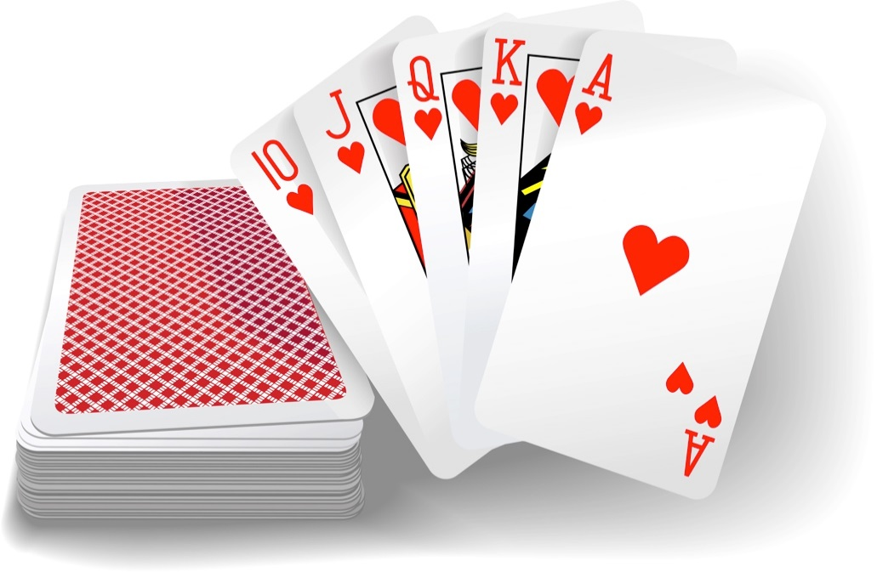
What do we need to know about Deck?
Shuffle
Deal next card
Know how many
Notes:
Deck has a collection of cards . So you need to get the next set of cards from the deck. You will need to identify certain methods from the deck class.

Slide 42
What do we need to know about Hand?
Know how many cards are in the hand
Know the value
Show the hand
Notes:
Then hand-in to show all the cards available on hand.

Slide 43

What do we need to know about Dealer?
Deal the cards
Shuffle deck
Give a card to player
Show the dealer’s hand
Calculate the value of the dealer’s hand
Know the number of cards in the dealer’s hand
Request a card (hit or hold)
Determine a winner
Start a new hand
Notes:
When you see a dealer, you see that a class as a lot of responsibilities. The dealer needs to shuffle the cards, give the cards to the players, if the players request for a card, the dealer has to give them the cards and so on. Ultimately, he will have to decide who is the winner. All this itself can map up into the responsibility of the dealer class and eventually becomes the method of the dealer class.

Slide 44
What do we need to know about Player?
Request a card (hit or hold)
Show the player’s hand
Calculate the value of the hand
Know how many cards are in the hand
Know whether the value is over 21, equal to 21 (blackjack won) or below 21
Notes:
Players can also request for a card, calculate its values, check how many cards he has on hand and know whether the value is over 21, equal to 21 (blackjack won) or below 21 and within the range of 17 to 21and decide whether or not to get additional cards.

Slide 45
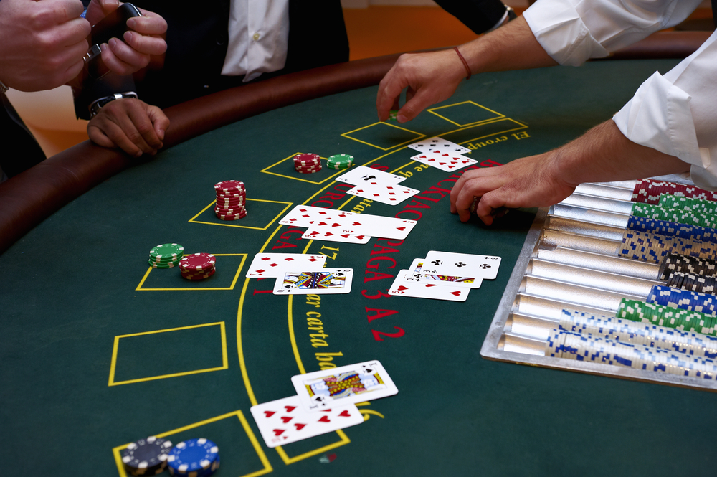
What do we need to know about Bet?
Know the type of bet
Know the value of bet
Know how much the player has left to bet
Know whether the bet can be covered
Notes:
Let us now talk about bet. You know that in a card game, bet can simple be a value where you put a certain value and when you win you get the same amount and more from the dealer. You can also store in different information like the type of bet. There can be different types of bet whereby each of the bet can give you a different multiplier which could be twice or thrice of the value. If you need to have these two kinds of information, you will need to have bet as a class and not just an attribute. At a certain point of time, you need to look at the application itself and figure if you actually need the class or is it just for the future. For this case, you might not need it right now but might need it later so you open it up. At this point of time, you leave it as a simple attribute and not as a class.

Slide 46
Let’s review our verbs
Remember we’re looking for classes and responsibilities.
We don’t rush. We logically review what’s needed and what’s not needed.
Let’s go over what we’ve put down.

Slide 47
Card
It’s face value.
It’s suit (although not needed for blackjack).
Whether it’s a face card, ace, or joker?- No need to have separate responsibilities for face cards aces and jokers but the report value can handle this.

Slide 48
Deck
Shuffle: Needed.
Deal next card: Needed.
Know how many: Needed.
What about? Know whether there is a full deck to begin: Let’s add this responsibly.

Slide 49
Hand- All Needed
Know how many cards are in the hand
Know the value
Show the hand

Slide 50
Dealer
Deal the cards
Shuffle deck
Give a card to player
Show the dealer’s hand
Calculate the value of the dealer’s hand: Rename to ‘Show the value of dealer’s hand’
Know the number of cards in the dealer’s hand
Request a card (hit or hold)
Determine a winner
Start a new hand

Slide 51
Player
Request a card (hit or hold)
Show the player’s hand
Calculate the value of the hand: Rename to ‘Show value of the player’s hand’
Know how many cards are in the hand
Know whether the value is over 21, equal to 21 (blackjack won) or below 21

Slide 52
Bet Class Issues
Know the type of bet
Know the value of bet
Know how much the player has left to bet
Know whether the bet can be covered
This class is not needed at this site, and can be added later if necessary
Notes:
You need to decide that this class is not needed and maybe add it later for other games.

Slide 53
Ready To Create CRC Cards
Now need to identify objects and messages it exchanges using CRC cards.
Class Name:
Superclasses:
Subclasses:
Responsibilities: | Collaborators:
Notes:
Let us now talk about how to identify classes by identifying the nouns and verbs. In the past people used this concept called CRC cards to identify the classes responsibilities. It literally means fiscal cards. In the past it was known to be a useful tool to design a class for projects.

Slide 54
CRC Cards
CRC cards are a useful tool that help design classes that you will use for any project.
Class Name:
Superclasses:
Subclasses:
Responsibilities: | Collaborators:

Slide 55
History on CRC Cards
CRC cards were introduced by Kent Beck and Ward Cunningham in their paper "A Laboratory for Teaching Object-Oriented Thinking" released in OOPLSA '89. Their original purpose was to teach programmers the object-oriented paradigm. When Kent Beck wrote the draft version of their paper, he changed Collaborators to helpers. Ward Cunningham changed it back to Collaborators when he reviewed the paper. The initials of Cunningham's son is CRC.
Notes:
This is just a research done by Kent Beck and Ward Cunningham. Designing a lab exercise to teach the participants the object oriented paradigm was a part of the research. The CRC initially though of by its creator used his child’s initials, but the actual name was not the sons name.

Slide 56
Why Use CRC Cards?
They are portable. No computers are required so they can be used anywhere.
They allow the participants to experience first hand how the system will work. No computer tool can replace the interaction that happens by physically picking up the cards and playing the role of that object.
It is a useful tool for teaching people the object-oriented paradigm.
Notes:
So how does the CRC work? It is basically a fiscal cut. The main purpose of this process is not have any computers where you want each of the participants to play the role of that class. It is just putting the participant in the shoe of the class and think that if I am this class, what will be my responsibility, who do I need to work with. Imagine that in a system itself you have to identify different classes where each of them play their parts to identify the responsibility and classes they are going to interact with and then they call it to discuss together and make it a complete class diagram. This is of course an imaginary thing. We are now trying to make the applications as fast as possible instead of spending two three hours just to go through this process. Going through this process is always there. You don’t actually go through this process but do so mentally where you are analyzing the classes.

Slide 57
Card CRC
Class | CARD
Responsibility |  | Collaborators
Get name |  | Deck
Get value

Slide 58
Deck CRC
Class | DECK
Responsibility |  | Collaborators
Reset deck |  | Dealer
Get deck size |  | Card
Get next card
Shuffle deck
Show deck

Slide 59
Dealer CRC
Class | Dealer
Responsibility |  | Collaborators
Start a new game |  | Hand
Get a card |  | Player
 |  | Deck

Slide 60
Player CRC
Class | Player
Responsibility |  | Collaborators
Want more cards? |  | Hand
Get a card |  | Dealer
Show hand
Get value of hand

Slide 61
Hand CRC
Class | Hand
Responsibility |  | Collaborators
Return value |  | Player
Add a card |  | Dealer
Show hand

Slide 62
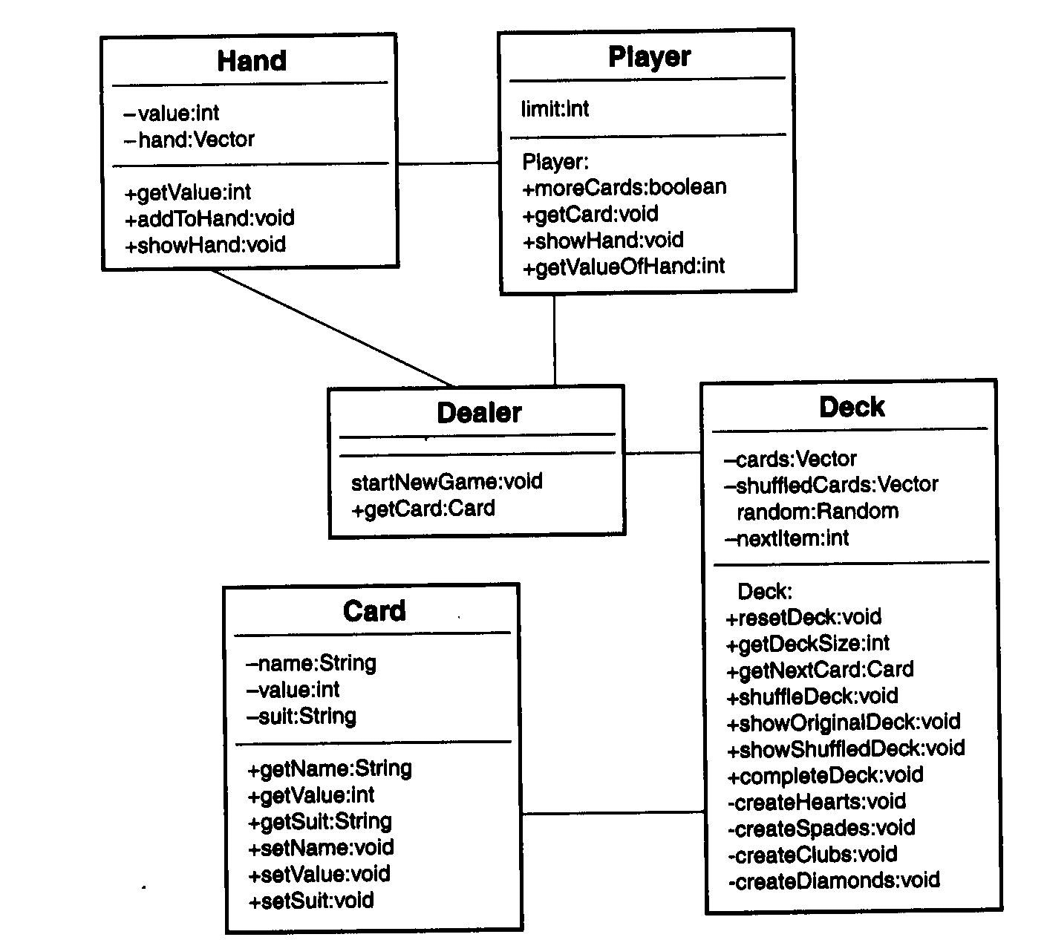
Blackjack UML
Hand
-value:Int
-hand:Vector
+getValue:Int
+addToHand:void
+showHand:void
Player
limit:Int
Player:
+moreCards:boolean
+getCard:void
+showHand:void
+getValueOfHand:int
UML shows structure of class along with attributes and methods.
A plus sign represents whether the attribute or method is public and a minus sign means it’s private.
Deck
-cards:Vector
-shuffledCards:Vector
Random:Random
-nextItem:int
Deck:
+resetDeck:void
+getDeckSize:int
+getNextCard:Card
+shuffleDeck:void
+showOriginalDeck:void
+showShuffleDeck:void
+completeDeck:void
-createHearts:void
-createSpades:void
-createClubs:void
-createDiamonds:void
Dealer
startNewGame:void
+getCard:Card
Card
-name:String
-value:int
-suit:String
+getName:String
+getValue:int
+getSuit:String
+setName:void
+setValue:void
+setSuit:void

Slide 63
What’s next ?
Designing of classes requires further thinking.
Teams are created and much discussion is done to generate good software design.
Is your design complete?
Will there be changes along the way?
Changes do take place but at least what you have here is a start to write the code.
Notes:
45.28

