Slide 1
AI-Based Restoration of Degraded Images for Semiconductor Inspection
Validation Snapshot
PSNR: 11.48
SSIM: 0.111
LPIPS: 0.660
Deep Learning Approach for Noise Removal and Super-Resolution

Slide 2
Problem and Objective
Semiconductor inspection images are often noisy, degraded, and low-resolution.
These degradations hide structural patterns that are critical for defect analysis.
The goal is to recover visually cleaner and more interpretable images in a single pass.
This helps improve downstream inspection and aids automated semiconductor quality review.
Challenge Constraints
• CPU-only environment
• No GPU available
• Real image restoration task

Slide 3
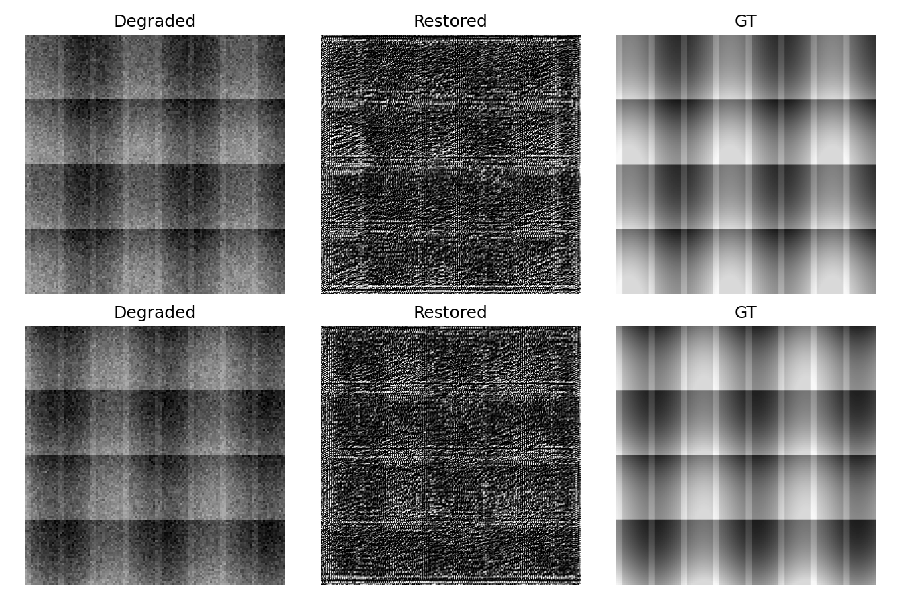
Dataset and Methodology
Paired noisy/ground-truth .npy dataset
Train/validation split from noisy and GT folders
External held-out noisy folder for generalization testing
Input normalization: clip to [0, 1.5], then scale by 1.5
Output target: clean grayscale image in [0, 1] range

Slide 4
Model Architecture
Residual CNN backbone
Instance normalization layers
Pixel-shuffle upsampling head
Single-pass restoration for denoising + super-resolution
Compact and efficient for CPU-based execution

Slide 5
Innovation & Uniqueness
Problem-targeted pipeline: a single-pass model that jointly handles speckle noise, Gaussian blur/noise, and 2x super-resolution.
Key innovation: compact residual SR network trained with semiconductor-specific augmentations that mimic real fab degradations (speckle, blur, intensity shifts).
Loss and training: composite objective (L1 + SSIM + Charbonnier + gradient-preservation) to balance pixel fidelity and structural sharpness.
Competitive advantage: small model (~150k params) with ~0.025s CPU inference — practical for on-line inspection and fast QA loops.
Deployment-ready: single forward pass recovers fine structural detail while suppressing fabrication artifacts, improving defect visibility.
Takeaway
Targeted, lightweight restoration for practical semiconductor inspection.

Slide 6
Conclusion
A working end-to-end image restoration pipeline was implemented for semiconductor inspection images.
The model was validated on real data and also tested on an unseen external noisy folder, confirming practical generalization.
Repository includes training, inference, evaluation, dependency setup, and submission summary for reproducibility.
The project is ready for presentation and further extension with larger models and GPU training.

