Slide 1
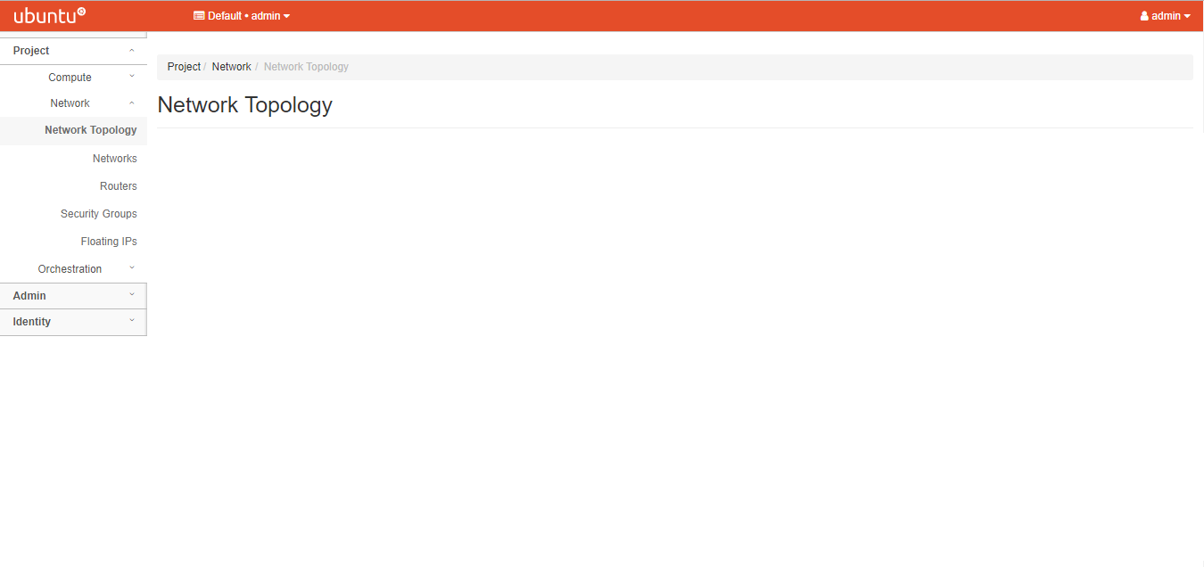
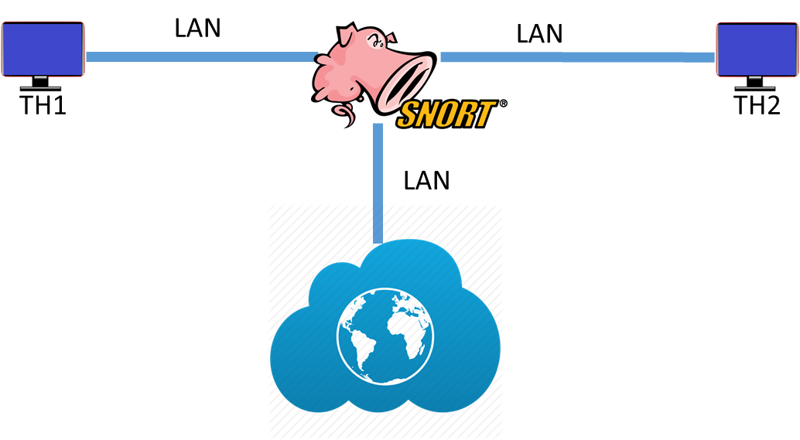
VNF Snort(IPS) Testing
THROUGH KEYWORD DRIVEN APPROACH
192.168.101.11
192.168.102.4
192.168.203.57
net101
net102
192.168.101.4
192.168.102.3
net102
Simple test (End to End)

Slide 2
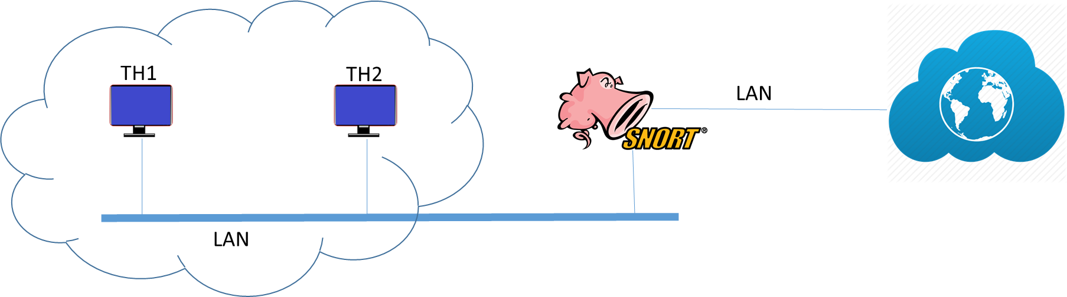
VM Life-Cycle-Management Testing
THROUGH KEYWORD DRIVEN APPROACH
192.168.101.16
192.168.102.8
192.168.203.55
192.168.101.5
192.168.101.3
Multiple hosts covering single firewall interface

Slide 3
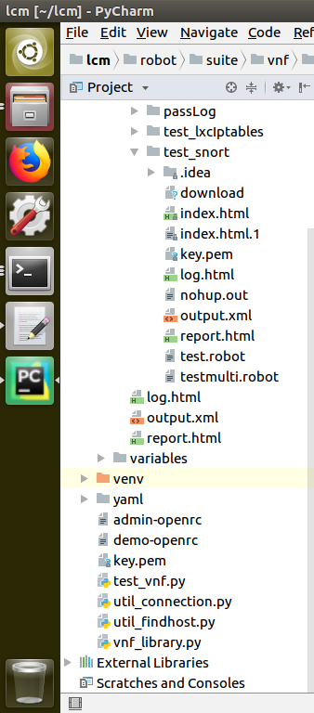
Robot framework design
ROBOT supporting library
Reports / Logs
Keywords, Test Cases and data inputs
Snort Library
Supporting python library

Slide 4
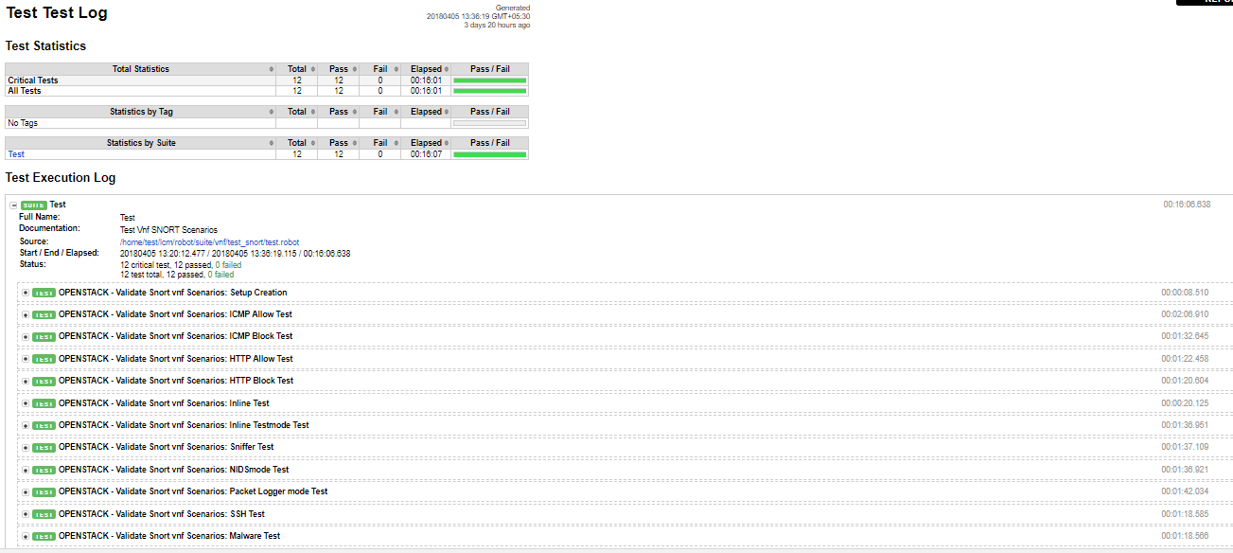
Test Report

Slide 5
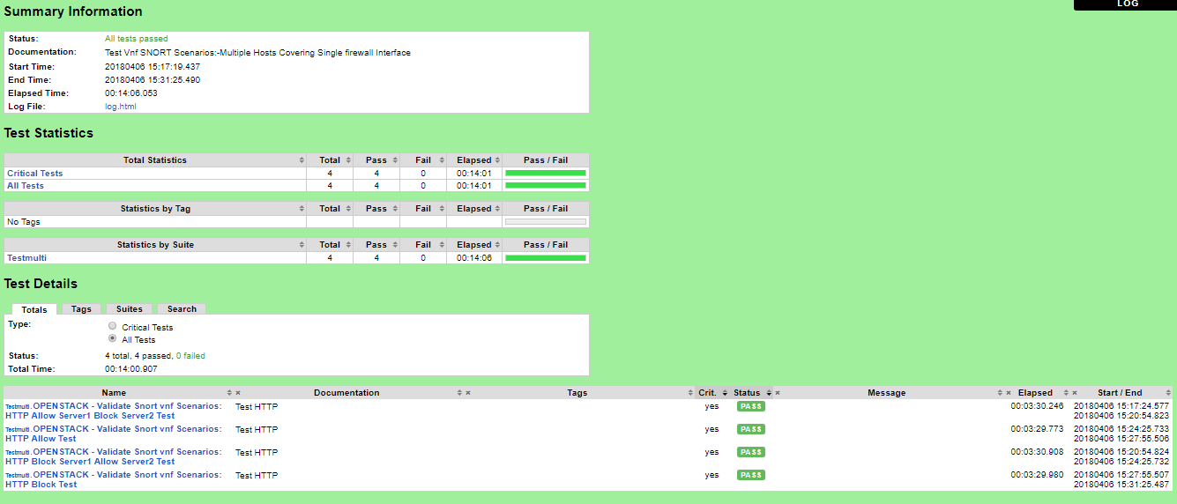
Test Report

Slide 6
Test Cases
END TO END PACKET FLOW VFIREWALL(SNORT)
END TO END PACKET BLOCK VFIREWALL(SNORT)
INGRESS AND EGRESS PACKET FLOW IN NAT MODE OF VFIREWALL(SNORT)
HTTP PACKET BLOCKING/BLOCK INTERNET
ALL ALLOWED/ALL DROP
NIDS MODE TEST
SNIFFER MODE TEST
PACKET LOGGER MODE TEST
PACKET LOGGER READ MODE TEST
INLINE MODE TEST
PASSIVE MODE TEST
INLINE-TEST MODE TEST
HIGH PERFORMANCE CONFIGURATION
MALWARE TEST
SSH TEST
UPGRADE VNF
MULTIPLE HOSTS COVERING A SINGLE FIREWALL INTERFACE(HTTP TEST/ALLOW TH1)
MULTIPLE HOSTS COVERING A SINGLE FIREWALL INTERFACE(HTTP TEST/ALLOW TH2)
MULTIPLE HOSTS COVERING A SINGLE FIREWALL INTERFACE(HTTP TEST/ALL BLOCK)
MULTIPLE HOSTS COVERING A SINGLE FIREWALL INTERFACE(HTTP TEST/ALL ALLOW)

Slide 7
Tested Images
UBUNTU

Slide 8
Debiprasanna Mohanty
Debiprasanna.m@happiestminds.com

