Slide 1
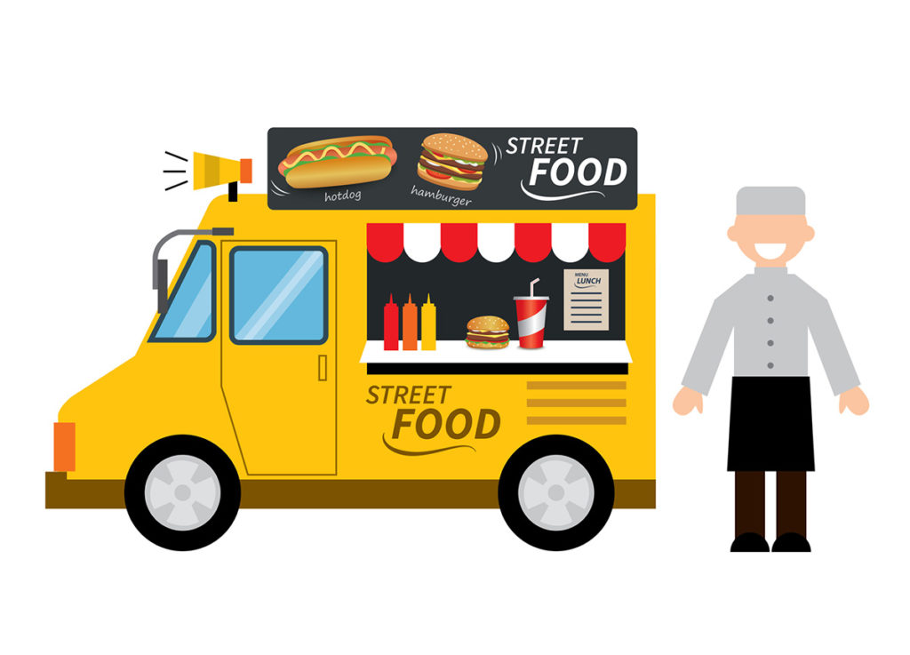
Battle of Neighbourhoods for Food Truck Establishment in Bangalore
Lekha KB

Slide 2

Introduction
Food culture that exists in Bangalore has opened to a wide range of varieties catering to the different people hailing from different cultures.
. Day by day many restaurants, cafes and bars are becoming innovative and creative in their form of delivery for customer satisfaction.
One of those trendy and innovative concepts is “Food Trucks”.

Slide 3
Target Audience
Entrepreneurs who have a skilled minset in building a food business.
Anyone who wants to open a highly competitive and affordable food truck with a passion for street food.

Slide 4
Workflow
Find the list of areas in and around bangalore
Collect the already existing food truck venues using Foursquare.
Unsupervised learning ,K-means clustering algorithm wil be used for the analysis.
average of all the food truck locations were found .
the local minimum of distance to every point was pin pointed .

Slide 5

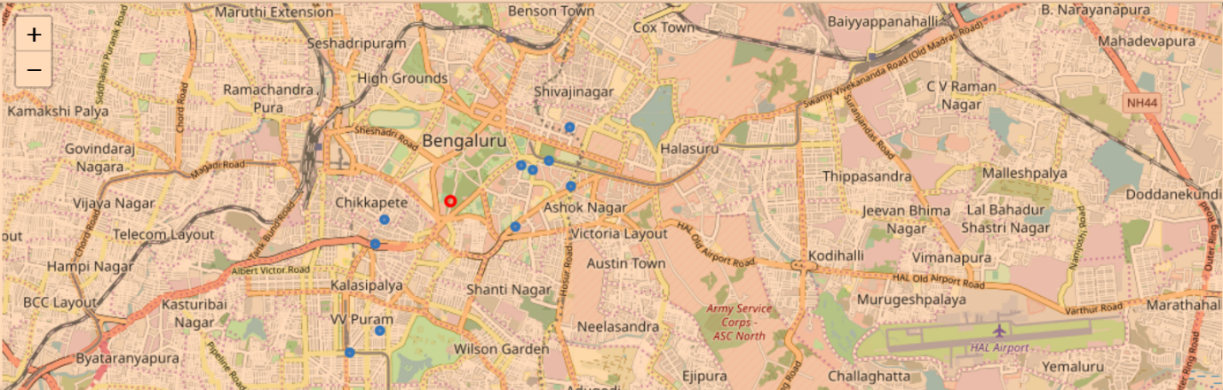
The location is ideal as it is been surrounded by the most famous Cubbon park, Kanteerava stadium and St.John’s College of Bangalore.

Slide 6
Conclusions
Using Foursquare API, a good amount of possible venues was considered .
Excellent Location was pin pointed for our establishment.
This model can be used for any other business idea.

