Slide 1

195 Questions · For: Boards

Slide 2
68% of nitric acid in water
A. Has zero enthalpy of mixing
B. Cannot be separated by distillation
C. Follows Raoult's Law
D. Has zero volume change of mixing

Slide 3
A. 1
B. 2
C. 3
D. 4

Slide 4
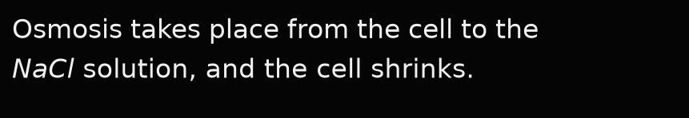
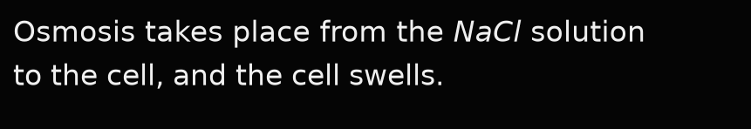
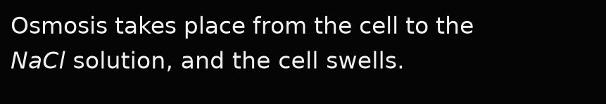
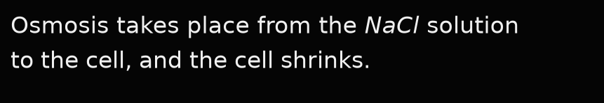
A.
B.
C.
D.

Slide 5
De-salination of sea water can be done by
A. Dialysis
B. Hypertonic solution
C. Evaporation
D. Reverse osmosis

Slide 6
During osmosis, the solvent molecules are moving from
A. Hypertonic solution to isotonic solution
B. Hypertonic solution to hypotonic solution
C. Higher concentrated solution to lower concentrated solution
D. Hypotonic solution to hypertonic solution

Slide 7




A.
B.
C.
D.

Slide 8
If abnormal molar mass is more than normal molar mass, the Van't Hoff factor (i) is
A. i > 1
B. i = 1
C. i < 1
D. i ≥ 1

Slide 9
In a solution containing a non-volatile solute, the mole fraction of solvent is 0.9. The relative lowering of vapor pressure is
A. 1
B. 0.1
C. 0.9
D. 1.1

Slide 10
Isotonic solutions have the same
A. Surface tension
B. Vapour pressure
C. Osmotic pressure
D. Viscosity

Slide 11
Pick out the ideal solution among the following
A. Phenol and Aniline
B. Ethanol and Acetone
C. Chloroform and Acetone
D. n-Hexane and n-Heptane

Slide 12
The concentration term depends on temperature is
A. ppm
B. mole fraction
C. molality
D. molarity

Slide 13
The condition caused when scuba divers go into deep sea water is
A. Anoxia
B. Hemophilia
C. Bends
D. None

Slide 14
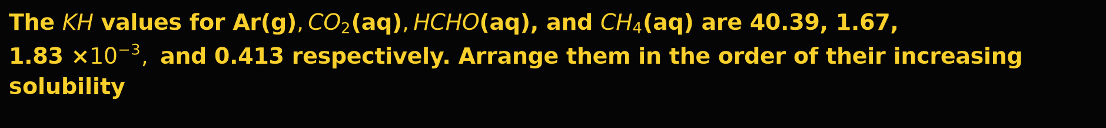
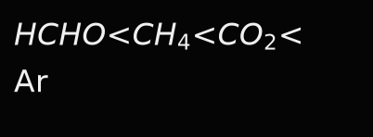
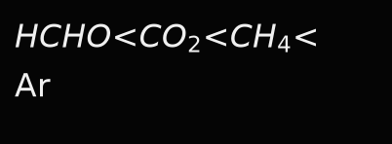
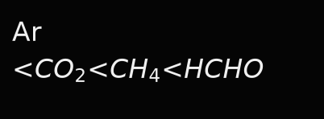
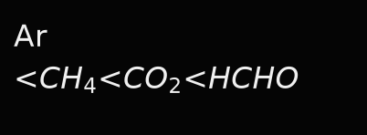
A.
B.
C.
D.

Slide 15
The dissolution of a gas in a liquid is governed by
A. Roult's law
B. Henry's law
C. Dalton's law of Pressure
D. Boyle's law

Slide 16
The maximum amount of a solid solute that can be dissolved in a specific amount of a given liquid solvent does not depend upon
A. Nature of solvent
B. Pressure
C. Nature of solute
D. Temperature

Slide 17
The mixture which shows positive deviation from Raoult's law is
A. Ethanol + Acetone
B. Benzene + Toluene
C. Acetone + Chloroform
D. Chlorobenzene + Bromoethane

Slide 18
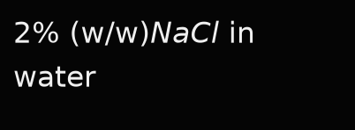



A.
B.
C.
D.

Slide 19
The pressure cooker reduces the cooking timing because
A. Heat is more evenly distributed
B. The boiling point of water inside the cooker is elevated
C. The boiling point of water inside the cooker is depressed
D. Higher pressure inside the cooker tenderizes food

Slide 20
The solubility of a gas in water depends on
A. Nature of the gas
B. Temperature
C. Pressure of the gas
D. All of the above

Slide 21
The solubility of a solid gas does not depend on
A. Nature of the solute
B. Nature of the solvent
C. Pressure
D. None of these

Slide 22
The solution which has lower osmotic pressure with respect to another is called
A. Isotonic solution
B. Hypertonic solution
C. Hypotonic solution
D. None of these

Slide 23
The solutions which show a large positive deviation from Raoult's law form
A. Minimum boiling point azeotrope
B. Maximum boiling point azeotrope
C. Minimum or maximum boiling point azeotrope
D. No azeotrope

Slide 24
A. 88.3%
B. 56.2%
C. 32.1%
D. 11.7%

Slide 25
A. Greater for gases with higher solubility.
B. Greater for gases with lower solubility.
C. Constant for all gases.
D. Not related to the solubility of gases.

Slide 26
A. Increases with increase in temperature
B. Decreases with increase in temperature
C. Remains constant
D. First increases, then decreases

Slide 27
When a substance is dissolved in a solvent, the vapor pressure for the solvent is decreased. This results in
A. The solution having a lower osmotic pressure than the solvent
B. A decrease in the boiling point of the solvent
C. The solution having a higher freezing point than the solvent
D. An increase in the boiling point of the solution

Slide 28




Which of the following aqueous solutions should have the highest boiling point?
A.
B.
C.
D.

Slide 29
Which of the following liquid-liquid solutions show negative deviation from Raoult's law?
A. Benzene and Toluene
B. Water and Ethanol
C. Acetone and Chloroform
D. Chlorobenzene and Bromobenzene

Slide 30
Which of the following solutions is used as an antifreezing agent in car radiators to cool the engine?
A. 35% (v/v) solution of ethylene glycol
B. 35% (m/m) solution of ethylene glycol
C. 35% (m/v) solution of ethylene glycol
D. 35% (v/m) solution of ethylene glycol

Slide 31
Which one of the following is not a solid solution?
A. Hydrogen in palladium
B. Camphor in nitrogen gas
C. Amalgam of mercury & sodium
D. Copper in gold

Slide 32
A galvanic cell has an electrical potential of 1.1 V. If an opposing potential of 1.1 V is applied to this cell, what will happen to the cell reaction and current flowing through the cell?
A. The reaction stops and no current flows through the cell.
B. The reaction continues but current flows in the opposite direction.
C. The concentration of reactants becomes unity and current flows from cathode to anode.
D. The cell does not function as a galvanic cell and zinc is deposited on the zinc plate.

Slide 33
An electrochemical cell can behave like an electrolytic cell when
A. Ecell = 0
B. Ecell > Eext
C. Ecell < Eext
D. Ecell = Eext

Slide 34
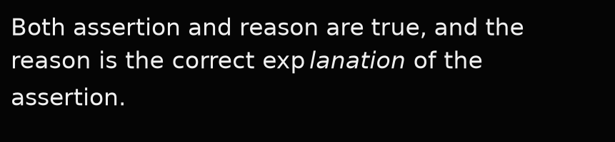
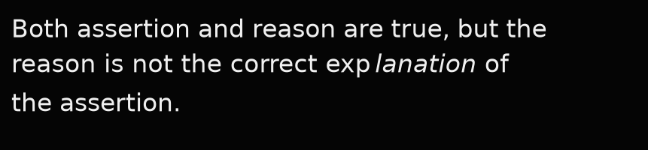
Assertion: The specific conductivity decreases with dilution. Reason: The number of ions per unit volume that carry the current in a solution decreases on dilution.
A.
B.
C. Assertion is true, but the reason is false.
D. Both assertion and reason are false.

Slide 35
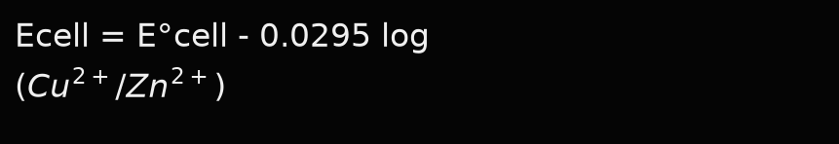

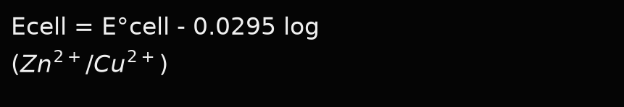

Ecell of Daniel cell is calculated by using the following formula
A.
B.
C.
D.

Slide 36

Fluorine has the highest standard electrode potential, indicating that fluorine gas is
A. Strongest reducing agent
B. Strongest oxidizing agent
C. Weak oxidizing agent
D.

Slide 37
If the E0cell for a given reaction has a negative value, then which of the following is the correct relationship for the value of ΔG0 and Keq?
A. ΔG0>0 and Keq>1
B. ΔG0<0 and Keq<1
C. ΔG0>0 and Keq<1
D. ΔG0<0 and Keq>1

Slide 38
In a galvanic cell
A. Chemical energy is converted into heat
B. Electrical energy is converted into heat
C. Chemical energy is converted into electrical energy
D. Electrical energy is converted into chemical energy

Slide 39
Match the batteries in
(i) Leclanché cell
(ii) Mercury cell
(iii) Lead storage battery
A. i-a, ii-b, iii-c, iv-d
B. i-b, ii-a, iii-d, iv-c
C. i-c, ii-d, iii-a, iv-b
D. i-d, ii-c, iii-a, iv-b

Slide 40
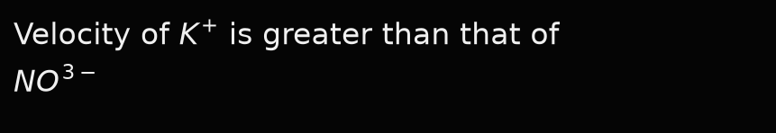
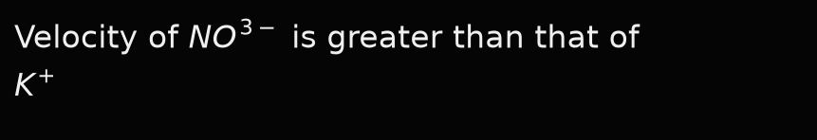


A.
B.
C.
D.

Slide 41
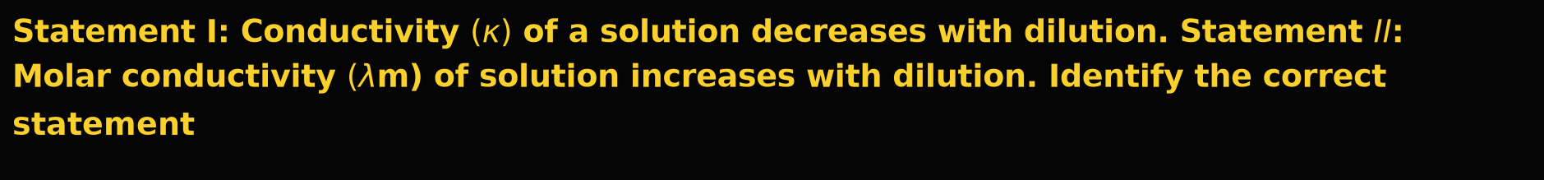




A.
B.
C.
D.

Slide 42



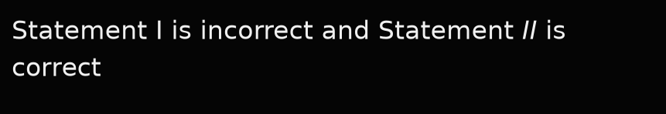
A.
B.
C.
D.

Slide 43
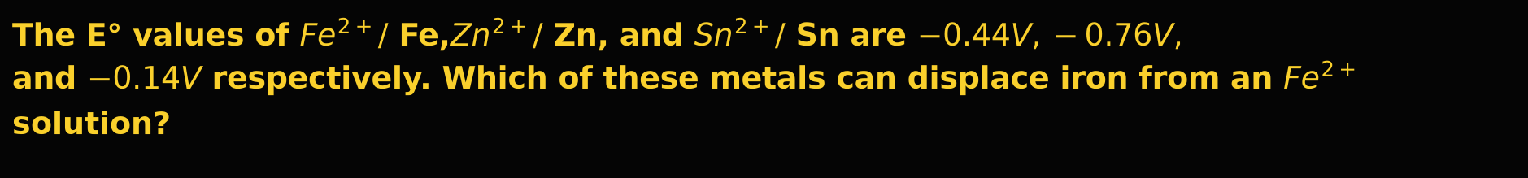
A. Both Zn and Sn
B. Zn only
C. Sn only
D. Neither Zn nor Sn

Slide 44
The molar conductivity is maximum for the solution of concentration
A. 0.005 M
B. 0.001 M
C. 0.004 M
D. 0.002 M

Slide 45



A.
B.
C. Na
D.

Slide 46
A. 1 Faraday
B. 2 Faraday
C. 3 Faraday
D. 4 Faraday

Slide 47
What will happen in the Daniel cell, when Eext<1.1 V?
A. Electrons flow from Zn rod to Cu rod; hence current flows from Cu to Zn
B. Electrons flow from Cu rod to Zn rod; hence current flows from Cu to Zn
C. Electrons flow from Zn rod to Cu rod; hence current flows from Zn to Cu
D. Electrons flow from Cu rod to Zn rod; hence current flows from Zn to Cu

Slide 48




When one Faraday current is passed, which of the following would deposit one-gram atomic mass of the metal?
A.
B.
C.
D.

Slide 49
Which of these statements about a galvanic cell are not true? i) The cathode carries a positive sign. ii) Oxidation occurs at the anode. iii) Electrons flow from cathode to anode in the external circuit. iv) The anode carries a negative sign
A. i and iii
B. i and ii
C. ii and iii
D. ii and iv

Slide 50
Acid hydrolysis of ethyl acetate is an example of
A. Zero order reaction
B. First order reaction
C. Second order reaction
D. Pseudo first order reaction

Slide 51
All natural and artificial radioactive decay of unstable nuclei take place by
A. Zero order kinetics
B. Half-order kinetics
C. First-order kinetics
D. Second-order kinetics

Slide 52

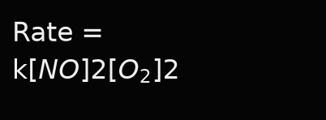
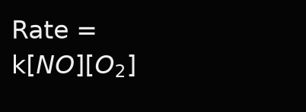
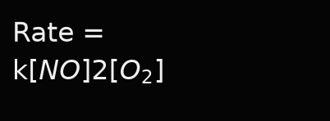
A.
B.
C.
D.

Slide 53
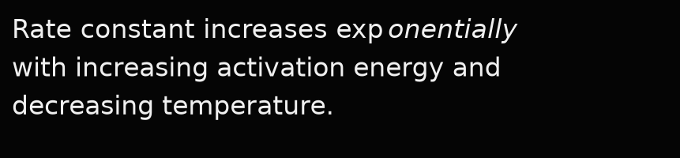
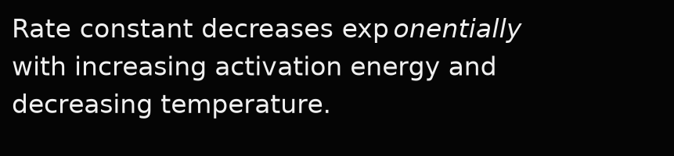

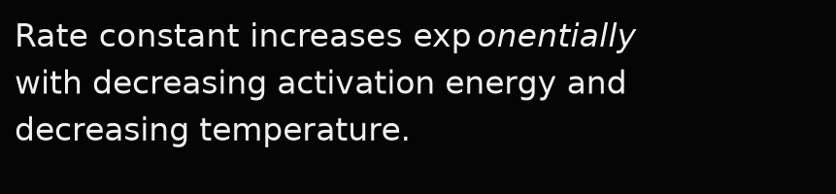
A.
B.
C.
D.

Slide 54
For a chemical reaction A → B, it is found that the rate of a reaction doubles when the concentration of A is doubled. The order of the reaction is
A. One
B. Two
C. Zero
D. Three

Slide 55


For a zero-order reaction, the intercept for the plot of concentration of reactants vs. time is equal to
A. -k
B. log k
C.
D.

Slide 56
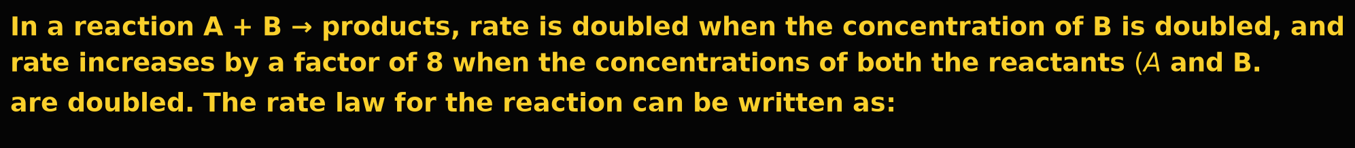




A.
B.
C.
D.

Slide 57
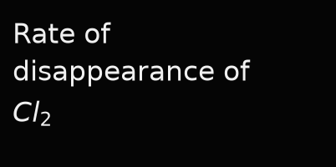
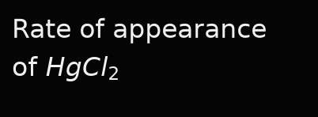
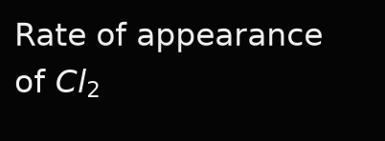
A.
B.
C.
D. Both (a) and (b)

Slide 58
In a reaction, when the concentration of a reactant is increased two times, the increase in the rate of reaction was four times. The order of the reaction is
A. First order
B. Zero order
C. Pseudo first order
D. Second order

Slide 59
In presence of a catalyst, the heat evolved or absorbed during the reaction
A. Increases
B. Decreases
C. Depends on the reaction
D. Remains unchanged

Slide 60
Order of a reaction in which unit of rate of reaction and rate constant are the same
A. 0
B. 1
C. 1 2
D. 2

Slide 61


Statement I: A catalyst does not alter Gibb’s energy (ΔG) of a reaction. Statement II: A catalyst alters the activation energy (Ea) of a reaction by providing an alternate pathway.
A.
B.
C.
D.

Slide 62
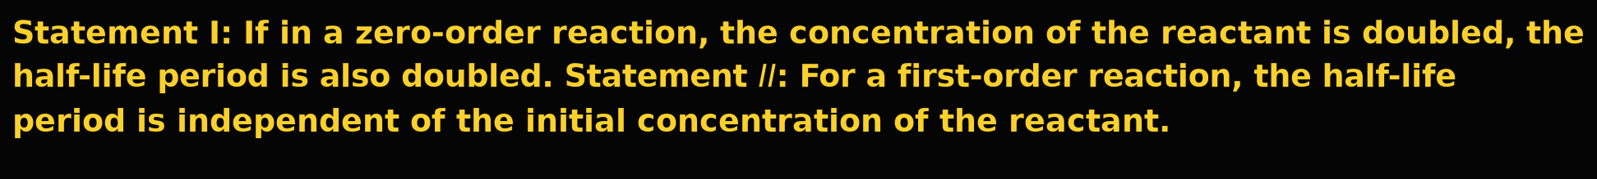

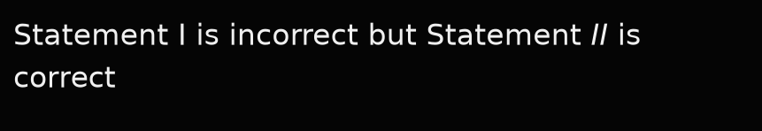
A.
B.
C.
D.

Slide 63
The collision frequency in a reaction depends on
A. Number of moles of reactants
B. Proper orientation
C. Activated reactant molecules
D. Both (b) and (c)

Slide 64
The following factor which does not affect the rate of reaction is
A. Molecularity
B. Temperature
C. Catalyst
D. Concentration of reactant

Slide 65
The half-life period of a first-order reaction is 15 minutes. The amount of substance left after one hour will be
A. One-half
B. One-fourth
C. One-eighth
D. One-sixteenth

Slide 66
The molecularity of a reaction cannot be
A. Zero
B. One
C. Both (a) and (b)
D. Whole number

Slide 67
A. Collision energy
B. Activation energy
C. Collision frequency
D. Kinetic energy

Slide 68
A. 1
B. 2
C. 1 2
D. 1 4

Slide 69
A. ½
B. 2
C. 3 2
D. 1

Slide 70
A. Zero
B. Fraction
C. One
D. Two

Slide 71
A. Zero
B. One
C. Two
D. Three

Slide 72




The S.I. unit of the rate constant of a first-order reaction is
A.
B.
C.
D.

Slide 73
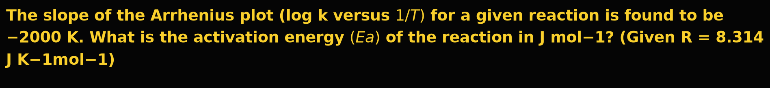
A. 38,314.5 J mol−1 (or 38.3 kJ mol−1)
B. 19,157.2 J mol−1
C. 76,629.0 J mol−1
D. 8,314.0 J mol−1

Slide 74




The time required for 100 percent completion of a zero-order reaction is
A.
B.
C.
D.

Slide 75
The unit of the rate constant of a reaction is the same as that of its rate. The order of the reaction is
A. Zero order.
B. First order.
C. Second order.
D. Pseudo order.

Slide 76
A. ½
B. 3/2
C. 4
D. 1

Slide 77
When the initial concentration of the reactant is doubled, then the half-life of a zero-order reaction
A. Is halved
B. Is doubled
C. Is tripled
D. Remains unchanged

Slide 78
Which of the following factors does not affect the rate of reaction?
A. Molecularity
B. Temperature
C. Catalyst
D. Concentration of reactant

Slide 79




Which of the following is correct for a zero-order reaction?
A.
B.
C.
D.

Slide 80
Actinoids are
A. Radioactive
B. Prepared in nanograms
C. Having smaller half-lives
D. All the above are correct

Slide 81



A.
B.
C.
D. All the above

Slide 82




Diamagnetic compound among the following is
A.
B.
C.
D.

Slide 83




Identify the correct sequence of the number of unpaired electrons of the following ions.
A.
B.
C.
D.

Slide 84
A. +7 to +2
B. +7 to +4
C. +6 to +4
D. +7 to +6

Slide 85
A. Oxidation
B. Reduction
C. Disproportionation
D. Redox reaction

Slide 86



A. S
B.
C.
D.

Slide 87




A.
B.
C.
D.

Slide 88
The characteristic feature of transition metal is
A. They show variable oxidation state
B. They do not form complexes
C. They are not good catalysts
D. They exhibit only diamagnetism

Slide 89




The correct order of magnetic moment is
A.
B.
C.
D.

Slide 90
The correct order of melting point is
A. Cr > Mn > Fe
B. Fe > Mn > Cr
C. Cr > Fe > Mn
D. Mn > Fe > Cr

Slide 91



A.
B.
C. Stability of both depends upon the nature of their salts.
D.

Slide 92
A. 2
B. 3
C. 1
D. 0

Slide 93



The most stable manganese compound is
A.
B.
C.
D.

Slide 94
A. 1/3
B. 3
C. 1/6
D. 6

Slide 95
The set of 3d series elements that show anomalous electronic configurations are
A. Cr and Mn
B. Cu and Zn
C. Cr and Cu
D. Mn and Zn

Slide 96
The transition metal present in bronze is
A. Zinc
B. Tin
C. Silver
D. Copper

Slide 97
The transition metal present in the red pigment of blood haemoglobin is
A. cobalt
B. Nickel
C. Iron
D. copper

Slide 98
Which of the following actinoids show oxidation states up to +7?
A. Am (Americium)
B. Th (Thorium)
C. U (Uranium)
D. Np (Neptunium)

Slide 99




Which of the following ions has the least magnetic moment?
A.
B.
C.
D.

Slide 100




Which of the following is a colorless ion?
A.
B.
C.
D.

Slide 101




Which of the following pairs have the same paramagnetic moment? (Atomic numbers: Ti = 22, Mn = 25, Ni = 28, Cu = 29)
A.
B.
C.
D.

Slide 102
Which of the following statements about transition elements is incorrect?
A. They show variable oxidation states.
B. All the ions are colored.
C. They exhibit diamagnetic and paramagnetic properties.
D. They exhibit catalytic properties.

Slide 103

Which of the following transition metal ions is colorless?
A.
B.
C.
D.

Slide 104
A mixture of chloromethane and chlorobenzene are treated with sodium in dry ether, the product obtained is
A. Ethane
B. Toluene
C. Diphenyl
D. All the above

Slide 105
A. R-I
B. R-Cl
C. R-F
D. R-Br

Slide 106
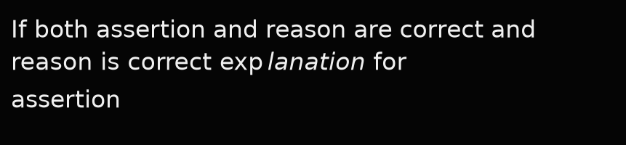
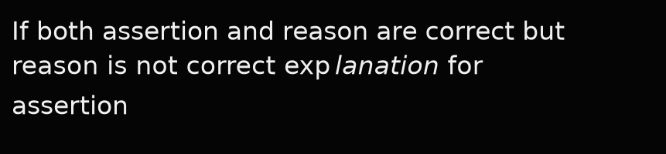
A.
B.
C. If assertion is correct but reason is incorrect
D. If assertion is incorrect but reason is correct

Slide 107




Chlorobenzene reacts with magnesium in dry ether to give a compound A, which is
A.
B.
C.
D.

Slide 108
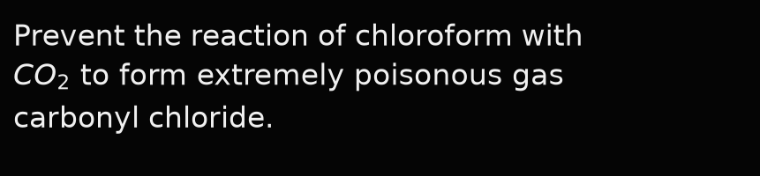
Chloroform is stored completely filled in a closed dark-colored bottle. This is to
A. Prevent the oxidation of chloroform by air in the presence of sunlight.
B. Prevent the evaporation of chloroform.
C. Prevent the reaction of chloroform with nitrogen in the air.
D.

Slide 109




Four haloalkane compounds represented by the letters M, N, O, and P having boiling points of 24.2°C, 38°C, 3.56°C, and 101.6°C respectively. Among the four compounds, N is most likely to be
A.
B.
C.
D.

Slide 110
Freon can be prepared by
A. Finkelstein reaction
B. Wurtz reaction
C. Friedel-Crafts reaction
D. Swartz reaction

Slide 111
In vinylic halides, the halogen atom is attached to a carbon atom with
A. sp3 hybridization
B. sp2 hybridization
C. sp hybridization
D. dsp2 hybridization

Slide 112
Match the organic compounds in
A.
B.
C.
D.

Slide 113
A. Wurtz reaction
B. Fittig reaction
C. Swarts reaction
D. Finkelstein reaction

Slide 114
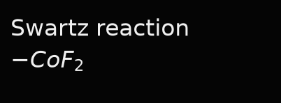
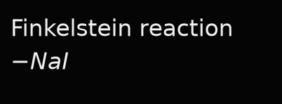
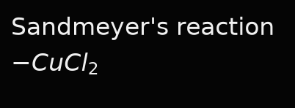
Select the incorrect match
A.
B.
C.
D. Wurtz reaction - Na / dry ether

Slide 115
A. Inductive effect
B. Steric effect
C. Resonance effect
D. Electrometric effect

Slide 116




The best reagent used to produce pure alkyl halides from alcohol is
A.
B.
C.
D.

Slide 117



The chemical formula of phosgene is
A.
B.
C.
D.

Slide 118
The chemical name of phosgene is
A. Acetyl chloride
B. Methyl chloride
C. Carbonyl chloride
D. Chloroform

Slide 119
The chiral molecule among the following is
A. 1-Bromo butane
B. 2-Bromobutane
C. 2-Bromo propane
D. 2-Bromopropan-2-ol

Slide 120
A. Allylic halides
B. Aryl halides
C. Benzylic halides
D. Vinylic halides

Slide 121




The increasing order of boiling points of alkyl halides is
A.
B.
C.
D.

Slide 122
A. 1-Chloroethene
B. 1-Chloroethyne
C. 1,2-Dichloroethane
D. 1,1-Dichloroethane

Slide 123
A. Swarts reaction
B. Wurtz reaction
C. Finkelstein reaction
D. Gattermann reaction

Slide 124
When 2-Bromo pentane is treated with alcoholic potash, the major product produced is
A. 1-Pentene
B. 2-Pentene
C. 2-Pentane
D. 3-Pentene

Slide 125




A.
B.
C.
D.

Slide 126
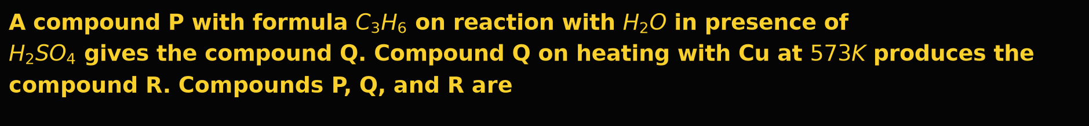
A. P = Propan-1-ol, Q = Propene, R = Propanone
B. P = Propene, Q = Propan-2-ol, R = Propene
C. P = Propene, Q = Propan-2-ol, R = Propanone
D. P = Propanone, Q = Propan-1-ol, R = Propane

Slide 127
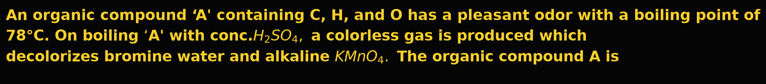




A.
B.
C.
D.

Slide 128
By which test can 1°, 2°, and 3° alcohols be detected?
A. Hinsberg test
B. Tollen's test
C. Lucas test
D. All of these

Slide 129
Byproduct obtained during preparation of phenol from cumene is
A. Ketone
B. Aldehyde
C. Alcohol
D. Cresol

Slide 130
Enantiomers only differ with respect to
A. Melting point
B. Boiling point
C. Refractive index
D. The rotation of plane-polarized light

Slide 131
Ethane-1,2-diol is an example of
A. Monohydric alcohol
B. Dihydric alcohol
C. Dihydric phenol
D. Monohydric phenol

Slide 132
A. Aromatic amine
B. Aromatic hydroxyl compound
C. Aromatic dihydroxy compound
D. Aromatic nitro compound

Slide 133
Halogenation of benzene occurs in the presence of Lewis acid, but halogenation of phenol occurs even in the absence of Lewis acid due to
A. Highly deactivating effect of -OH group attached to the benzene ring
B. Highly activating effect of -OH group attached to the benzene ring
C. Highly deactivating effect of the benzene ring
D. Highly activating effect of the benzene ring

Slide 134
A. 1
B. 2
C. 3
D. 4

Slide 135




Identify the simple ether from the following
A.
B.
C.
D.

Slide 136
In Kolbe's reaction, phenol is converted into
A. Salicylic acid
B. Salicylaldehyde
C. Benzoic acid
D. Benzaldehyde

Slide 137
In picric acid
A. Three -OH groups are present
B. Two -OH groups are present
C. Three -NO2 groups are present
D. One -NO2 group is present

Slide 138
O-nitrophenol and p-nitrophenol are separated by
A. Sublimation
B. Fractional distillation
C. Crystallization
D. Steam distillation

Slide 139
Phenol is less acidic than
A. o-Nitrophenol
B. Ethanol
C. o-Methylphenol
D. o-Methoxyphenol

Slide 140
Phenol is more acidic than
A. Ethanol
B. o-Nitrophenol
C. m-Nitrophenol
D. p-Nitrophenol

Slide 141
Phenol on oxidation with chromic acid gives
A. Benzoquinone
B. Catechol
C. Hydroquinone
D. Phthalic acid

Slide 142
Salicylaldehyde can be prepared by
A. Finkelstein reaction
B. Dow's process
C. Reimer-Tiemann reaction
D. Kolbe's reaction

Slide 143
The boiling points of alcohols increase with
A. Increase in the number of C-atoms
B. Decrease in van der Waals forces
C. Increase of branching in the C-chain
D. Decrease in the surface area of the C-chain

Slide 144
The C-O bond angles of P, Q, and R are found to be 111.7°, 109°, and 108.9°, respectively. Compound P, Q, and R are
A. P = Phenol, Q = Methanol, R = Methoxy Methane
B. P = Methoxy Methane, Q = Methanol, R = Phenol
C. P = Methanol, Q = Phenol, R = Methoxy Methane
D. P = Methoxy Methane, Q = Phenol, R = Methanol

Slide 145
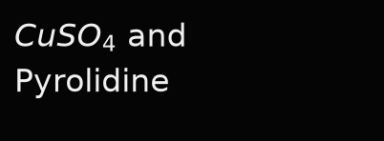
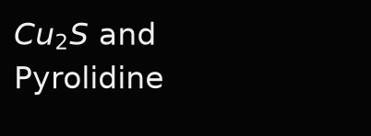
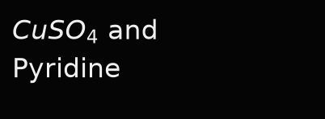
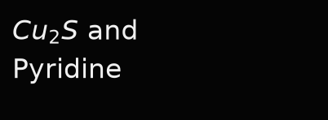
The chemicals used to convert commercial alcohol into denatured alcohol are
A.
B.
C.
D.

Slide 146
The compound that reacts fastest with Luca’s reagent at room temperature is
A. 2-Methylpropan-2-ol
B. Butan-2-ol
C. 2-Methylpropan-1-ol
D. Butan-1-ol

Slide 147
The correct order of acid strength of the following compounds is: (i) o-bromophenol (ii) p-bromophenol (iii) picric acid (2,4,6-trinitrophenol) (iv) 2,4,6-tribromophenol
A. (iii) > (iv) > (i) > (ii)
B. (iii) > (iv) > (ii) > (i)
C. (iv) > (iii) > (i) > (ii)
D. (i) > (ii) > (iv) > (iii)

Slide 148
The decreasing order of boiling points of ethanol, propane, and dimethyl ether is
A. Ethanol > Dimethyl ether > Propane
B. Ethanol > Propane > Dimethyl ether
C. Propane > Dimethyl ether > Ethanol
D. Propane > Ethanol > Dimethyl ether

Slide 149

A. Intra-molecular hydrogen bonding
B. Inter-molecular hydrogen bonding
C.
D. None of these

Slide 150
The major byproduct during the preparation of phenol from cumene is
A. Acetone.
B. Cresol.
C. Alcohol.
D. Acetaldehyde.

Slide 151
The major product formed when phenol is treated with excess bromine water is
A. o-Bromophenol
B. p-Bromophenol
C. Picric acid
D. 2,4,6-Tribromophenol

Slide 152
A. acts as catalyst
B. act as nucleophile
C. act as weak electrophile
D. act as strong electrophile.

Slide 153
What is the correct order of boiling points of alcohols having the same number of carbon atoms?
A. 1° > 2° > 3°
B. 3° > 2° > 1°
C. 3° > 1° > 2°
D. 2° > 1° > 3°

Slide 154
When an alcohol is treated with Luca’s reagent, if immediate turbidity appears, then it confirms the presence of
A. Primary alcohol
B. Secondary alcohol
C. Tertiary alcohol
D. All of these

Slide 155
When phenol is heated with chloroform in sodium hydroxide followed by acidification, the product is
A. Chlorobenzene
B. Benzyl chloride
C. Salicylaldehyde
D. Salicylic acid

Slide 156
When phenol is heated with Zn dust, it gives
A. Benzyl alcohol
B. Ethanol
C. Methanol
D. Benzene

Slide 157
When phenol is treated with bromine water, a white precipitate of the product obtained is
A. 2-Bromophenol
B. 4-Bromophenol
C. Both 2-Bromophenol and 4-Bromophenol
D. 2,4,6-Tribromophenol

Slide 158




According to the spectrochemical series, the strongest field ligand is
A.
B.
C.
D.

Slide 159
According to Werner's theory, the primary valencies of the central atom are
A. Satisfied by negative ions or neutral molecules
B. Satisfied by negative ions
C. Are equal to coordination number
D. Decide the geometry of the complex

Slide 160
Among the following statements, which statement is correct about metal carbonyls?
A. Metal carbonyls are s-bonded organometallic compounds
B. Metal carbonyls are p-bonded organometallic compounds
C. Metal carbonyls involve both s and p bonds between metal and oxygen of the carbonyl group
D. Metal carbonyls involve both s and p bonds between metal and carbon of the carbonyl group

Slide 161




An ambidentate ligand is
A.
B.
C.
D.

Slide 162

An example of an ambidentate ligand is
A.
B.
C.
D.

Slide 163




A.
B.
C.
D.

Slide 164




A.
B.
C.
D.

Slide 165
A. 4 and 1
B. 6 and 1
C. 2 and 3
D. 3 and 6

Slide 166

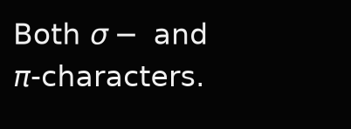

A.
B.
C. Ionic character.
D.

Slide 167
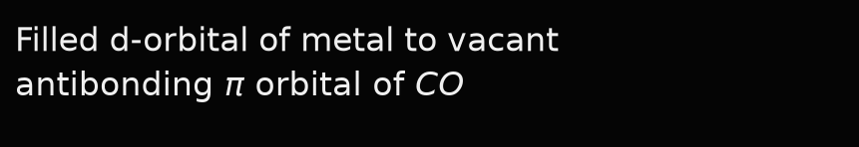
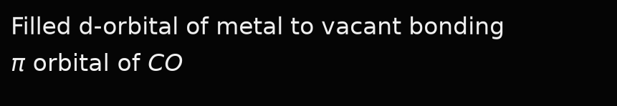
In metal carbonyls, the M-C sigma bond is formed by the donation of a lone pair of electrons on the
A. Carbonyl carbon atom to filled orbital of metal
B. Carbonyl carbon atom to vacant orbital of metal
C.
D.

Slide 168
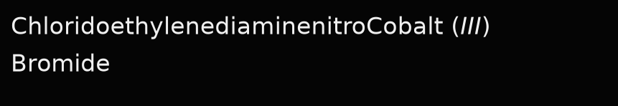
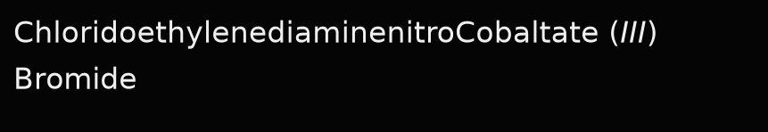
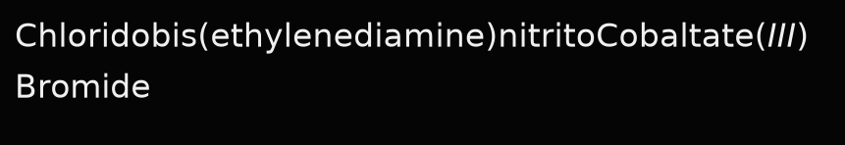

A.
B.
C.
D.

Slide 169
A. Two Cis and one Trans
B. Two Cis and Two Trans
C. One Cis and two Trans
D. One Cis and One Trans

Slide 170
A. Two cis and one trans
B. One cis and two trans
C. All three are cis only
D. All three are trans only

Slide 171


A. Synergic effect
B. Chelating effect
C.
D.

Slide 172
The central metal atoms/ions in coordination compounds are also called as
A. Lewis bases
B. Brønsted acids
C. Brønsted bases
D. Lewis acids

Slide 173
A. Linkage isomerism
B. Fac-mer isomerism
C. Ionization isomerism
D. Cis-trans isomerism

Slide 174

A. 6 and 1
B. 6 and 2
C. 4 and 6
D. 3 and 6

Slide 175
A. 6 and 1
B. 6 and 2
C. 4 and 6
D. 3 and 6

Slide 176
A. Geometrical isomerism
B. Ionization isomerism
C. Coordination isomerism
D. Linkage isomerism

Slide 177


A.
B.
C.
D.

Slide 178
A. octahedral
B. tetrahedral
C. trigonal bipyramidal
D. square pyramidal

Slide 179
A. Linkage isomerism
B. Coordination isomerism
C. Ionisation isomerism
D. Solvate isomerism

Slide 180




A.
B.
C.
D.

Slide 181




A.
B.
C.
D.

Slide 182




A.
B.
C.
D.

Slide 183


A.
B.
C.
D.

Slide 184
A. +1
B. +4
C. +2
D. +3

Slide 185
The oxidation state of metal in metal carbonyl complexes is
A. 1
B. 2
C. 3
D. 0

Slide 186
A. 3 and 3
B. 3 and 6
C. 6 and 3
D. 0 and 3

Slide 187
A. 3 and 3
B. 6 and 6
C. 3 and 6
D. 6 and 3

Slide 188
The sum of coordination number and oxidation number of the metal M in the complex
A. 6
B. 7
C. 8
D. 9

Slide 189
A. 0, 2
B. 6, 1
C. 5, 2
D. 6, 2

Slide 190

Which of the following is an ambidentate ligand?
A.
B.
C.
D.

Slide 191




Which of the following is the correct increasing order of strength in the spectrochemical series of ligands?
A.
B.
C.
D.

Slide 192

Which of the following ligands can exhibit linkage isomerism?
A.
B.
C.
D.

Slide 193
Which of the following ligands produces a synergic effect in coordination complexes?
A. Oxalates
B. Carbon Monoxide
C. Sulphate
D. Nitrates

Slide 194



Which of the following species is not a ligand?
A.
B.
C.
D.

Slide 195
A. Primary Valencies are ionisable while Secondary Valencies are non-ionisable.
B. Primary Valencies are non-ionisable while Secondary Valencies are ionisable.
C. Both Primary and Secondary Valencies are non-ionisable.
D. Both Primary and Secondary Valencies are ionisable.

Slide 196




Which type of complexes doesn't show geometrical isomerism?
A.
B.
C.
D.

