Slide 1

20 Questions · For: Boards

Slide 2


Slide 3

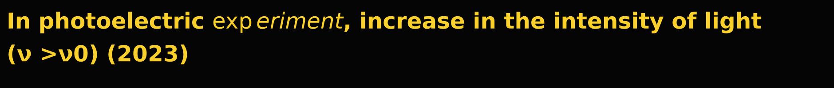
A. increases kinetic energy of photoelectrons
B. increases photoelectric current
C. decreases kinetic energy of photoelectrons
D. photoelectric current remains constant

Slide 4
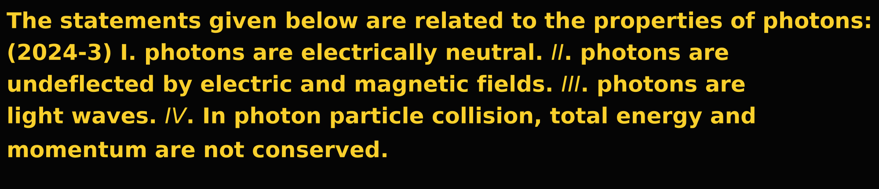



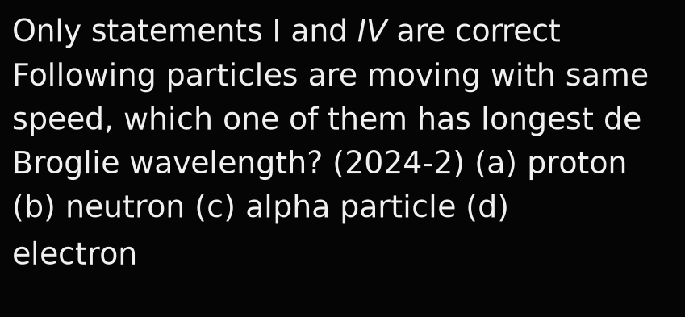
A.
B.
C.
D.

Slide 5
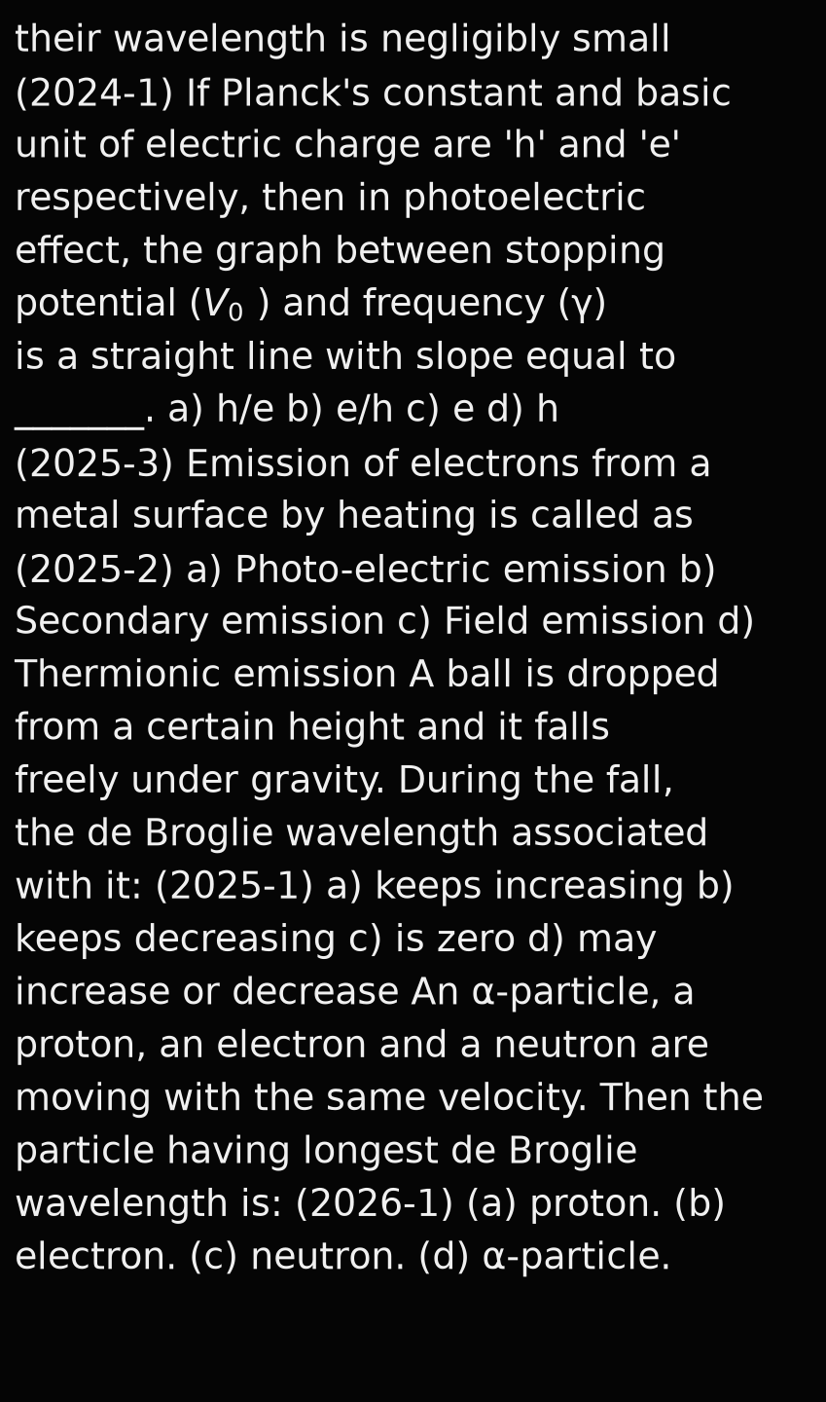
Macroscopic particles in our daily life do not show wave-like properties because
A. they are not associated with waves
B. their wavelength is extremely high
C. their wavelength is zero
D.

Slide 6
An α-particle, a proton, an electron and a neutron are moving with the same speed. Then the particle having shortest de Broglie wavelength is: (2026-2)
A. proton.
B. electron.
C. neutron.
D. α-particle.

Slide 7
In interaction of radiation with matter, radiation behaves as if it is made up of packet of energy called ______.
A.
B.
C.
D.

Slide 8


Slide 9

Answer:

Slide 10


Slide 11

Photoelectric effect is a/an _____________ effect.
A.
B.
C.
D.

Slide 12


Slide 13

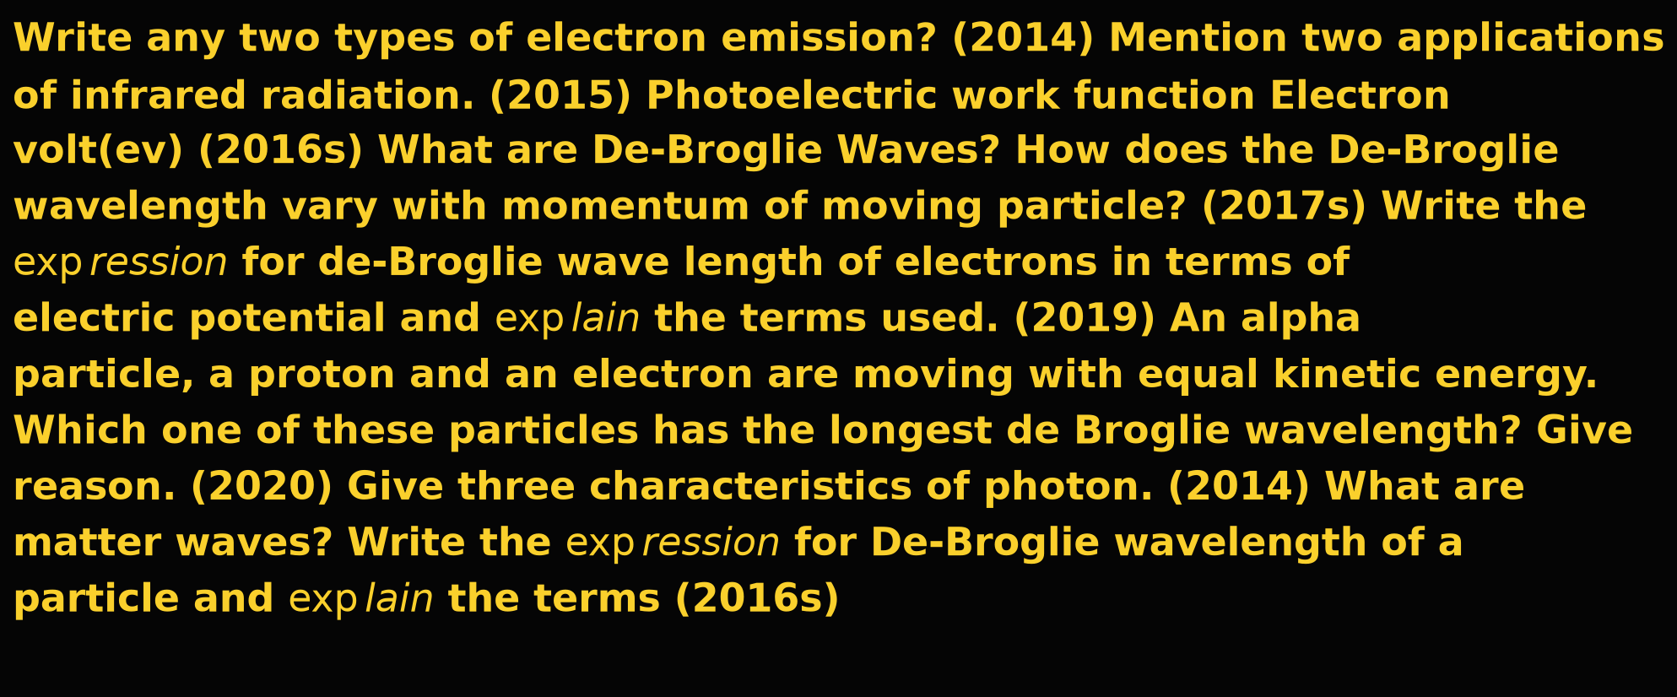
Answer:

Slide 15
The tiny packet of energy of light is called ________.
A.
B.
C.
D.

Slide 16


Slide 17

Answer:

Slide 19
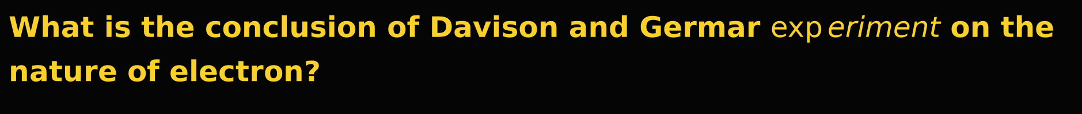
A.
B.
C.
D.

Slide 21
Define the terms: a) Threshold frequency b) Work function c) Stopping potential (2017s)
Answer:

Slide 23
Mention any one type of electron emission.
A.
B.
C.
D.

Slide 25
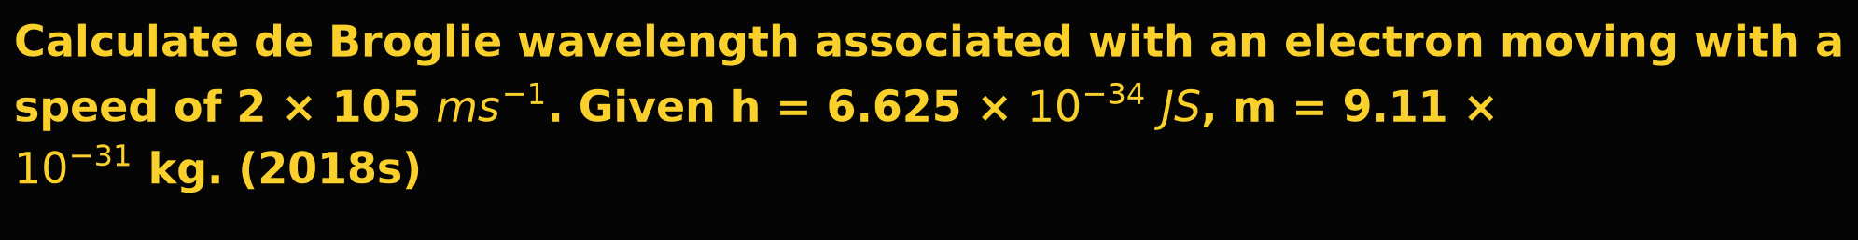
Answer:

Slide 27
What is the rest mass of photon?
A.
B.
C.
D.

Slide 29
Answer:

Slide 31
How does the stopping potential of a photosensitive material vary with intensity of incident radiation?
A.
B.
C.
D.

Slide 33
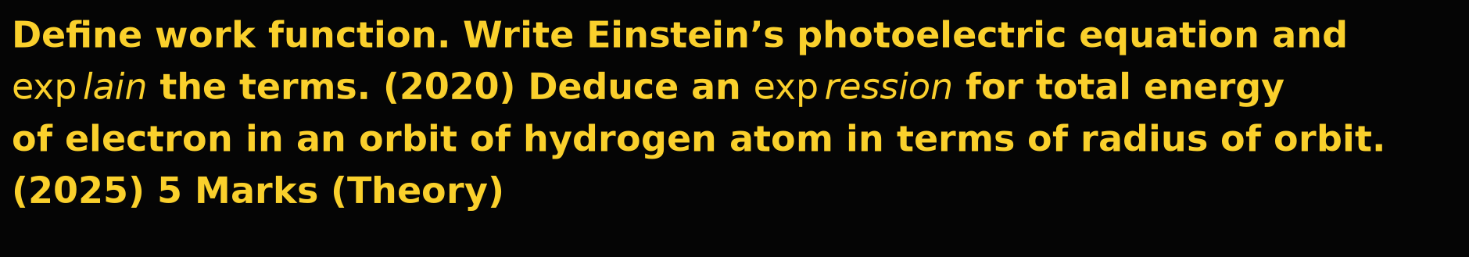
Answer:

Slide 34
Answer:

Slide 35
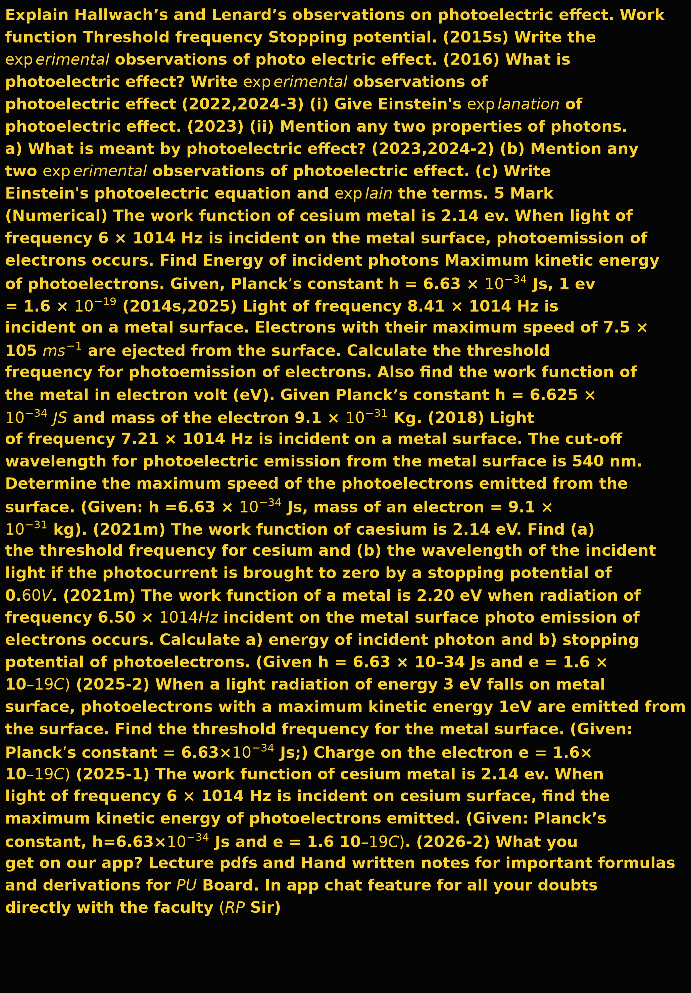
Answer:

