Slide 1

141 Questions · For: Boards

Slide 2
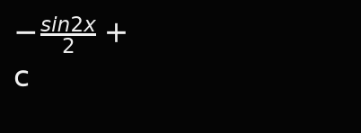

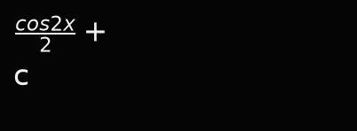
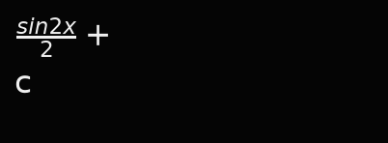
2024M
A.
B.
C.
D.

Slide 3




2024M,2026,2025-2
A.
B.
C.
D.

Slide 4




2025M
A.
B.
C.
D.

Slide 5


2025M
The point of inflection for the following graph is
A. 0
B. point of inflection does not exist
C.
D.

Slide 6




2025M
A.
B.
C.
D.

Slide 7
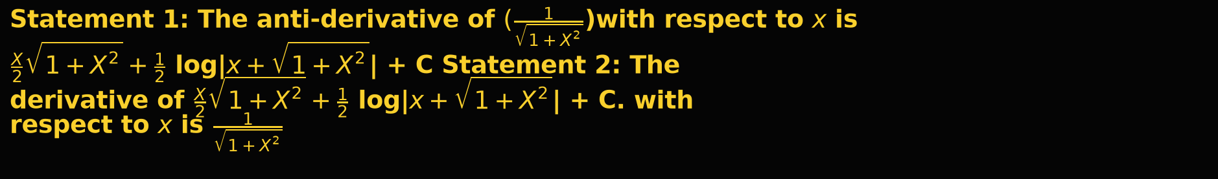

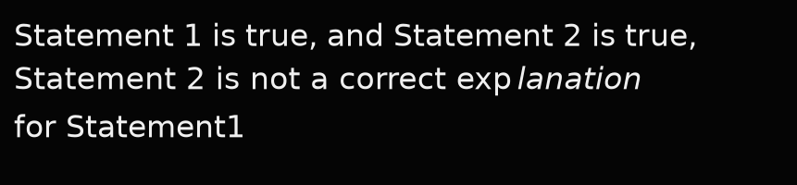
2025M
A. Statement 1 is true, and Statement 2 is false.
B.
C.
D. Both statements are false.

Slide 8
2026M
A. 2
B. 3
C. 0
D. 1

Slide 9




2026-1
A.
B.
C.
D.

Slide 10
2026M
A. 2tan⁡x-3sec⁡x+c
B. 2tan⁡x+3sec⁡x+c
C. 2tan⁡x-2sec⁡x+c
D. 2sec⁡x-3tan⁡x+c

Slide 11




2026M,2025-2
A.
B.
C.
D.

Slide 12




2026M
A.
B.
C.
D.

Slide 13
2026M
A. 0
B. 1
C. –1
D. –2

Slide 14




2024,2026M
A.
B.
C.
D.

Slide 15



2026M
A.
B.
C.
D.

Slide 16


2026M
A.
B.
C.
D.

Slide 17




2026M
A.
B.
C.
D.

Slide 18




2026M
A.
B.
C.
D.

Slide 19




2024-1
A.
B.
C.
D.

Slide 20
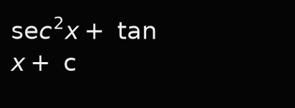
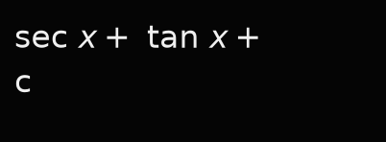
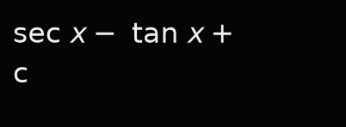
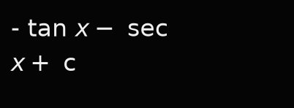
2024-1
A.
B.
C.
D.

Slide 21




2024-2
A.
B.
C.
D.

Slide 22
2024-2
A.
B.
C.
D.

Slide 23




2024-3
A.
B.
C.
D.

Slide 24




2025-1
A.
B.
C.
D.

Slide 25



2025-3
A.
B.
C.
D.

Slide 26
2024-3,2026-1
A. 1
B. 0
C. -1
D. 7

Slide 27
2014

Slide 28
2014S

Slide 29
2015

Slide 30
2015S,2017S,2022

Slide 31
2016

Slide 32
2016S,2020,2021M

Slide 33
2017

Slide 34
2017S

Slide 35
2018

Slide 36
2019

Slide 37
2019S

Slide 38
2022

Slide 39
2023

Slide 40
2021M

Slide 41
2014

Slide 42
2014S

Slide 43
2014S

Slide 44
2014,2022

Slide 45
2015

Slide 46
2015

Slide 47
2015S

Slide 48
2015S

Slide 49
2016

Slide 50
2016,2021M

Slide 51
2016S

Slide 52
2016S

Slide 53
2017

Slide 54
2017

Slide 55
2017S

Slide 56
2017S

Slide 57
2018S

Slide 58
2018S

Slide 59
2018

Slide 60
2018

Slide 61
2019

Slide 62
2019

Slide 63
2020

Slide 64
2022

Slide 65
2024M,3

Slide 66
2023

Slide 67
2023,2024-1

Slide 68
2020,2021M

Slide 69
2021M

Slide 70
2021M

Slide 71
2024M

Slide 72
2024-2

Slide 73
2024-2

Slide 74
2024-3

Slide 75
2025-1

Slide 76
2025-2

Slide 77
2025-3

Slide 78
2026-1

Slide 79
2014,2022

Slide 80
2014

Slide 81
2014S

Slide 82
2014S

Slide 83
2015,2024

Slide 84
2015,2015S

Slide 85
2015S,2016S,2017S,2018,2021M,2023M,2026-1

Slide 86
2016

Slide 87
2016

Slide 88
2016S

Slide 89
2017

Slide 90
2017,2018

Slide 91
2018S,2023

Slide 92
2018S

Slide 93
2017S

Slide 94
2019

Slide 95
2019

Slide 96
2020,2021M,2023

Slide 97
2020

Slide 98
2023

Slide 99
2021M,2022

Slide 100
2021M

Slide 101
2021M

Slide 102
3 MARKS

Slide 103
2024-1

Slide 104
2024-2,3

Slide 105
2025-1

Slide 106
2014

Slide 107
2014S

Slide 108
2015

Slide 109
2015S

Slide 110
2016,2020,2024-1

Slide 111
2016S

Slide 112
2017

Slide 113
2017S

Slide 114
2018S

Slide 115
2018

Slide 116
2019,2022,2024M

Slide 117
2019S

Slide 118
2023

Slide 119
2021M,2025-2

Slide 120
2021M

Slide 121
2024-2

Slide 122
2024-3

Slide 123
2025-1

Slide 124
2025-3

Slide 125
2026-1

Slide 126
2014

Slide 127
2014S,2019S

Slide 128
2015,2017S

Slide 129
2014,2015S,2019,2021M

Slide 130
2016

Slide 131
2016S,2022,2026-1

Slide 132
2017

Slide 133
2018,2021M

Slide 134
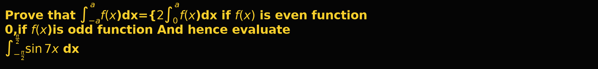
2018S,2024M

Slide 135
2019,2023,2024-2

Slide 136
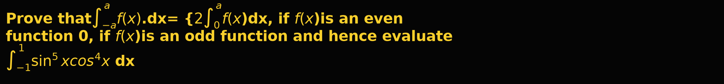
6 MARKS

Slide 137
2020

Slide 138
2024-1

Slide 139
2024-3

Slide 140
2025-1

Slide 141
2025-2

Slide 142
2025-3

