Slide 1

Analyzing Amazon sales and subscription KPI to improve Revenue & Retention
January 22, 2023 → May 1, 2024 (About 15 months of sales + subscriptions)

Slide 2
Solution: Use sales and customer data to uncover key patterns and recommend actions
Problem:
Amazon wants to boost revenue and reduce subscription cancellations.

Slide 3
Analytical Goals:
Analytical Goals:
Why?
To help Amazon grow revenue and keep more subscribers by understanding:
What products make the most money
Identify valuable customers
Why customers stop their subscriptions
How product ratings affect sales

Slide 4
Analytical Goals:
Why?
To help Amazon grow revenue and keep more subscribers by understanding:
What products make the most money
Identify valuable customers
Why customers stop their subscriptions
How product ratings affect sales
How?
We used customer and sales data to:
Find top-selling product categories
Identify valuable customers
Spot trends in subscription cancellations
Compare prices of high vs low-rated products

Slide 5
Analytical Goals:
Why?
To help Amazon grow revenue and keep more subscribers by understanding:
What products make the most money
Identify valuable customers
Why customers stop their subscriptions
How product ratings affect sales
How?
We used customer and sales data to:
Find top-selling product categories
Identify valuable customers
Spot trends in subscription cancellations
Compare prices of high vs low-rated products

Slide 6
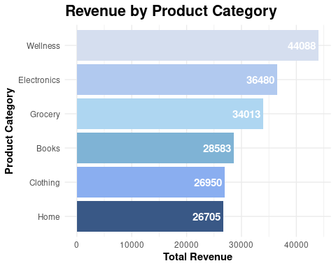
Wellness products generate the highest revenue among all categories (₹44,088)
We expected traditional categories like Electronics or Clothing to drive most revenue, but surprisingly, Wellness products led the charts. This could signal a consumer shift toward self-care and lifestyle products, reflecting changing priorities post-pandemic or during seasonal trends.

Slide 7
Analytical Goals:
Why?
To help Amazon grow revenue and keep more subscribers by understanding:
What products make the most money
Identify valuable customers
Why customers stop their subscriptions
How product ratings affect sales
How?
We used customer and sales data to:
Find top-selling product categories
Identify valuable customers
Spot trends in subscription cancellations
Compare prices of high vs low-rated products

Slide 8
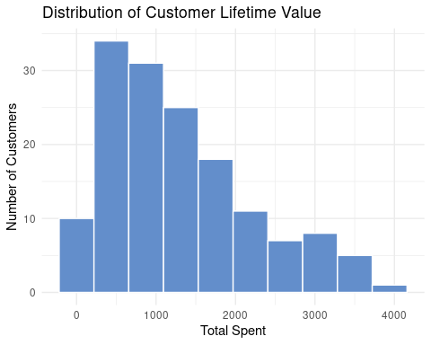
A large number of customers have low total_spent — under ₹1000, with only a small group crossing ₹3,000.
But that doesn’t automatically mean they’re all one-time buyers.

Slide 9
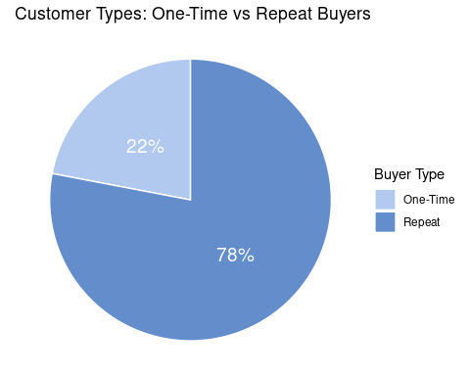
78% of customers are repeat buyers, showing strong customer retention and satisfaction. However, the 22% one-time buyers signal an opportunity to improve first-time user experience, they may require better onboarding, post-purchase nudges, or incentives to return.
Among the 78% repeat customers, how often did they actually shop?

Slide 10
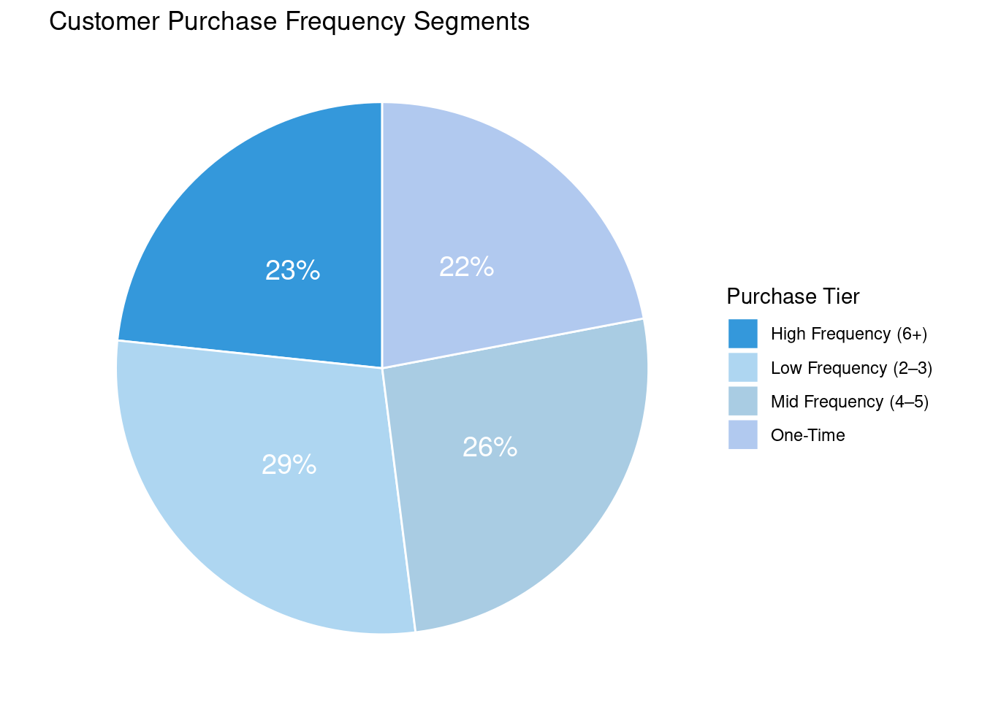
Among the 78% repeat purchases, 23% are highly engaged customers making 6+ purchases, indicating a strong loyal base.
This suggests opportunities for targeted loyalty programs or upselling to mid-frequency shoppers (26%) to increase retention and revenue.

Slide 11
Analytical Goals:
Why?
To help Amazon grow revenue and keep more subscribers by understanding:
What products make the most money
Identify valuable customers
Why customers stop their subscriptions
How product ratings affect sales
How?
We used customer and sales data to:
Find top-selling product categories
Identify valuable customers
Spot trends in subscription cancellations
Compare prices of high vs low-rated products

Slide 12
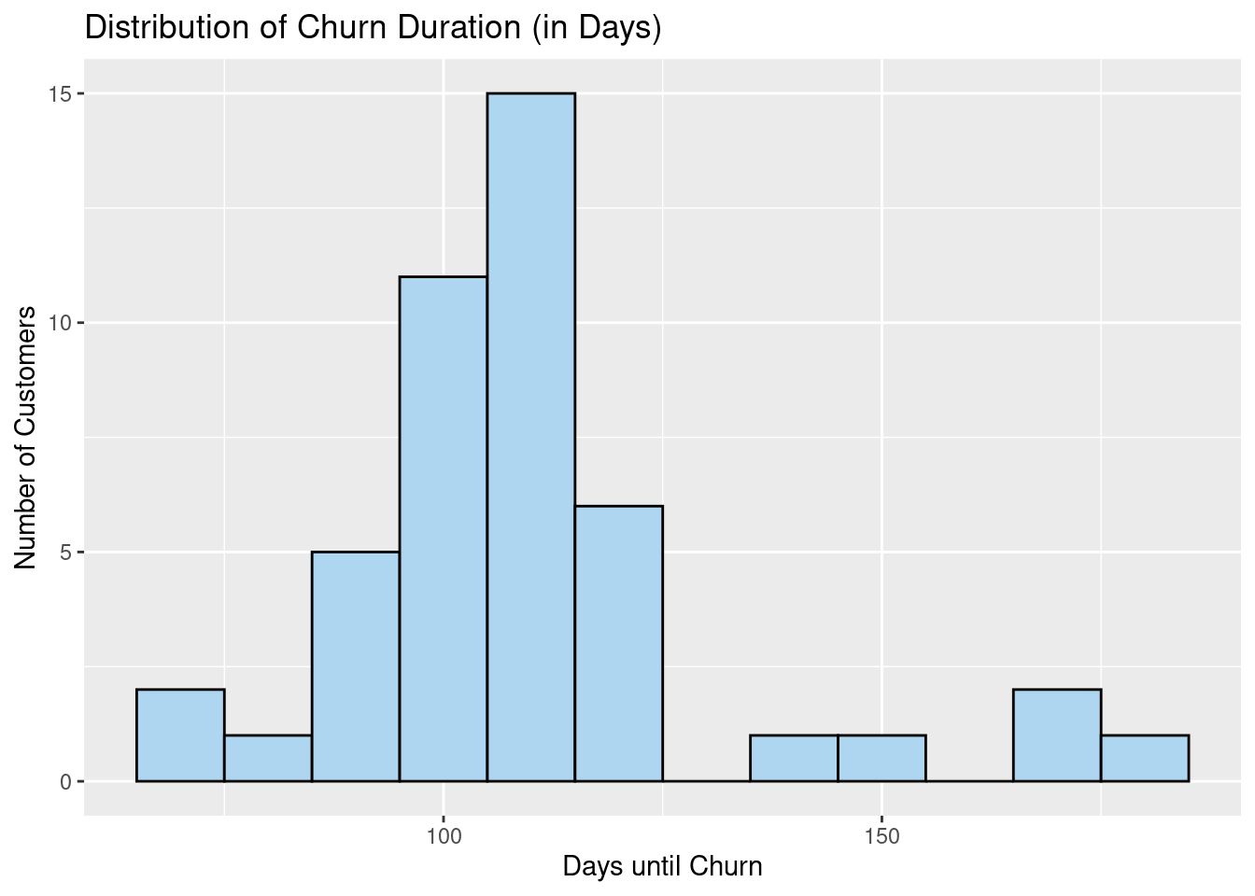
Most customers churn around 100–120 days.
There's a peak at ~110 days, meaning that's the most common point of churn.
Very few customers stay beyond 150+ days or churn before 70 days.
Note: This plot includes only customers who have churned, identified by non-missing values in the subscription_end_date field.

Slide 13
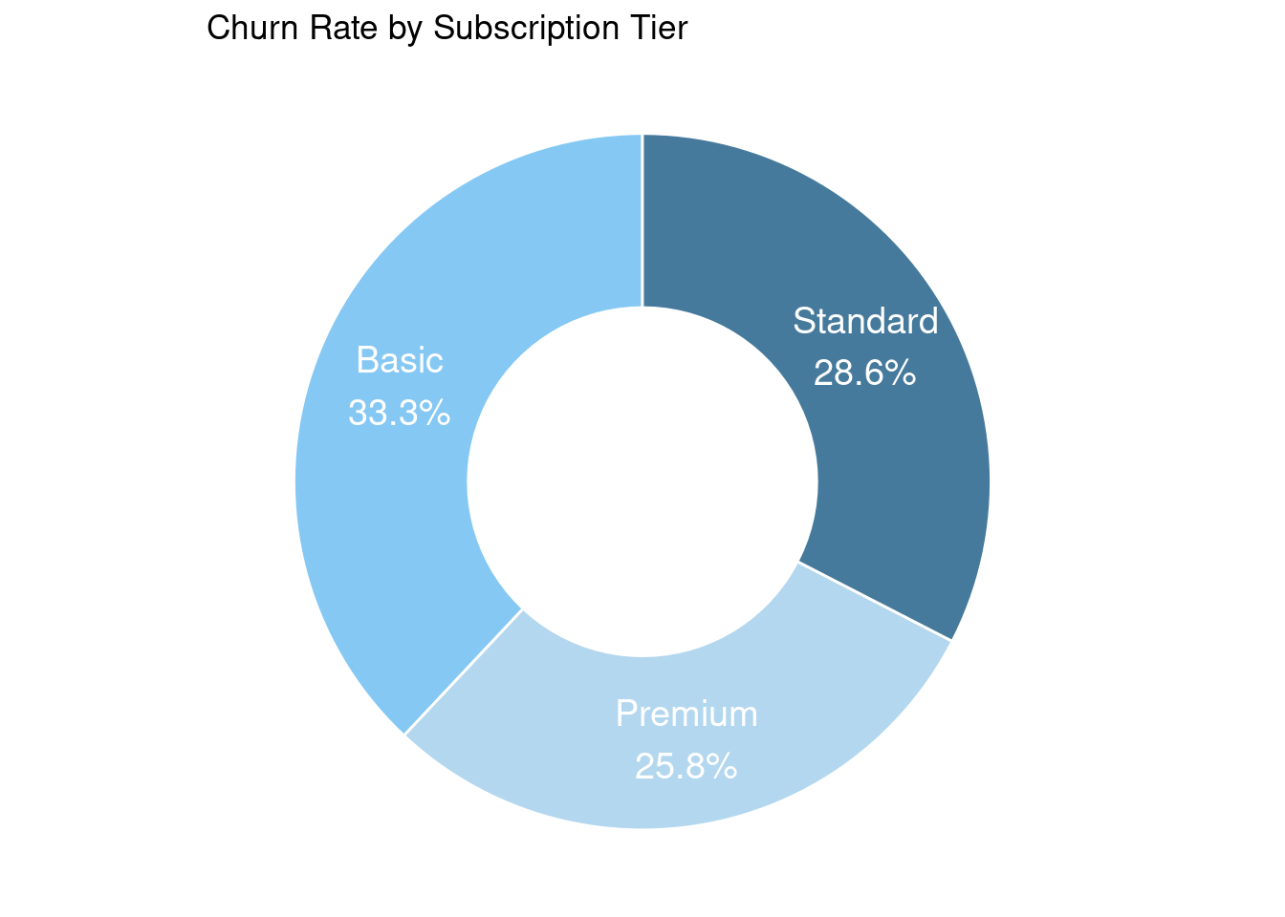
Customers on the Basic subscription churn more frequently (33.3%) compared to Standard (28.6%) and Premium (25.8%) tiers. This suggests that higher-value tiers may foster stronger retention, possibly due to better features or perceived value.

Slide 14
Analytical Goals:
Why?
To help Amazon grow revenue and keep more subscribers by understanding:
What products make the most money
Identify valuable customers
Why customers stop their subscriptions
How product ratings affect sales
How?
We used customer and sales data to:
Find top-selling product categories
Identify valuable customers
Spot trends in subscription cancellations
Compare prices of high vs low-rated products

Slide 15
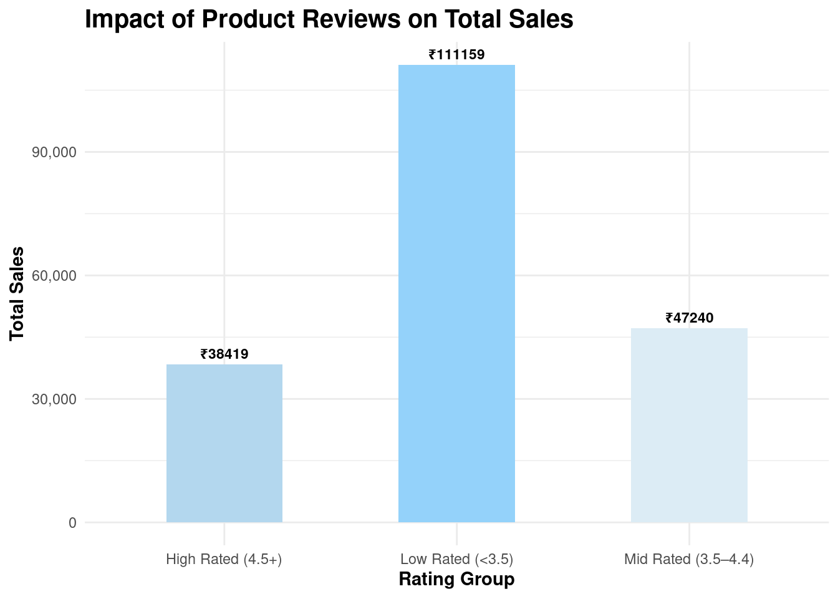
Surprisingly, Low Rated products (<3.5) drove the highest total sales, contributing more than ₹1L in revenue. This suggests that factors beyond review scores—like price, demand, or product necessity—may be influencing purchase decisions more heavily than perceived quality.
While Low Rated products drive the most revenue, further analysis reveals they are also priced significantly lower and bought in bulk suggesting utilitarian purchases where reviews matter less.

Slide 16
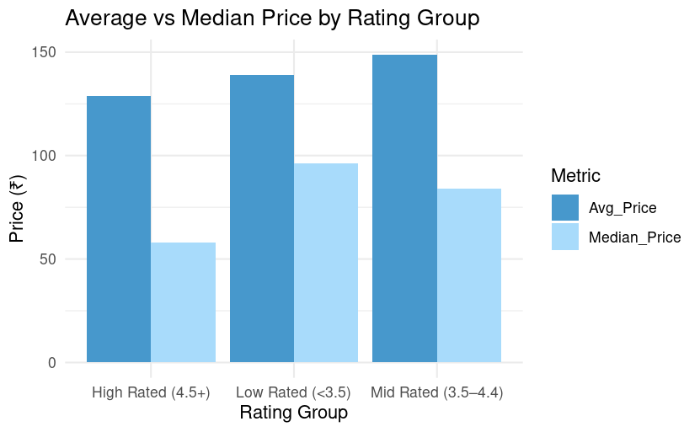
High-rated products tend to be lower priced, suggesting customers are more satisfied when the product meets or exceeds expectations for its price. In contrast, low-rated products are priced higher, indicating a possible mismatch between price and perceived value.
Low-rated and mid-rated products have a higher average and median price to high-rated ones. compared

Slide 17
In Summary
Focus on High-Revenue Categories: Wellness & Electronics contribute the most to revenue — prioritize them in promotions.
Target Mid & High-Frequency Buyers: 49% of repeat customers buy 4+ times — ideal for personalized offers or exclusive deals.
Improve Retention in Basic Tier: Highest churn rate observed — consider loyalty rewards or simplified upgrade options.
Encourage More Product Reviews: High-rated products generate less revenue; incentivize honest reviews to balance perceptions and drive conversions.
Monitor Low-Rated Price Ranges: Low-rated products are priced high (avg ₹139) — reassess pricing or quality to reduce customer dissatisfaction.

Slide 18
Thank You

