Slide 1
COLORIZATION ANALYSIS

Slide 2
HELLO!
Nhóm có 4 thành viên:
1. Lê Khánh Hoàng - 3122410425.
2. Nguyễn Minh Thuận - 3123410365.
3.Nguyễn Tiến Trung - 3123410396.
4. Phan Hoàng Vũ - 3123410436.

Slide 3
Mục lục:
1. Introduction
2. Data summary
3. Model Architecture
4. Training Methodology
5. Evaluation Metrics
6. Experimental Results
7. Applications & Conclusion

Slide 4
Introduction
1

Slide 5
Image colorization is a process that assigns plausible colors to grayscale images. This research proposes a fully automatic deep learning-based approach to generate realistic and vibrant colorizations. Unlike previous methods, which often required user intervention or produced desaturated outputs, our system leverages convolutional neural networks (CNNs) and self-supervised learning.

Slide 6
Data sumary
2

Slide 7
The training dataset consists of over one million color images. These images were converted into grayscale for input, with the original color images serving as ground truth.

Slide 8
Key data components
3

Slide 9
L Channel (Lightness): Input grayscale image
A/B Channels (Chromaticity): Target output color channels in the CIE Lab color space
Dataset Sources: Large-scale datasets such as ImageNet

Slide 10
Model Achitecture
4

Slide 11
Our architecture is a deep CNN inspired by VGG-style networks but with added depth and dilated convolutions. The network is structured as follows:
Input Layer: Accepts grayscale images
Convolutional Blocks: Multiple layers with BatchNorm and ReLU activations
Final Output: Predicts color distributions for each pixel

Slide 12
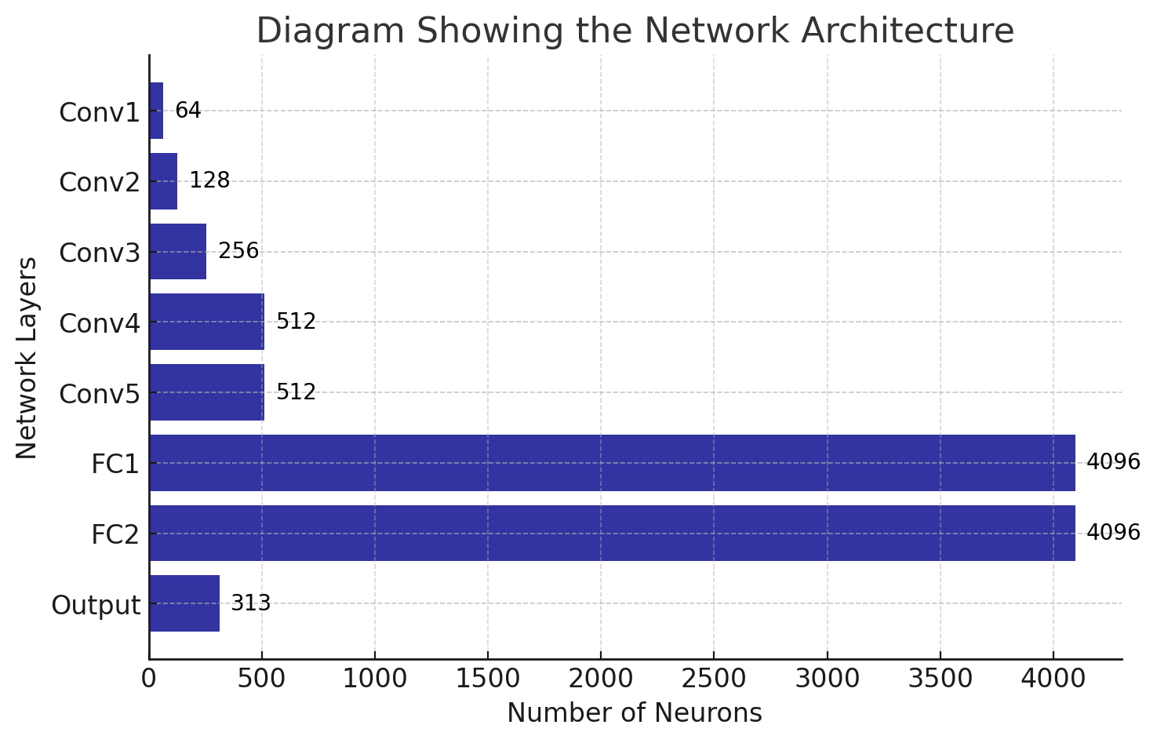

Slide 13
Trainning methodology
5

Slide 14
The model is trained using a classification-based loss function rather than traditional regression methods. This helps mitigate the issue of desaturated predictions.

Slide 15
Key trainning Ehencements
6

Slide 16
Class Rebalancing: Ensures diverse color predictions by emphasizing rare colors.
Annealed-Mean Prediction: Averages the color distributions while maintaining vibrancy.
Pretext Learning: The model also learns useful representations for other vision tasks.

Slide 17
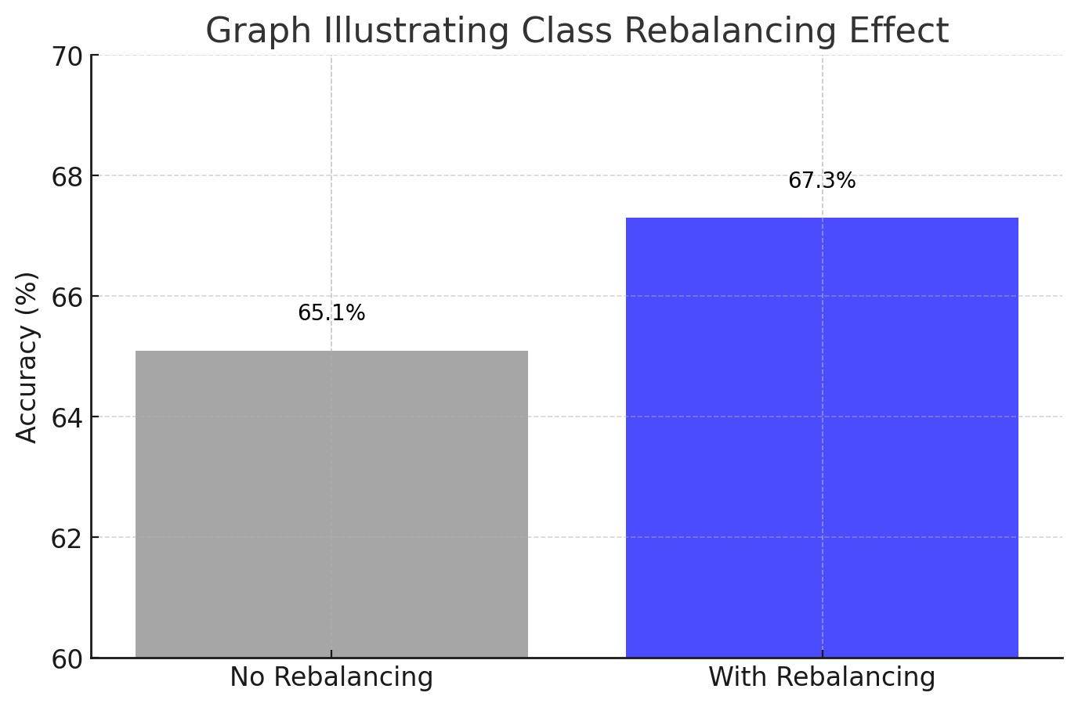

Slide 18
Evaluation metrics
7

Slide 19
Evaluating colorized images is challenging. We adopt multiple metrics:
Turing Test: Human participants distinguish real vs. generated images.
Classification Accuracy: Using a VGG classifier on colorized images.
Color Distance (AUC Metric): Measures raw accuracy in predicting colors.

Slide 20
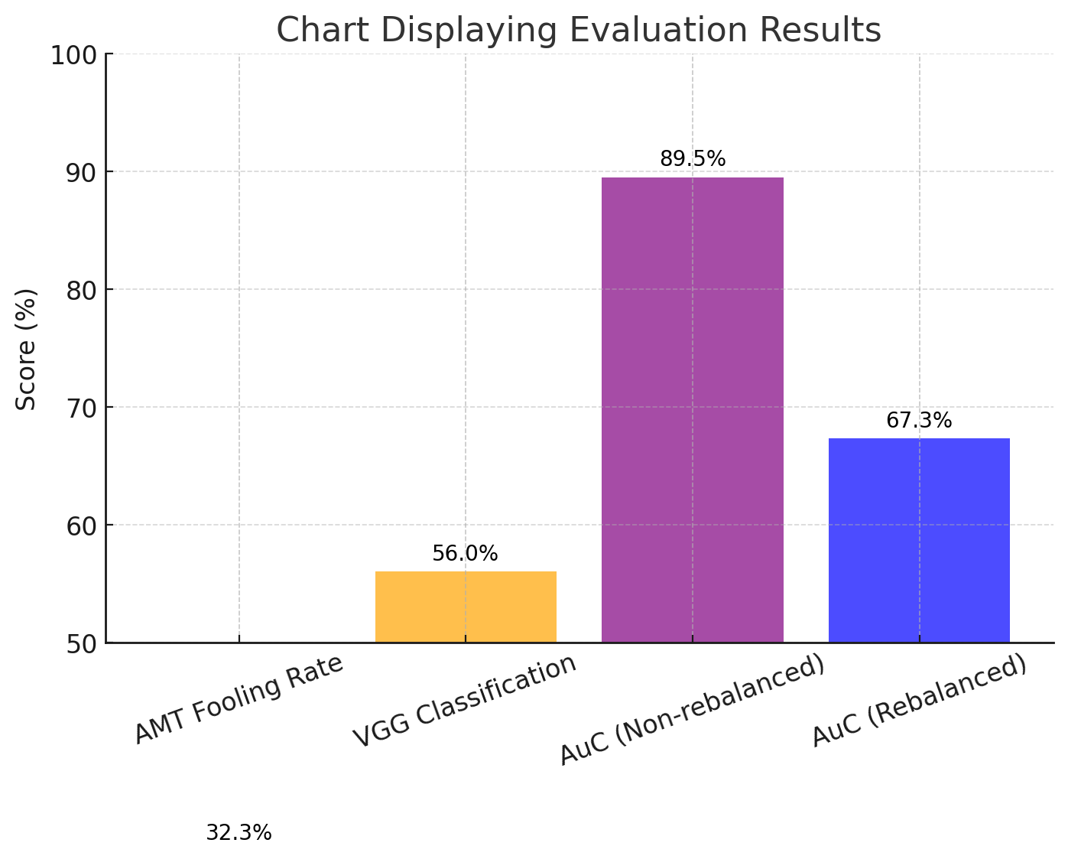

Slide 21
Experimental result
8

Slide 22
The model successfully fooled human evaluators in 32% of cases, outperforming prior methods. It also demonstrated strong performance in downstream tasks such as object recognition and segmentation.

Slide 23
Key findings
9

Slide 24
Perceptual Realism: Higher than previous methods
Semantic Consistency: Object colors align with real-world expectations
Feature Learning: Achieves competitive results on self-supervised benchmarks

Slide 25
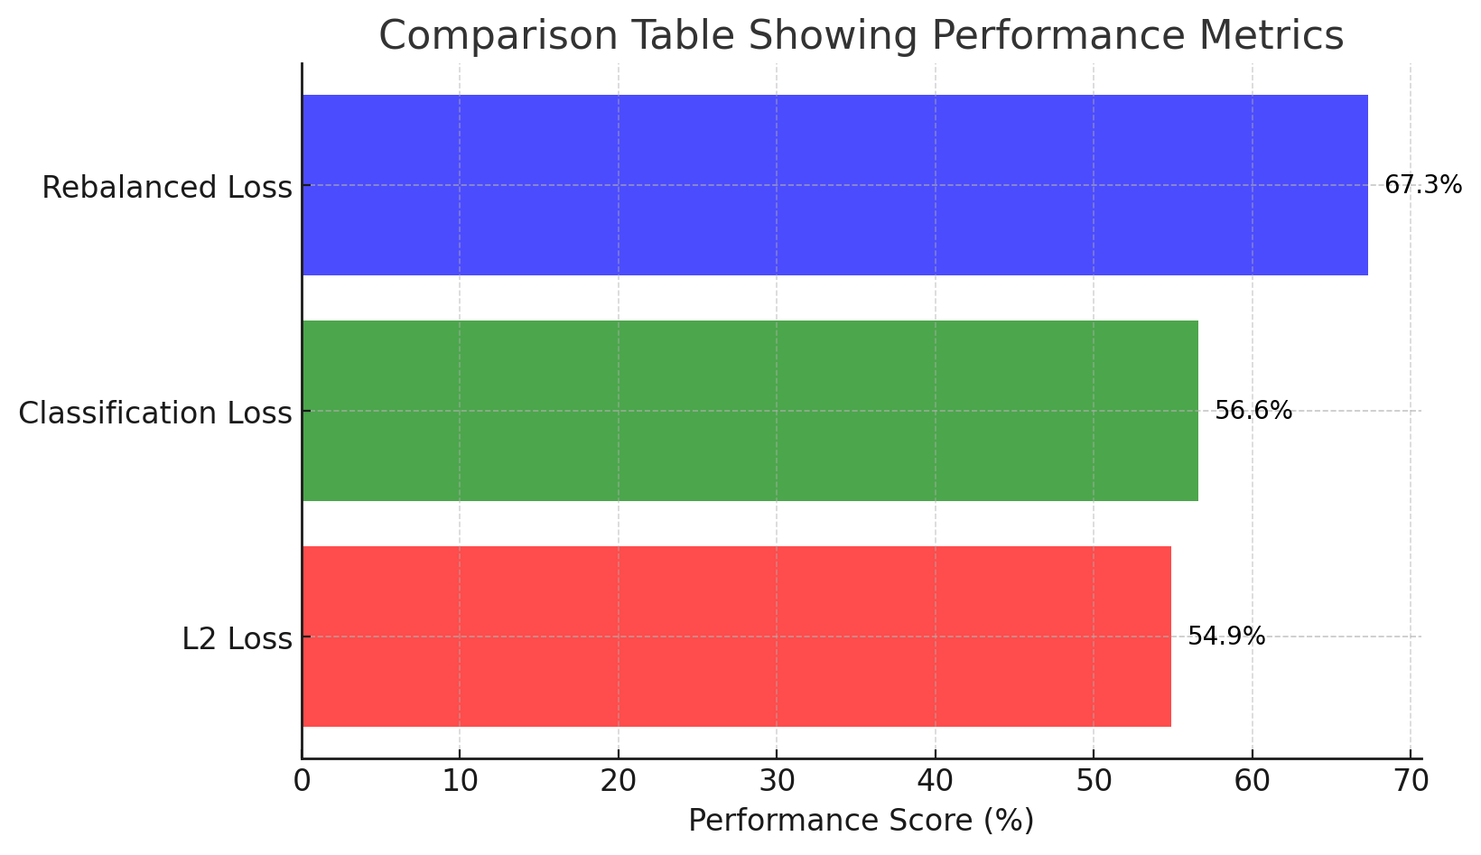

Slide 26
Aplications & conclusion
10

Slide 27
The model has practical applications in:
Restoring legacy black-and-white photographs
Enhancing artistic and creative projects
Boosting performance in self-supervised learning

Slide 28
Sumary
11

Slide 29
Innovative classification-based approach improves color vibrancy.
Trained on large datasets for robust colorization.
Achieves state-of-the-art results in multiple benchmarks.

Slide 30
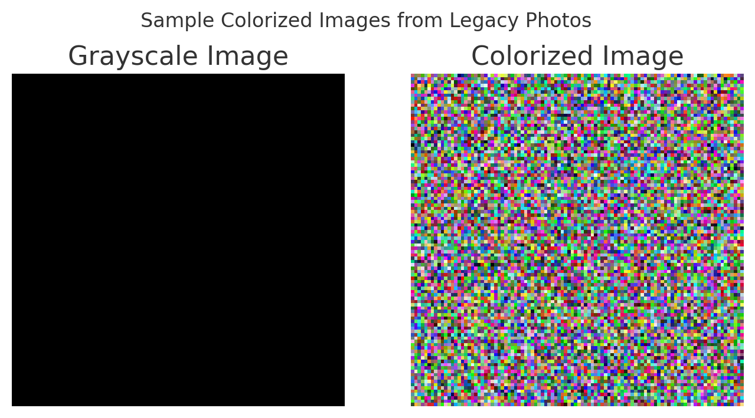

Slide 31
THANKS!
Any questions?

