Slide 1
PROJECT EXAM 4
Subject:
Online Order for digital printing of Photos
Group : STH
Student:
1. Le Khanh Sinh
2. Bui Nguyen Thang
3. Nguyen Tien Hoang
Instructors: Nguyen Tuan

Slide 2
Introduction
“My Image” is a group of people who wants to develop an online site
were the user can upload his or her photographs and can order them
for printing. A customer can have a set of digital photographs in his
desktop which he/she wants to print. He/she can provide the
application the path to the folder where the photographs are stored
and can choose the photos that he/she wants to print and choose the
size of the prints. The application will calculate the price after
downloading the price information from the database for the different
print sizes and show it to the user. The user will enter his/her credit
card/other payment option (or choose any other mode of payment)
and shipping information if he/she wants to go ahead with the order. If
the credit card information is found correct, the photos are uploaded to
the server and a purchase order is created in the database.

Slide 3




Language
ReactJs
NodeJs
Apollo
Ant Design

Slide 4
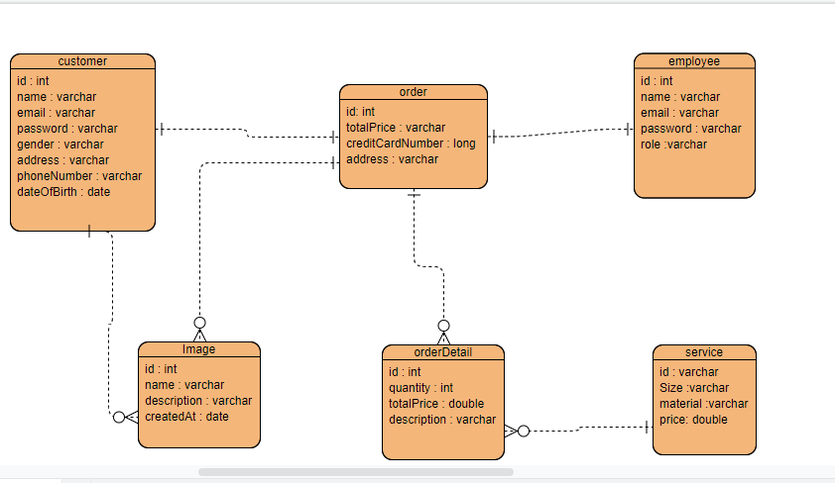
Database

Slide 5
In charge
Le Khanh Sinh : Database + backend API, Project structurer
Bui Nguyen Thang : Fontend Admin + doc
Nguyen Tien Hoang : Fontend Web + silde

Slide 6
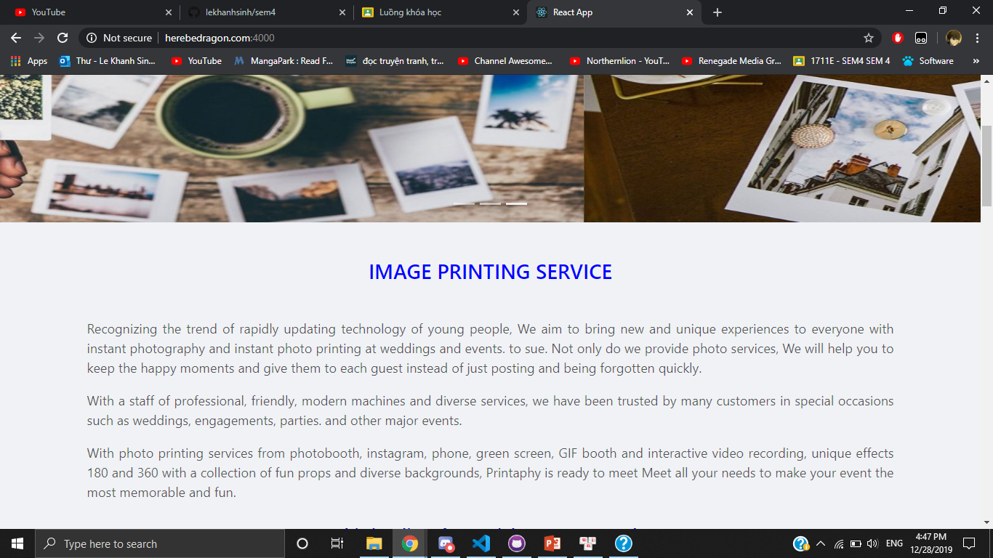

Slide 7
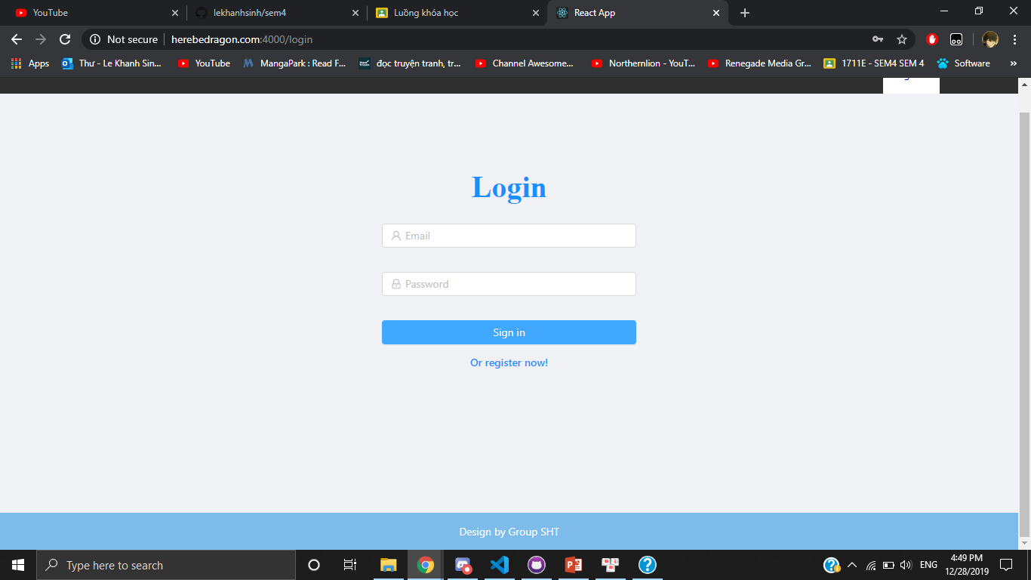
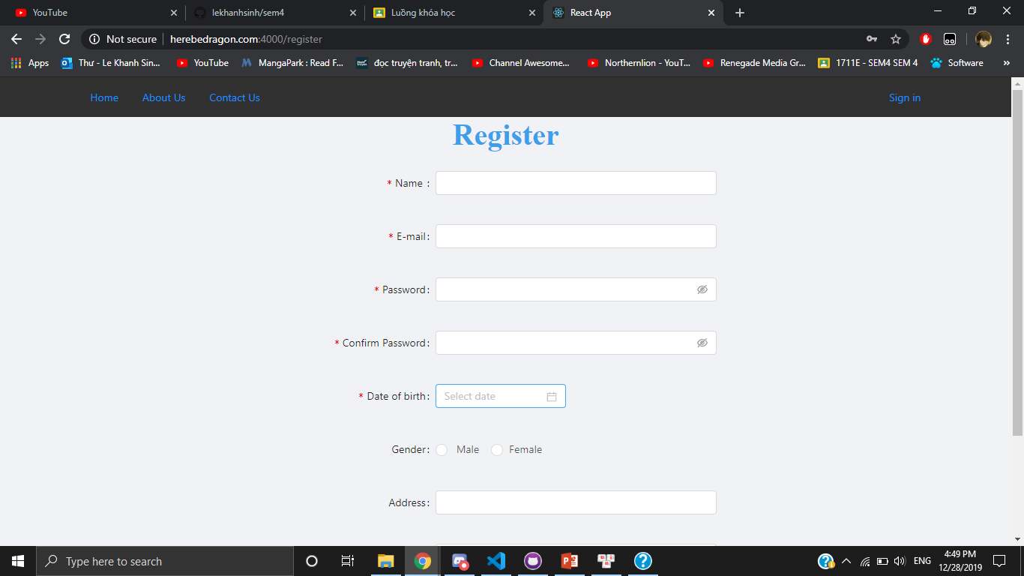

Slide 8
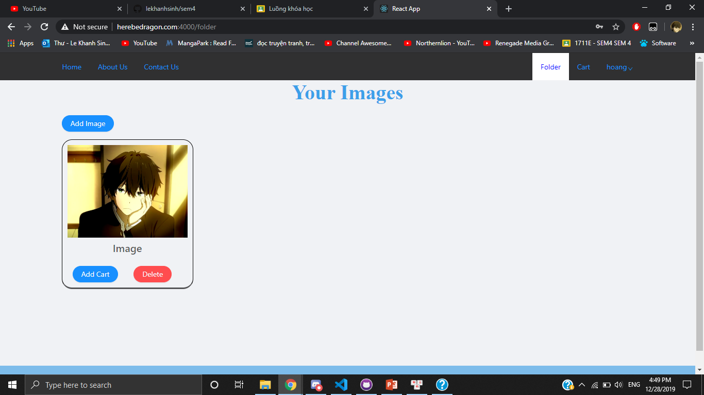
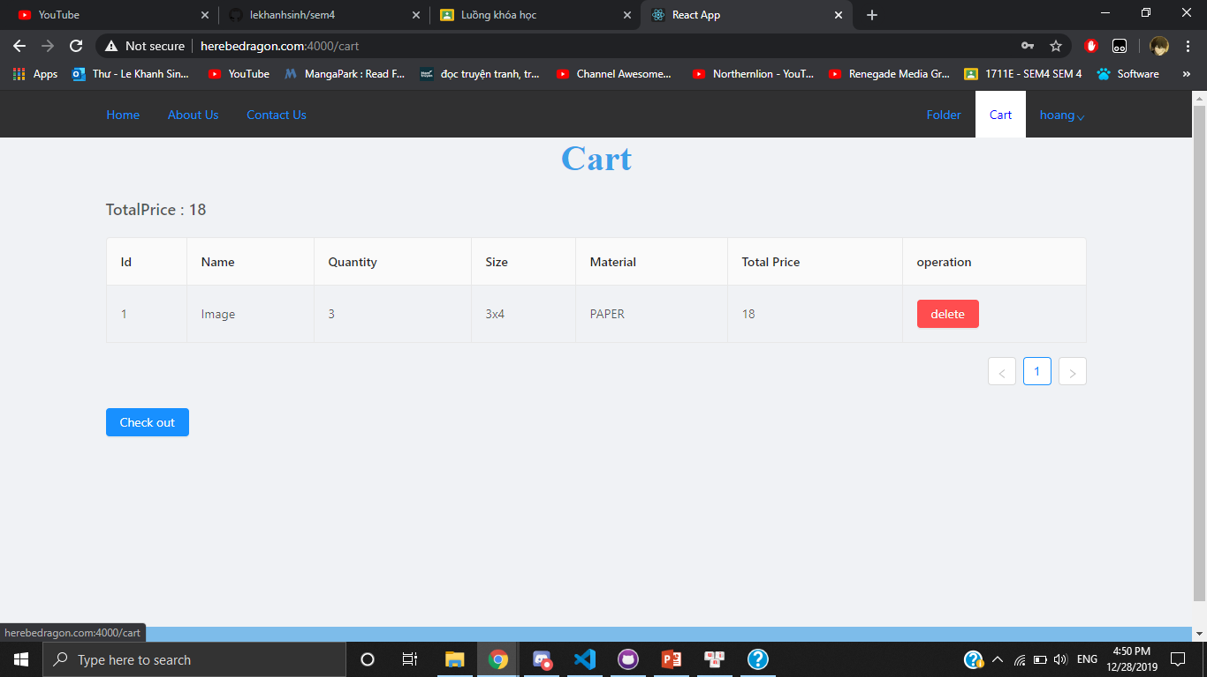

Slide 9
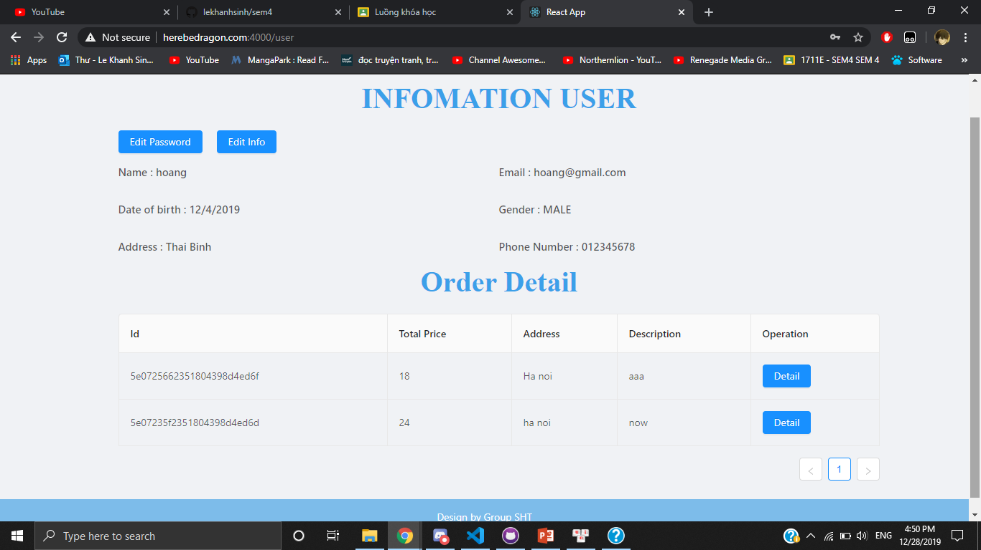
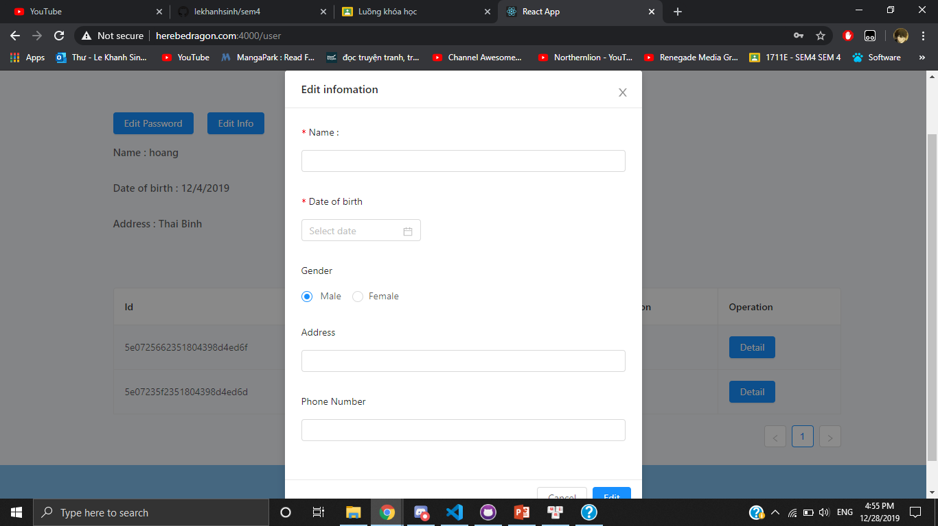

Slide 10
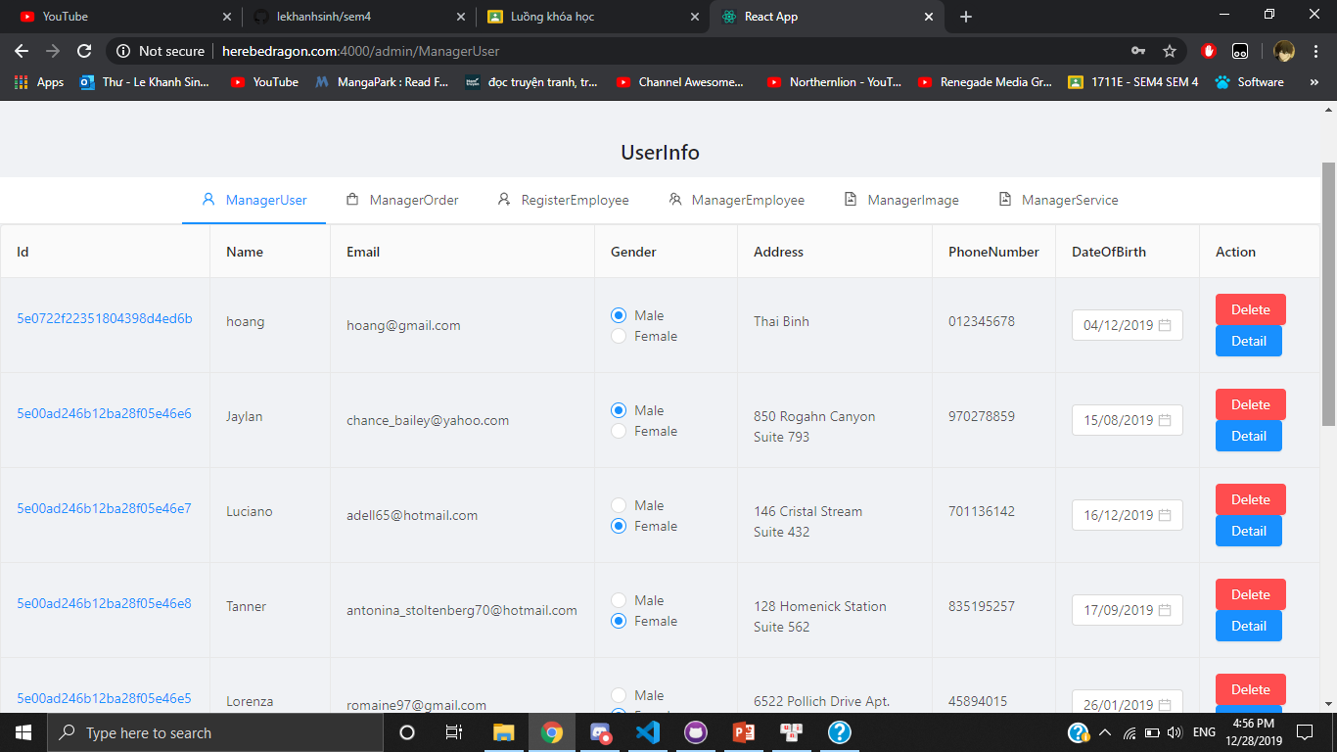
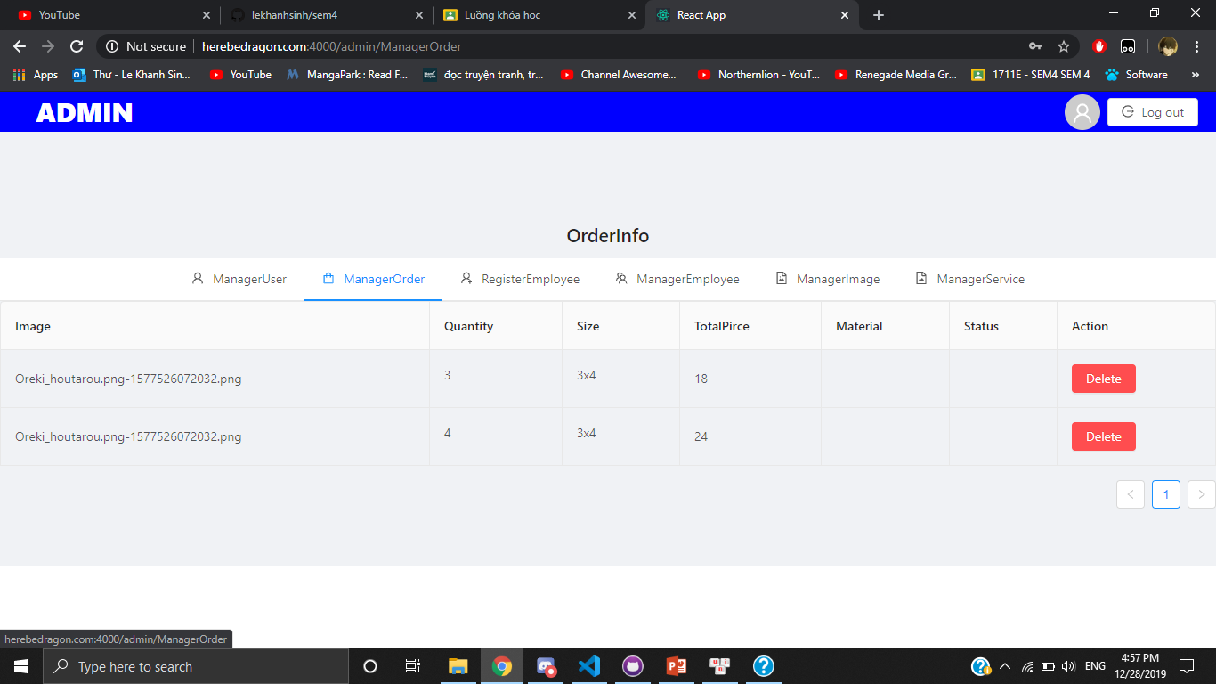

Slide 11
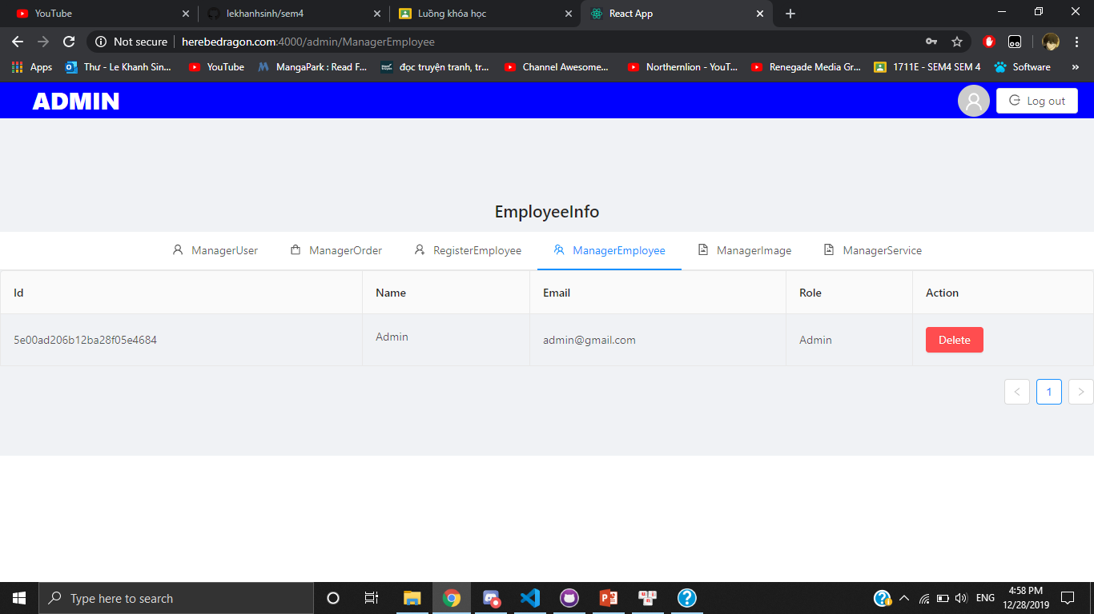
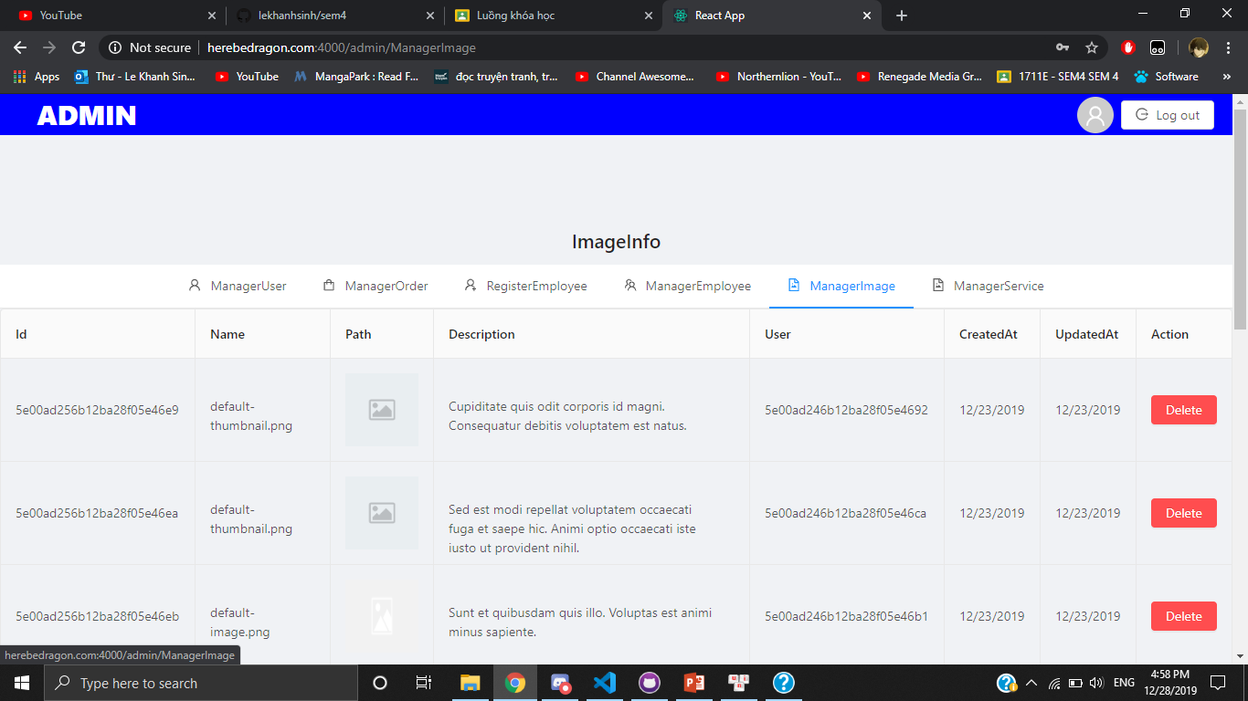

Slide 12
DEMO . . . Thank you!!!

