Slide 1

Nhóm 3: Web-Chat Application
Member:
Phan tất phúc
Lê khánh toàn
Nguyễn tuấn linh
Hà minh tuấn
Nguyễn trung hiếu
Phan quang hưng

Slide 2
Purposement
- To make our own chat application to not totally depend on Messeger of Facebook.
- Is which we can communicate with other about secret information.
- To practise about programming a Web Application.
- To learn about both Frontend and Backend of a Web application.

Slide 3









Technique
- ExpressJS
- Passport (Authentication)
- Socket.io (Chat real-time)
- MongoDB, Mongoose (Store, Query Data)
- Redis (Adaper for Socket.io)
- Winston(Log errors, exceptions)

Slide 4
Features
Login
Chat-room
Chat real-time
Signin

Slide 5
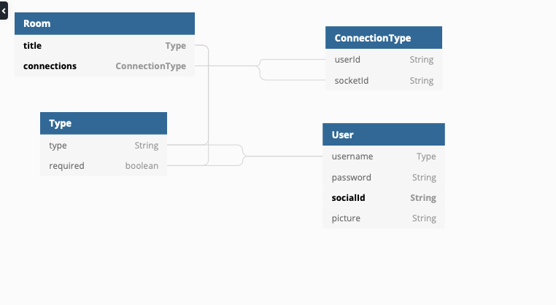

Database

Slide 6
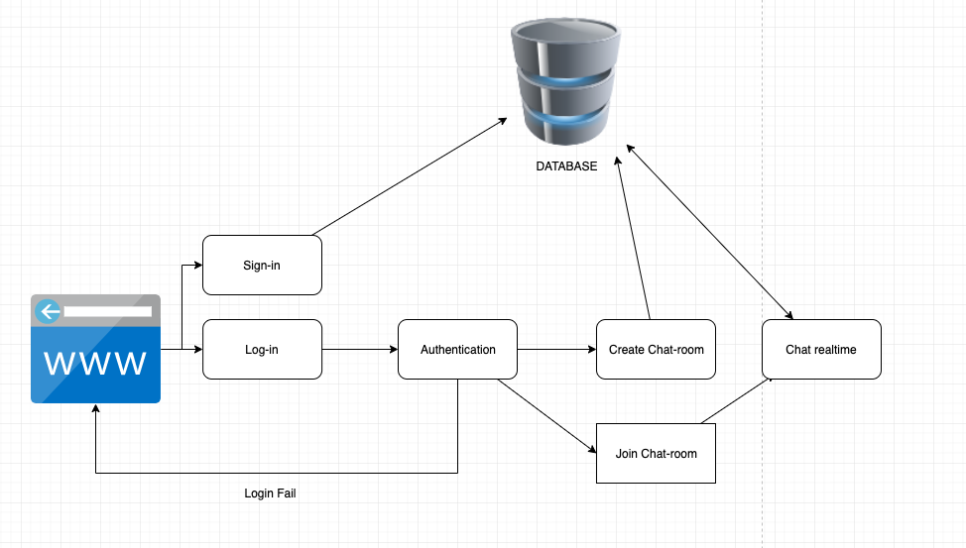
Application Flow

Slide 7
TIME TO DEMO

Slide 8

The end

