Slide 1
Machine Learning ABC: Linear Regression

Slide 2
Objectives
Have a basic understanding over linear regression
Eliminate the fear of having difficulty learning machine learning
Confident to build a linear regression program on python

Slide 3

LEARN
SUPER COMPLEX MATH
PREDICT
LABEL
COLLECT DATA
Notes:
We’ll never know until we touch it

Slide 4
How many data we have in our digital universe?
2.7
Zetabyte
≈ 2.7 * 10^12 Terabyte
≈ 2700 billion Terabyte
Notes:
15000 h = 2 year

Slide 5
How about now and the future?
less than 0.5% of available data is actually being analyzed
Right now: 1.7 megabytes /second/ person
2025: 150 Zetabyte
Notes:
Can’t process all these data in traditional way

Slide 6
Machine learing is all around you
Camera
Content suggestion
Advertising
Search engine
Social network
This presentation
Notes:
that's enough, để trấn tĩnh mọi người

Slide 7
It’s is all about
linear regression
statistic

Slide 8
Hot Girl
Notes:
ML give us a better view over data relation

Slide 9
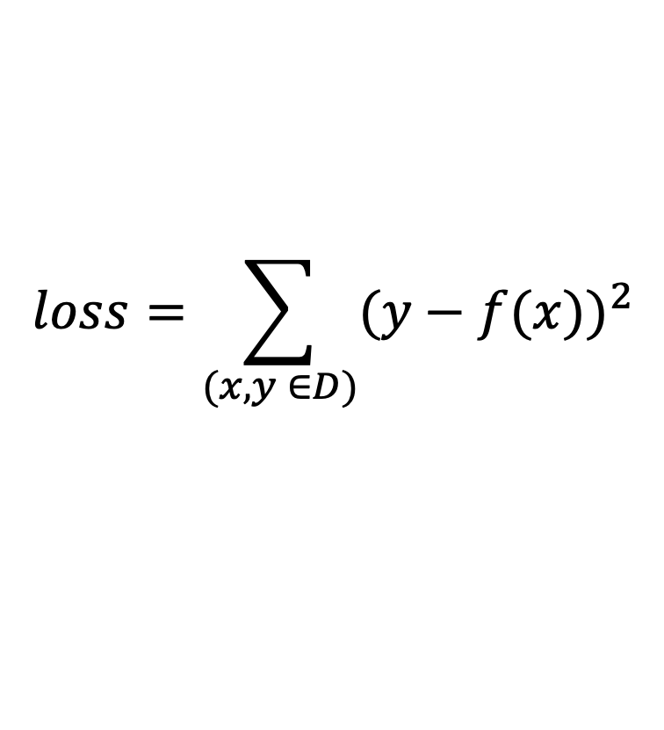
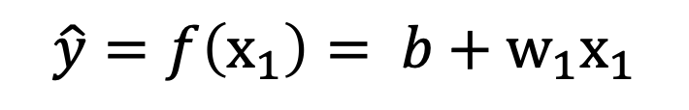
The relation of data
$$\hat{y}=f\left(x_{1}\right)= b \text{+} w_{1}x_{1}$$
$$loss=\sum_{(x,y ∈D)}{{(y−f(x))}^{2}}$$
Notes:
Can’t try all possible values of the line

Slide 10
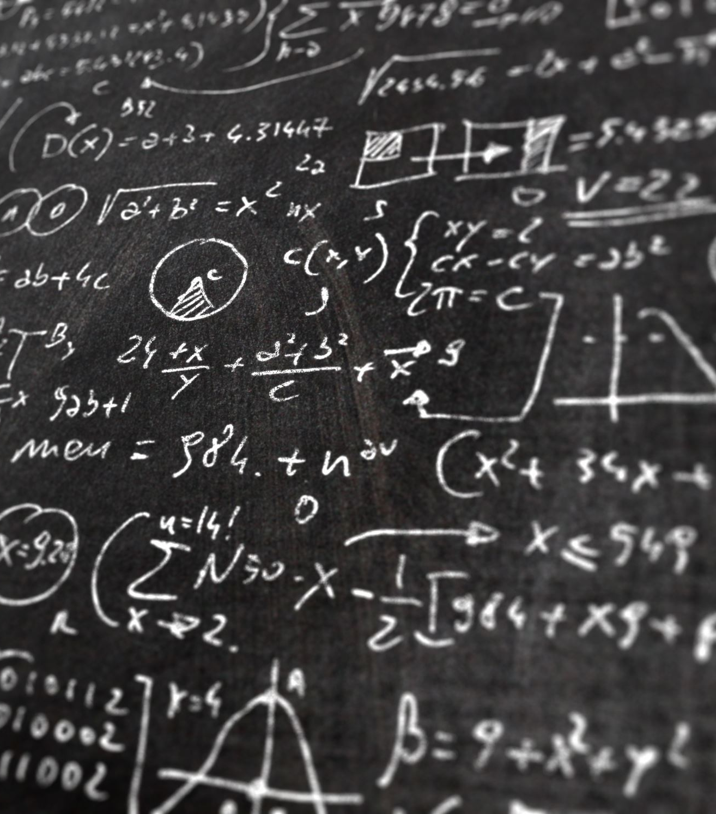
Derivative
Notes:
Đạo hàm riêng – đạo hàm theo một biến

Slide 11




Slope
Δx / Δy = const = slope
Y
Y
$$y_{2}$$
Δy
$$y_{1}$$
Slope = 0 ?
$$x_{1}$$
$$x_{2}$$
Δx
X
X
slope > 0
slope < 0
Y
Derivative
X
Notes:
Đạo hàm cho ta biết độ dốc của hàm y tại x
Độ dốc càng cao, số càng lớn

Slide 12
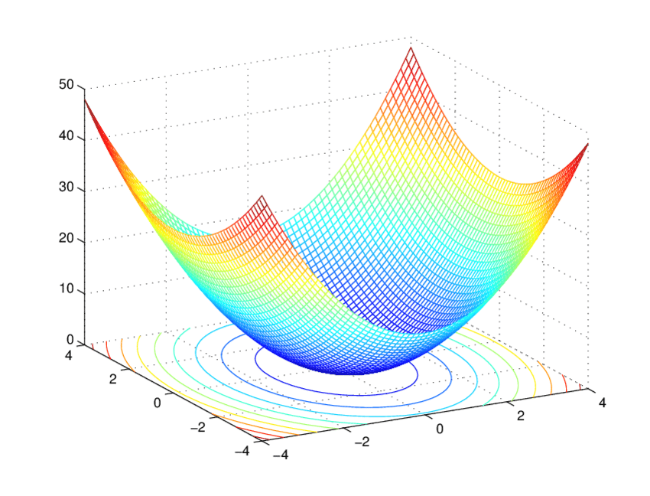

Minimize loss function
𝑙𝑜𝑠𝑠
b
$$w_{1}$$
Notes:
có một điểm hội tụ, nếu ta di chuyển b và w1 ...
cho nó lăn xuống dốc
cố định b và tìm cách nào đó điều chỉnh w1 để cho hàm loss nhỏ hơn

Slide 13


Gradient descent
Let’s code

Slide 14
Multiple linear regression
It’s the same
$\hat{y}=f\left(x_{1}\right)= b\text{ + }w_{1}x_{1}+w_{2}x_{2}$ + $w_{3}x_{3}+… +w_{k}x_{k}$

Slide 15
You know there are more
Other datatypes
Model optimization
Missing data
…
That’s all
Notes:
ML give us a better view over data relation

Slide 16

Thank you

