Slide 1
Machine Learning ABC: Linear Regression

Slide 2
Objectives:
Have a basic understanding over simple linear regression
Wipe out the fear about the hardness of learning machine learning
Confident to try to build a simple linear regression program on python

Slide 3
Table of content
Relax and enjoy the presentation

Slide 4
How many data we have in our digital universe?
2.7 Zetabyte
≈ 2.7 * 10^12 Terabyte
Notes:
1 TB = 15000 hours of playing music
2700 billion terabyte

Slide 5
Machine learing is all around you
Camera
Content suggestion
Advertising
Search engine
Social network

Slide 6
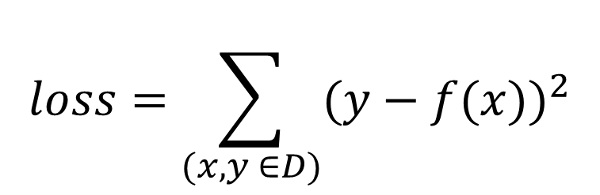

The relation of data
$$\hat{y}=f\left(w1\right)= b \text{+} b_{1}w_{1}$$
$$loss=\sum_{(x,y ∈D)}{{(y−f(x))}^{2}}$$
Notes:
Can’t try all possible values of the line
Đạo hàm riêng – đạo hàm theo một biến

Slide 7
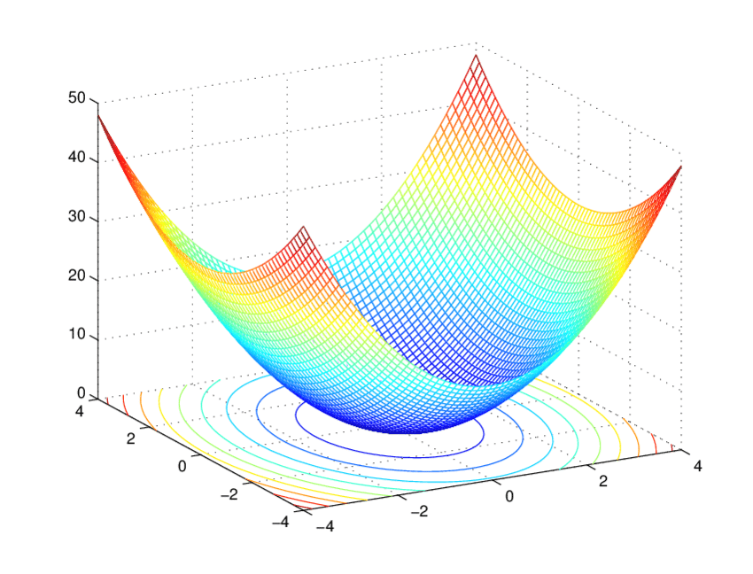
Minify loss function

