Slide 1
WebHDFS: beyond the Namenode
Extending WebHDFS for easy use by backend stores other than HDFS

Slide 2
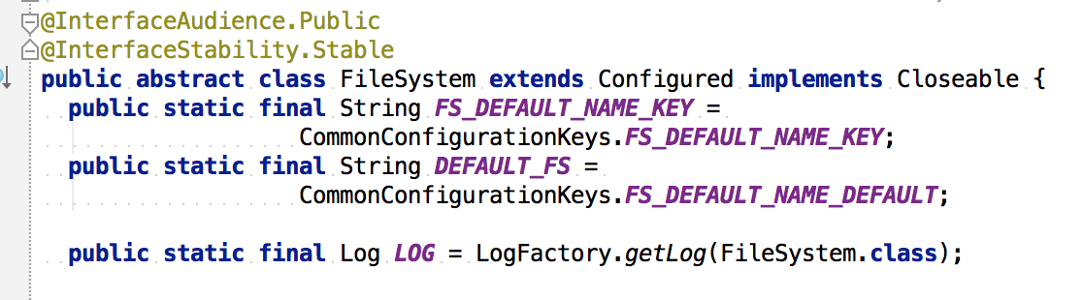
Current situation
org.apache.hadoop.FileSystem
Key interface in Hadoop ecosystem

Slide 3
Nexus of Hadoop ecosystem
Stores provide:
DistributedFileSystem
Namenodes and datanodes
AzureFileSystem
S3FileSystem
LocalFileSystem
MapRFileSystem
ViewFileSystem
Applications target:
MapReduce
Hbase
Spark
Giraph
Flume
Camus

Slide 4
Pros and cons
Pros
Common JVM interface
Cons
Common JVM interface
Previously had poor interversion compatability

Slide 5
WebHDFS
Designed to solve interversion compatibility issues
Fully implements FileSystem interface over REST servlets in Namenode and Datanode

Slide 6
Good news: clients are easier
Non-JVM clients can whitebox their way to the NameNode
Language | Library name | URL
Perl | Apache::Hadoop::WebHDFS | http://bit.ly/perlwebhdfs
Python | pywebhdfs | http://bit.ly/pythonwebhdfs
.NET | WebHDFSClient | http://bit.ly/dotnetwebhdfs
node | Node webhdfs | http://bit.ly/nodewebhdfs
JVM | Tusk (LI) | http://bit.ly/jvmwebhdfs
PHP | PHP-WebHDFS | http://bit.ly/phpwebhdfs
Ruby | kzk-webhdfs | http://bit.ly/rubywebhdfs

Slide 7
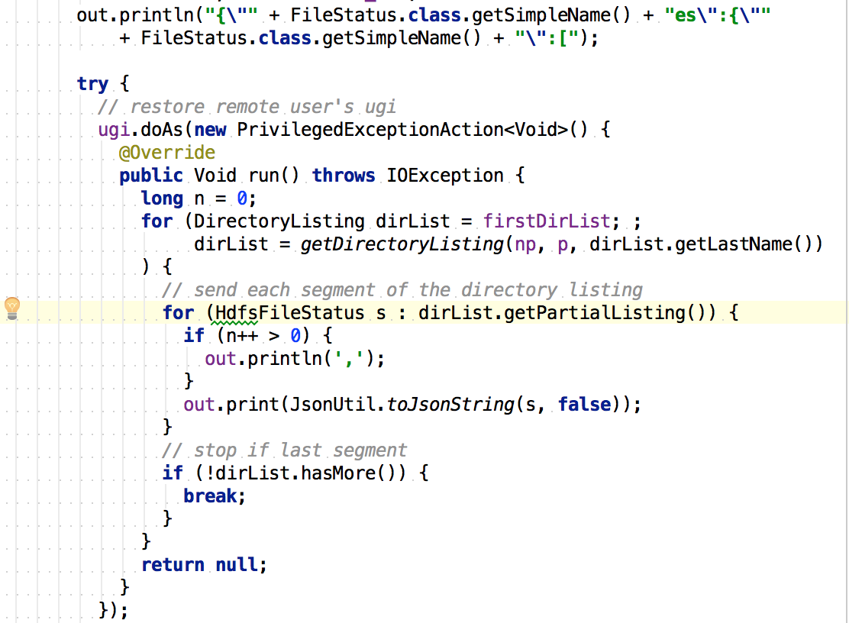
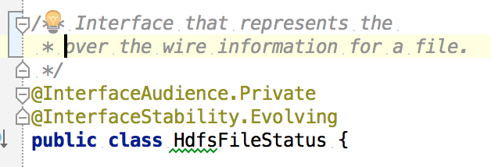
Bad news: Servers aren’t
WebHDFS Spec exists as human-readable document
Only implementation (Namenode) deeply tied to Namenode internals

Slide 8
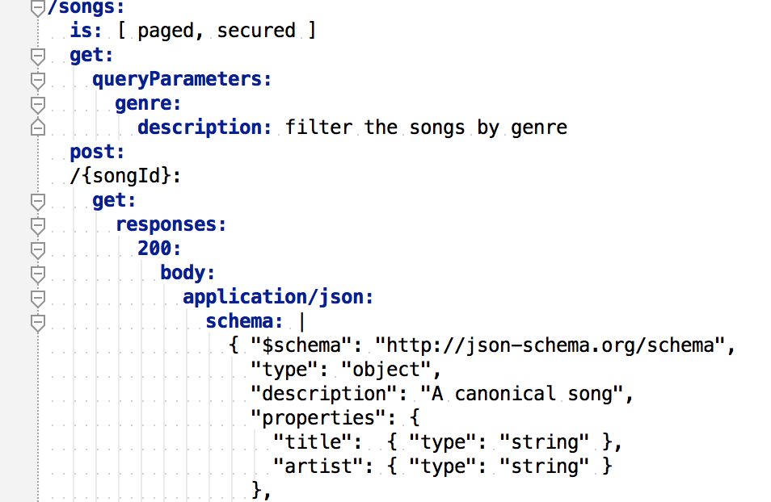
Task: Make servers (and clients) easier
Tasks
Provide WebHDFS specification in computer-consumable format (RAML, Swagger, RSDL, etc.)
Provide tooling to generate JVM interfaces from that spec
Refactor existing Namenode code to use those interfaces
Refactor existing Namenode code to provide common library for JVM servers implementing the spec

Slide 9
Final result
Easy to provide new backends for existing Hadoop ecosystem
Guaranteed, provable compatibility with oah.FileSystem

Slide 10
Powerful proxy solution
Easy to write proxies between different backends:
Rewrite paths
Cache files
Provide locality routing
Can subsume current HttpFs functionality

Slide 11
Not deeply considered yet
Security
Hadoop’s UserGroupInformation is very ingrained in code
Performance
HTTP is well understood and performant transport, but it may require work to get best throughput

Slide 12
Alternatives
Just code against NameNode implementation
Con: A reasonably large amount of code to maintain separate from open source
Write server against protocol buffers
Con: PB not as widely adopted as REST
HttpFs
This approach is more powerful than HttpFs, is how HttpFs should have been implemented

Slide 13
Done

