Slide 1
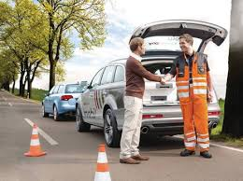
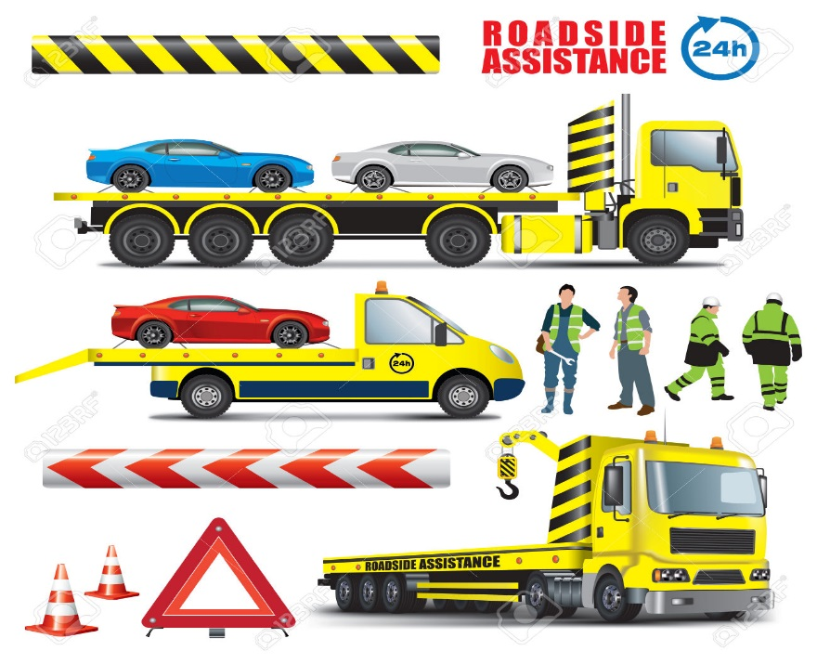
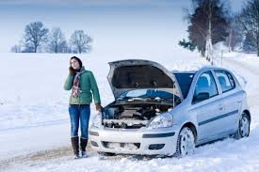
Predict Emergency Roadside Assistance Car Breakdown Call Volume

Slide 2
Data Set
Using the following data
Integrated historical data and public road side events
Data set from NJ DOT
http://www.state.nj.us/transportation/refdata/
Weather Data
http://www.wunderground.com/

Slide 3
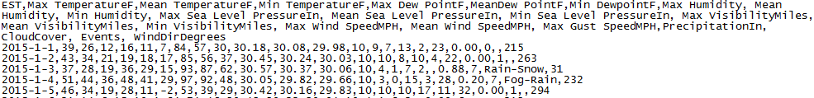
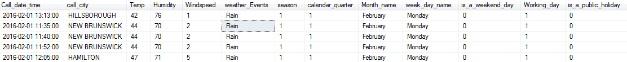
Data Processing and Cleanup
Historical Call volume data set
nn
Weather dataset
Final data set

Slide 4
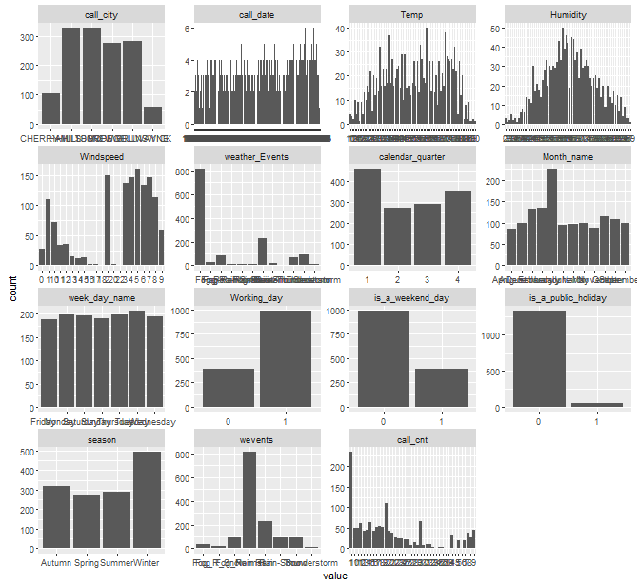
Univariate Variable distributions

Slide 5
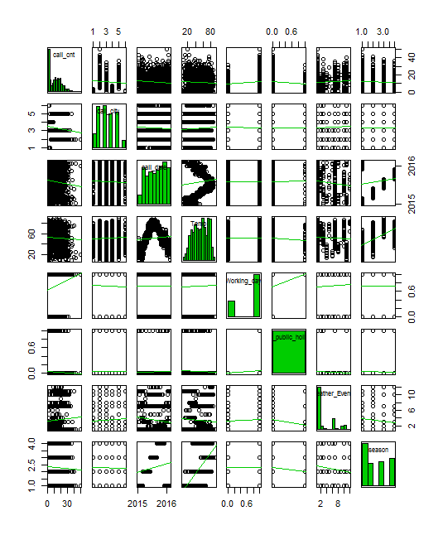
Scatter Plot Matrix

Slide 6
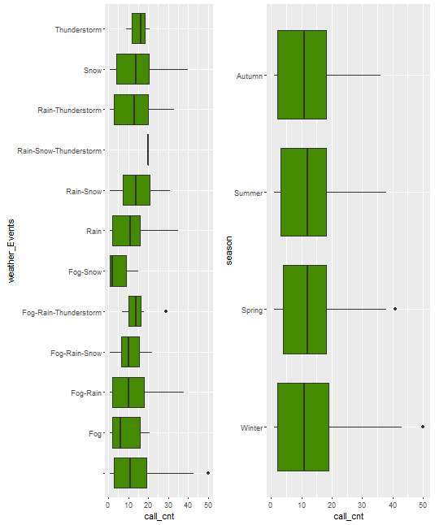
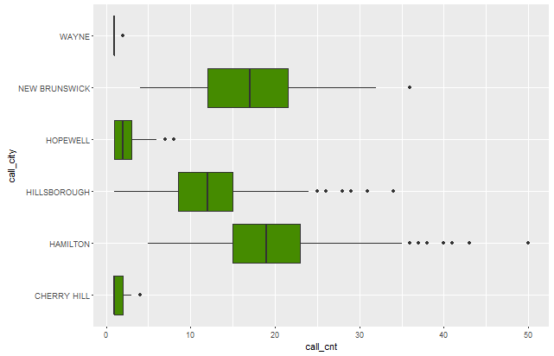
Data distributions

Slide 7
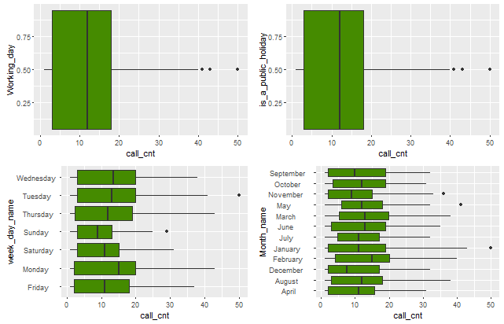
Continued

Slide 8
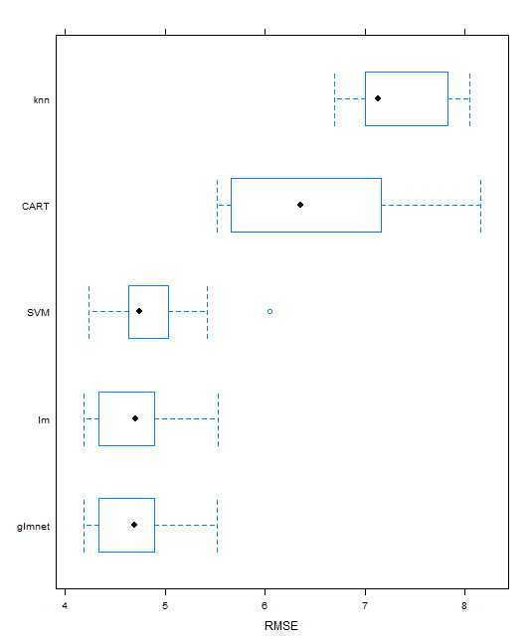
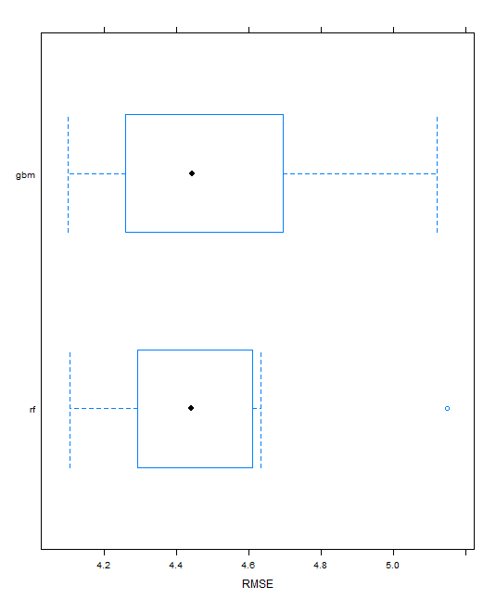
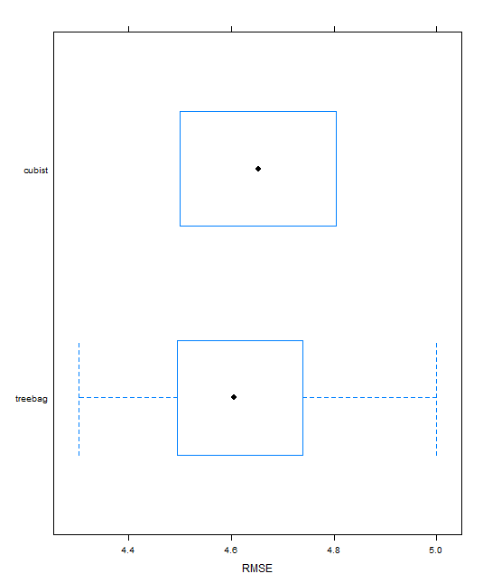
Model Training and Evaluate Algorithms
method
 | RMSE | Rsquared
glmnet | 4.69 | 0.73
CART | 6.48 | 0.47
SVM | 4.86 | 0.72
Linear regression (lm) | 4.69 | 0.73
K-Nearest Neighbour (knn) | 7.3 | 0.35
Ensemble method
 | RMSE | Rsquared
gradiant boosting(gbm) | 4.50 | 0.75
random forest(rf) | 4.47 | 0.75
Ensemble method
 | RMSE | Rsquared
cubist | 4.66 | 0.74
treebag | 4.63 | 0.73

Slide 9
After further tuning the Models
After Preprocessing BoxCox transform
 | RMSE | Rsquared
glmnet | 4.68 | 0.73
CART | 6.49 | 0.47
SVM | 4.67 | 0.73
Linear regression (lm) | 4.69 | 0.73
K-Nearest Neighbour (knn) | 6.94 | 0.4
gradiant boosting(gbm) | 4.48 | 0.75
random forest(rf) | 4.5 | 0.75
cubist | 5.3 | 0.66
treebag | 4.63 | 0.73
After log transform on y variable
 | RMSE | Rsquared
glmnet | 0.41 | 0.87
CART | 0.64 | 0.66
SVM | 0.45 | 0.85
Linear regression (lm) | 0.41 | 0.87
K-Nearest Neighbour (knn) | 6.94 | 0.87
gradiant boosting(gbm) | 0.44 | 0.86
random forest(rf) | 0.42 | 0.87
cubist | 0.44 | 0.86
treebag | 0.44 | 0.85
After Tuning the model with tunelength
 | RMSE | Rsquared
glmnet | 4.69 | 0.73
SVM | 4.8 | 0.72
random forest(rf) | 4.48 | 0.75

Slide 10
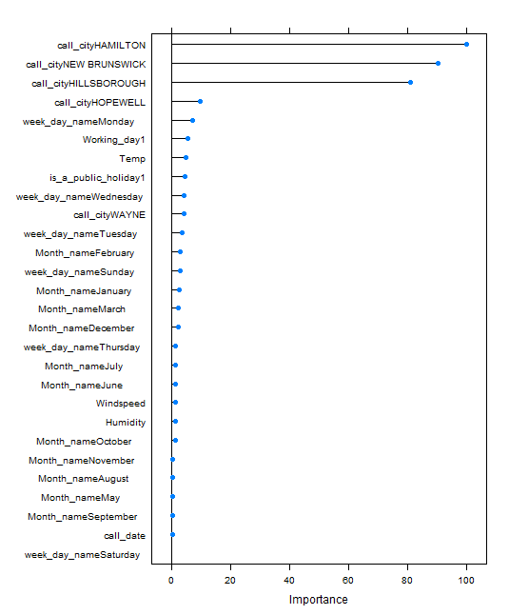
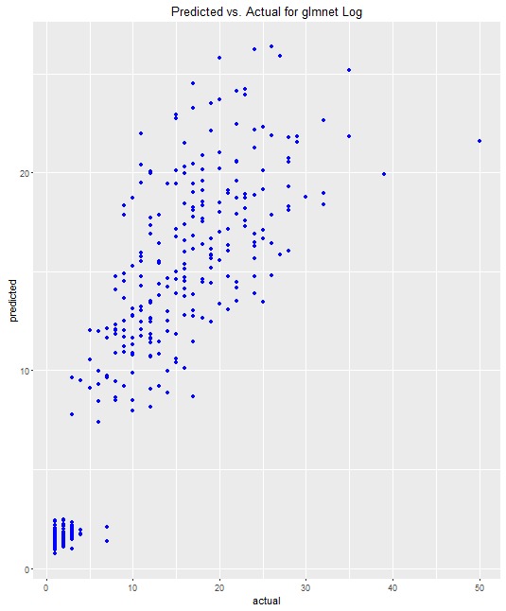
Predict and evaluate the accuracy
Predicted Values on the test dataset
 | RMSE | Rsquared
Linear regression (lm) | 4.43 | 0.75
glmnet with log | 4.34 | 0.77
lmtransx | 4.43 | 0.75
glmnettune | 12.6 | 0.7

Slide 11
Client usage and further Investigation
How would Client benefit by predicting the Call Volume.
Be prepared for inclement weather conditions and respond faster to customer for assistance
Reduce the wait time and response time
CSAT scores can be improved and customer acquisition can be improved.
“Expect the best. Plan for the worst” – customer loyalty

