Slide 1

SMART VISION
Smart Assistive Navigation Device
for Blind and Visually Impaired

Slide 2
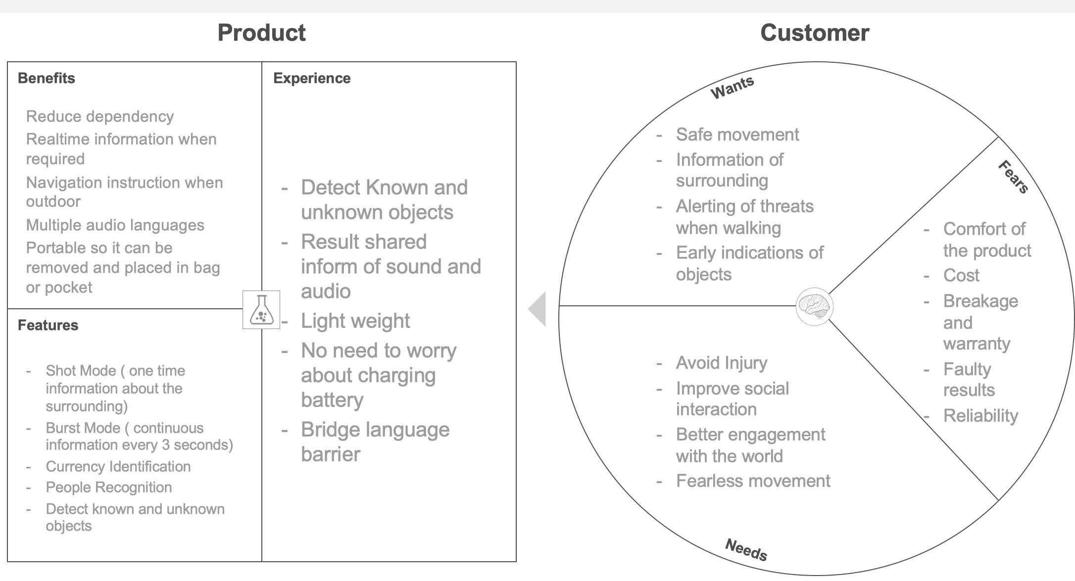
Value Proposition Canvas

Slide 3
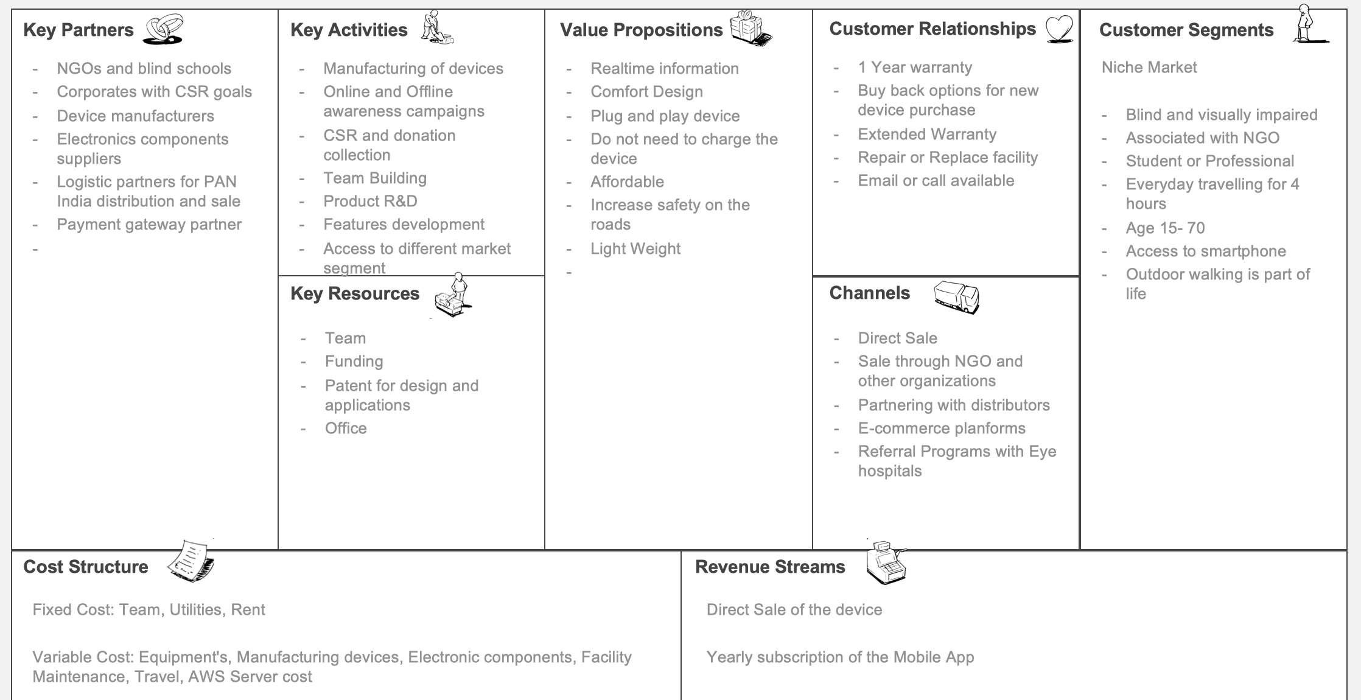
Business Model Canvas

Slide 4
MVP Description
MVP Product
Off-the-shelf Electronics components have been integrated. The glasses has been 3D printed using SLS
technology for better finish.
Characteristics and operation
The Glasses are going to be opaque and camera is placed in the center. The glasses are connected to phone
via USB cable for power and data transfer. There are two buttons for mode selection and information gathering.
Features
On the walk object detection and identification update to the user every 3rd second.
Price
MVP manufacturing price is expected to be Rs. 2500 and we expect to sell the device at Rs. 7000 to NGOs.

Slide 5
MVP Validation
Test Details: 10 glasses will be manufactured for testing with potential users and awareness activities to draw traction for the product.
Duration of Test: 1 Month
Target Audience: Male & Female with ages of 15 –65 who are professionally active
Getting the Audience: Association with NGOs and blind school for testing
MVP Testing needs to be completed.

Slide 6


Revenue Model
SUBSCRIPTION
Yearly: Rs. 1000 ($13) Pricing Dependent on the Feature
Selection
DEVICE SELL
Price: Rs. 10,000 ($132)
Sell of Glasses with 1 Year of Subscription

Slide 7
Unit Economics
 | Single Unit
MRP | 10,000
Discount to NGO and Distributor | 3,000
Sell Price | 7,000
Cost Of the Device | 3,000
Gross Profit | 4,000
Gross Margin | 57%
Customer Acquisition Cost | 350
Opex Cost | 1,000
Total Expense | 1,350
Net P&L | 2,650
Net Margin | 38%
Manufacturing 1000 Devices
All Amount in Rs.
Based on Sale of 300 Devices Per Month

Slide 8




Go-To-Market Strategy
Awareness Through NGOS
D2C Through E- Commerce and Website
Retail Distribution
Referral Programs with Hospital

Slide 9




Marketing Strategy
Focus is Awareness and Cause
Digital Marketing
Targeting D2C and B2B for awareness and Lead Generation
Influencer Marketing
Sharing photos, videos,
events and stories
Radio Presence
Physical Events
Public Talent Show and sale of items made by blind
Broadcast life stories and
events for higher visitors

Slide 10





Ecosystem Applications
Industrial Applications
Video Enabled Machine Maintenance
Employee Productivity monitoring Warehouse Inventory Management
Personal Use
FinTech
E-Tech
Security
Vision Loss
Tourism
Shopping Experience Driving Assistance
Payment Gateway
Reading Difficulty Educational Learning
Body Camera for the Law
Enforcement

Slide 11
Investability
Strategy to reduce CAC and Churn rate
Practicing extensive marketing promotions
Retargeting Customers
Gathering customer feedback
Improving customer Retention
Prioritizing Proactive Customer Service
Strategy to increase CLV, ARPU and Net profit
Creating customer Loyalty program
Collecting actionable customer feedback
Fostering Good customer service and Relationships

Slide 12
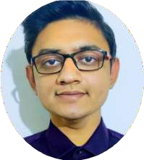
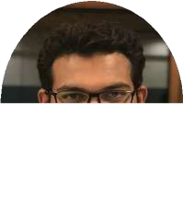
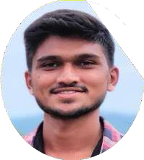
Team
Deep Parmar
Co-Founder : AI-Software Developer
Over 4 Years of experience in AI system Development
MEBE in Computer Engineering Government Engineering College
Suket Amin
Co-Founder : Product and Business Development
Over 5 Years of experience in Product
Development and Engineering MEBE in Mechatronics and Robotics University of Leeds, UK.
Ravi Jadav
Software Developer
Over 3 Years of experience in Frontend
Development
BE in Computer Engineering Government Engineering College

Slide 13
THANK YOU

