Slide 1

SMART VISION
Smart Assistive Navigation Device
for Blind and Visually Impaired

Slide 2
Did You Know?
People suffering from Blindness and vision loss which cannot be corrected. 49M Blind alone.
303 M
India has the worlds largest blind population along with 0.27M blind children
9 M
48 M
Indian are visually impaired with 9.3M Children
Source: WHO Report 2020, Orbis 2021 and Investigative Ophthalmology Visual Science (IOVS) 2020.

Slide 3
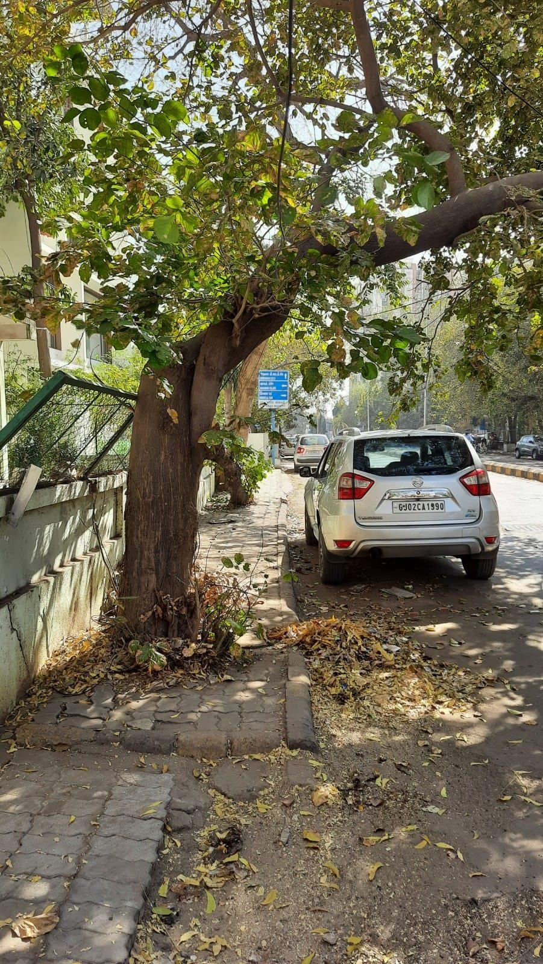
Problem
Navigation Assistance in an Outdoor and Unknown Environment
Need for Realtime Information of obstacle on the path
Lack of Detailed Information for safe avoidance
Source: Indian Journal of Ophthalmology

Slide 4
Statistics & Market Size
303 M
55 M
Population of Blind & Visually Impaired
World
49 M Blind
India
9 M Blind
800 M
55 M
1.35 B
Market Size
Estimation
(10 M People x $ 128 (Rs. 10,000)
2020
2028
With increasing ageing population, market is expected to grow
Source: The Tribune, Indian Journal of Ophthalmology, Orbis 2021, Investigative Ophthalmology Visual Science (IOVS) 2020, Verified Market Research

Slide 5
Market Size
TAM
$ 40.0 B
(303 M People x Product Price)
SAM
$ 6.6 B
(50 M People x Product Price)
SOM
$ 1.3 B
(10 M People x Product Price)
Product Price: $132 or Rs. 10,000 (Assumption)
With increasing ageing population, market is expected to grow
Source: The Tribune, Indian Journal of Ophthalmology, Orbis 2021 and Investigative Ophthalmology Visual Science (IOVS) 2020.

Slide 6
Early Adopter
Fully Blind
Age of 15 - 50
Access to Smartphone
Pursuing Education or Working
Independent Traveler using Public Transport or Walk
Living in Tier I Cities
Associated with NGO’s or any other Organization

Slide 7
Customer Persona
Early Adaptors
Only Blind
Adult of 18 – 50 Age Group
Working Professional or Student
Having Smartphone (Android)
Associated with NGO
Living in Tier I Cities
Expansion
Blind or Visually Impaired or Vision Difficulty
All Age Group
Living or access to Tier I, II and III city

Slide 8



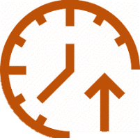
Value Proposition
Sunbots optimize use of resource and allows for real-time information ensuring:
Easy To Use
Individual Independence
Enhanced Visibility
Increased Productivity
At Affordable Cost

Slide 9
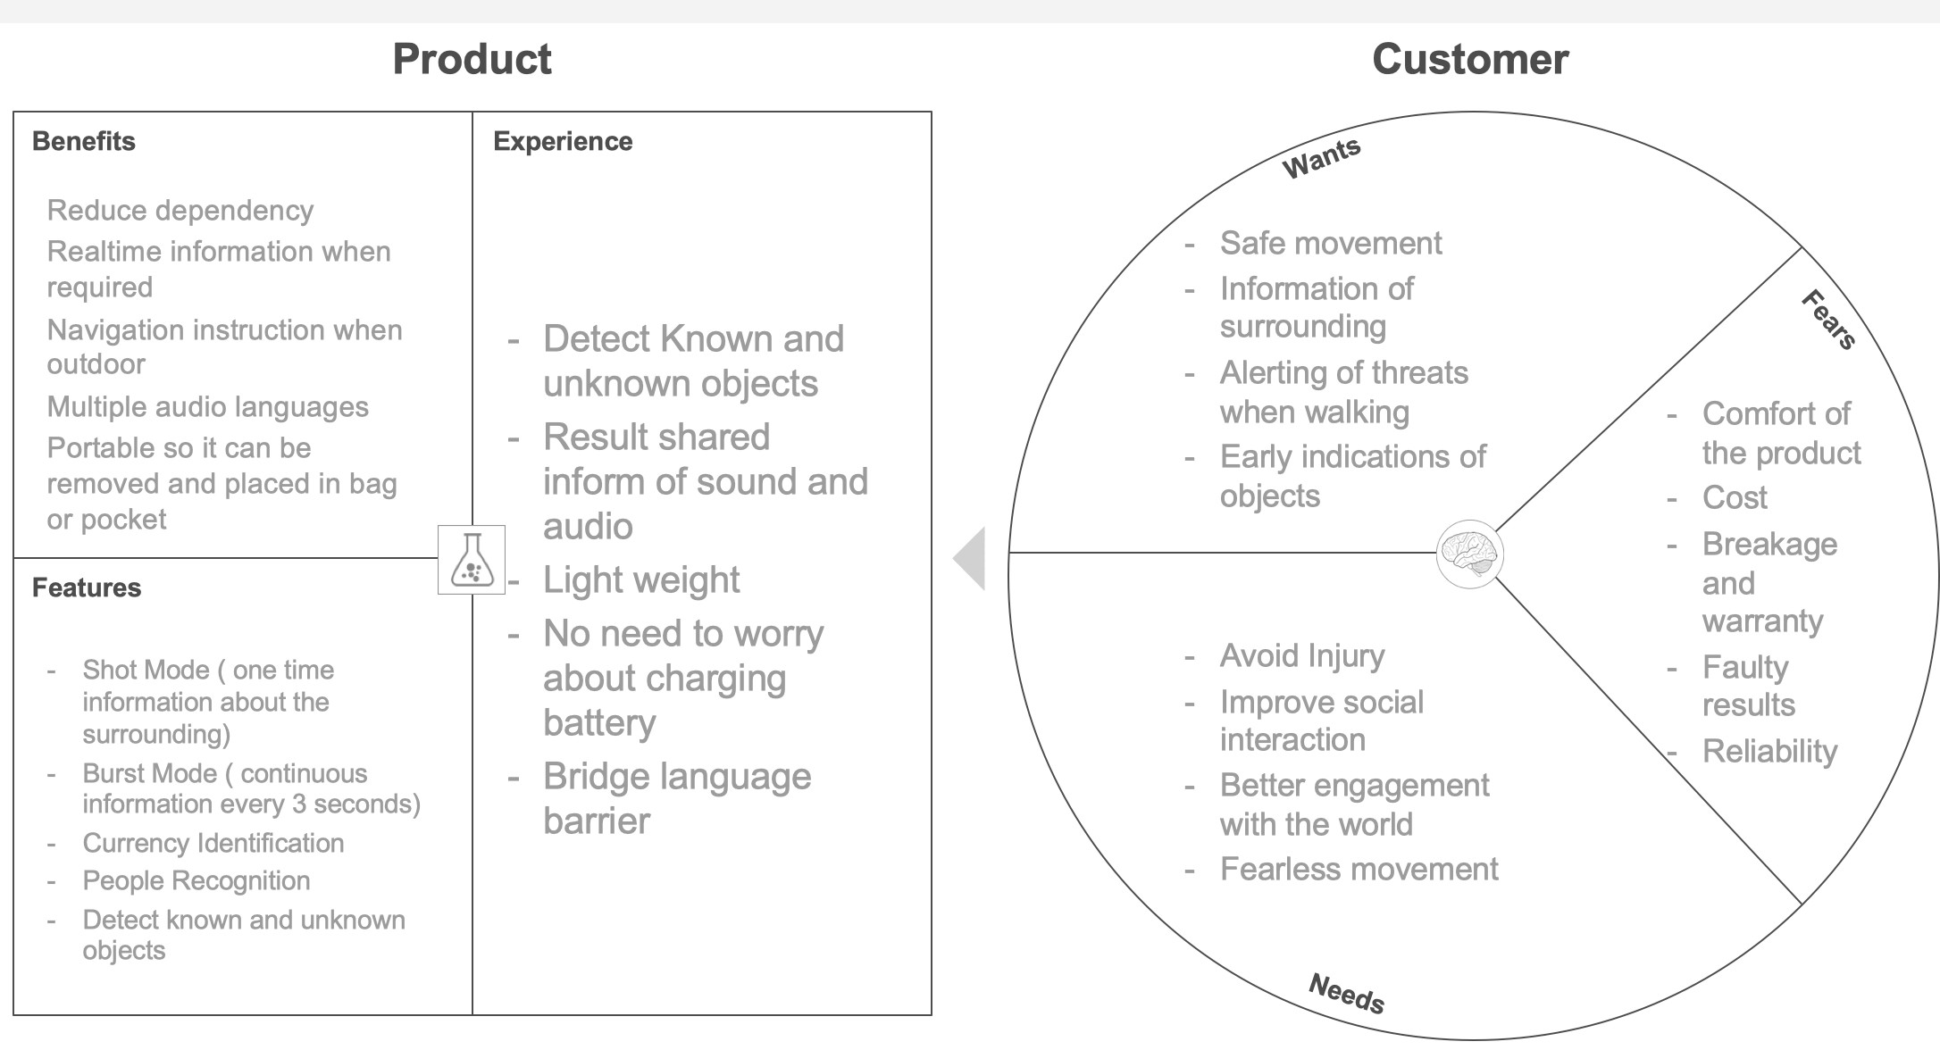
Value Proposition Canvas

Slide 10
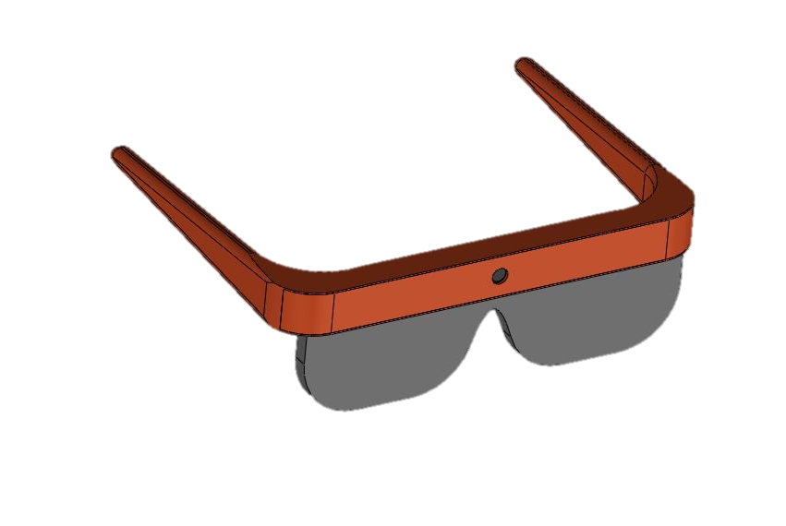
Product
An AI Enabled Smart Wearable Device that Translates the Visual World into Audio, in the Desired Language
5 MP Camera
Power through Phone
Object Identification at 5 Meters
Connected Over Cable
Edge Processing
Audio On Phone
No Internet Required
Automatically Open The App
MVP Design
Mobile Application

Slide 11




Features
Burst Mode
Image captured every 3rd second
Object Identification
Detecting known and unknown Objects
Currency Identification
Identify various denomination of Indian Currency
Identify People
Face recognition of known people from the database

Slide 12
Demo

Slide 13
Competitive Advantage
Unique Value Proposition?
Realtime and detail information of surrounding with safe navigation instruction every 3rd Second
Competitive advantage will you build to keep the promise?
Low cost and more features to improve social interaction for blind and visually impaired
How will you defend the competitive advantage?
Introduce new products with upgraded Mobile application features for various other application ranging from tourism, warehouse management, helping people with reading difficulty etc.

Slide 14
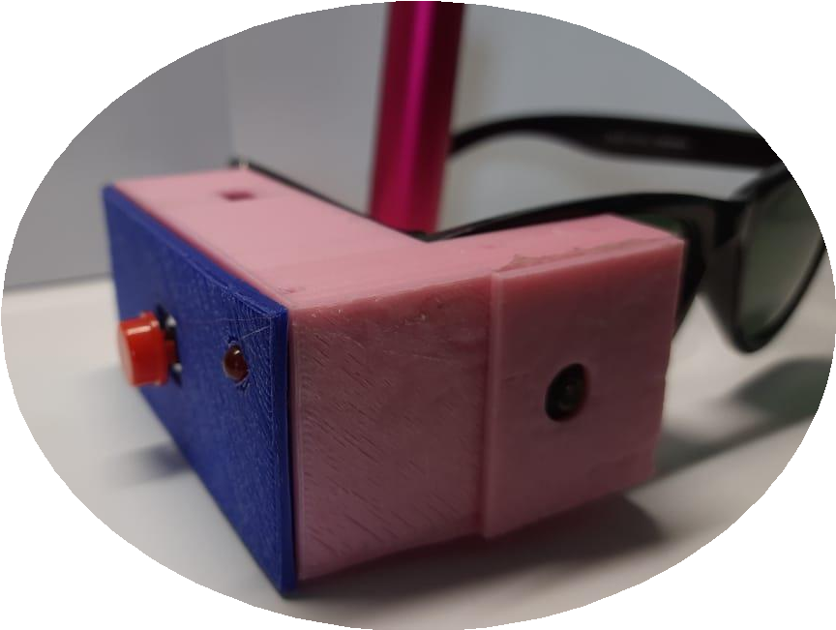
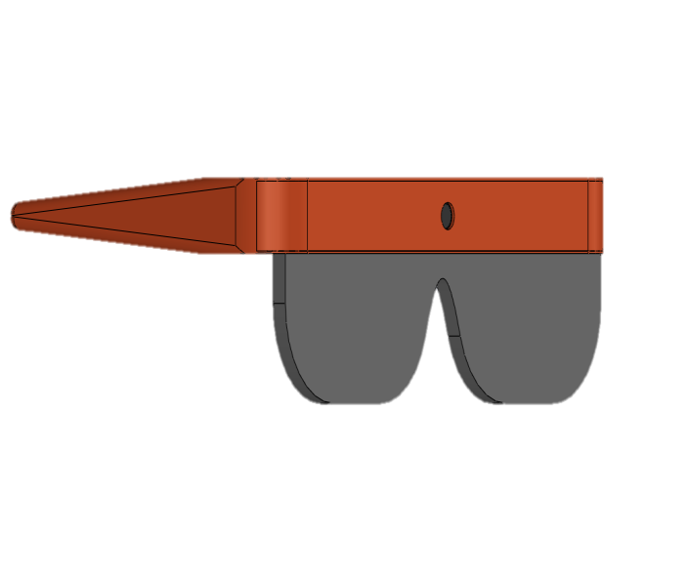
Current Status
Prototype Testing Completed with 5 Users
Feedback: Bulky Device, Auto Photo capture, Spectacle Inbuild camera, Lower Cost and Limited features at early stage.
MVP Development Duration: 2 Months with Testing
Objective: Feedback on the design with inbuild camera, Auto mode, Features accuracy, SLS 3D printing for MVP and testing with 50 blind

Slide 15
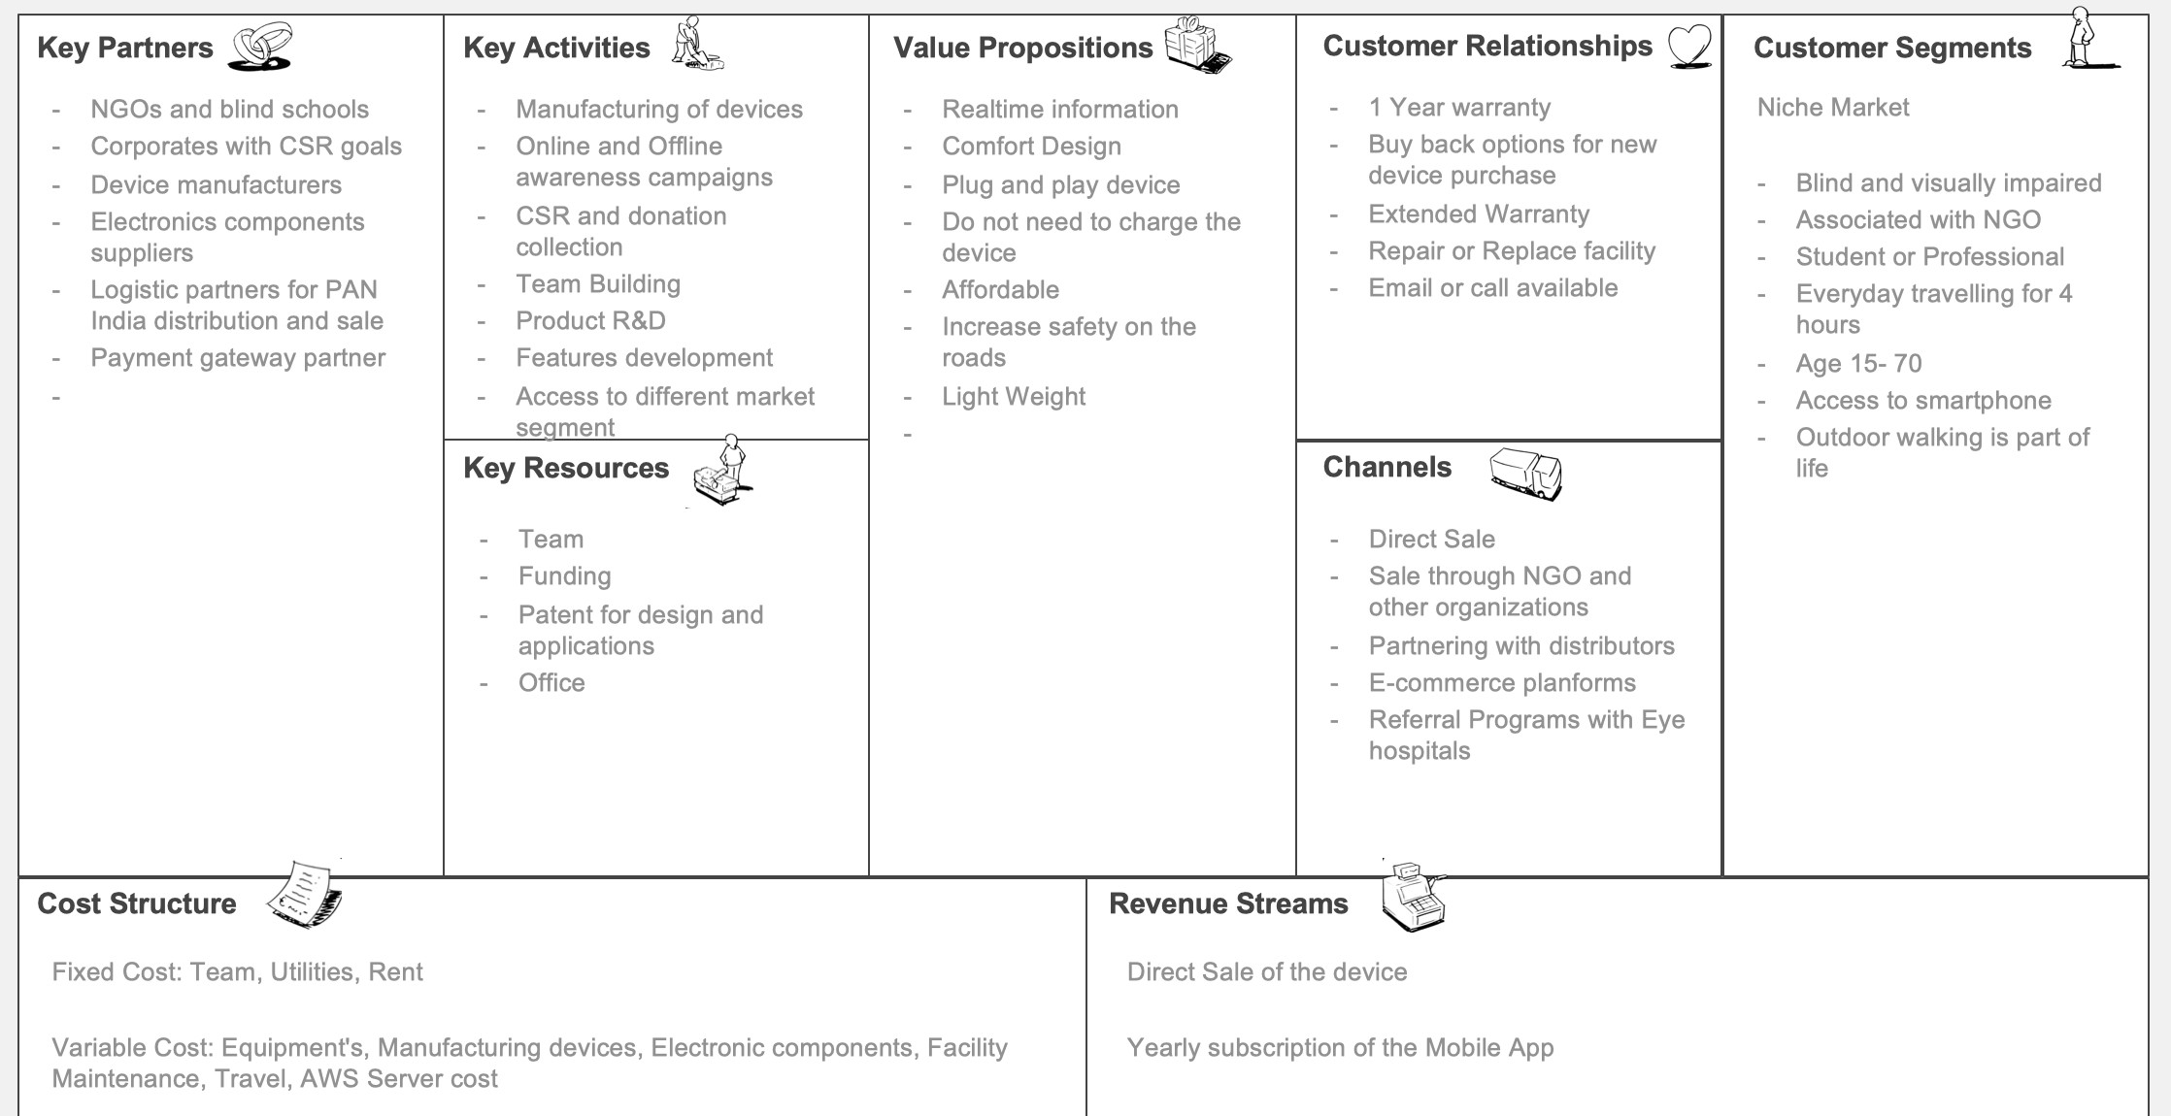
Business Model Canvas

Slide 16
MVP Description
MVP Product
Off-the-shelf Electronics components have been integrated. The glasses has been 3D printed using SLS technology for better finish.
Characteristics and operation
The Glasses are going to be opaque and camera is placed in the center. The glasses are connected to phone via USB cable for power and data transfer. There are two buttons for mode selection and information gathering.
Features
On the walk object detection and identification update to the user every 3rd second.
Price
MVP manufacturing price is expected to be Rs. 2500 and we expect to sell the device at Rs. 7000 to NGOs.

Slide 17
MVP Validation
Test Details: 10 glasses will be manufactured for testing with potential users and awareness activities to draw traction for the product.
Duration of Test: 1 Month
Target Audience: Male & Female with ages of 15 – 65 who are professionally active
Getting the Audience: Association with NGOs and blind school for testing
MVP Testing needs to be completed.

Slide 18
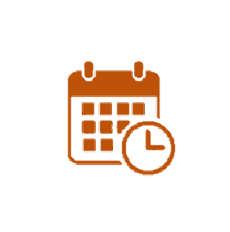

Revenue Model
SUBSCRIPTION
Yearly: Rs. 1000 ($13) Pricing Dependent on the Feature
Selection
DEVICE SELL
Price: Rs. 10,000 ($132)
Sell of Glasses with 1 Year of Subscription

Slide 19
Unit Economics
 | Single Unit
MRP | 10,000
Discount to NGO and Distributor | 3,000
Sell Price | 7,000
Cost Of the Device | 3,000
Gross Profit | 4,000
Gross Margin | 57%
Customer Acquisition Cost | 350
Opex Cost | 1,000
Total Expense | 1,350
Net P&L | 2,650
Net Margin | 38%
Manufacturing 1000 Devices
All Amount in Rs.
Based on Sale of 300 Devices Per Month

Slide 20




Go-To-Market Strategy
Awareness Through NGOS
D2C Through E- Commerce and Website
Retail Distribution
Referral Programs with Hospital

Slide 21




Marketing Strategy
Focus is Awareness and Cause
Digital Marketing
Targeting D2C and B2B for awareness and Lead Generation
Influencer Marketing
Sharing photos, videos,
events and stories
Radio Presence
Broadcast life stories and
events for higher visitors
Physical Events
Public Talent Show and sale of items made by blind

Slide 22





Ecosystem Applications
Industrial Applications
Video Enabled Machine Maintenance
Employee Productivity monitoring Warehouse Inventory Management
Personal Use
Vision Loss
Tourism Shopping Experience
Driving Assistance
FinTech
Payment Gateway
E-Tech
Reading Difficulty Educational Learning
Security
Body Camera for the Law
Enforcement

Slide 23
Investability
Strategy to reduce CAC and Churn rate
Practicing extensive marketing promotions
Retargeting Customers
Gathering customer feedback
Improving customer Retention
Prioritizing Proactive Customer Service
Strategy to increase CLV, ARPU and Net profit
Creating customer Loyalty program
Collecting actionable customer feedback
Fostering Good customer service and Relationships

Slide 24
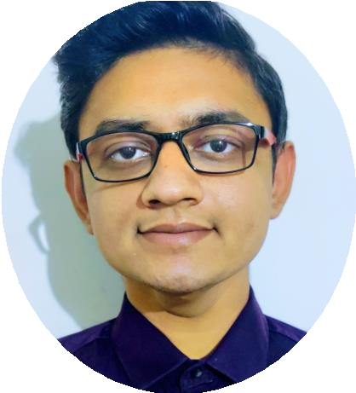
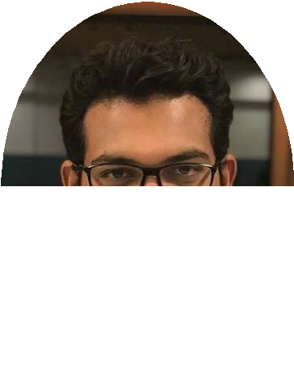
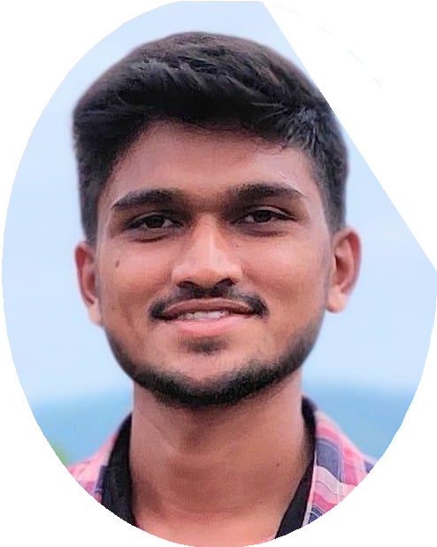
Team
Deep Parmar
Co-Founder : AI-Software Developer
Over 4 Years of experience in AI system Development
MEBE in Computer Engineering Government Engineering College
Suket Amin
Co-Founder : Product and Business Development
Over 5 Years of experience in Product Development and Engineering
MEBE in Mechatronics and Robotics University of Leeds, UK.
Ravi Jadav
Software Developer
Over 3 Years of experience in Frontend Development
BE in Computer Engineering Government Engineering College

Slide 25
THANK YOU

