Slide 1




Kaggle movie dataset

Slide 2


Motivation
The primary motivation behind this dataset is I wanted to try something different that I haven’t tried so that I can explore the process of working with other open data platforms.
Due to the pandemic, people find comfort staying at their own homes, and most likely, they tend to spend their time binge-watching movies and shows on streaming services like Netflix, Hulu, Amazon Prime Video, HBO, Disney plus considering the increase in subscription in streaming platforms.
With this analysis, I can recommend people the movie regarding ratings, votes and popularity, or I can use this analysis for streaming services to get these movies on their platform

Slide 3

Kaggle movie dataset
This data set had 8 columns and 9463 rows, and it was cleaned data. Its column's name were 'title', 'release_date', 'overview', 'popularity’, 'vote_average', 'vote_count', 'video’. For my analysis I added new columns 'Year', 'Month', 'day’ and ‘Decade’.
I rename the above column and convert the month number to month name.
My analysis on basis of following questions:
How many years does this data set covers?
What are the Top 10 Highest Rated Movies?
What are the Top 10 popular movies?
What are the Top 10 highest voted Movies?
Which movie has least rating and which year was it released?
Decade wise Movies Released and Top-rated movies of Decade
Name all the movies that were released between 2015 and 2020, have a ratings above 8.0 but made below the 25th percentile in popularity
On which day most of movies were released between 2015 and 2020?
Latest year (2021) on which day, month most of movies were released, Highest rated and Popularity And maximum and minimum Votes

Slide 4
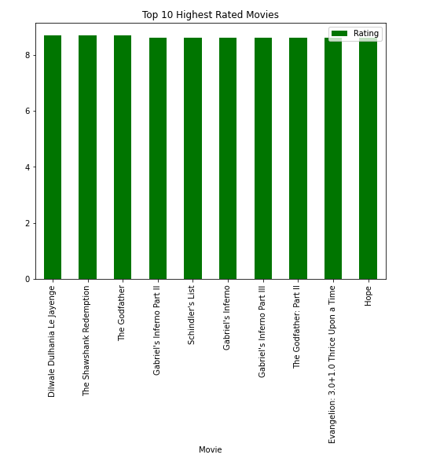
Top 10 Highest Rated movies
1902-2021

Slide 5
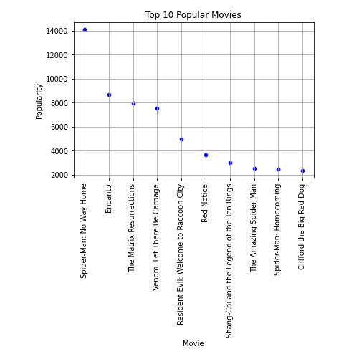
Top 10 Popular movies
1902 -2021

Slide 6
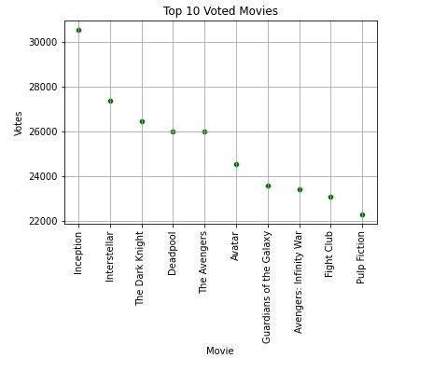
Top 10 Voted movies
1902-2021

Slide 7
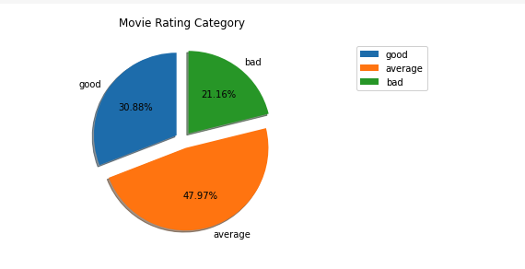
Movies Ratings Category
1902-2021
Notes:
Ratings above 7, GOOD, Between 6 to 7, AVERAGE, Below 6, Bad.

Slide 8
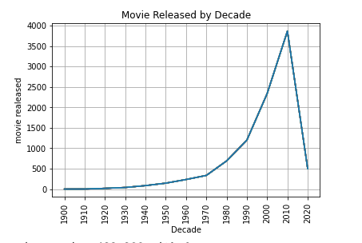
Movies were released highest in 2010
Notes:
1900 had 2 movies released
2000 had 2337
2010 had 3865
2020 499

Slide 9
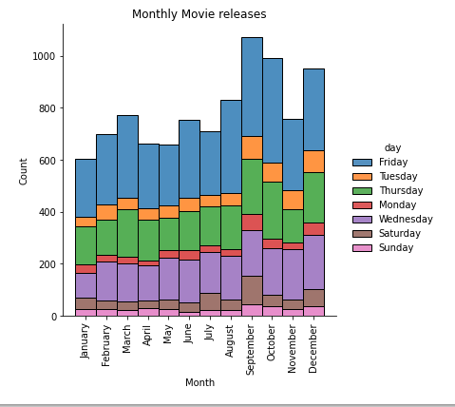

Movies were released highest in month of September and Friday of week
Notes:
Movies released: January 602, September 1071, October 992, December 950

Slide 10
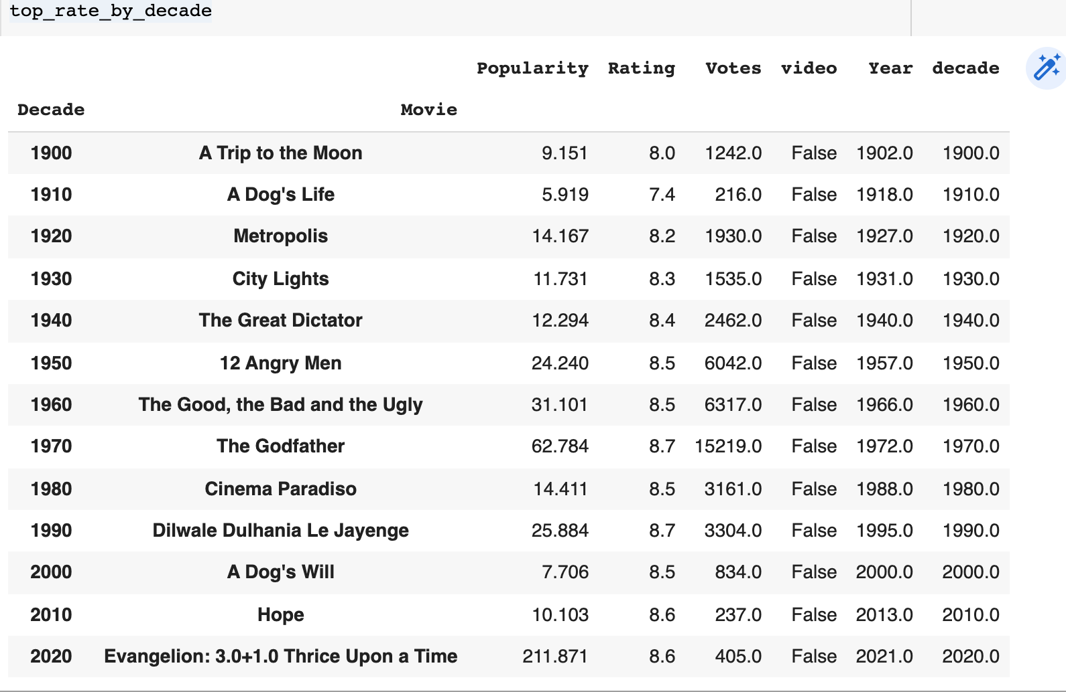

Top Movies of decade by Ratings

Slide 11
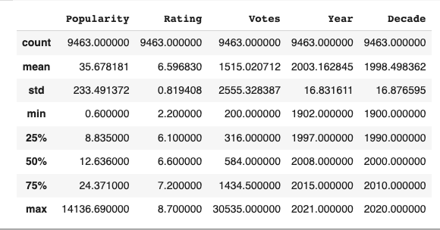

Slide 12
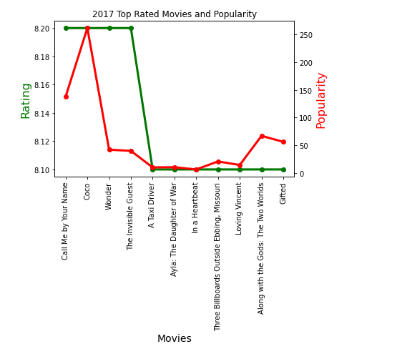
Movies were released highest in Year 2017
Notes:
2017 had 454 movie released.

Slide 13
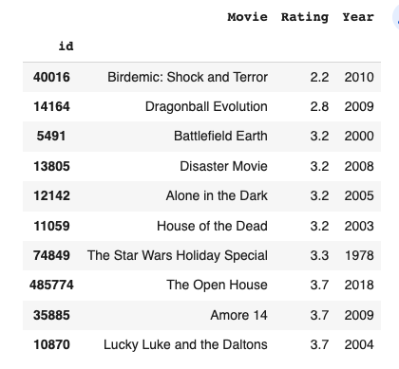
1902-2021
Bottom 10 Rated Movies

Slide 14
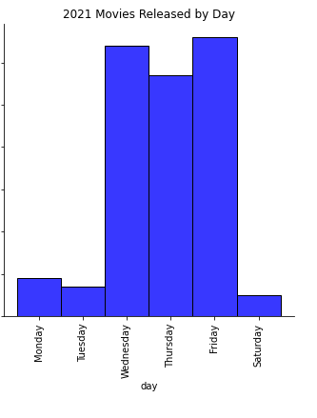
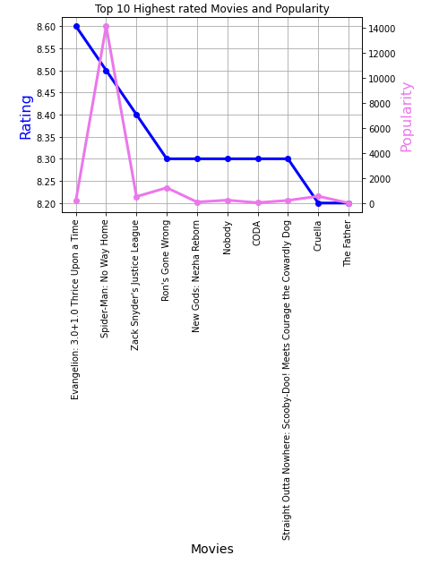
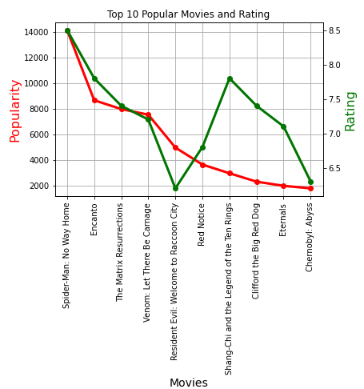
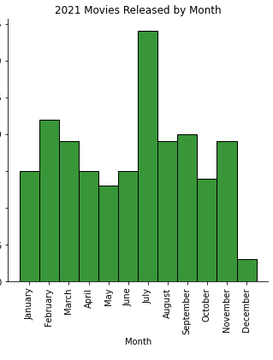
Year 2021

Slide 15
Conclusion:
This dataset contains data from Year 1902 to 2021. Highest number of movies were released in 2017.
Decade wise highest movies were released in 2010. Least rated movie Birdemic: Shock and Terror (2.2) was released in Year 2010.
Most of movies were released in month of September and Friday of week.
Latest Year (2021) data suggest that Highest movies were released in July and least in December this may be due to on going pandemic and complete lockdown in the early stage of covid in 2020.
Surprisingly, Movies that were released on Wednesday(64) is almost closed to Friday(66)
Top Voted Movies of 2021 is Godzilla vs. Kong
Top Rated Movies of 2021 is Evangelion: 3.0+1.0 Thrice Upon a Time
Top Popularity movie of 2021 is Spider-Man: No Way Home

