Slide 1
Phase 2 Project Presentation

Slide 2
Business Problem.
The company decided to start a new movie studio to create original movie content.
Company doesn’t know anything about creating movies.
Company’s objective is to obtain actionable insights on current high-performing and trending movies.
These insights will help company decide on what movies to make.

Slide 3
Proposed Solution.
Identify the most profitable movie genres.
Identify key movie metrics that have impact on movie success.
For each genre*, examine the effect of selected key metrics on movie’s box office performance.
Recommend metric values that would maximize the success for each genre*.
*In the context of available box office data for a genre

Slide 4
Datasets.
Kaggle:
Oscar Awards.
Golden Globe Awards.
TMDB Dataset*.
Movies with Content Ratings*.
IMDB Dataset.
The Movie Dataset*.
*Dataset has Budget/Gross data.

Slide 5
Data Manipulation.
For all datasets, we performed standard data cleaning.
We added cast and crew info IMDB and TMDB dataset.
We added budget information to

Slide 6
Data Manipulation.
For all datasets, we performed standard data cleaning

Slide 7
Dataset Metrics
Movie Budget
Movie Net Profit = Movie Gross - Movie Budget
Movie Genre
Release Time
Content Rating
Cast and Crew
Movie Reviews
Movie Rating

Slide 8
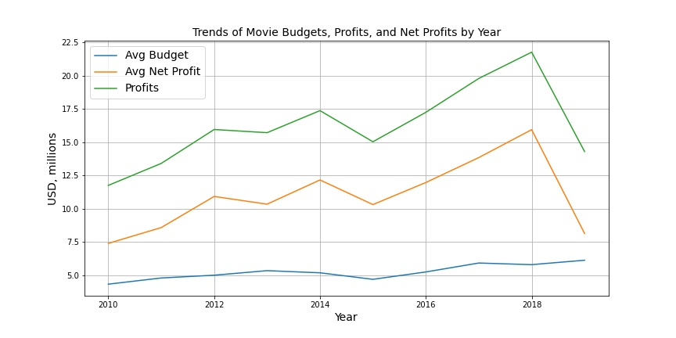

Historic Trends

Slide 9
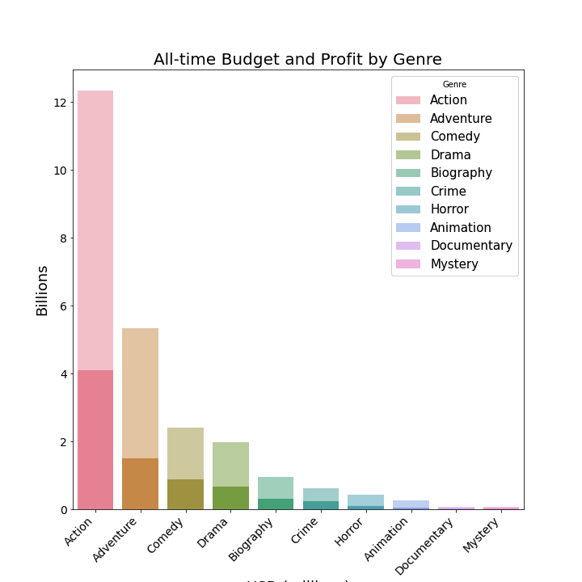
Identifying Top 10 Most Profitable Genres.

Slide 10
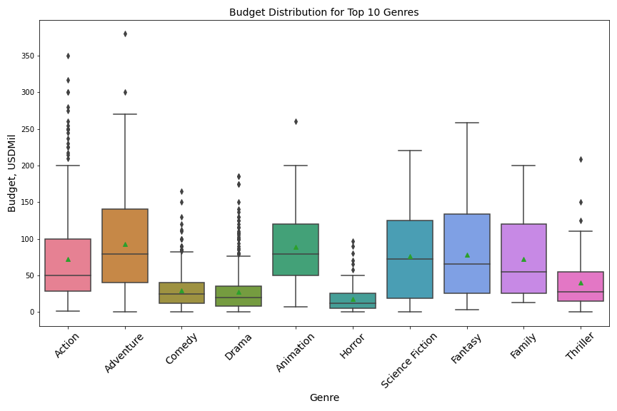

Slide 11
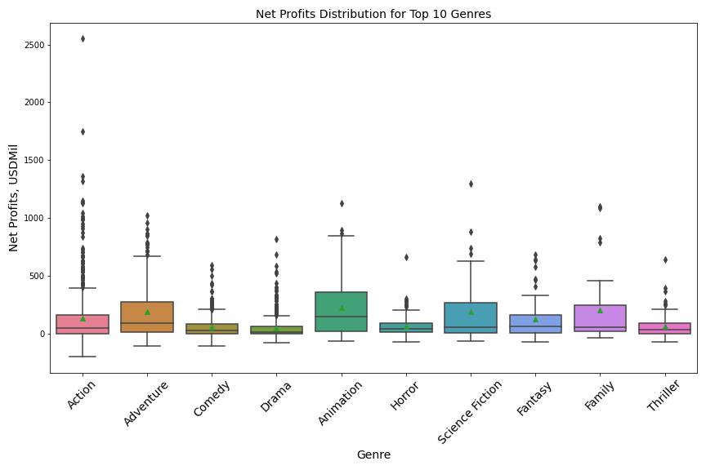

Slide 14
Movie Net Profits By Genres
Distributions of genres
Top 10-5: expected revenue for 1 mil invested from linear regression
Budget histogram: entry point
Maybe what to avoid?

Slide 15
What to invest and what to avoid
Add table here per genre roi per mil and recommended entry budget

Slide 16
What % of movies per genre had roi < 1 , >1.5, >2 > 10
3 datasets:
1. PG Ratings Dataset for PG gross: Select Genre, budget, profit.
2. IMDB dataset for EDA and recommendations (plots)
Structure:
1. Overview:
Top 10 genres since 2000 budget + gross
For each top 10, ratings and reviews
2. Selection.
Narrow it down to 5 genres (using combo )?
For each genre, fit linear regression and plot distribution for budget/Net profit (success and failure)
Conclusion: Table of Genres, recommended budget, profit trends for each genre
3. Content rating (if applies).
4. Release date
5. Cast/crew awards vs success
3. TMDB Datset (5000) + Awards dataset for cast/crew icking up top 10

Slide 17
Release Date Analysis
For Proposed

Slide 18
Content rating analysis

Slide 19
Cast and crew: using critically acclaimed

Slide 20
Conclusion

Slide 21
Future work

