Slide 1

project
CREDIT CARD FRAUD DETECTION SYSTEM
A Tri-Model Architecture Leveraging Decision Trees, XGBoost, and Heterogeneous Graph Neural Networks for Transaction Security
Presented By:
M. R Lekshmi Priya (253011)
Hemalekshmi R (253114)
Ashna Jabin N.K (253107)

Slide 2

Introduction & Problem Statement
The Problem: Credit card fraud costs the global economy billions annually.
The Challenge: Fraudulent patterns are "needles in a haystack" (imbalanced data) and are constantly evolving.
The Goal: Build a system that not only looks at transaction numbers but also at how users, devices, and cards are interconnected.

Slide 3
Dataset Overview
Source: IEEE Computational Intelligence Society (IEEE-CIS) dataset from Kaggle.
Complexity: Contains two main tables: Transactions (amounts, timestamps) and Identity (device info, network details).
Scale: Over 500,000 transactions with hundreds of features (V-features, C-features, D-features about 870 columns).
Imbalance: Highlighting that only a tiny percentage of the data is actually fraud.

Slide 4
EDA
Dataset Overview:
Total Transactions: 590,540 (Original) | Notebook Sample: 177,162 (30%)
Dimensionality: 434 Initial Features (Transaction + Identity data join).
Target Class Imbalance - Legitimate: 96.42% | Fraudulent: 3.58%
Imbalance Ratio: 1 : 26.9 (Requires stratified sampling).
Missing Value Analysis: Identified 214 columns with >50% missing data (primarily in Vesta and Identity features).
High sparsity in "V" features suggests the need for dimensionality reduction (PCA).
Statistical Findings: Transaction amounts follow a long-tail distribution (Outliers identified at $1,104+).
Temporal analysis reveals cyclical "midnight" spikes in fraudulent attempts.

Slide 5
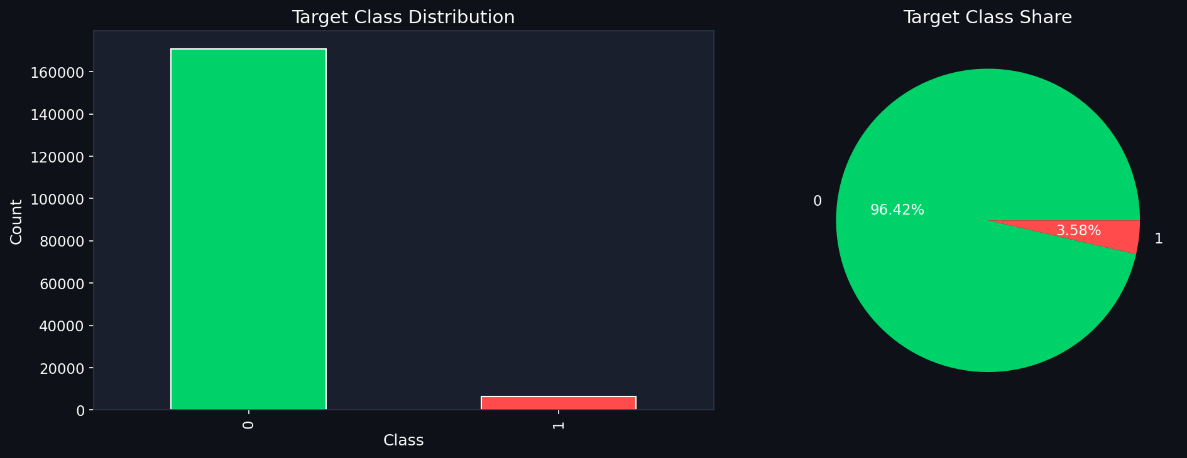
Target Class Distribution

Slide 6
Feature Engineering & Preprocessing
Data Cleaning:
Memory Optimization: Downcasted numeric types, reducing RAM usage by ~60%.
Missingness Strategy: Median imputation for numeric gaps; "Unknown" tagging for categorical text.
Outlier Capping: Applied 99th percentile clipping ($1,104) to stabilize model gradients.
Feature Transformation & Scaling:
Z-Score Scaling: Normalized all features to Mean=0, Variance=1.
Label Encoding: Transformed 9 categorical features (DeviceType, card4, etc.) into numeric inputs.
Dimensionality Reduction (PCA):
Condensed 339 "V-features" into 50 Principal Components (PCA applied only for XGBoost model)
Maintains 90%+ variance while removing noise and multi-collinearity.

Slide 7
Decision Tree (Baseline Model)
Model Objectives:
Establish a "glass-box" baseline to understand feature importance.
Implement SMOTE (Synthetic Minority Over-sampling Technique) to address the 1:27 class imbalance.
Training Configuration:
Algorithm: Decision Tree Classifier (max_depth=12).
Resampling: Increased fraud representation from 4,439 to 59,786 samples using synthetic generation.
Weighting: Utilized class_weight='balanced' to further penalize misclassified fraud.
Baseline Results (Test Set):
Fraud Detection Rate (Recall): 54.57% (519/951 frauds detected).
Precision: 29.29% (Low precision due to aggressive flagging).
ROC-AUC: 0.8390.
The model successfully identified over half of the fraud cases but produced 1,253 false alarms.
Top Predictors: Features related to Transaction Amount and Card Identity proved most influential.
Conclusion: Serves as a benchmark; more advanced models (XGBoost/HGNN) are required to reduce "Customer Friction" (False Positives).

Slide 8
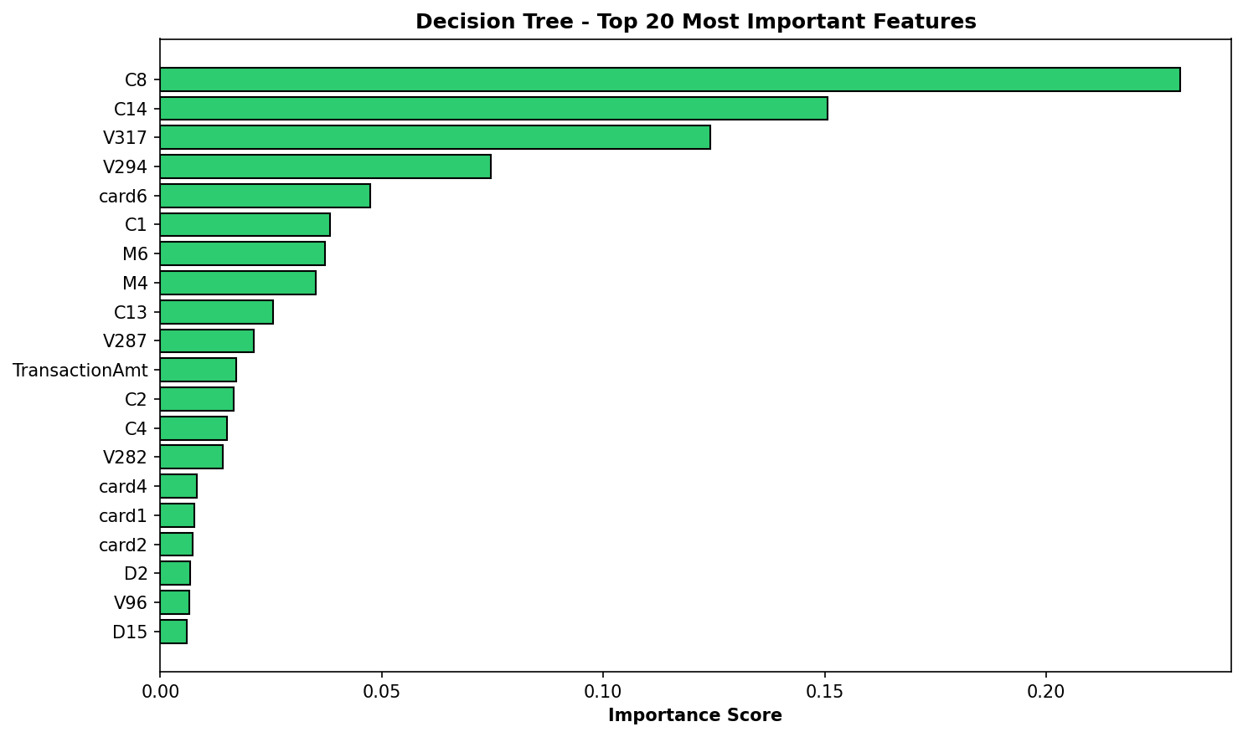

Slide 9
XGBoost Model
Algorithm: XGBoost (Extreme Gradient Boosting) using 500 trees and a max depth of 8.
Imbalance Handling: SMOTE Resampling - Generated 55,347 synthetic samples to balance the training set.
Cost-Sensitive Learning: Set scale_pos_weight = 26.9 to penalize missed fraud more heavily.
Performance Metrics:
ROC-AUC: 0.9198 (Strong overall discriminative power).
Recall: 72.66% (Catches nearly 3/4 of all fraud cases).
Precision: 31.11% (Trade-off: higher false-alarm rate to ensure security).
Top 15 Predictors: Model reliance is concentrated in specific "V" (Vesta behavioral) and "C" (Count) features, which provide significantly more information than the raw transaction amount.
Efficiency: Entire training process completed in 35.8 seconds with total features used - 217, making it highly scalable for large datasets.

Slide 10
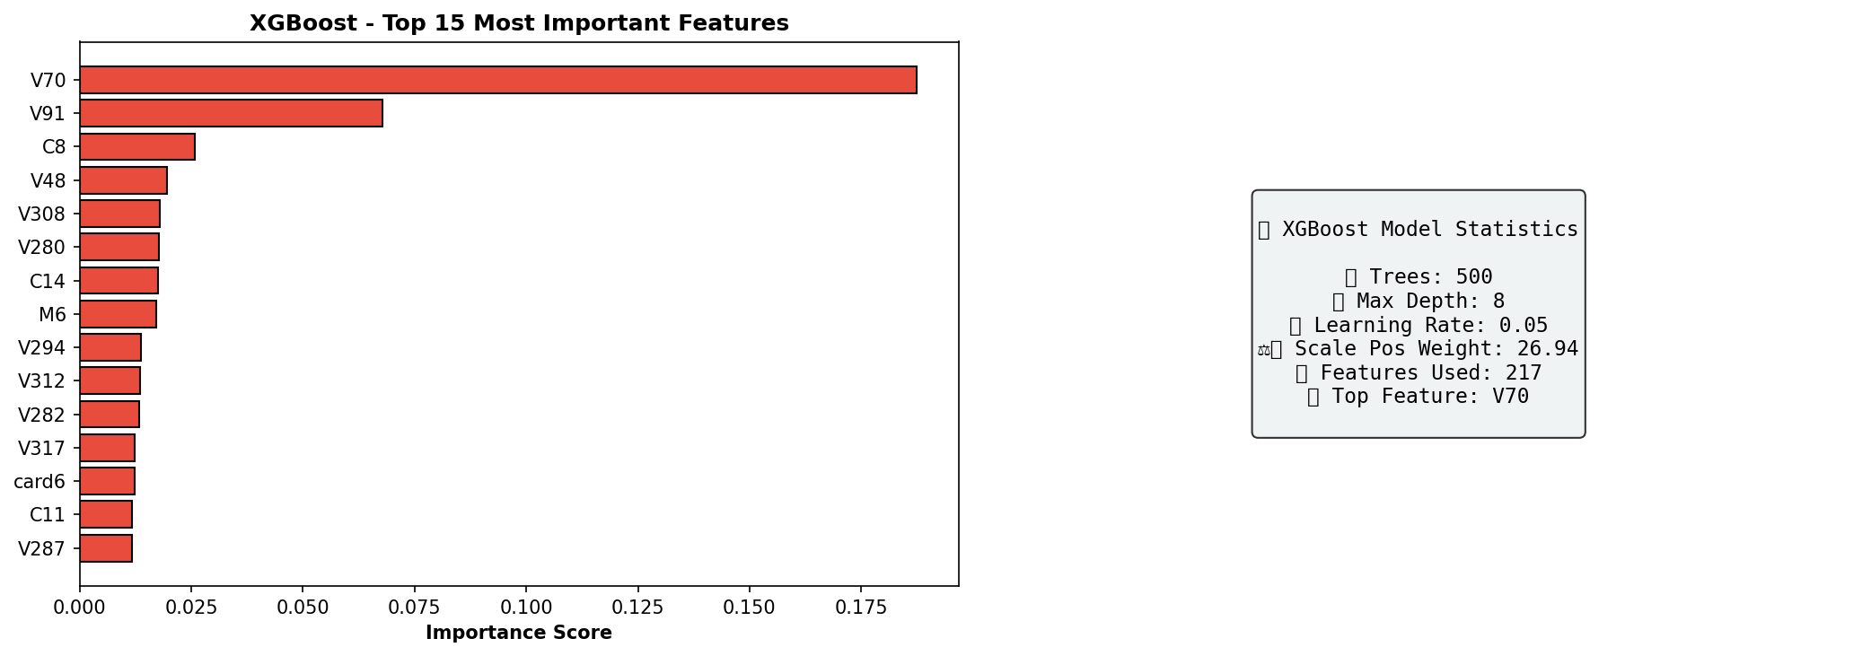

Slide 11
HGNN Model
Graph-Based Fraud Architecture
Concept: Moves beyond tabular analysis to Relationship Mapping.
Heterogeneous Graph: Connects three distinct node types: Transactions, Cards, and Devices.
Attention Mechanism: Uses a Transformer-based architecture to automatically weigh the importance of different connection types (e.g., identifying "High-Risk Devices").
Temporal Intelligence: Incorporates Temporal Decay to prioritize recent behavioral patterns over historical data.
Ideal Use Case: Best used as a high-confidence filter to automatically block transactions without needing manual review.

Slide 12
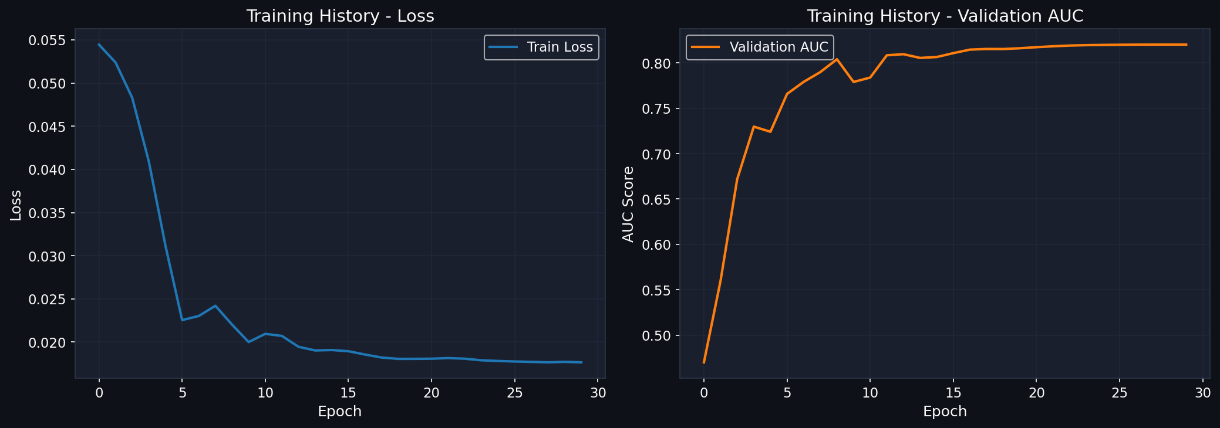
Training Curves

Slide 13
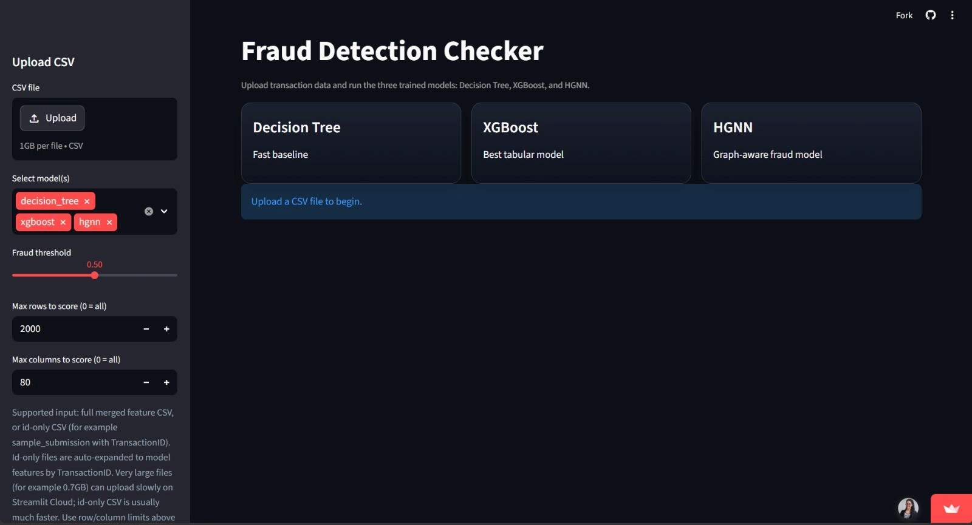
Preview
Deployed via Streamlit:
https://credit-card-fraud-detection-system-hyyu5xm7adgwjhhweyg8gt.streamlit.app/

Slide 14
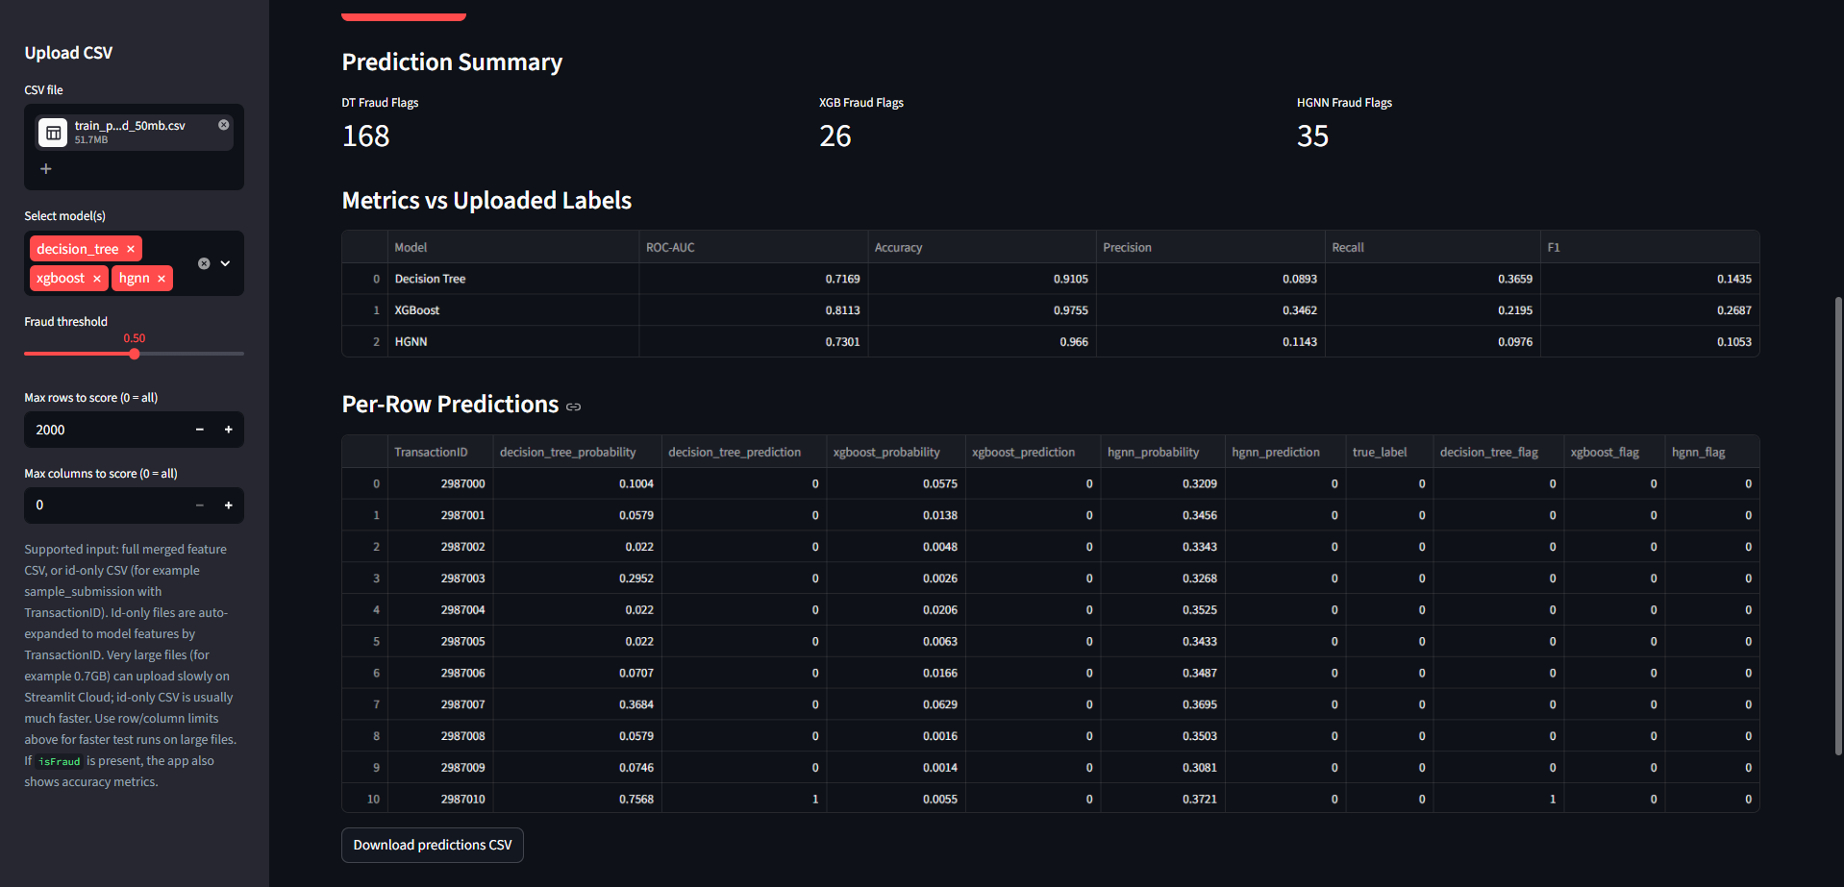
Prediction Preview

Slide 15
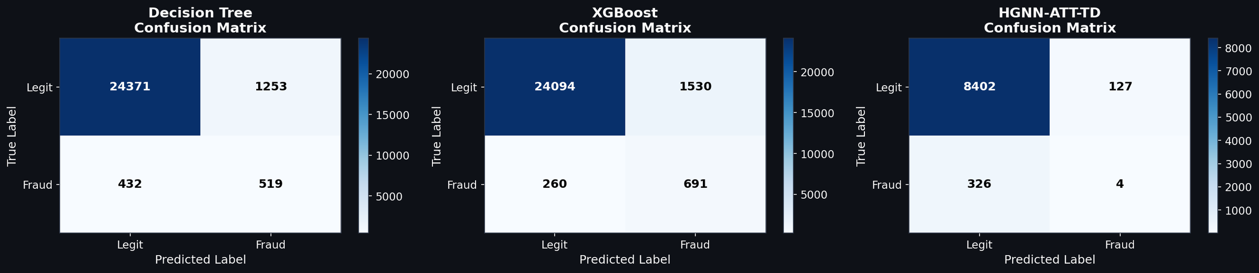
Model Evaluation
Confusion Matrices

Slide 16
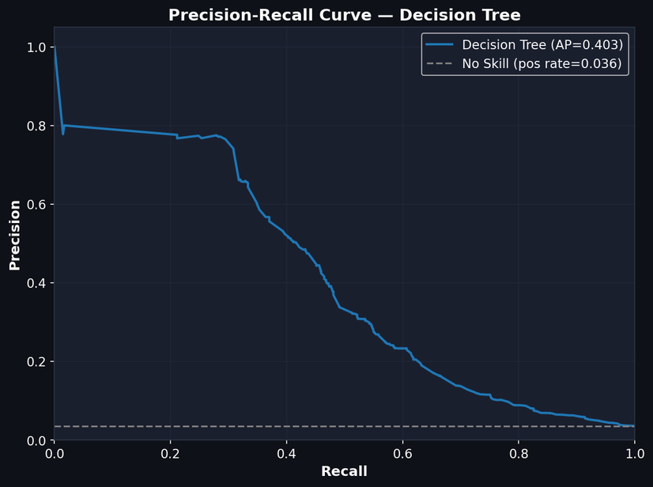
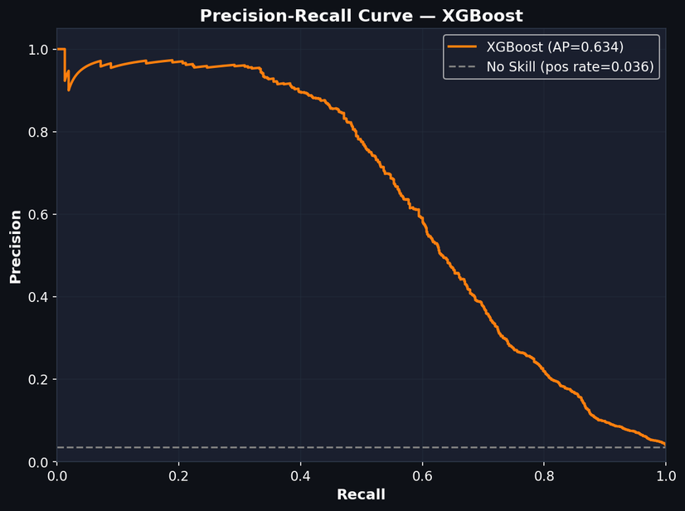
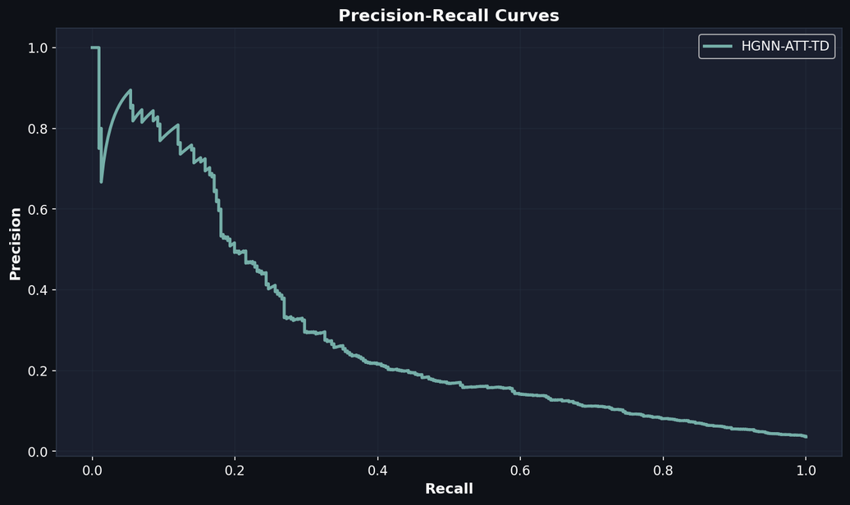
Precision Recall Curves
Decision Tree
XGBoost
HGNN

Slide 17
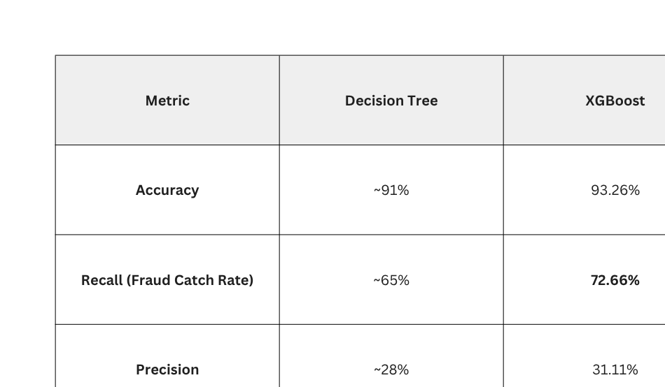

Slide 18
Conclusion
HGNN-ATT-TD (Top Performer): Achieved highest accuracy (96.60%) with lowest false positives (0.77%); best for reliable, low-friction automated systems.
Strong Detection: Correctly predicted 35/41 cases (~85%), making it the most effective overall model.
XGBoost (Balanced Model): Highest ROC-AUC (0.8113); best at distinguishing fraud patterns and offers strong recall for deeper analysis.
Decision Tree (High Sensitivity): Captures more fraud cases (higher recall) but with many false positives (over-flagging)
For a production environment, the HGNN-ATT-TD is the superior choice for automated fraud prevention.
By analyzing relationships (Graph data) rather than just independent rows (Tabular data), it provides the most stable and reliable detection with nearly zero impact on legitimate users.

