Slide 1
DevOps
LA Corps.

Slide 2
What is DevOps
A software engineering culture.
Aims at unifying SOFTWARE DEVELOPMENT (Dev) and SOFTWARE OPERATIONS (Ops).
Focuses on automation and monitoring of all steps of software construction.
Aims at shorter development cycles.
Increases development cycles and deployement frequency.

Slide 3
BENEFITS:
Speed.
Reliability.
Improved collaboration.
Security.

Slide 4
Use Cases
Encourage a fail fast, learn quick mindset.
Foster innovation and accountability
Promote open and honest sharing of lessons learned.
Build trust across organizational boundaries
Expect that it will be a work-in-progress

Slide 5
Continuous Integration
Best practices of CI include:
Committing code frequently.
Categorizing developer tests.
Using a dedicated integration build machine.
Using continuous feedback mechanisms.
Staging builds.

Slide 6
Continuous integration relies
Maintain a code repository
Automate the build
Make the build self testing
Everyone commits to the baseline every day
Keep the build fast
Make it easy to get the latest deliverables
Every one can see the latest build

Slide 7
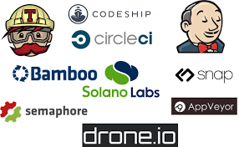
CI Tools
There are many Continuous Integration tools out there, and in this article, we will go through some of the greatest tools available on the market and see how they fare.
Jenkins
TeamCity
Travis CI
Go CD
Bamboo
GitLab CI

Slide 8
what is Continuous Deployment
Continuous deployment automation is performed by a new set of agile DevOps tools called application release automation.
It is a method to develop, build and test new code rapidly with automation so that only code that is known to be good becomes part of a software product.
For continuous deployment, IT automation and Configuration management tools, such as Puppet and Ansible are used.
Continuous deployment extends continuous delivery so that the software build will automatically deploy if it passes all tests.
In such a process, there is no need for a person to decide when and what goes into production.

Slide 9
CONTINUOUS DEPLOYMENT TOOLS
Ansible
Jenkins
Jenkins provides hundreds of plugins to support building, deploying and automating any project.

Slide 10
Agile Model
Agile SDLC model is a combination of iterative and incremental process models with focus on process adaptability and customer satisfaction by rapid delivery of working software product
phases of agile model
planning
Requirements Analysis
Design
Coding
Unit Testing and
Acceptance Testing
graphical illustration of the Agile Model

Slide 11
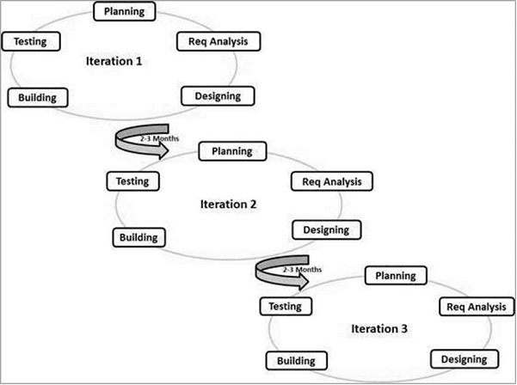

Slide 12
Agile Manifesto principles
Individuals and interactions
Working software
Customer collaboration
Responding to change

