Slide 1
VICTORIA VR AI BUILDER HACKATHON 2026
WorldPilot
Create interactive 3D worlds.
Keep them working as they change.
Natural-language authoring with connected rules, local checks and repairs.
Browser prototype and research study
Bruno DELB
github.com/lelab-ai/world-pilot
WorldPilot / Bruno DELB
01
Notes:
Project by Bruno DELB for the Victoria VR hackathon. Product framing follows README.md and the author's supplied project. Research paper: https://zenodo.org/records/24059294. This deck documents a local browser demonstration and a separate synthetic benchmark. It makes no claim of formal general correctness, peer review or official Victoria VR certification.

Slide 2
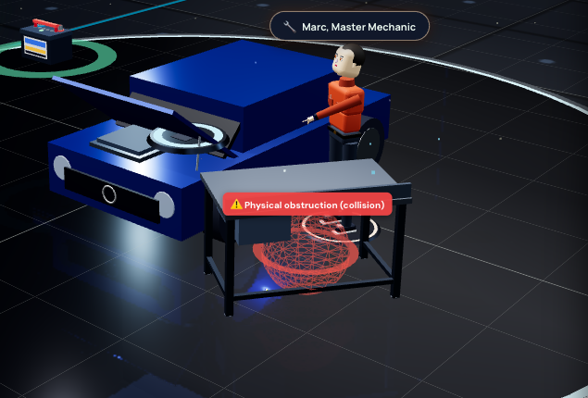
A CREATOR’S PROBLEM
A scene edit can break an interaction
The user
A trainer builds a car-maintenance workshop.
The edit
Move the workbench in front of the engine bay.
The scene still exists. Access to the task area becomes obstructed.
WorldPilot / Bruno DELB
02
Notes:
Illustrative creator persona, not an interviewed customer. Actual local workshop screenshot after the supported move command. The application displays a spatial-conflict indicator. This is a selected local diagnostic, not proof of navigation failure for a physically controlled player. Screenshot from 2026-11-09, with two visible display labels translated into English; geometry and diagnostic state unchanged.

Slide 3
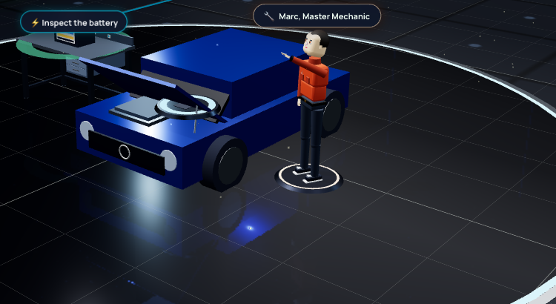

CREATION FROM A REQUEST
A request sets up the scene and its task
The actual request
The workshop includes a task:
1. Inspect the battery.
2. Install it in the engine bay.
Captured mode: local rules + built-in workshop.
WorldPilot / Bruno DELB
03
Notes:
Capture made 2026-11-10 using the existing local dist build dated 2026-11-08. Request: Show how to change a car battery. The UI reports Interpreted via deterministic local rules. This supported instruction selects a built-in workshop and task; it is not evidence of a newly synthesized open-ended LLM scene. An actual textarea screenshot shows the submitted request. Two visible scene labels were translated into English only for the capture; underlying task state and geometry unchanged. Current source routing: /Users/b.delb/Documents/antigravity/worldpilot/src/authoring/parser.ts, parseInstructionAsync. Browser UI reports 4 entities, 2 rules, 1 invariant.

Slide 4
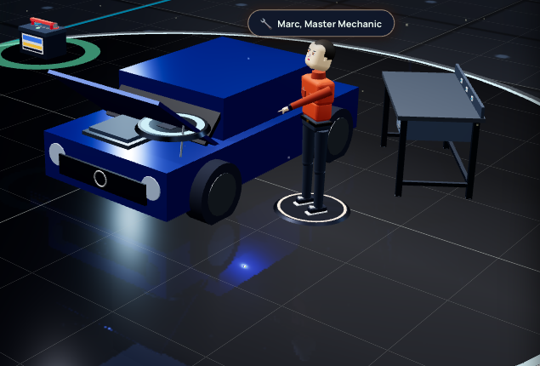
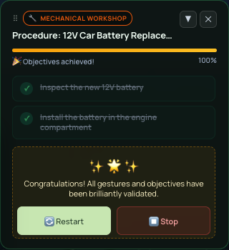
REPAIR AND OBSERVED COMPLETION
Task completion after local repair
1. Apply the supported local repair
2. Inspect, then install the battery
Completed through the in-app action controls.
WorldPilot / Bruno DELB
04
Notes:
On 2026-11-10, the local browser flow created the workshop, applied the workbench-move command and repair prompt, then used the visible Launch action and Drop on target controls. The quest changed to Objectives achieved, 100%, with both steps completed. No force-validation or direct state injection was used. Source QuestHUD.tsx: Launch action dispatches INTERACT; Drop on target moves the object to its target and dispatches DROP. This proves the selected event/quest flow remains executable after repair; the UI controls do not prove physical walking, drag reachability or headset interaction. The repair scene is from the earlier same supported scenario; completion HUD from the new run. No latency or clearance measurement is inferred from fixed UI badges.

Slide 5
HOW IT WORKS
Where AI and local rules each contribute
The captured workshop uses local rules. Other requests can use a configured LLM.
1. Interpret the request
2. Apply structured edits
3. Run the interaction
Recognized commands use local rules and scenario templates.
Other requests can use Gemini or DeepSeek.
WorldPatch describes changes to objects and rules.
Selected checks detect spatial conflicts and support repair.
The browser processes interaction events and updates the quest.
This task needs no per-action LLM call.
EO-Bench tests the deterministic interpreter, not general LLM prompt quality.
WorldPilot / Bruno DELB
05
Notes:
Inspected source: /Users/b.delb/Documents/antigravity/worldpilot/src/authoring/parser.ts lines around parseInstructionAsync and src/authoring/llm.ts. Supported system, observability, spatial and workshop intents may return local_rules. Otherwise a configured LLM is attempted, with a recognized-rule fallback or an unresolved result if no interpretation succeeds. LLM providers in the inspected implementation are Gemini and DeepSeek, not OpenAI. Model outputs are normalized and validated into structured plans and patches. No live LLM generation was exercised in these captures. The runtime distinction explains architecture, not a tested 60 FPS or zero-risk claim.

Slide 6
RESEARCH PAPER & EO-BENCH
Edits can also depend on each other
Edit Order Sensitivity in Language-Driven Executable 3D Worlds: A Benchmark for Cross-Layer Semantic-State Divergence
Research paper: zenodo.org/records/24059294
EO-Bench tests A then B against B then A, from the same starting world.
A: Replace a plasma torch
with a fiber laser head.
B: Set the laser head’s
power to 4,500 watts.
If B runs first, the target does not exist yet. Dependency handling matters.
Case WP2-EO-002. Synthetic suite: 200 cases, 74 worlds, 68 unique edit pairs.
WorldPilot / Bruno DELB
06
Notes:
Paper title and abstract supplied by the author: https://zenodo.org/records/24059294. Exact corpus example verified in work/final_reconciled/data/raw_results.jsonl: WP2-EO-002, edit A Remplace la torche plasma par une tête laser à fibre haute précision; edit B Calibre la puissance d'amorçage de la tête laser à 4500 watts. English renderings on slide. C0 SAT_AB=true, SAT_BA=false, equivalent=false. C5 SAT_AB=true, SAT_BA=true, equivalent=true, BA ordering reason DEF_USE. The question differs from the spatial-repair demo: this example evaluates edit order. EO-Bench compares state equivalence under its criteria and joint instruction satisfaction. Four strata: direct, indirect, lexical false positive, true independence. 90% domestic, educational or workshop scenarios. The results concern one implementation and internal evaluators; repeated textual motifs and internal oracle coupling limit generalization.

Slide 7
CENTRAL RESEARCH RESULT
Matching states can still violate instructions
Two checks: do the final states match, and do both requested edits hold?
Execution method | Equivalent states | Both edits satisfied
Sequential baseline (C0) | 86/200 43.0% | 129/200 64.5%
Fixed hash order | 200/200 100% | 135/200 67.5%
WorldPilot repair pipeline (C5) | 200/200 100% | 199/200 99.5%
A fixed order can produce the same wrong outcome. C5 satisfies both edits in 199 cases.
Paper results on 200 synthetic cases in one implementation. Detailed variants in the appendix.
WorldPilot / Bruno DELB
07
Notes:
Values from the author's supplied abstract for https://zenodo.org/records/24059294, not a new current-code benchmark. Fixed hash ordering: 67.5% satisfaction, C4: 92% equivalence/99.5% satisfaction. These differ from a later local pitch-script draft, which reports 78.5% for hash and 43%/64.5% for C4. The deck preserves the supplied paper snapshot. Counts calculated with denominator200. C0 asymmetric instruction-satisfaction regressions71/200; C5 detected invariant-violation cases16 to0. Neither convergence nor internal satisfaction validates all gameplay behavior or arbitrary LLM inputs.

Slide 8
DELIVERED CONTRIBUTIONS & SCOPE
A prototype with observable checks
What WorldPilot brings together
Demonstrated scenarios
Natural-language scene commands
Connected object, rule and quest state
Local conflict detection and repair
An edit-order benchmark and paper
Workshop creation from a request
Repair followed by quest completion
Battery replacement with a generator, followed by quest completion
Creator value to measure: fewer broken interactions and less manual rewiring.
Supported scenarios were checked. Broader prompts, user effort and experimental exports need separate evaluation.
WorldPilot / Bruno DELB
08
Notes:
Author ownership and hackathon context supplied in this conversation. No unsupported timeline of which modules were built during the event is asserted. On 2026-11-10 the second local run reset the workshop, replaced the battery with a generator through the supported English prompt, then completed both quest steps using the visible UI controls. The generator is visible in the scene and entity list. Quest text still refers to the battery: this is a remaining labeling limitation, not evidence of full semantic or physical correctness of the replacement. No general orphan-reference audit, manual-edit savings or arbitrary-prompt success rate was measured. Playtests and readiness checks are prototype heuristics. Unreal/LeRobot remain experimental extensions.

Slide 9
PROJECT & CONTACT
Try WorldPilot and explore the research
Bruno DELB
brunodelb@gmail.com
github.com/lelab-ai/world-pilot
Research paper: zenodo.org/records/24059294
Run locally: English hands-on guide
Build, interact, edit, check and improve.
WorldPilot / Bruno DELB
09
Notes:
Author-confirmed GitHub URL and email. Hosted-demo and video URLs were not present in docs/SUBMISSION.md when inspected and were requested from the author while work continued. This slide links to local-run documentation and does not present that guide as a hosted demo or video. The official hackathon expects a hosted browser demo and a demo video under3minutes in addition to the public repository, short description and focus category. See the companion handoff document for outstanding submission items.

Slide 10
APPENDIX: METHODS & LIMITS
EO-Bench v2.5: paper results and scope
Execution method | Equivalent states | Both edits satisfied
Sequential baseline (C0) | 86/200 43.0% | 129/200 64.5%
Hash canonicalization | 200/200 100% | 135/200 67.5%
Dependency lookahead (C4) | 184/200 92.0% | 199/200 99.5%
Invariant-guided local repair (C5) | 200/200 100% | 199/200 99.5%
C5: detected invariant-violation cases fall from 16 to 0. One satisfaction failure remains.
Fixed synthetic suite. Internal state and satisfaction evaluators. Repeated textual motifs limit generalization.
WorldPilot / Bruno DELB
10
Notes:
Source: title and abstract supplied by Bruno DELB for https://zenodo.org/records/24059294. EO-Bench is a fixed stratified synthetic benchmark of200cases,74initialworlds,68unique editpairs. Four strata S1 Direct,S2 Indirect,S3 Lexical False Positive,S4 True Independence. The study includes Three.js geometric validation, depth and component ablations. Textual motif leakage and internal oracle coupling are methodological limitations. The evaluated implementation is a deterministic interpreter, not a general comparison of LLM products. Web implementation: TypeScript, React, Three.js/React Three Fiber, Rapier. No peer-review status, headset FPS, UI-badge latency, universal safety guarantee or official integration is asserted.

