Slide 1
Acquisition Due Diligence Project
Leland Murrin

Slide 2
Introduction
Mergers & Acquisitions
Mergers and Acquisitions (M&A) from 2020 to 2023
80,000 Closed
$8.8 Trillion
Successful Transactions
Only 10-50% reached expected value
The problem stems from companies handling M&A in addition to their other responsibilities
From Yahoo Finance: ”…lack of dedicated resources and expertise dooms many mid-sized transactions from the start.”
Accounting firms specialize in helping companies with due diligence work for the merger or acquisition process
From Yahoo Finance: “For mid-sized companies, the solution lies in seeking outside expertise to supplement internal resources.”
Sources: IMAA, Yahoo Finance

Slide 3
Introduction
Stakeholders & Acquisition Process
Private Equity Firm:
Main goal is to make informed decisions on what companies (target firms) to invest in or to acquire
The Accounting Firm:
Goal is to perform due diligence analysis efficiently no matter the size of the company
The Target Firm:
Goal is to provide a thorough accounting of its business practices and revenue sources
Private Equity Firm:
Hire accounting firms to help advise during key steps in the acquisition process
The Accounting Firm:
Role is to audit the target firm’s revenue to measure its viability as an acquisition candidate
The Target Firm:
Hopes to increase its market share and diversify its services
Private Equity Firm
Accounting Firm
Target Firm
Accounting Firms and Private Equity Firms are looking for new ways to automate the due diligence process, thereby guaranteeing a more successful result and achieving the expected value

Slide 4
Background
Scenario
Who we are:
Accounting Firm Consultants specializing in performing due diligence on more mid to small-size target firms that incur the same overhead as large firms
Target Audience:
Private Equity Firm (or other Acquisition Firm) conducting due diligence on prospective acquisitions
Private Equity Firm Concerns:
Is the target company’s revenue stream volatile (i.e., are there extreme swings in revenue from period to period)?
Is there any component of the revenue stream that seems inconsistent or sporadic (i.e., are there random transactions that make up a large percentage of the revenue stream)?
Is the target company experiencing reliable growth (i.e., is this company a good long-term investment)?

Slide 5
Background
Bookkeeping & Data
Target Firm:
A mid-sized manufacturing company with older accounting software and practices
Responsible for delivering the General Ledger data, which consists of itemized transaction items by date and time
Supplies trial balance data as a summary of account performance
Accounting Firm:
Compiles due diligence workbook, which includes metric visualizations for decision-making (See Appendix A)
Anonymizes data before analysis to safeguard privacy
Assumes partial visibility into the target firm’s accounting procedures and process, including transaction categories and labels

Slide 6
Data Processing
Raw Data
Data Filtering:
Filtered non-sales revenue accounts
Anonymization:
Labels changed:
Descriptions
Organizations
Accounts
Multiplied transaction data by random scalar
Data Cleaning
Feature | Description
Description (Transaction ID) | Unique for each initial sale (13,947 unique values)
Organization | Internal department label (4 total)
Account | Internal accounting label (20 total)
Transaction Amt | Recorded Debit or Credit amount
Fiscal Year | General Ledger accounting year (FY20 to FY23)
Period | Accounting monthly time unit (1 to 12)
Date | Transaction time stamp (09/28/19 to 08/25/23)
Feature Engineering
Feature | Description
Desc1 Desc2 | First part of Description (355 unique two-letter combinations) Second part of Description (5-digit combination)
Period Fiscal Year | Dataset monthly time unit (0 to 46)
Week Week Fiscal Year | Calendar week (1 to 52 or 53) Dataset week index (0 to 204)
Notes:
Note: Change the tab indentation for the second level here

Slide 7
Data Processing
Final Data
Sample Transformed Data
Desc1 | Desc2 | Description | Account | Txn_Amt | Date | Fyear | Period | Period_Fyear | Week | Week_Fyear
AU | 5324 | AU 05324 | Acct 4 | 74.91 | 2021-06-07 | 2021 | 9 | 20 | 23 | 89
BR | 9866 | BR 09866 | Acct 4 | 79.62 | 2022-06-17 | 2022 | 9 | 32 | 24 | 142
CV | 6521 | CV 06521 | Acct 4 | 55.55 | 2021-09-21 | 2021 | 12 | 23 | 38 | 104
CA | 6040 | CA 06040 | Acct 6 | 475.62 | 2021-08-09 | 2021 | 11 | 22 | 32 | 98
FS | 9940 | FS 09940 | Acct 9 | 395.67 | 2022-06-28 | 2022 | 9 | 32 | 26 | 144
80% of the Debit transactions are less than $1250 (i.e., most of the transactions are small with a mean of $1688.16)
Transactions in November are almost 2x the number of transactions in April
11 periods for FY23 had approximately the same # of transactions as a full year of FY20
For efficiency, when Period or Week is mentioned during the remainder of the presentation, it refers to period_fyear and week_fyear respectively

Slide 8
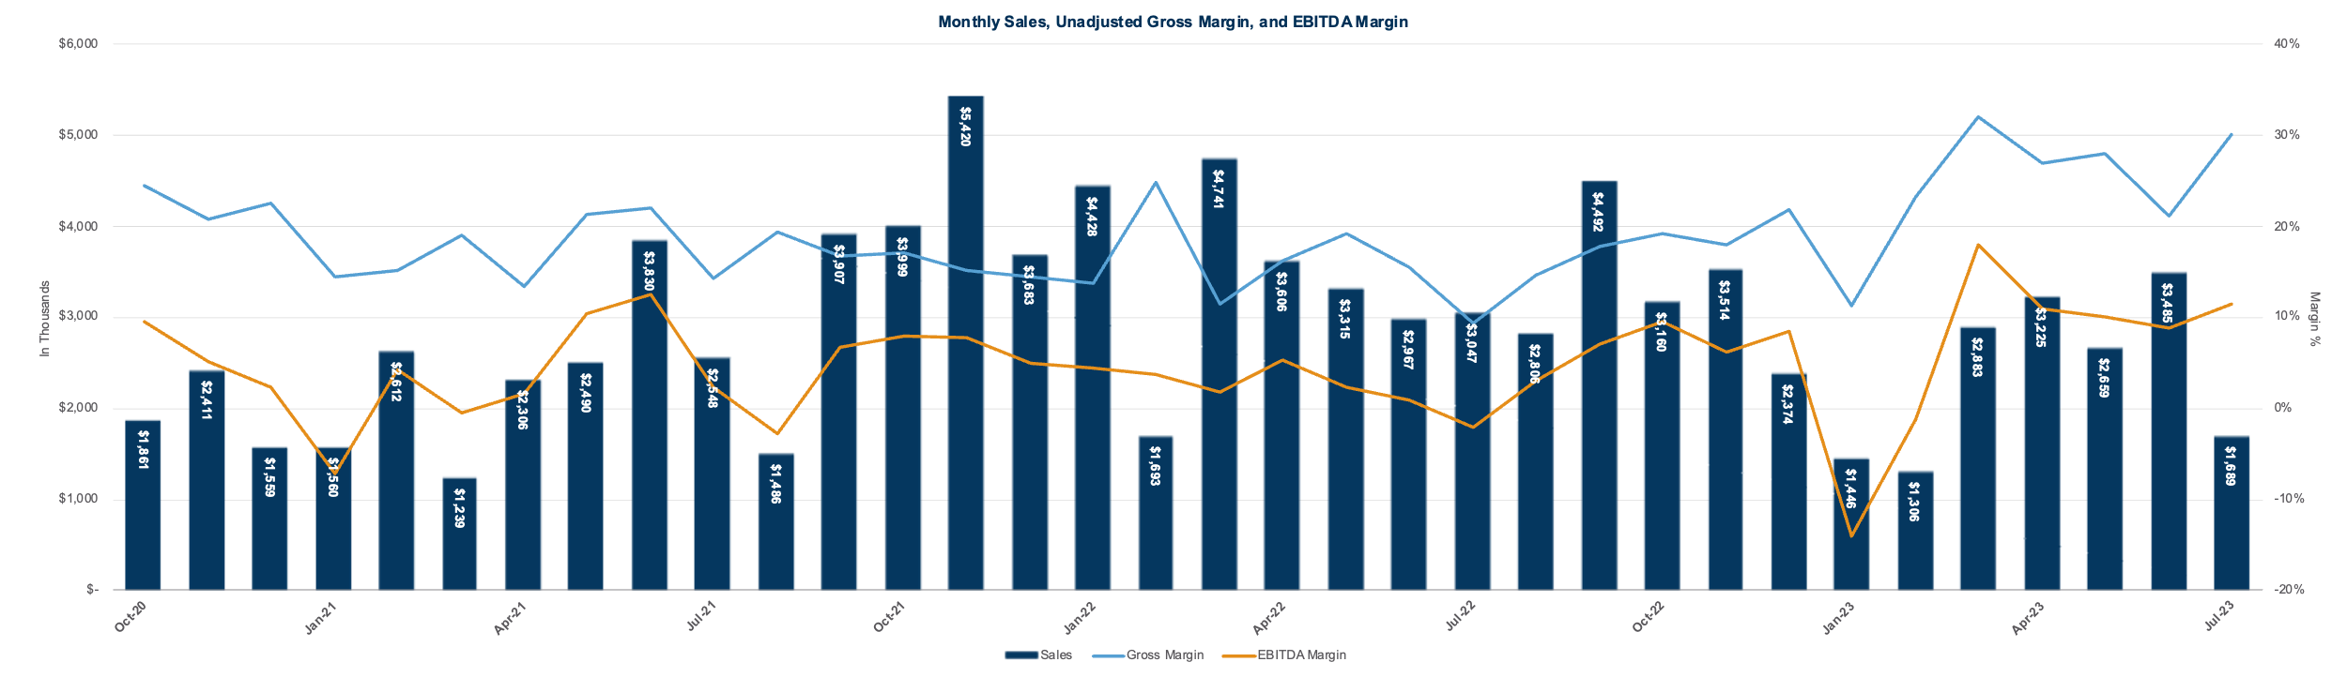
EDA
Accounting Firm Visualization
This graph was created as a product of the due diligence analysis conducted by the accounting firm from the General Ledger data
Revenue, Gross Profit Margin (see Appendix B), and EBITDA Margin as designed by the accounting firm using Excel
Automated recreation can be found in Appendix A
The revenue stream seems to be highly volatile
There are dramatic differences between peaks and troughs, especially in February 2022 and 2023
No significantly visible upward trend is present
Notes:
TODO: Replace plot with clearer version (may have been completed already, check)

Slide 9
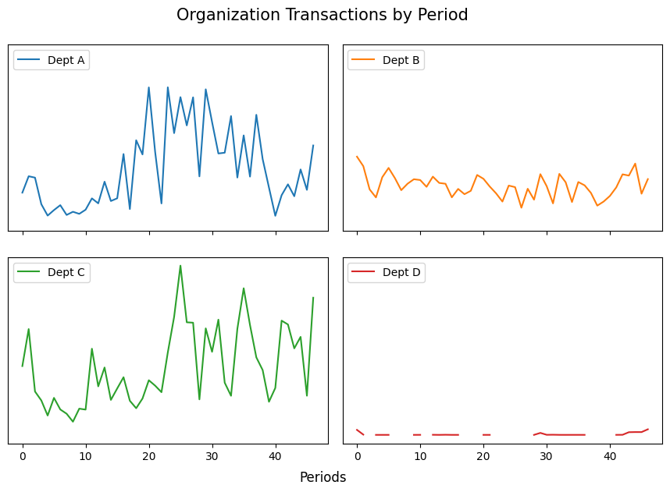
EDA
Transactions by Organization
Dept D
Discontinuous
Constant
Dept B
Continuous
Low Variability
Depts A & C
Continuous
High Variability
Notes:
Note: Change the tab indentation for the second level here

Slide 10
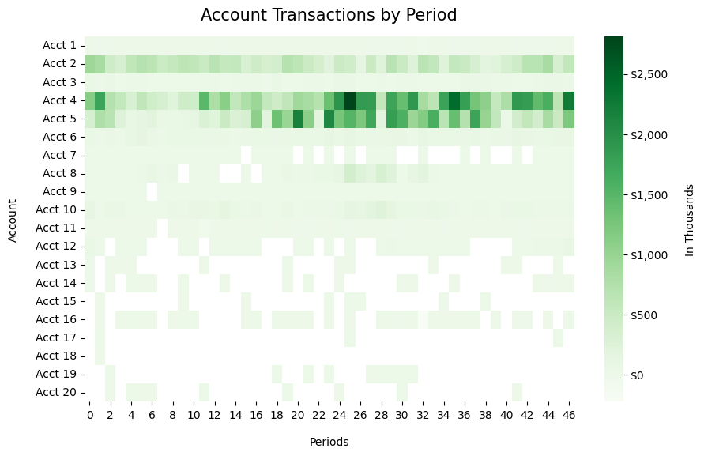
EDA
Transactions by Account
Accts 15, 17 & 18:
Discontinuous
Accts 1, 6 & 10:
Continuous
Constant
Accounts 2, 4 & 5:
Continuous
High Variability
Notes:
Note: Change the tab indentation for the second level here

Slide 11
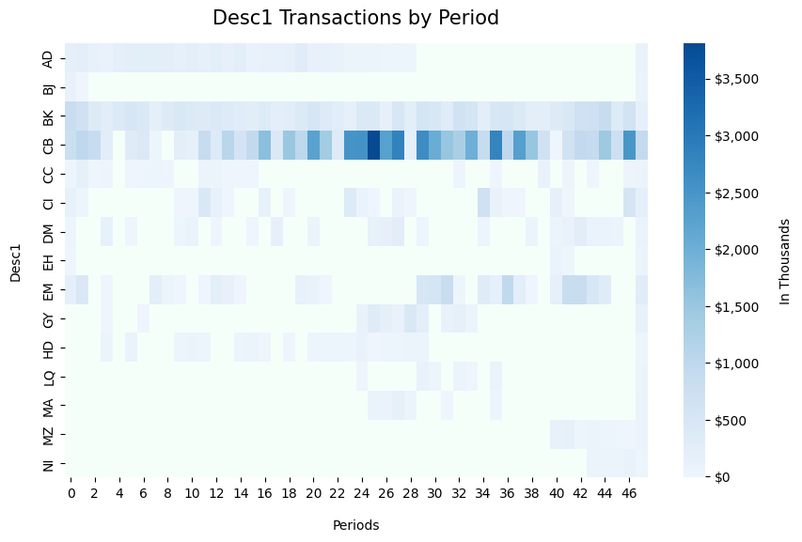
EDA
Transactions by Desc1
BK and CB
Continuous
High Variability (CB)
CI and EM
Discontinuous
Variable
AD
Continuous (50%)
Note: Heatmap displays top 15 (95th pct) out of 355 total desc1s
Notes:
Note: Change the tab indentation for the second level here

Slide 12
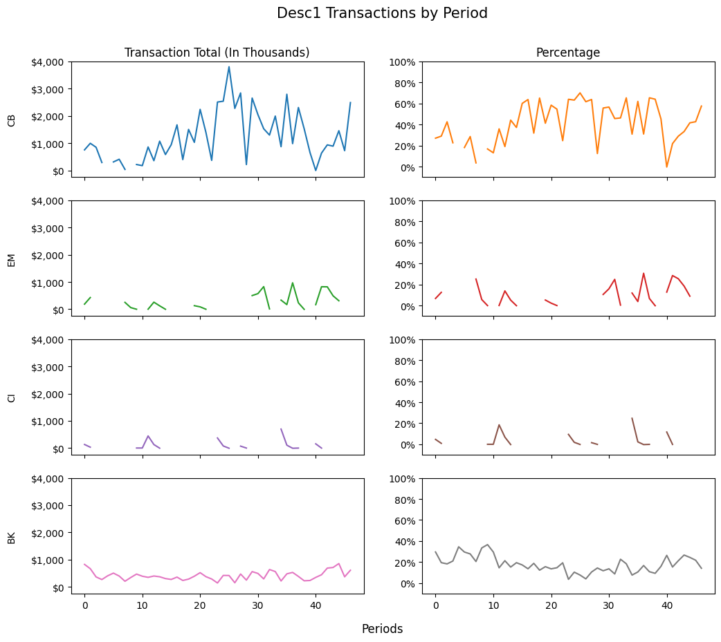
EDA
Transaction Monthly Percentage by Desc1
CB:
High Variability (Total > Percentage)
Other 3 Desc1s:
Low Variability (Total = Percentage)
Note: Percentage = desc1’s portion of total amount
Notes:
TODO:
Make colors across same desc1s the same
Fix second level tab indentation

Slide 13
EDA
Large Transactions by Frequency
Large transactions:
Signs of major sales
Top priority for analysis
Repeated transactions:
Systematic stream of revenue
Accounting practices that are occurring consistently
Table shows large repeating transactions:
Greater than $50,000
Frequency > 1
Label ‘other’ = not repeated
Note: $83,359.94 occurred 57 times, which is approximately more than 14 times a year across 4 years
Large Transactions by Frequency
Debit | Freq
$83,360 | 57
other | 31
$84,194 | 8
$135,659 | 7
$84,050 | 2
$84,324 | 2
$84,603 | 2
$86,290 | 2
$91,054 | 2
$97,603 | 2
Notes:
Graph shows large transactions (>$50,000), particularly those that repeat (freq > 1). Those labelled ‘other’ do not repeat.
Dotted red line shows scaled sales revenue
Generally, when sales revenue is at a trough, there’s a lack of large repeated transactions
Dramatic increase in repeated transactions after FY21, specifically starting with Period 6, FY22
Most repetitive transaction amount ($50640.5, shown in dark blue), is tied to desc1: EM

Slide 14
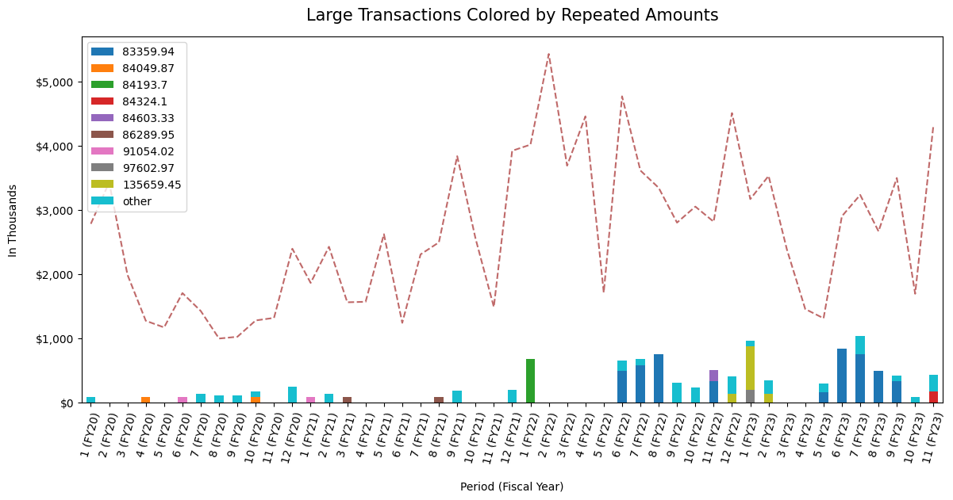
EDA
Large Transactions by Frequency
Period 5, FY22:
Lack of large transactions at troughs
Period 6, FY22:
Increase in repeated transactions
Note: Sales revenue = dashed red line
Notes:
Graph shows large transactions (>$50,000), particularly those that repeat (freq > 1). Those labelled ‘other’ do not repeat.
Dotted red line shows scaled sales revenue
Generally, when sales revenue is at a trough, there’s a lack of large repeated transactions
Dramatic increase in repeated transactions after FY21, specifically starting with Period 6, FY22
Most repetitive transaction amount ($50640.5, shown in dark blue), is tied to desc1: EM

Slide 15
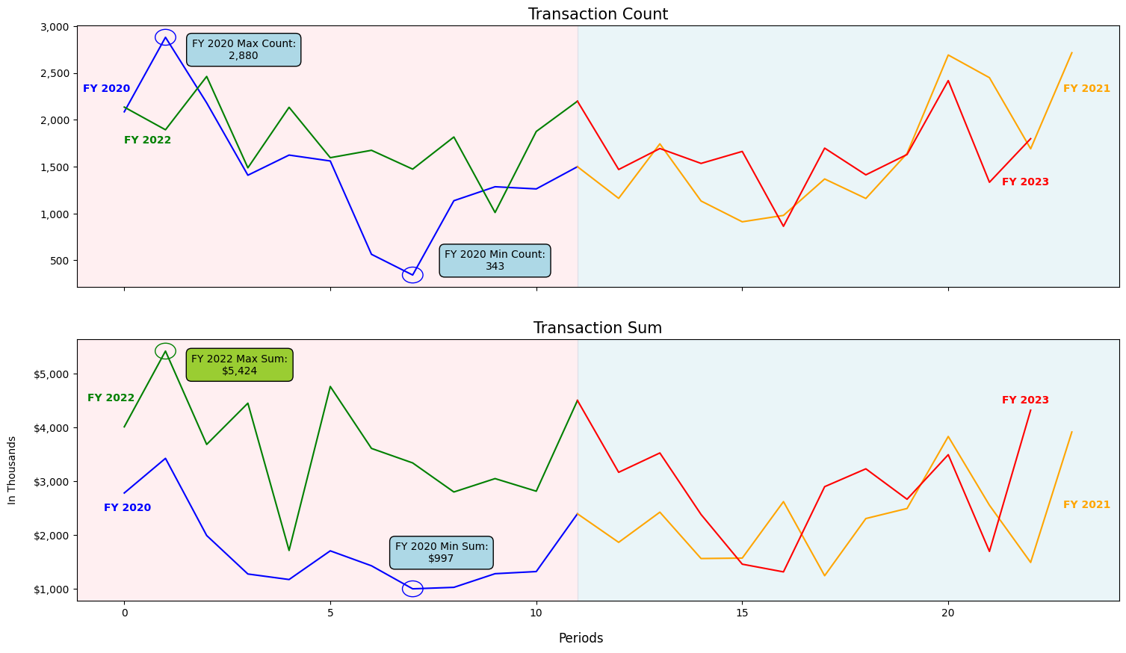
EDA
Covid Effects
Transaction Count:
Max and min occurred in FY 2020
Transaction Sum:
Max (FY 2022)
Min (FY 2020)
Yearly Sum < Others
Note: Pandemic began in Spring 2020
Notes:
Difference between data before and after the onset of Covid is significant and suspicious (particularly for large repeating transactions, which are mostly concentrated in the post-covid era)

Slide 16
Methods
Introduction
Testing (Granger Causality):
Determines if there are significant relationships between past transactions (lags) and total transaction amount
Further discussion in Appendix C
Modelling (ARIMA, RandomForest, and GradientBoosting):
Feature selection
Feature prioritization
Variance prediction
Performance optimization
Clustering (PCA & KMeans):
Aggregating data into groups with similar characteristics
PCA: similar variance
KMeans: similar data
Clustering works better than imputation for this dataset
Seasonal Decomposition:
Decomposes time series data into plots:
Trend
Seasonality
Residual
May help identify anomalies:
Inaccurate accounting
Lack of seasonality
Unexplained variation
Testing
Clustering
Decomposition
Modelling
Notes:
Modelling:
Helps prioritize the features that affect variability
Fitted various models to determine predictions for variance

Slide 17
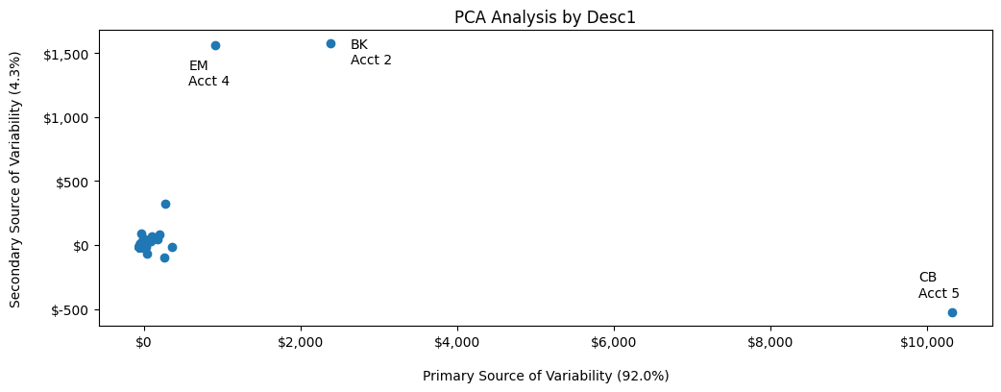
Methods
PCA (Desc1)
Desc1 T-testing
Test | P-Value
no_EM | 0.43
no_BK | 0.05
no_CB | 0.0
Note: Table results compare transaction amount vs. transaction amount (w/o Desc1)
Desc1 “CB” shows the greatest variation by a factor of 6 compared to all other desc1s
Notes:
For PCA, a pivot table was created with desc1s as index, period as columns and transaction sums as the values
The diagram above shows the top 2 components of PCA (horizontal being the primary with 92% of variability)
The diagram shows the accounts most associated with each desc1

Slide 18
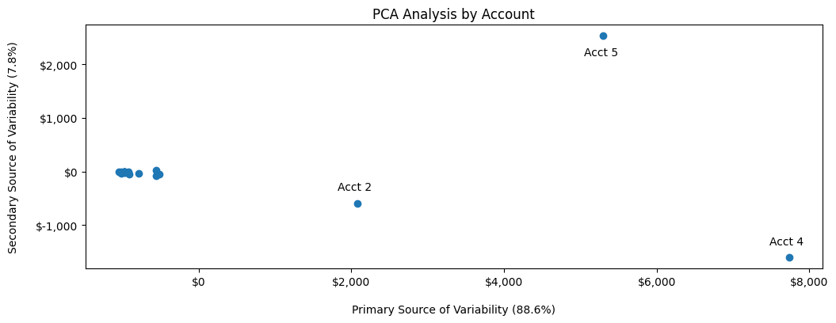
Methods
PCA (Account)
Account T-testing
Test | P-Value
no_Acct2 | 0.03
no_Acct5 | 0.0
no_Acct4 | 0.0
Note: Table results compare transaction amount vs. transaction amount (w/o Account)
Account 4 shows the greatest variability
Notes:
Similar pattern to desc1s

Slide 19
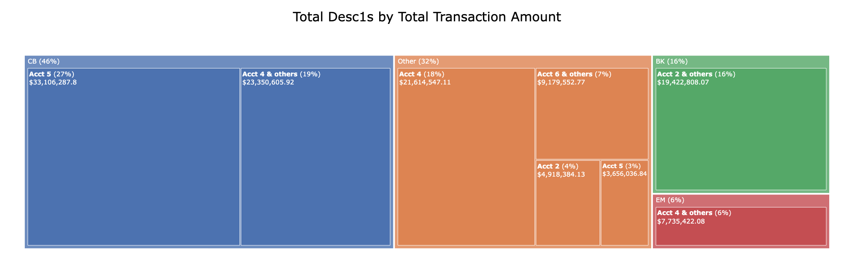
Methods
KMeans
KMeans Analysis yielded 4 distinct clusters:
3 consisted of desc1s EM, BK, and CB
1 consisting of all other desc1s
The Top 3 Desc1s account for 68% of total transactions

Slide 20
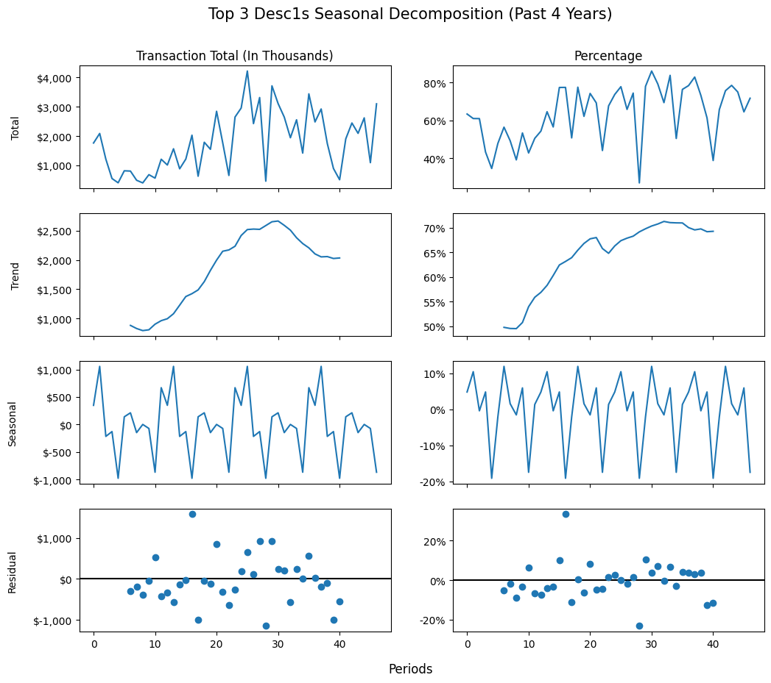
Methods
Seasonal Decomp (4 Years)
Total:
Transactions emphasize peaks
Percentages emphasize troughs
Trend:
Similar across both
Average upward progression
Seasonal & Residual:
Transaction:
Same magnitude
Percentage:
Seasonal range is approx. half of residual range
Transaction seasonality is slightly more significant than percentage seasonality

Slide 21
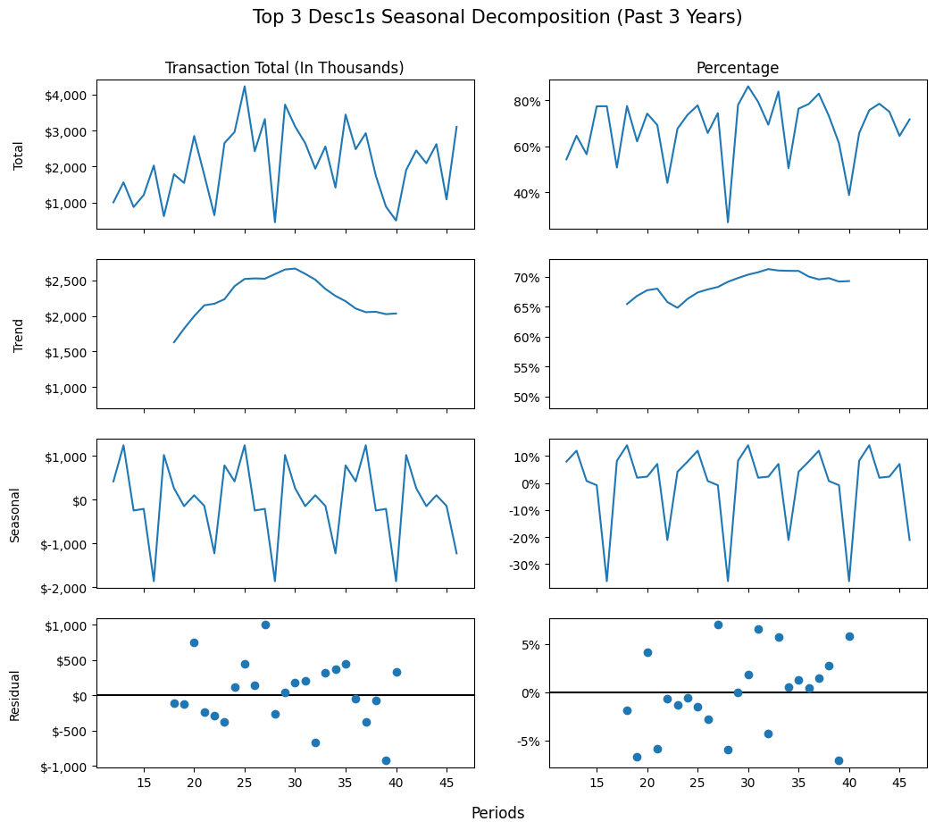
Methods
Seasonal Decomp (3 Years)
Seasonal & Residual:
Transaction:
Same magnitude
Percentage:
Seasonal range is approx. 4x residual range
Percentage seasonality is much more significant than transaction seasonality
Notes:
recall original visually inspected plot of revenue and highlight difference in lack of growth with trend plot here

Slide 22
Methods
Time Series Models
All Models:
Transaction/Percent Revenue by period is used for all models
The scoring metric used was Mean Absolute Percentage Error (MAPE)
Advantage of MAPE: it’s a relative measure of error that requires no past knowledge of transaction values to determine a threshold for good performance vs bad
ARIMA Models:
Used the ‘auto_arima’ function for optimization
Dropped fiscal year 2020 (as seasonal decomposition suggests)
Ensemble Models:
A 12-month feature window was created for every window (to include seasonality considerations)
The first target period starts in fiscal year 2021
Optimization done using ‘GridSearchCV’

Slide 23
Methods
ARIMA Modelling (Top 3 Desc1s vs. Others)
Top 3 desc1s:
Best Model: Percentage 3 years
MAPE: 0.18
Parameters: Seasonal Q = 1 (Seasonal only)
Other desc1s:
Best Model: Transaction total 4 years
MAPE: 0.26
Parameters: D = 1, Q = 2
Note: MAPE is based on in-sample predictions
ARIMA Model Results
Data Type | Years | P | D | Q | Seasonal P | Seasonal D | Seasonal Q | MAPE
Transaction Total | 4 | 0 | 1 | 1 | 0 | 0 | 0 | 0.61
Percentage | 4 | 1 | 0 | 0 | 0 | 0 | 0 | 0.21
Transaction Total | 3 | 0 | 1 | 1 | 0 | 0 | 0 | 0.64
Percentage | 3 | 0 | 0 | 0 | 0 | 0 | 1 | 0.18
ARIMA Model Results Others
Data Type | Years | P | D | Q | Seasonal P | Seasonal D | Seasonal Q | MAPE
Transaction Total | 4 | 0 | 1 | 2 | 0 | 0 | 0 | 0.26
Percentage | 4 | 1 | 0 | 0 | 0 | 0 | 0 | 0.36
Transaction Total | 3 | 2 | 2 | 1 | 0 | 0 | 0 | 0.36
Percentage | 3 | 0 | 0 | 0 | 0 | 0 | 1 | 0.34
Notes:
TODO: generate graph for total txns and 4 years for others
Also create graphs for ensemble
Highlight row
Remove index in tables in this slide and the next

Slide 24
Methods
Ensemble Modelling (Top 3 Desc1s vs. Others)
Top 3 Desc1s:
Best Model: Percentage Gradient Boosting
MAPE: 0.19
Large difference between percentage and transaction total
Other Desc1s:
Best Model: Transaction Total Random Forest Regressor
MAPE: 0.31
Data Structure:
Features: last 12 periods (seasonality)
Target feature: current period
Note: MAPE is based on cross-validation with cv = 3
Ensemble Model Results
Data Type | Model | MAPE
Percentage | Gradient Boosting Regressor | 0.19
Percentage | Random Forest Regressor | 0.19
Transaction Total | Gradient Boosting Regressor | 0.82
Transaction Total | Random Forest Regressor | 0.74
Ensemble Model Results Others
Data Type | Model | MAPE
Percentage | Gradient Boosting Regressor | 0.37
Percentage | Random Forest Regressor | 0.34
Transaction Total | Gradient Boosting Regressor | 0.33
Transaction Total | Random Forest Regressor | 0.31

Slide 25
Results
OLS & Adfuller Testing
Large Transactions Regression Results
Transaction Amounts | P-Values
Intercept | 0.0
$83,360 | 0.06
$84,050 | 0.16
$84,194 | 0.12
$84,324 | 0.16
$84,603 | 0.95
$86,290 | 0.73
$91,054 | 0.51
$97,603 | 0.17
$135,659 | 0.12
other | 0.4
Week Lags
Variables | Coefficients | P-Values
Intercept | 0.02 | 0.73
Lag 1 | -0.02 | 0.75
Lag 2 | 0.03 | 0.68
Lag 3 | 0.22 | 0.0
Lag 4 | 0.23 | 0.0
Lag 5 | -0.11 | 0.16
Lag 6 | 0.15 | 0.05
Lag 7 | 0.04 | 0.65
Lag 8 | -0.1 | 0.2
Lag 9 | 0.25 | 0.0
Stationarity Testing Results
Time Interval | P-Values
period (d=0) | 0.1
period (d=1) | 0.0
week (d=0) | 0.0
Adfuller:
Period is not stationary
Confirms trendline in seasonal decomposition
Granger Causality/OLS:
Inconclusive
Only 19.1% of the variation explained
Further discussion in Appendix C
Large Transactions/OLS:
Have no significant association with total transaction amount
Notes:
Most repetitive transaction amount ($50640.5, shown in dark blue), is tied to desc1: EM

Slide 26
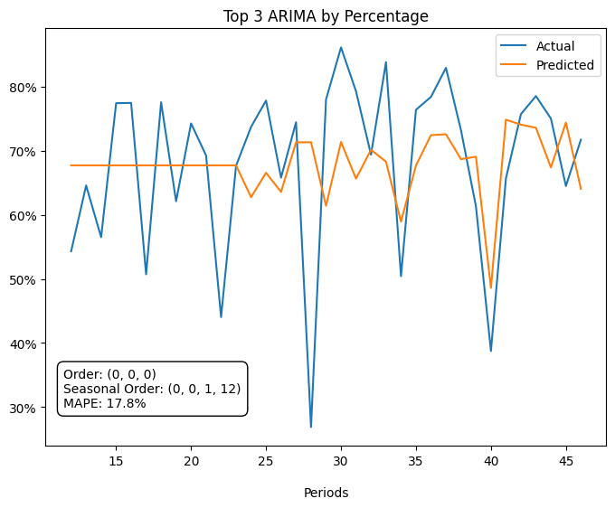
Results
ARIMA (Best Model Top 3)
Best Seasonality Model:
Based on prior year’s period
Predictions can be made on a year-to-year basis purely on seasonality

Slide 27
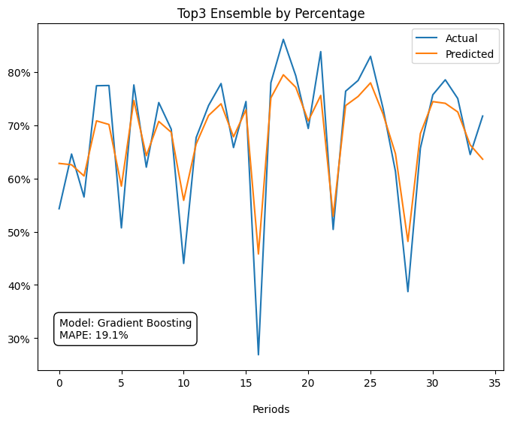
Results
Ensemble (Best Model Top 3)
Best Trend Model:
Cross validation MAPE: 19.1%
In-sample MAPE: 8.2%
Only creates a few months of forecast
Notes:
Todo: Change prediction and true line colors to match previous slide

Slide 28
Results
Summary
Testing (Best Predictors):
Desc1s (validated by account analysis)
Decomposition (Transactions by period):
Upward trend because transaction data by period is non-stationary (Adfuller, p > 0.05)
Significant seasonality
Clustering (Top 3 Desc1s):
CB, BK, and EM
CB was most important Desc1
Modelling (Best Model):
Post-pandemic (last 3 years)
Percentage
Testing
Clustering
Decomposition
Modelling

Slide 29
Conclusion
Main Concern
Question:
Is the variability in the data explained by seasonality or randomness (particularly concerning identified troughs)?
Assumptions:
The pandemic caused a significant change in business revenue streams
3 transaction categories (desc1s CB, EM, BK) drive the main variability in the revenue stream
Answer:
Based on the best models, seasonality was found to be the prominent component of the prediction

Slide 30
Conclusion
Private Equity Concerns
Is the target company’s revenue stream volatile?
Yes, due to 66% of the revenue consisting of volatile top 3 desc1 transactions that were 41 times the average standard deviation
Is there any component of the revenue stream that seems to be inconsistent or sporadic?
No inconsistency was found amongst the top 3 desc1s since the stream depends heavily on seasonality
Is the target company experiencing reliable growth?
Yes, the revenue stream grouped by period seems to show non-stationarity and shows a positive trend, though this effect could be due to post-pandemic trends

Slide 31
Conclusion
Future Application
This analysis is generally applicable to small or mid-sized companies by using the following steps
Feature Engineering:
Transforming IDs that persist across multiple periods
Grouping:
Clustering methods that help with determining the predictors with the highest variations
Decomposition:
Splitting the data, separating trends from seasonality
Modelling:
ARIMA –best for predicting seasonality
Ensemble –best for predicting trends
Using this methodology expedites the acquisition process by creating an automated blueprint for the due diligence analysis

Slide 32
Limitations & Future Work
Limitations:
Limited access to protocols and procedures:
Assumptions made about meaning of features
Used general accounting principles
Time wasted on EDA
Dataset size:
Fiscal Year 2023 ended in August
4 fiscal years (47 periods) led to limited insights (inadequate for post-pandemic analysis)
Future Work:
Explore gross profit margin (Appendix B)
Focus more on moving average to mitigate sparse data
Investigate desc1 “CB” individually
Compare models for accounts with desc1 models
Notes:
Didn’t have full access to the feature reference for the dataset, so assumptions had to be made about what each feature is using general accounting principles and exploratory data analysis
less than 4 fiscal years of data was provided for analysis, making pre-pandemic trends particularly hard to identify

Slide 33
Q & A

Slide 34
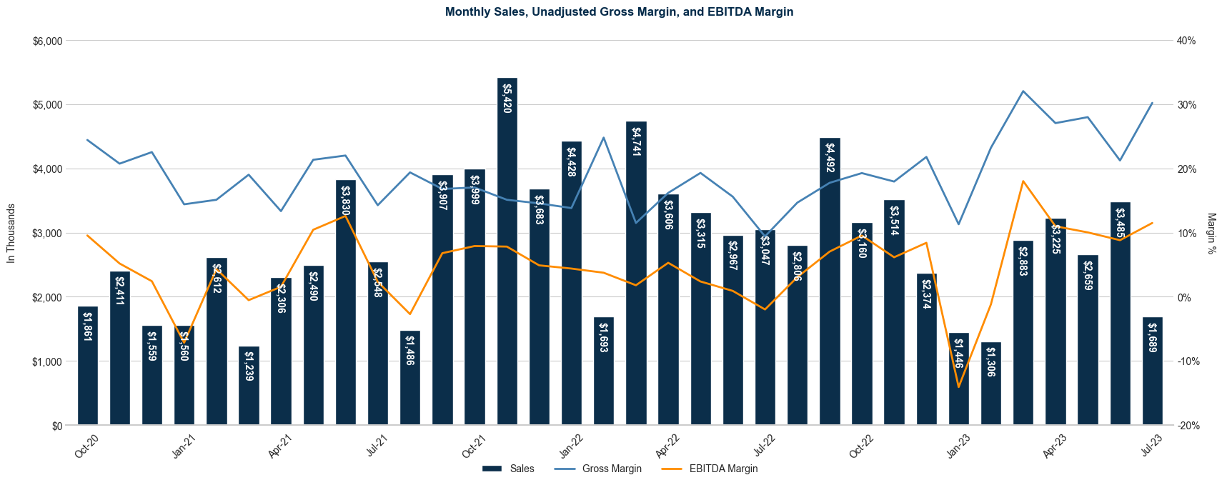
Appendix A
Plot Automation
Recreation of Excel plot based on imported data from General Ledger data
Python Matplotlib and Seaborn were used
Part of the effort to automate the generation of the Due Diligence Workbook, which currently is manually created through parsing General Ledger data

Slide 35
Appendix B
Gross Profit Margin
Unable to accurately calculate gross profit margin from General Ledger data to match it with the Trial Balance data. Particularly the Cost of Sales component of gross profit margin had to be taken directly from Trial Balance data instead.
Cost of Sales wasn’t subdivided into accounts or descriptions, so it’s difficult to analyze on anything other than a Period basis.
Gross Profit Margin troughs didn’t coincide with Sales troughs, thus predicting troughs in Sales data using GPM was too difficult
Missing Data for FY20 for COS, so GPM could only be considered from FY21 to June FY23.

Slide 36
Appendix C
Granger Causality
Input:
X: Time series based on the labels for different features (e.g., desc1 & account)
Y: Total transaction time series
Output:
Significance of all X time series (including lags) causing Y
E.g., total for Oct FY22 affected by desc1 ”EM” total for Jul FY21
Time Intervals (based on Adfuller test):
Granger Causality requires stationary time series
Period is preferable but not stationary
Week is stationary
Process:
Two-step process where testing was done with week and translated to period scale
Focused on troughs to determine causality
Looked for correlation between the lagged feature category and the response variable using an OLS model
Notes:
Time series matrix was used for different features (e.g., desc1 and Account) and the subtotal for each feature was compared against the total transaction amount
Granger Causality takes the total transaction amount and compares it against subtotals in previous (or lagged) timeframes (e.g., the total for Oct FY22 could be compared to the EM desc1 total for Jul FY21)
Period was preferable to week in keeping with the organization of the data, but using adfuller testing, period_fyear was found to be non stationary
Isolated volatility (e.g., transaction troughs) to determine the reliability of the revenue stream for answering concerns about its predictability

Slide 37
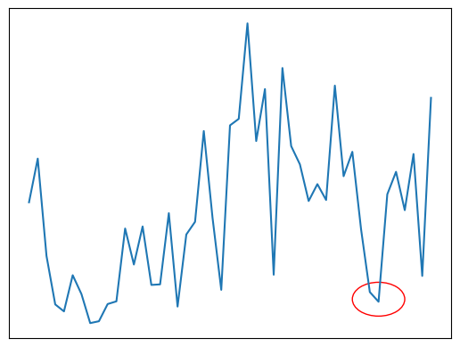
Appendix C
Granger Causality
Desc1 Lag Metrics for Feb FY23
Desc1 | Metric | Value | Week FY | Lag | Period | FY
CB | sum | $187,871 | 172 | [3, 5] | 4 | 2023
FJ | freq | 0.08 | 173 | [3, 5] | 4 | 2023
EI | mean | $27,047 | 171 | [5] | 4 | 2023
Analysis of period 40 (Feb FY23)
Test Features: Desc1
Time Col: Week
Causal relationship in weeks 171 to 173 which exists in period 39
Highest transaction value: CB

Slide 38
Appendix C
Granger Causality
Desc1 CB Comparison for Jan and Feb Periods
 | Acct 1 |  | Acct 10 | Acct 11 |  | Acct 4 |  | Acct 5 |  | Trends
Year | Jan | Feb | Jan | Jan | Feb | Jan | Feb | Jan | Feb | Jan | Feb
2020 | 0.03 | 0.0 | 0.93 | 0.0 | 0.0 | 0.1 | 0.0 | 0.73 | 0.0 | downward | --
2021 | 0.0 | 0.0 | 0.13 | 0.11 | 0.0 | 0.8 | 0.72 | 0.93 | 0.93 | upward | peaks
2022 | 0.52 | 0.0 | 0.0 | 0.0 | 0.37 | 0.63 | 0.15 | 0.98 | 0.64 | peaks | troughs
2023 | 0.0 | 0.0 | 0.0 | 0.0 | 0.98 | 0.45 | 0.0 | 0.73 | 0.06 | downward | troughs
Analysis of Period 40 (Feb FY23, red circle on the left)
Analyzing Account 5, a decrease from period 4 to 5 generally shows a downward trend
This is inconclusive because of sparse data for other 4 accounts
Notes:
TODO:
Highlight one or two rows in the table

