Slide 1
Bayesian Network Modeling of
NFL Game Stats &
Market Signals
3,990
NFL Games
15
Seasons
Leland Weeks · Johnny Belichev · Ishant Somal
CS 610 · Drexel University · June 2026
6
Market Pts / Game
2
Data Sources

Slide 2
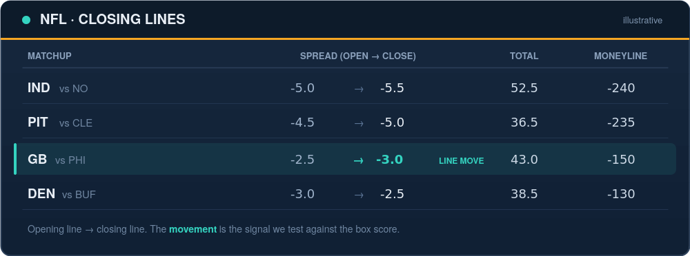
The Question, Before the Math
Does any of this tell you something the box score doesn't?

Slide 3
Objectives
Is line movement conditionally independent
of ATS outcome given game fundamentals?
Objectives
Test whether line movement is conditionally independent of ATS outcome given game fundamentals
Isolate whether market signals add predictive information beyond game statistics
Our models proved that market signals:
do NOT improve accuracy beyond game stats
but they DO improve calibration

Slide 4
Gap in the Literature
BNs for Sports Prediction
Stats + Odds Combined
Market Efficiency
Constantinou, Fenton & Neil (2012–13): BN for soccer forecasting — game variables only, no market movement.
Egidi, Pauli & Torelli (2018): hierarchical Bayes blending odds — no conditional dependence structure.
Simon (2024), Moskowitz (2021): line-movement efficiency — no game-stats integration.
GAP CONFIRMED

Slide 5
Methodology
MODEL ARCHITECTURE
ASSUMED CAUSAL STRUCTURE
Naive Bayes baseline — all features independent
Hill Climbing BN — score-based learning
PC Algorithm BN — constraint-based check
Game fundamentals
EPA, TD, turnover, yards diff
Opening line
EVALUATION
Line movement
research question — direct effect?
Accuracy — hard prediction performance
Log Loss — probability calibration
Target: Cover / Loss / Push (3-class)
Closing line
ATS outcome
Ablation: 3 feature sets (Stats · Market · Combined) × 3 models (NB · HC · PC) = 9 configurations, each scored on accuracy and log loss.

Slide 6
The Result Is Not What You'd Expect
ACCURACY
CALIBRATION
Market signals HURT
Market signals HELP
84.1%
0.345
Stats-only Naive Bayes
vs
Combined PC log loss (best)
81.0%
0.439
Combined (stats + market)
Stats-only NB log loss
Adding market features lowers accuracy.
Adding market features improves calibration.

Slide 7
Results: Accuracy vs. Calibration
ACCURACY
CALIBRATION (LOG LOSS)
84.1%
0.345
Stats-only Naive Bayes is the highest of any configuration. Adding market features lowers NB accuracy to 81.0%; both Bayesian Networks stay at or below the 58.0% majority baseline in every configuration.
Combined PC algorithm — best log loss of all nine runs. Market signals sharpen probabilities without changing hard predictions.
Config | NB Acc | HC Acc | PC Acc | NB Loss | HC Loss | PC Loss
Stats-Only | 84.1% | 50.4% | 50.4% | 0.439 | 0.375 | 0.368
Market-Only | 56.4% | 58.6% | 58.6% | 0.840 | 0.776 | 0.760
Combined | 81.0% | 50.4% | 47.3% | 0.538 | 0.375 | 0.345
CENTRAL FINDING
Market signals improve how certain the model is — not what it predicts.

Slide 8
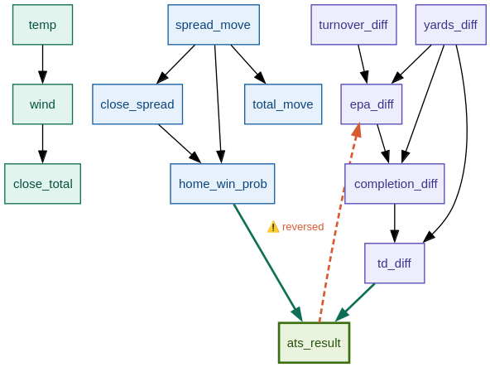
The Model Made a Causal Error — a Second Algorithm Caught It
HILL CLIMBING — raw learned DAG
PC ALGORITHM — independent result
Hill Climbing learned ats_result → epa_diff — a betting outcome cannot cause the on-field play that produced it. Causally impossible.
Run independently, the PC algorithm recovered epa_diff → ats_result on its own — with home_win_prob and close_spread as direct parents. Not confirmation bias: a second method found the same structure.
The algorithm made a causal error — and we caught it:
domain knowledge flipped the edge, and a second, independent algorithm (PC) recovered the same direction on its own.

Slide 9
Implementation
DATA PIPELINE
MODELS
VALIDATION
nflverse (game stats) + SportsBookReviewsOnline (market data)
3,990 games, 2007–2022, joined by season + matchup
Game Stats: EPA, TD, turnover, yards differentials
Market Signals: spread & total movement, home win prob, rolling ATS
Gaussian Naive Bayes => continuous features, no discretization
Hill Climbing BN + PC Algorithm BN => 3-bin ordinal encoding
80/20 train-test split
Dual-algorithm approach: HC and PC run independently and cross-checked
HC reversed edge corrected via domain knowledge, confirmed by PC

Slide 10
Challenges & Limitations
Retrospective Statistics
EPA and other game stats are post-game measurements. Stats-only accuracy reflects information content, not pre-game predictive power.
Discretization Penalty
BNs require binning continuous features; magnitude information is lost. The main reason BNs trail Naive Bayes on accuracy.
Class Imbalance
Push is only 3.0% of the data. Neither BN ever predicts it; NB reaches just 22% F1 on the class.
Spread Direction
We bin the closing spread by magnitude, which discards direction: a home team laying seven and one receiving seven fall in the same bin. Recovering signed direction is left to future work.

Slide 11
Future Work & Conclusions
FUTURE WORK
CONCLUSIONS
Continuous (Gaussian) BN formulations to eliminate the discretization penalty
Post-2018 PASPA analysis only — isolate the modern legal betting market
Recover spread direction; revalidate the target variable
Add quarterback injury data as a high-signal feature
Partial efficiency confirmed: the market's hard prediction is already encoded in game stats
Calibration finding: the market's uncertainty estimate adds information beyond statistics alone
PC + HC dual-algorithm design caught and corrected a causally impossible edge
A nuanced answer that advances both sides of the efficiency debate

Slide 12
QUESTIONS & DISCUSSION
For accuracy: the market adds no signal beyond game stats.
For calibration: the market's uncertainty estimate does.
Leland Weeks · Johnny Belichev · Ishant Somal
lhw22@drexel.edu · jb4458@drexel.edu · is488@drexel.edu

