Slide 1
The Effect of Activating Factor 42 on Gene Expression
Lauren Elborough

Slide 2
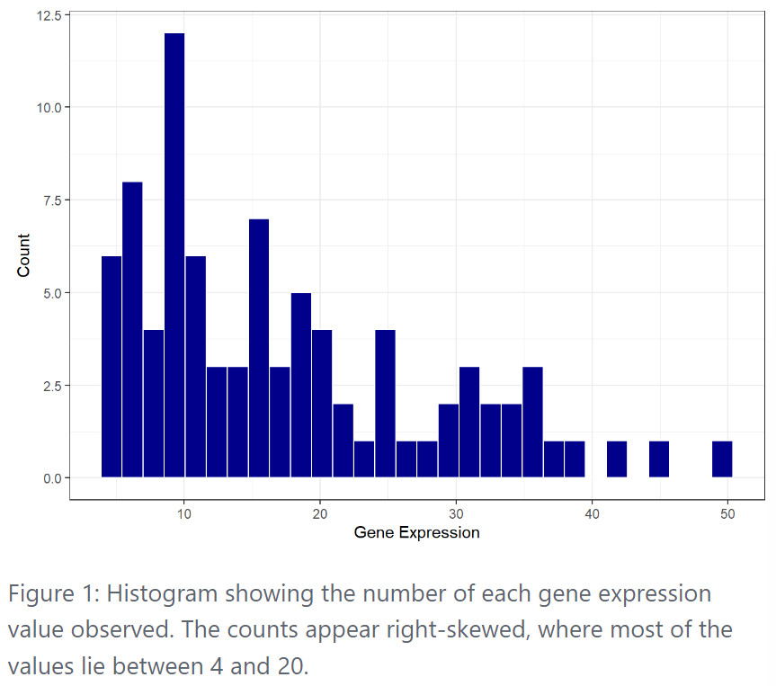
Distribution of gene expression recordings

Slide 3
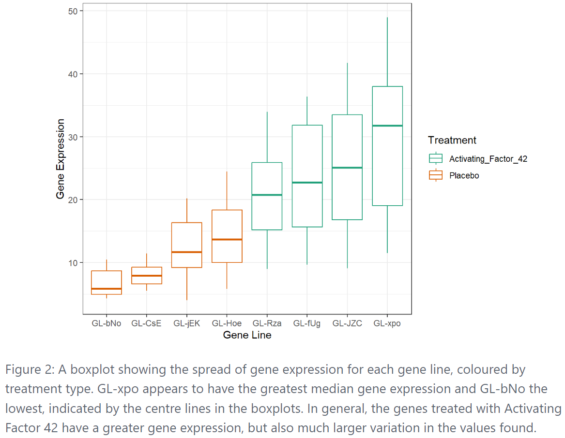
Gene expression for each gene line

Slide 4
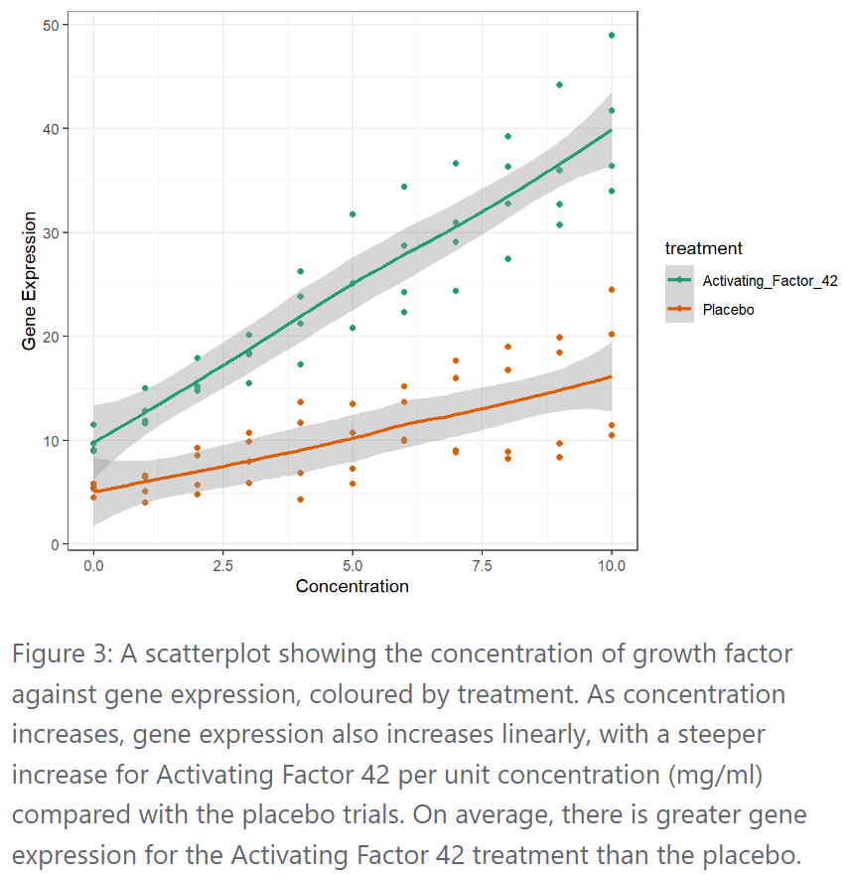
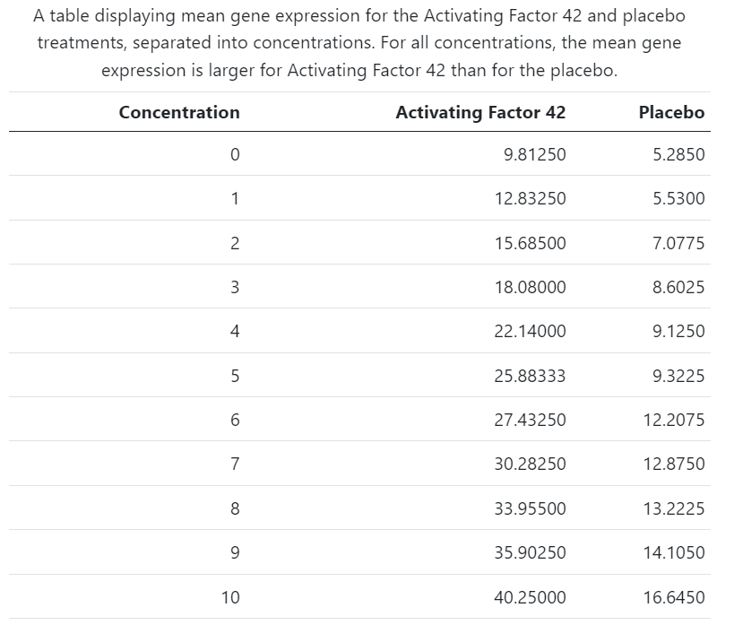
Mean gene expression by treatment type

Slide 5
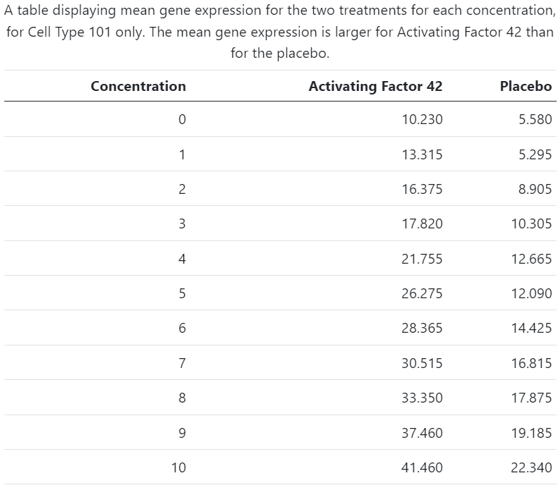
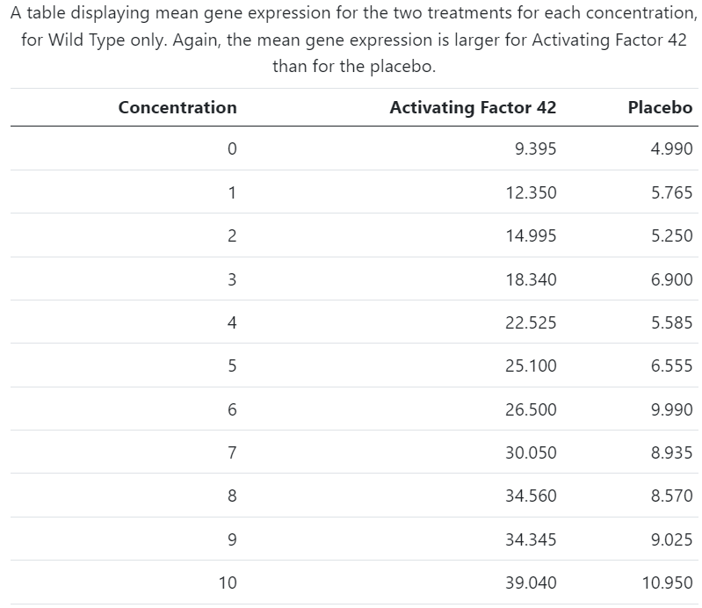
Mean gene expression by cell line
Cell type 101
Wild type

Slide 6
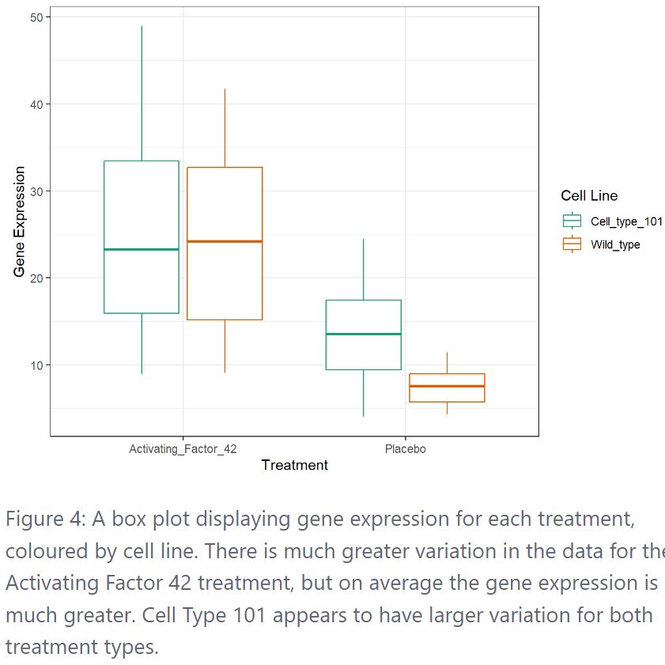
Mean gene expression by cell line
Cell type 101

Slide 7
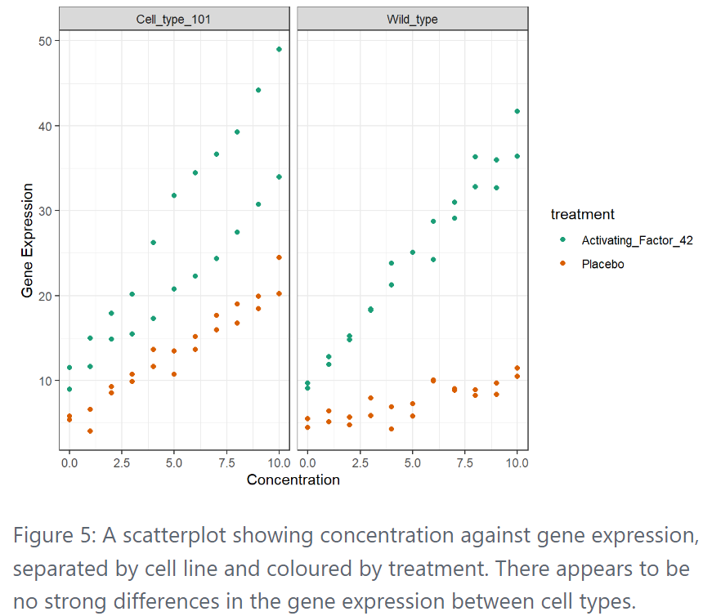
Mean gene expression by cell line
Wild type

Slide 8
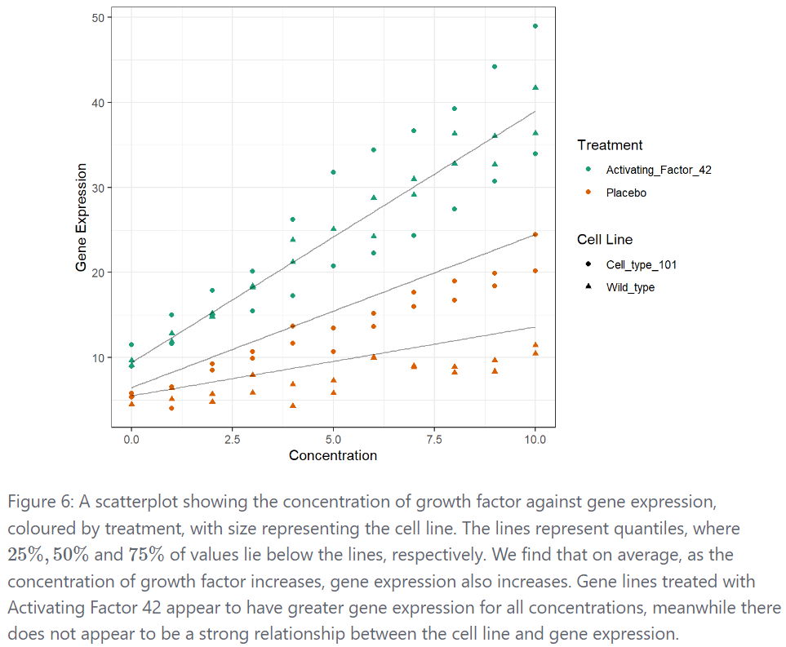
The effect of treatment type on gene expression

