Slide 1

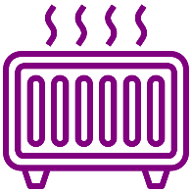

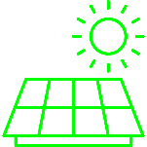
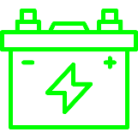





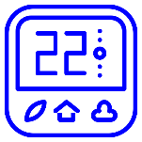
Building N
Electricity Source
Building 1
Heat Supply
Grid
Power
Electric heater
Heat pump
Solar PV
Energy Storage
Charge/
Discharge
Control Agent
Battery
Domestic hot water and/or space heating storage
Cooling storage
End Use
Setpoint
Occupant Model
Non-shiftable plug loads
Domestic hot water heating
Space cooling & heating
Observations

Slide 2
Building N
Electricity Source
Building 1
Heat Supply
Grid
Power
Electric heater
Heat pump
Solar PV
Energy Storage
Charge/
Discharge
Control Agent
Battery
Domestic hot water and/or space heating storage
Cooling storage
End Use
Setpoint
Occupant Model
Non-shiftable plug loads
Domestic hot water heating
Space cooling & heating
Observations

Slide 3
Environment
Building 1
Building N
Energy Storage
Battery
Domestic hot water heating storage
Cooling storage
Building 1 Observations
Control Agent 1
Actions
Control Agent N
Optional Information Sharing

Slide 4
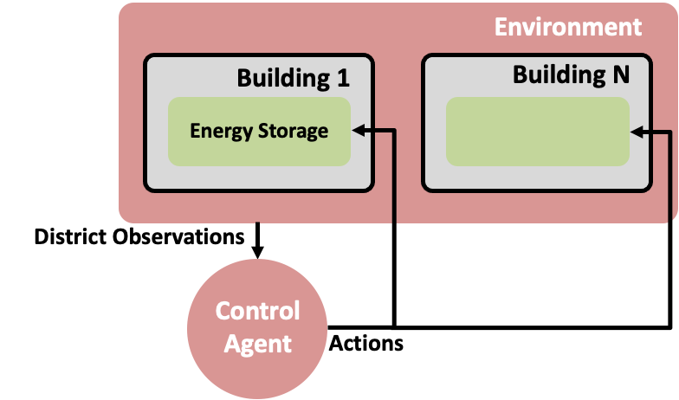
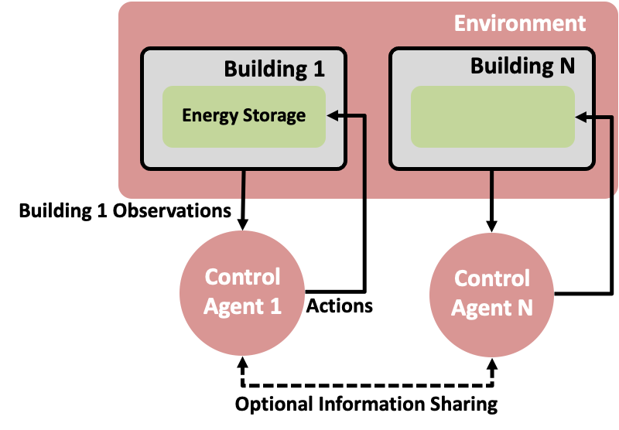
Environment
Environment
Building 1
Building N
Building 1
Building N
Energy Storage
Energy Storage
Building 1 Observations
District Observations
Control Agent 1
Control Agent N
Control Agent
Actions
Actions
Optional Information Sharing

Slide 5

Building 1
Electricity Source
Heat Supply
Building N
Electricity Source
HVAC
Grid
Power
Electric heater
Heat pump
Solar PV
Electric heater
Heat pump
Solar PV
Energy Storage
Energy Storage
Charge/
Discharge
Battery
Domestic hot water heating storage
Cooling storage
Control Agent
Battery
Domestic hot water and/or space heating storage
Space cooling storage
Setpoint
change
End Use
End Use
Temperature
Dynamics Model
Non-shiftable plug loads
Domestic hot water heating
Space cooling & heating
Non-shiftable plug loads
Domestic hot water heating
Space cooling & heating
Observations

Slide 6
Building 1
Electricity Source
Heat Supply
Building N
Electricity Source
HVAC
Grid
Electric heater
Heat pump
Solar PV
Electric heater
Heat pump
Solar PV
Energy Storage
Energy Storage
Charge/
Discharge
Battery
Domestic hot water heating storage
Cooling storage
Control Agent
Battery
Domestic hot water and/or space heating storage
Space cooling storage
End Use
End Use
Non-shiftable plug loads
Domestic hot water heating
Space cooling & heating
Non-shiftable plug loads
Domestic hot water heating
Space cooling & heating
Observations

