Slide 1


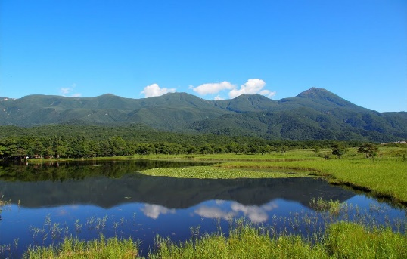








Call for Papers
2020 IEEE International Conference on Real-time Computing and Robotics (RCAR 2020)
August 2-6, 2020, Asahikawa, Hokkaido, Japan
The 2020 IEEE International Conference on Real-time Computing and Robotics (IEEE RCAR 2020) will take place from August 2 to 6, 2020 in Asahikawa, Japan. The objective of this conference is to provide a forum for researchers in robotics and real-time computing to share the latest results and to explore the opportunity of research collaboration. With wide applications of robots in industry and services sectors, real-time computing plays one of the major roles in various topics in robotics including real-time control, human-robot interactions, sensor perception and fusion, robot intelligence, etc. The scope of IEEE RCAR 2020 covers research, development and applications in the dynamic and exciting areas of real-time computing and robotics.
Contributed Papers: Original papers are solicited in all related areas of robotics, mechatronics, control engineering. Full papers must be submitted in PDF format prepared strictly following the requirements for creating PDF documents. For detailed format information, please visit the conference website. All accepted papers will be included in the IEEE Xplore database and indexed by EI.
Tutorials & Workshops: Proposals for tutorials and workshops addressing new topics related to robotics and real-time computing are invited for submission to the T/W chairs.
Journal Publications: Expanded versions of the accepted and presented papers with high quality will be invited for publication in the RCAR 2020 special issues in the selected leading international journals.
Areas and topics of contributed papers include but are not limited to the following:
• robotics and intelligent mechatronics systems;
• sensing, perception and control theories and their applications;
• real-time imaging, image/video processing and their applications;
• selected frontier areas, such as soft robotics, artificial intelligence, computational
biomechanics, etc, and their applications.
Asahikawa, located in the center of Hokkaido is the island‘s second largest city after Sapporo with a population over 350,000. Before the colonization of Hokkaido, Asahikawa was an important center of Ainu culture reflected in its museums and festivals. Asahikawa has a humid continental climate. In winter, it is well known as the most coolest city in Japan. Summers in this city are generally warm but not humid. This city is surrounded by the largest national park of Japan (Daisetsuzan National Park). Near Asahikawa there are also some picturesque rolling fields of summer flowers including Furano and Biei. Many tourists choose Asahikawa as the base to explore the other parts of Hokkaido island. .
IEEE RCAR 2020 promises to be a great event for all participants, with excellent technical and social programs.
General Chair
Xinkai Chen, Shibaura Institute of Technology, Japan
General Co-Chair
Hiroshi Yokoi, The University of Electro-Communication, Japan
Organizing Chair
Chi Zhu, Maebashi Institute of Technology, Japan
Program Chair
Xin Jiang, Harbin Institute of Technology, Shenzhen, China
Program Co-Chair
Tiantian Xu, Shenzhen Institutes of Advanced Technology (SIAT), China
Important Dates:
Submission of full papers: Dec. 31, 2019
Submission of organized session/workshop: Dec. 31, 2019
Notification of acceptance: Feb. 20, 2020
Final paper submission: Mar. 20, 2020
Early bird registration: May 1, 2020
For more information, please visit the conference website
www.ieee-rcar.org

