Slide 1
A real-time system for emotion detection
Emanuele Alessi
Ivan Ferrante

Slide 2
Task decription
Develop a real-time emotion detector using:
A Convolutional Neural Network (CNN)
FER-2013 dataset

Slide 3
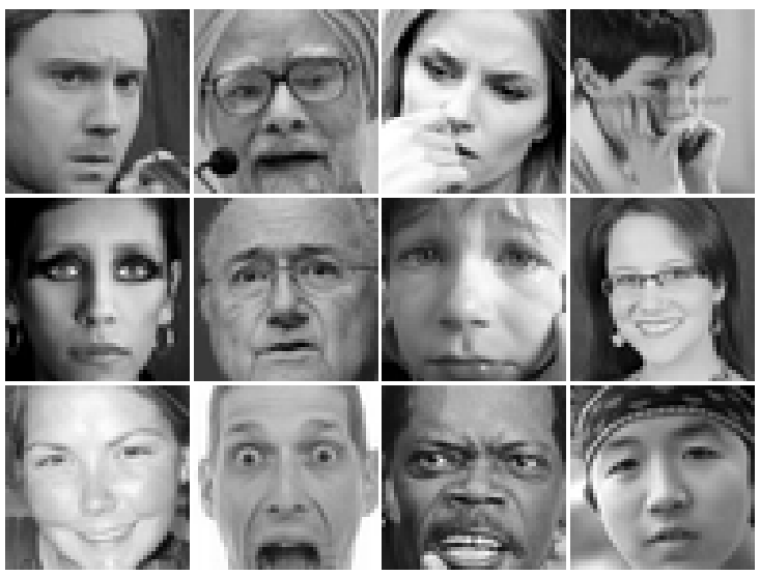
FER-2013 dataset
A dataset composed by:
35888 greyscale images with shape of 40x40
Each image has an associated emotion

Slide 4


Our objective
Input
CNN
Probabilities
Angry
Disgust
Fear
Happy
Sad
Surprise
Neutral

Slide 5

TensorFlow
An open source machine learning library
Developed by Google
The most used nowadays
It guarantees a very efficient computation

Slide 6
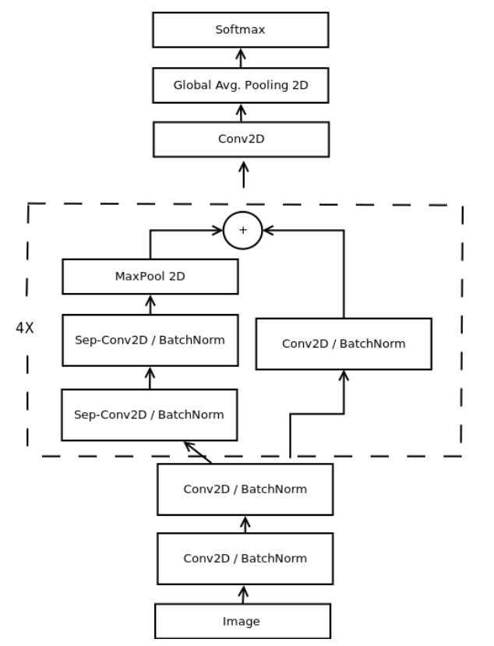
The CNN (mini-Xception)
Each convolutional layer has been applied:
RELU
Batch normalization
60000 parameters

Slide 7
Training phase
We trained the mini-Xception neural convolutional network with:
Batch size=32 (32 images per step)
Adam optimizer
Learning rate = 0,001
Exponential decay = 0,95
Data augmentation techniques

Slide 8
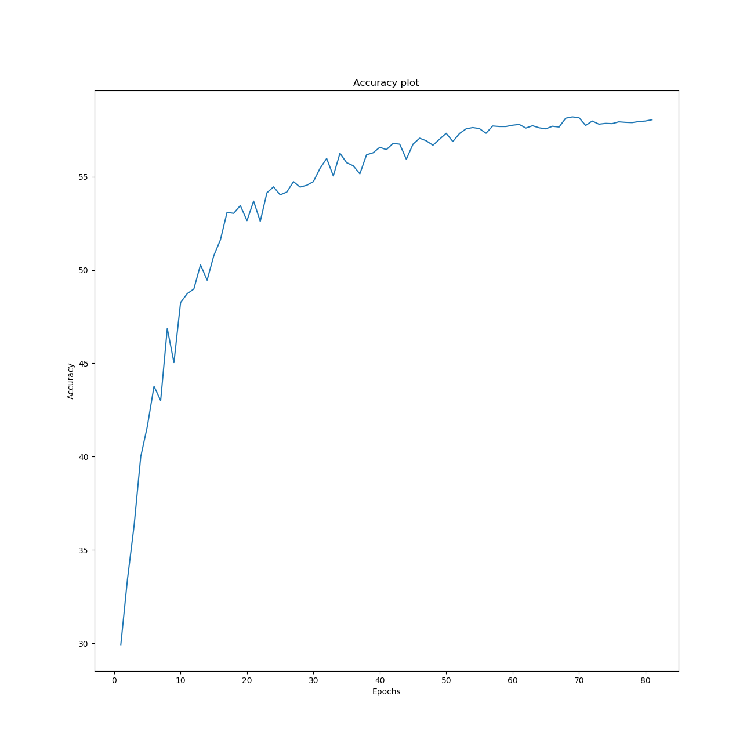
Accuracy

Slide 9
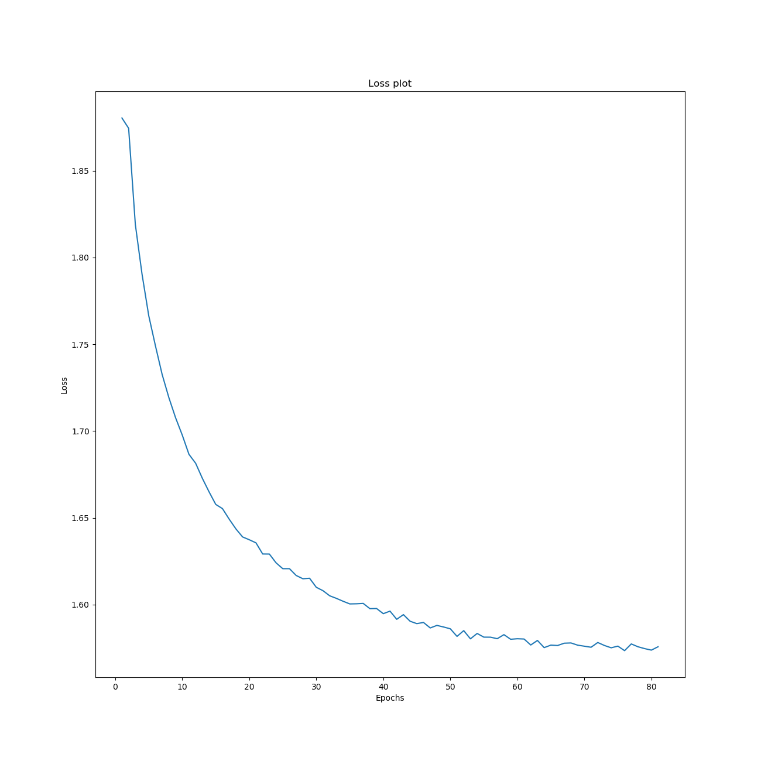
Loss

Slide 10
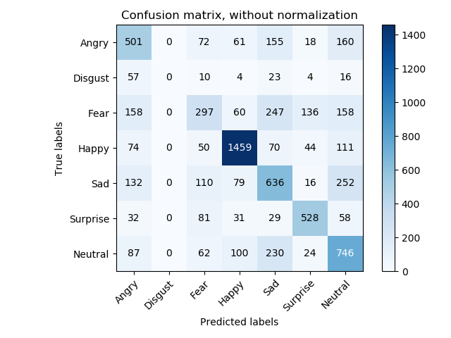
Confusion matrix

Slide 11
THANKS!
Stay tuned for the live demo!

