Slide 1



Project Future Data & Decision Science
Cohort III Team 1 Members :
Aliki Pialoglou
Lefteris Eleftheriou
Stavros Sfyris
June 2020

Slide 2
INTRODUCTION
Target
Exploratory Data Analysis (EDA)
Engaged and Unengaged Users
Results/ Conclusion
Proposals for future Business Actions

Slide 3
Target
Produce value for the bank, through the analysis of the data.
Predict Users Plan (Paid vs Standard)
Users descriptive characteristics
Find Engaged and Unengaged Users
Try to reduce Churn through business actions

Slide 4
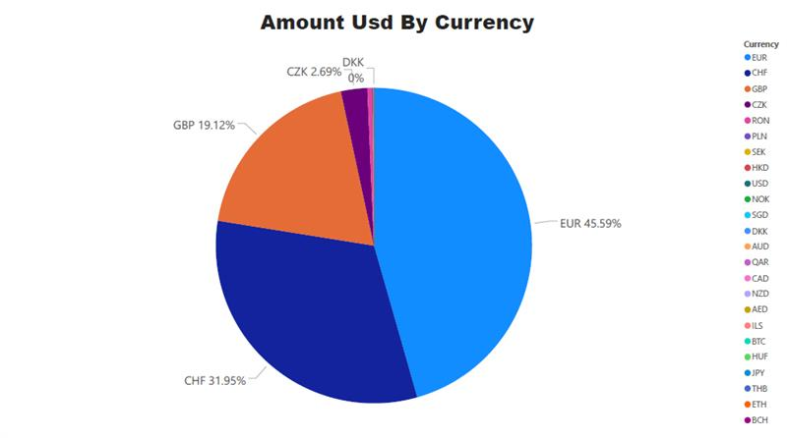
Exploratory Data Analysis
What we used
Python
SQL
Power BI

Slide 5
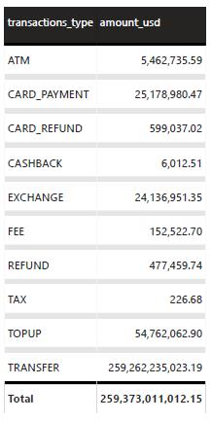
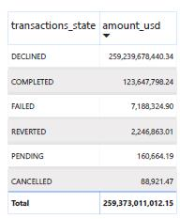

Slide 6
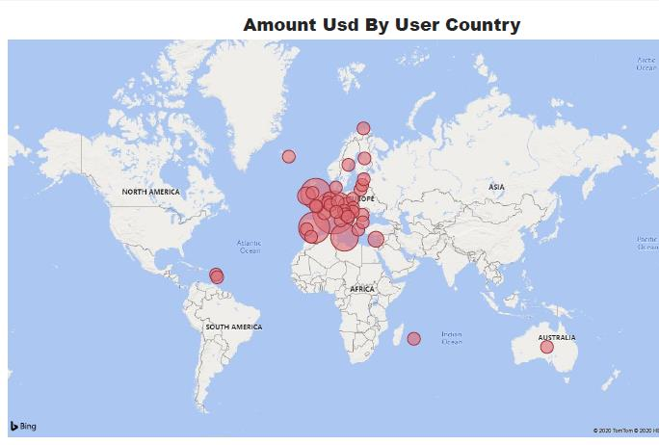
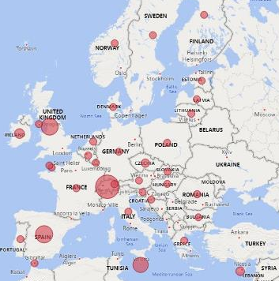
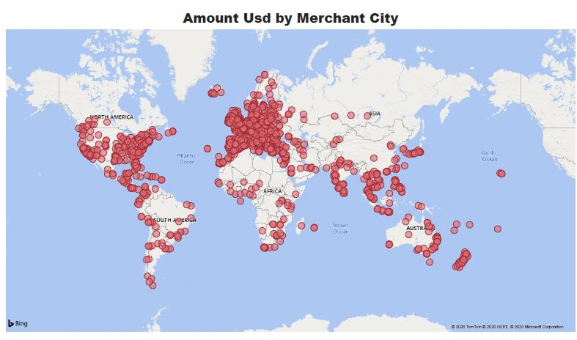

Slide 7
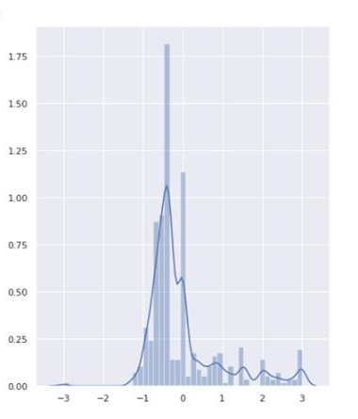
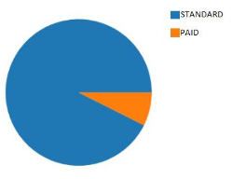
[9:00 PM] Leuteris Eleutheriou
dict_days_of_transactions,total_ammount,number_transactions,avg_ammount
[9:00 PM] Leuteris Eleutheriou
dict_days_of_transactions,total_ammount,number_transactions,avg_ammount
Predict Users Plan (Standard, Paid)
Important Features
Distinct Days of Transactions
Total spent amount
Total Number of Transactions
Average Spent amount
New features
Standardization
Imbalanced Classification
Algorithms Testing

Slide 8
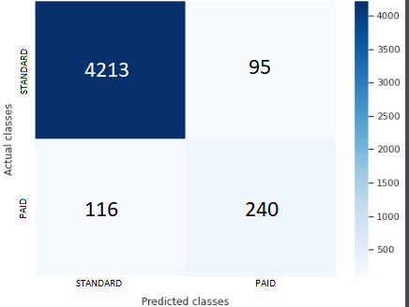
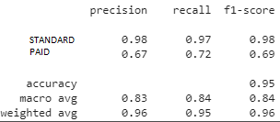
Gradient Boosting Classifier
Metrics

Slide 9
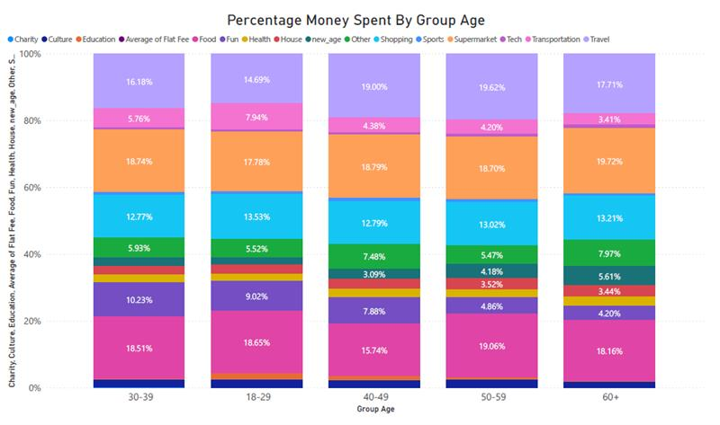

Slide 10
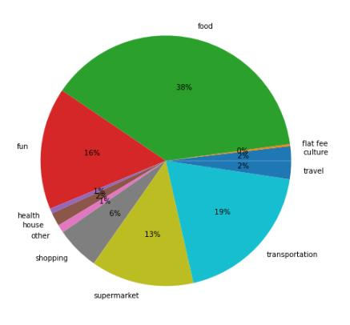
Descriptive characteristics
User: 15541
Age: 42
Country: UK

Slide 11
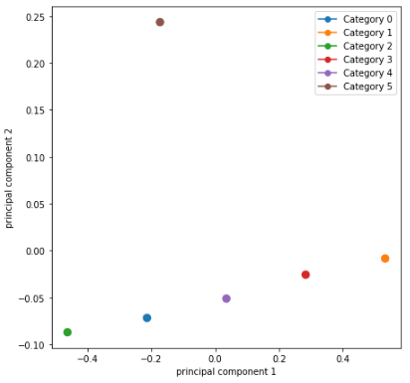
Descriptive characteristics

Slide 12
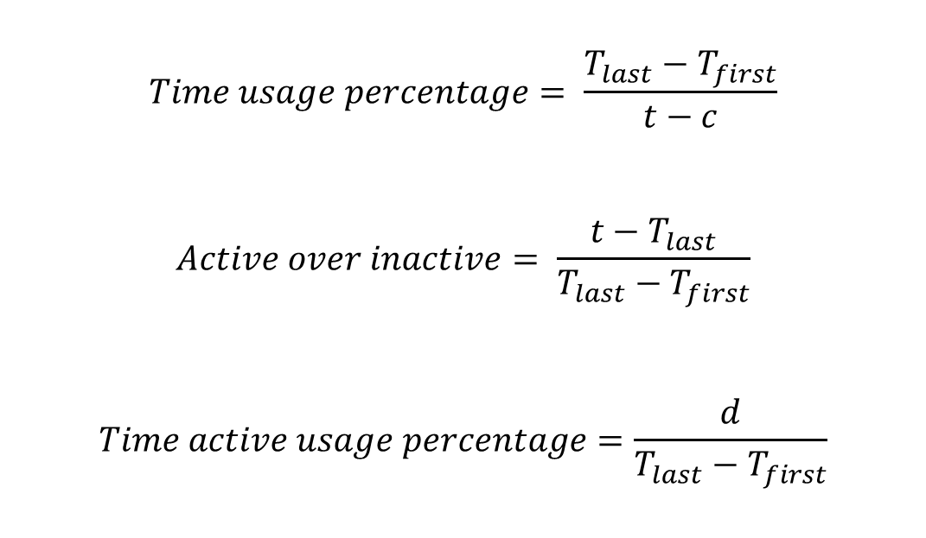
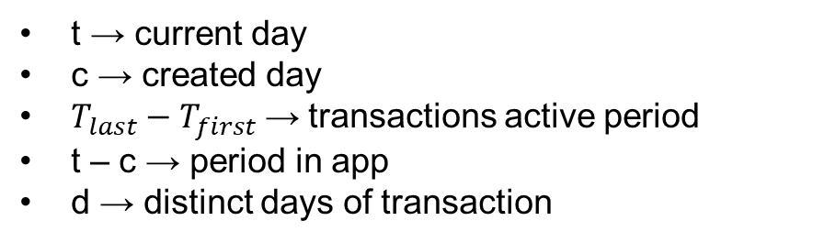
Engaged vs Unengaged Users
$$Time usage percentage= \frac{T_{last}−T_{first}}{t−c}$$
$$Active over inactive= \frac{t−T_{last}}{T_{last}−T_{first}}$$
$$Time active usage percentage=\frac{d}{T_{last}−T_{first}}$$
t → current day
c → created day
$T_{last}−T_{first} \text{→}$ transactions active period
t – c → period in app
d → distinct days of transaction

Slide 13
Clustering Criteria
Active Users:
All Users – Inactive Users
Inactive Users:
Time Usage Period < 0.6
Active over Inactive < 0.6
Time active usage percentage < 0.08
High Risk Users:
Time Usage Period < 0.6
Active over Inactive < 0.6
Time active usage percentage < 0.08
Time active usage percentage > 0.05

Slide 14

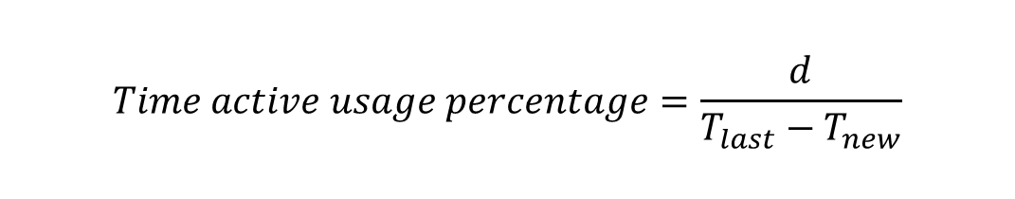
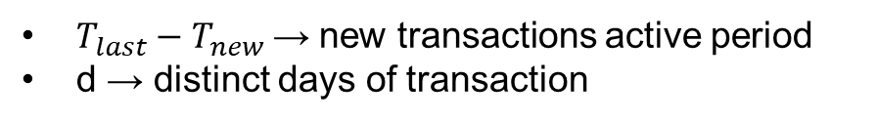
Reengaging Unengaged Users
Did we reduce churn?
$$Time active usage percentage=\frac{d}{T_{last}−T_{new}}$$
$T_{last}−T_{new} \text{→}$ new transactions active period
d → distinct days of transaction

Slide 15
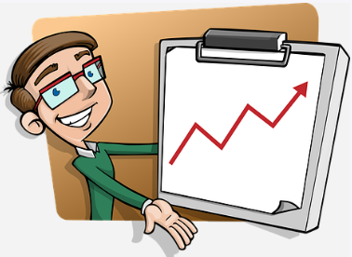
Future Business Actions
Reminders to the user by email or financial motives
Lottery
Learning the app features

Slide 16
Thank you for your attention!!

