Slide 1
Adversarial Deletion Attacks on
Approximate Graph Unlearning
Thesis
Deletion interfaces in approximate graph unlearning can be exploited to amplify approximation error, and fragility differs sharply across method families.
The inheritance of safety behavior within graph unlearning families
EE5003 MSc Project Report
National University of Singapore
Problem -> Method -> Results -> Takeaway
Liu Chengyu
April 2026

Slide 2
Why Graph Unlearning Matters
02 / 14
Deletion requests are operationally plausible, and approximation turns them into a security question.
Real deletion requests
Approximate unlearning
Attack surface
User-level or node-level removal is realistic in citation, social, and recommendation graphs.
Exact retraining is expensive, so practical systems use approximation.
A malicious requester may exploit the deletion interface itself by choosing harmful targets.
Delete
Compliance tool and attack interface
EE5003 MSc Project | Liu Chengyu
Approximate Graph Unlearning Audit

Slide 3
Research Question And Objectives
03 / 14
Research question
Can malicious deletion requests amplify approximation error and degrade retained-model utility beyond ordinary deletion at the same budget?
Objective 1
Objective 2
Build an attack pipeline with multiple deletion strategies.
Compare vulnerability across method families, not just one algorithm.
Objective 3
Objective 4
Add attribution metrics for collateral and retrain gap.
Measure whether adversarial node selection is practically efficient.
EE5003 MSc Project | Liu Chengyu
Approximate Graph Unlearning Audit

Slide 4
Method Families And Threat Model
04 / 14
Families under test
Learning-based
Threat model
GNNDelete is the main fragile representative in this study.
Attacker capability: choose which nodes to delete through the normal interface.
Out of scope: poisoning labels, features, or hidden training code.
Target: maximize post-unlearning utility loss beyond random deletion.
IF-based
GIF remains comparatively stable under adversarial selection.
Shard-based
ΔF1
Gap
26.2%
GraphEraser behaves differently and often improves in the tested settings.
attack-over-random
vs exact retrain
non-target changes
EE5003 MSc Project | Liu Chengyu
Approximate Graph Unlearning Audit

Slide 5
Attack Pipeline And Experimental Matrix
05 / 14
The workflow compares approximate unlearning against an exact-retrain control on the same deletion set.
1
Select nodes
Experimental matrix
Use random or structured attack targets.
Methods: 5
Datasets: 2 citation graphs
Backbones: 3 GNN architectures
Strategies: 6 node-selection methods
Runs: 950 experiment executions
Story: spectrum, deep dive, attribution, and efficiency.
2
Apply unlearning
Run the selected graph unlearning method.
3
Exact retrain control
Retrain on the same deletions for the gold-standard reference.
4
Compare outcomes
Read utility loss, retrain gap, and collateral damage.
EE5003 MSc Project | Liu Chengyu
Approximate Graph Unlearning Audit

Slide 6
What Was Built In OpenGU
06 / 14
The project contribution is a reusable adversarial-audit workflow, not only a single batch of experiments.
Execution
Result discovery
Structured batch experiment runs across methods, datasets, and deletion ratios.
Auto-discovery of stored outputs to reduce manual bookkeeping.
Collateral analysis
Statistical summary
Retained-node prediction tracking to reveal spillover.
Relative F1 drop, support thresholds, and effect-size comparisons.
Figure generation
Reusable plotting scripts that turn stored outputs into report figures.
Reproducible
analysis from stored outputs
EE5003 MSc Project | Liu Chengyu
Approximate Graph Unlearning Audit

Slide 7
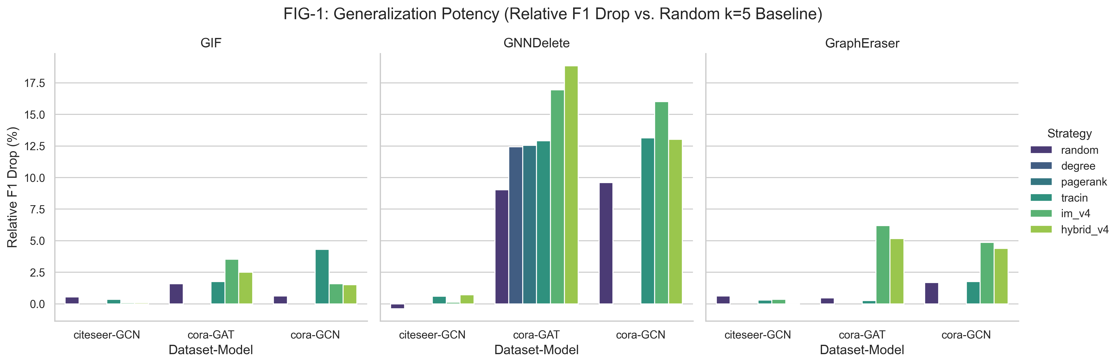
Main Finding: Vulnerability Spectrum
07 / 14
Core read
Approximate graph unlearning does not fail uniformly. Vulnerability depends strongly on the mechanism family.
Readout
GNNDelete highest.
GIF comparatively stable.
GraphEraser shows no collapse.
The family-level pattern is consistent across the tested settings.
Mechanism choice, not just deletion budget, determines fragility.
Figure 1. Relative F1 drop across datasets and backbones at ratio = 0.05.
EE5003 MSc Project | Liu Chengyu
Approximate Graph Unlearning Audit

Slide 8
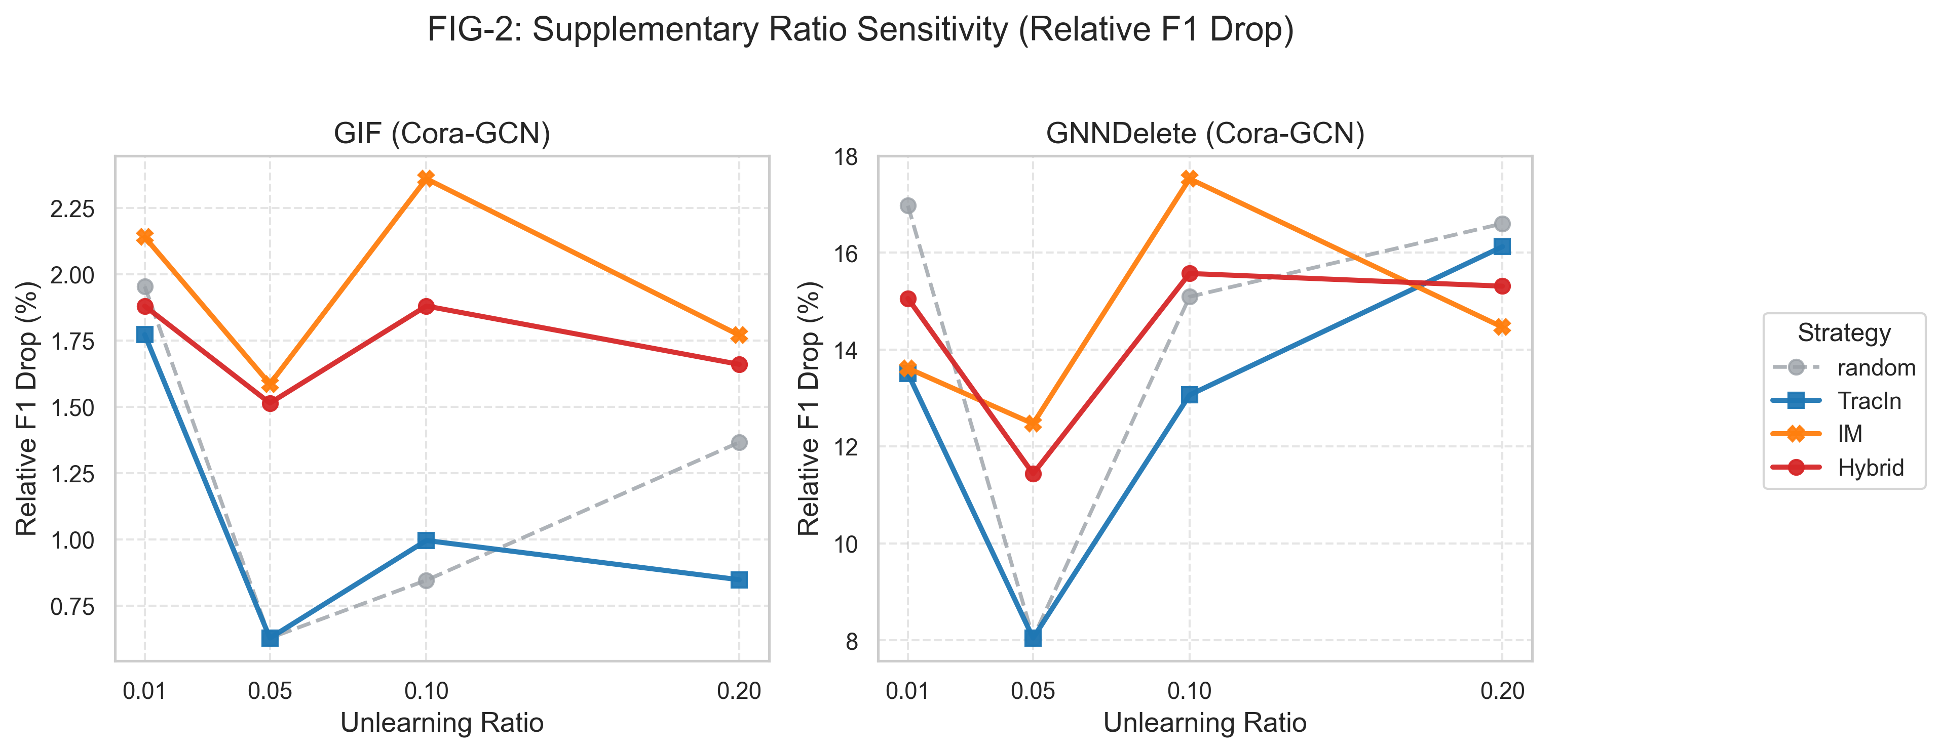
Deep Dive: GNNDelete Fragility
08 / 14
21.53%
retrain gap at ratio 0.01 on Cora
26.2%
non-target prediction changes
Interpretation
Exact retraining on the same deletion set shows only a small intrinsic decrease. The large collapse is therefore mainly approximation error, not simply node importance.
Figure 2. Ratio sensitivity view for GIF and GNNDelete on Cora/GCN.
EE5003 MSc Project | Liu Chengyu
Approximate Graph Unlearning Audit

Slide 9
Attribution And Collateral Damage
09 / 14
Exact retraining tells us what the deletion should have done. The remaining gap is mechanism-induced spillover.
Deleted targets
Retained nodes
Some drop is legitimate because removed nodes can be informative. A correct system may still lose a small amount of utility when those nodes disappear.
When predictions on non-target retained nodes shift substantially, the damage is no longer only about the deleted nodes. It indicates spillover from the approximate unlearning mechanism.
Bottom line
Approximate unlearning vs exact retrain is the attribution lens; collateral-damage metrics show how far the error propagates beyond the requested deletion.
EE5003 MSc Project | Liu Chengyu
Approximate Graph Unlearning Audit

Slide 10
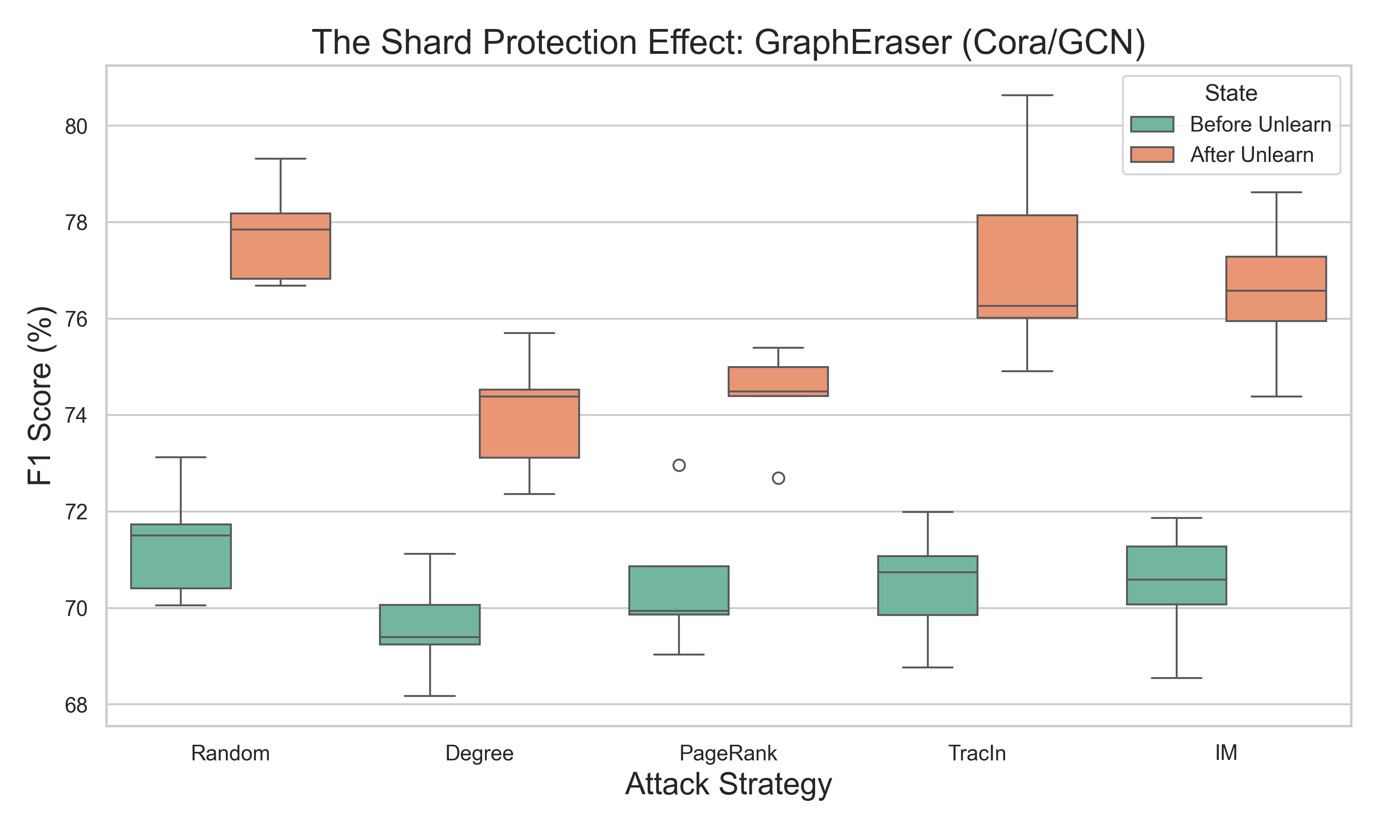
Why GraphEraser Behaves Differently
10 / 14
Observed pattern
After-unlearning scores shift upward across the tested attack strategies, matching the non-collapse pattern seen in the main results.
Interpretation
A plausible reading is that deleting bridge or hub nodes can simplify shard-local classification and reduce cross-shard interference.
Caution
This is setting-specific evidence, not a claim of universal robustness.
Observed shard-level score shift for GraphEraser on Cora/GCN.
EE5003 MSc Project | Liu Chengyu
Approximate Graph Unlearning Audit

Slide 11
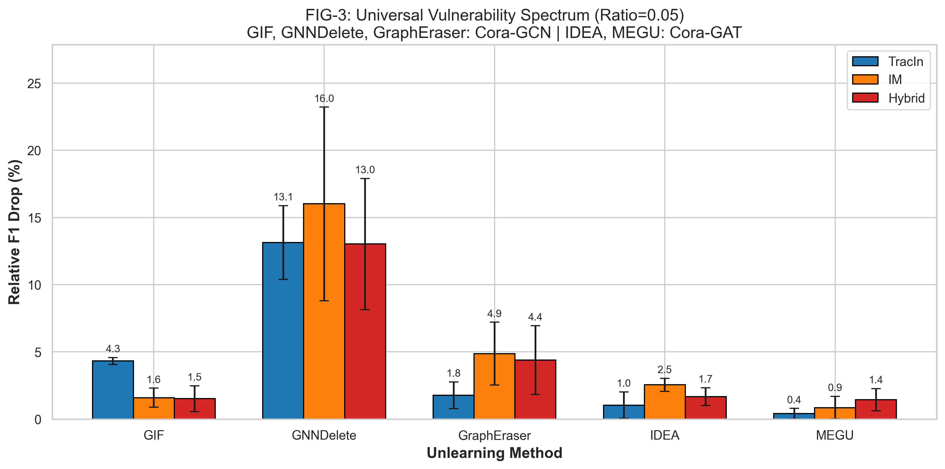
Attack Strength And Practicality
11 / 14
Reading key
Relative F1 drop measures the attack-over-random advantage at the same budget.
18.9s
1.3%
IM-v4 selection time
spread loss vs CELF
Practical
Selection is operationally feasible.
Structured attacks outperform random deletion most clearly on GNNDelete.
IM-v4 makes attack selection fast enough to matter in practice.
Figure 3. Cross-family comparison of the main attack strategies at ratio = 0.05.
EE5003 MSc Project | Liu Chengyu
Approximate Graph Unlearning Audit

Slide 12
Limitations And Future Work
12 / 14
The project is complete; these scope limits and follow-up directions define what this report does and does not claim.
Limitation 1
Future work 1
Evidence is concentrated on the tested citation benchmarks and backbones.
Validate the same pattern on larger graph benchmarks such as PubMed.
Project status
Completed MSc project
Final course submission with a reusable audit workflow.
Limitation 2
Future work 2
The mechanism-level explanation for GNNDelete fragility is still incomplete.
Add targeted ablations that explain when and why GNNDelete fails.
EE5003 MSc Project | Liu Chengyu
Approximate Graph Unlearning Audit

Slide 13
Takeaways
1. Auditability matters
2. Family behavior differs
3. Workflow contribution
Approximate graph unlearning should be evaluated not only for accuracy but also for adversarial deletion robustness.
In the tested settings, GNNDelete is most fragile, GIF is comparatively stable, and GraphEraser exhibits shard protection.
The project contributes a reusable OpenGU-based audit pipeline alongside the findings themselves.
Thank you. Q&A
EE5003 MSc Project | Liu Chengyu

Slide 14
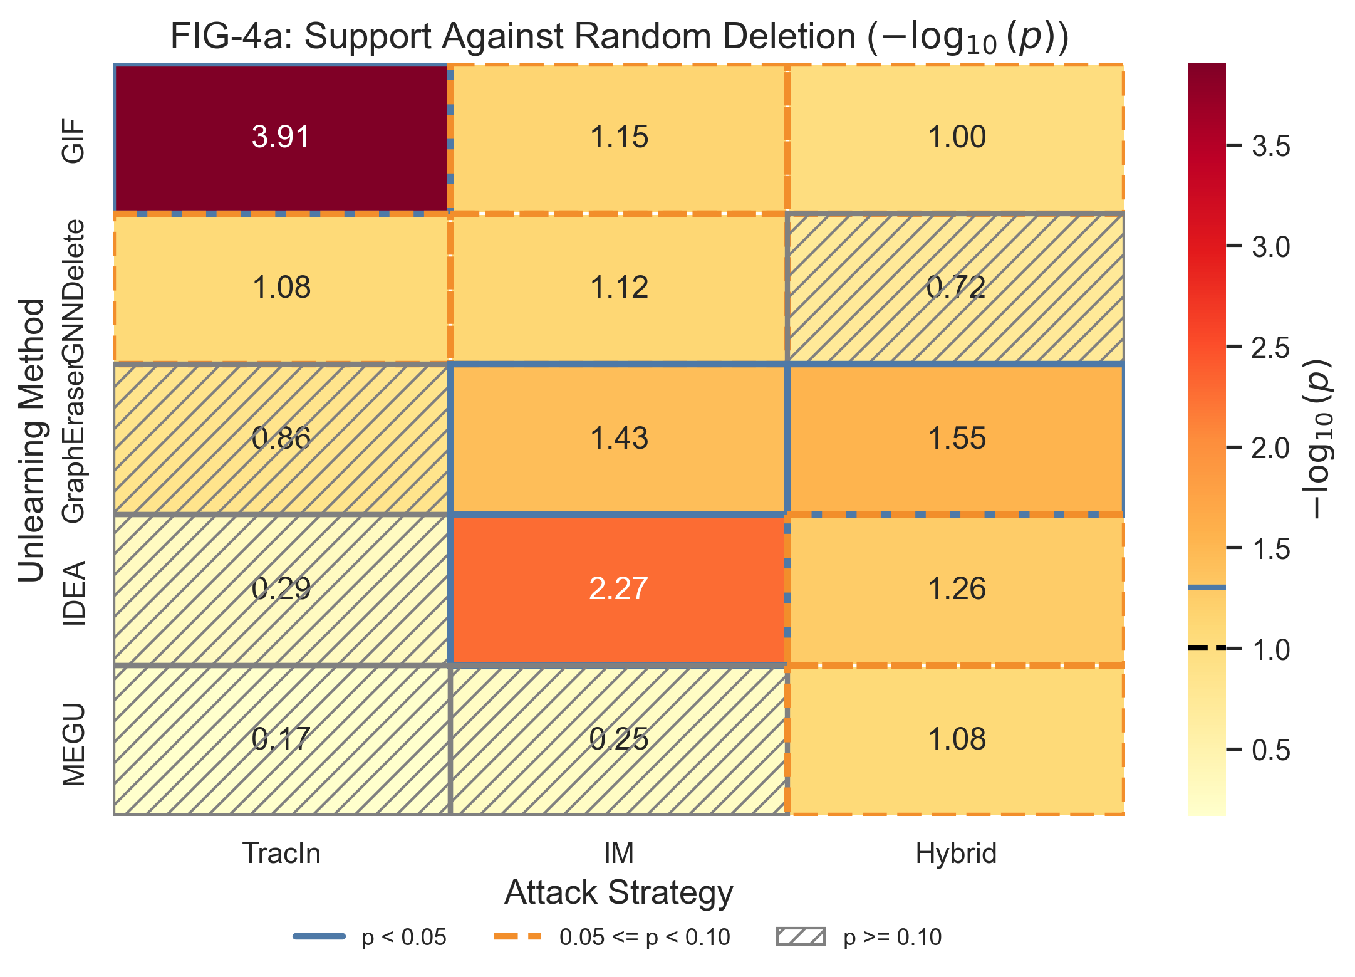
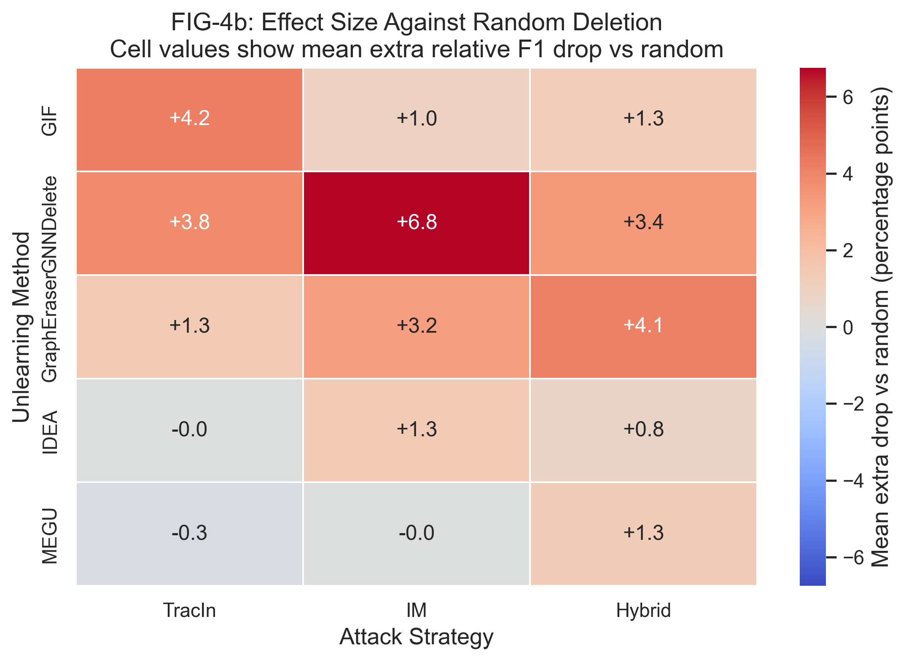
Backup Appendix: Statistical Support
14 / 14
Figure 4a. -log10(p) support against random deletion.
Figure 4b. Effect size beyond random deletion.
EE5003 MSc Project | Liu Chengyu
Approximate Graph Unlearning Audit

